Slide 1
Discovery Challenge – Aggregate Queries – Tripadvisor Rankings
Hunter Betz

Slide 2
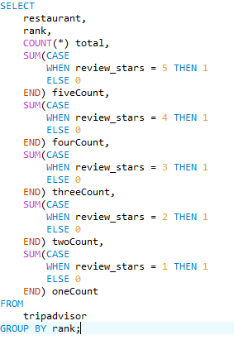
Right off the bat...
•Restaurants with a score of 4, 4.5, and 5 still ranked low
•# of restaurant reviews doesn’t really matter
•Restaurants with similar #s of 4 and 5 stars ranked lower than those with higher #s of 5 stars
•Some exceptions exist however
•“Popular” restaurants (restaurants with >100 reviews) generally did not make the top 10
•Only 4 with >100 reviews made it to the top 10

Slide 3
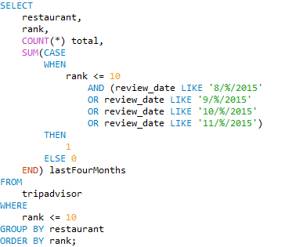
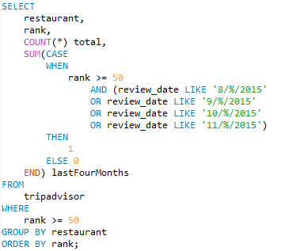
Positive reviews (4 & 5 stars) within a short time span generally lead to a high rank
On average 54% of reviews were made between August and November for top 10 restaurants
On average 33% of reviews were made between August and November for bottom 10 restaurants

Slide 4
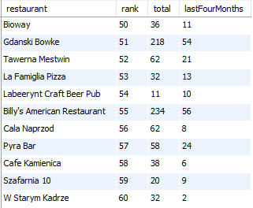
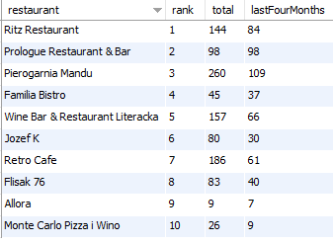
Results:
Restaurants such Allora, Prologue, and Familia Bistro must have opened relatively recently since a large portion of their reviews are between a 4 month span
These restaurants were far less popular since they received fewer reviews in the same 4 month span as the top 10 restaurants

Slide 5
Interpretations:
•New restaurants, or restaurants that are experiencing a popularity boost rise up the ranks faster than other restaurants
•Additionally, the wider the gap between the # of 5 stars a restaurant receives and # of 4 or lower stars, the better
•Restaurants with # of 5 stars closer to the # of 4 stars tend to rank lower

