Slide 2
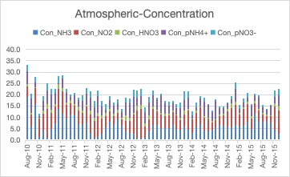
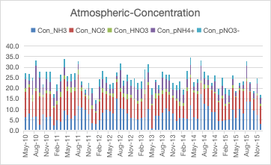
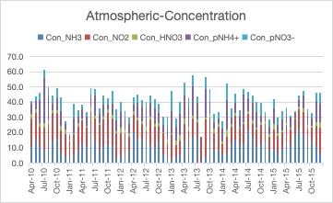
Fenghua
Baiyun
Beijing

Slide 3
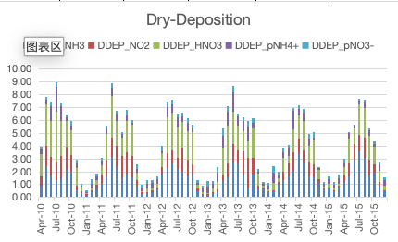
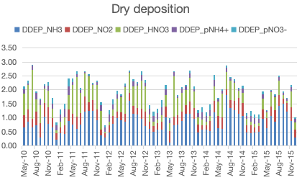
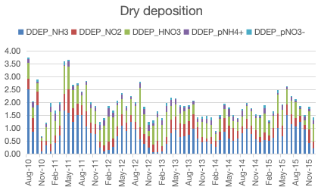
Units in
kg N ha-1 month-1
Beijing
Fenghua
Baiyun

Slide 4
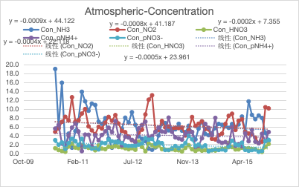
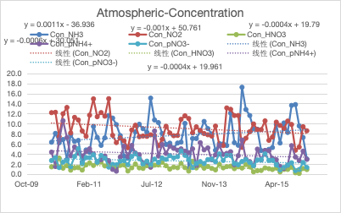
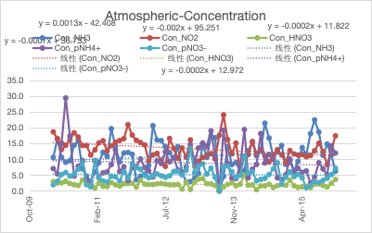
Baiyun
Beijing

Slide 6
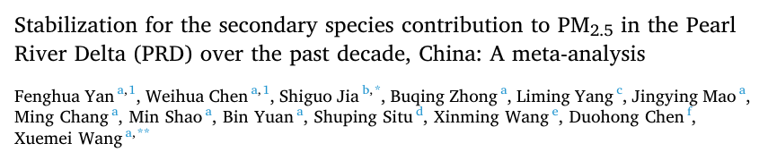
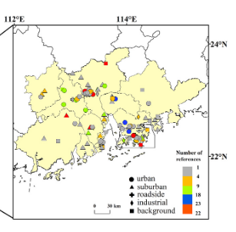
2000 – 2019, PRD
Spatiotemporal change of the main compositions of PM2.5
Published PM2.5 and its chemical composition data
Guangdong-Hong Kong-Macao PRD Regional Air Quality Monitoring Network
OMI
annual average concentration of PM2.5 in the PRD changed from 49.8 ± 17.0 to 33.4± 10.3 μg/ m3, with a mean value of 60.3 ± 16.8 μg/m3.

Slide 7
PM2.5(PRD) | 60.3+-16.8 miug/m3 | Decrease 3.9 per year 2004-2009
Proportion of secondary species | 73%(average) | 83%→55%(2010.2005)
PM2.5 in PRD and YRD showed higher abundance of SIA than carbonaceous particle matter
PM2.5 concentration in PRD is lower than other Chinese megalopolises
The proportion of each secondary inorganic compositions showed a decrease in the proportion of SO4(2-) is corresponding to an increase in the ratio of NO3 and NH4+.
Emission decrease → SO2decrease, but SO4(2-) limited decline

Slide 8
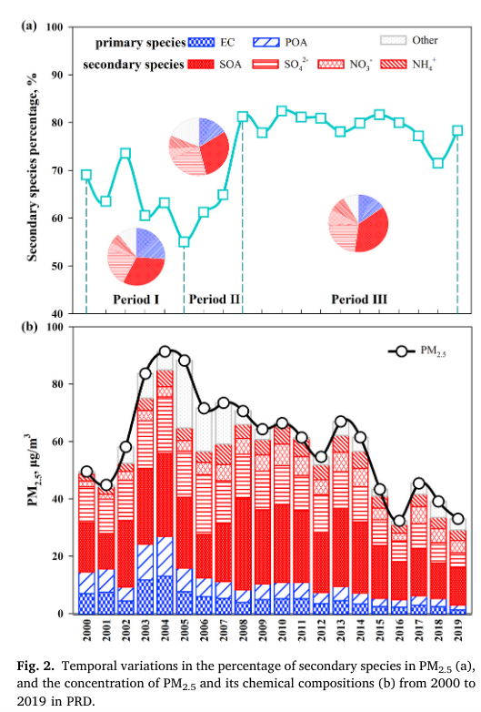
The proportion of secondary species in PM2.5 ranged between 83% (in 2010) and 55% (in 2005), with an average value of 73%
Peak of PM in 2005
Period I: 2000 -2005
secondary species declined declined 3% per year
(higher primary emissions)
Period II: 2005-2008
Secondary species percentage doubled
Lowest percentage of SP in 2005
Period III: 2008 -2019
Stability of 80%
Average SIA (22.1 ± 5.1 μg/m3) concentration slightly higher than SOA concentration (21.2 ± 5.9 μg/m3)

Slide 9
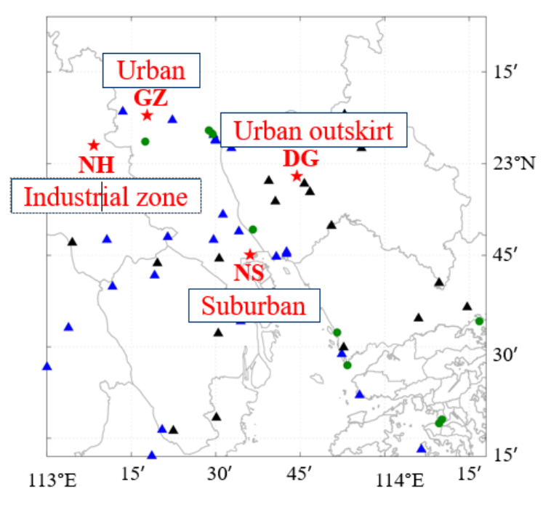
GZ (Guangzhou) | 20070724-20171227
NS (Nanshan) | 20070724-20171227
NH (Nanhai) | 20080114-20141227; 2017
DG (Dongguan) | 20080706-20141127
TW (Tsuen Wan) | 20070805
113.16’; 23.9’

Slide 10
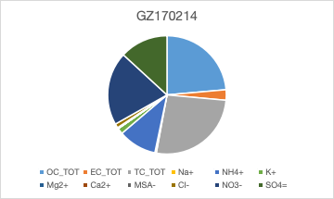
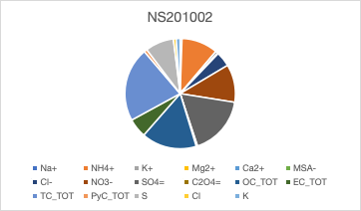
weekly
forPM2.5 measurement：GZ：2010；20133；2014；2017
NS：2010；2013-2017

Slide 11
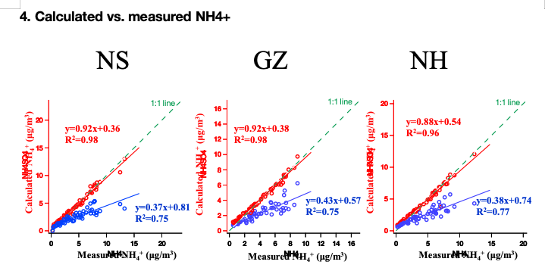
Red: (NH4)2SO4
Blue: NH4HSO4

Slide 12
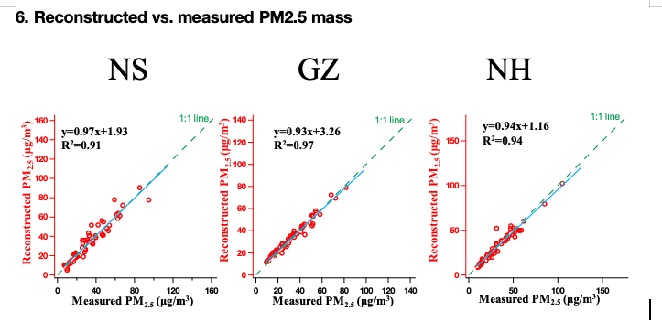

Slide 14
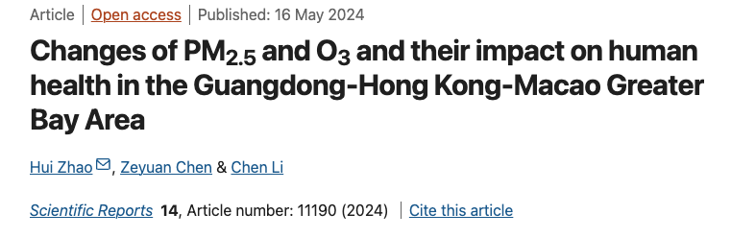
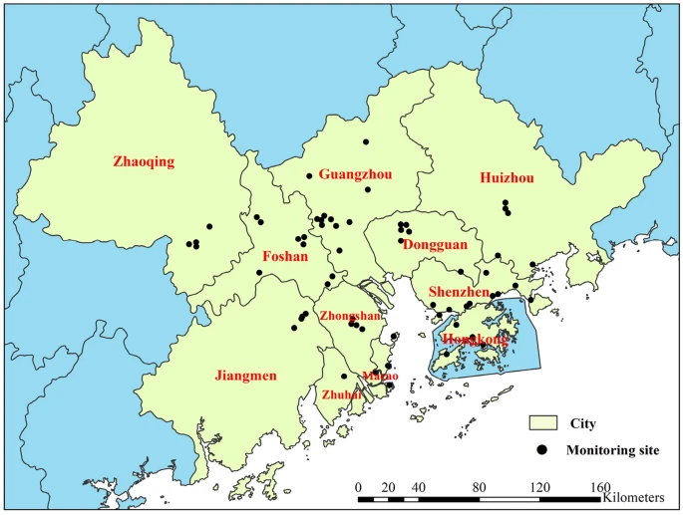
This study utilized monthly PM2.5 and MDA8 O3 data from nine cities in the PRD, Hong Kong, and Macao spanning from 2015 to 2019. These data were obtained from two sources: https://quotsoft.net/air/ and the monitoring results reports of the Guangdong-Hong Kong-Macao Pearl River Delta Regional Air Quality Monitoring Network (http://gdee.gd.gov.cn/kqjc/index.html)

Slide 15
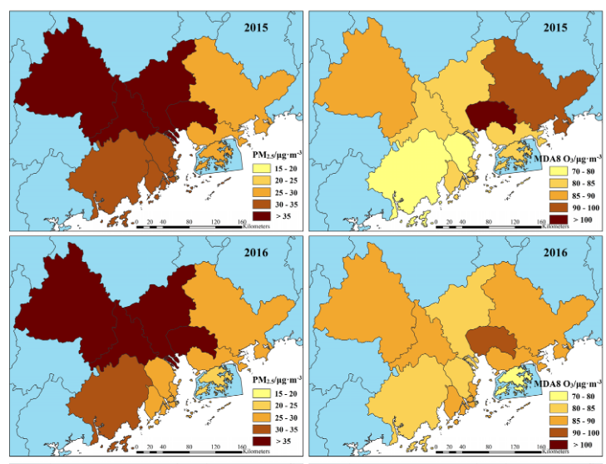
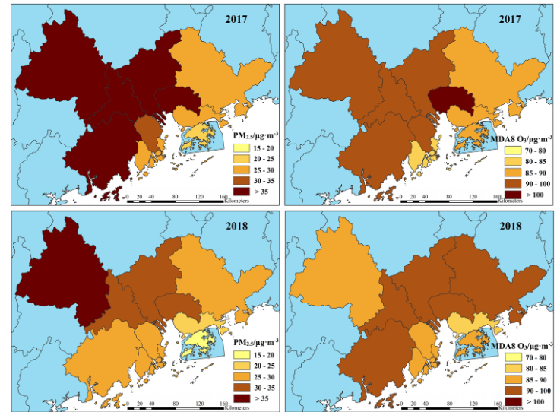
Figure 2. Spatio-temporal distribution of PM2.5 and MDA8 O3 in each city from 2015 to 2019 (The map was generated by ArcGIS 10.7 https://www.esri.com/en-us/arcgis/products/arcgis-desktop/resources).

Slide 16
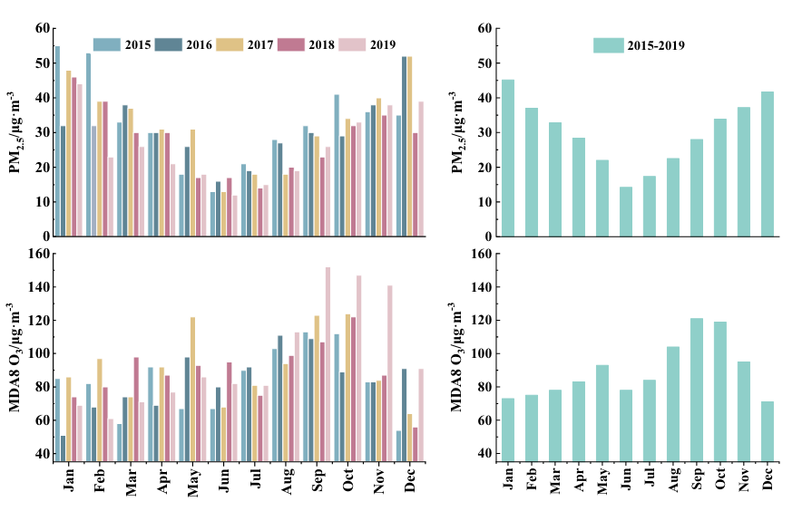
Figure 3. Monthly variation characteristics of PM2.5 and MDA8 O3 in the GBA.

Slide 19
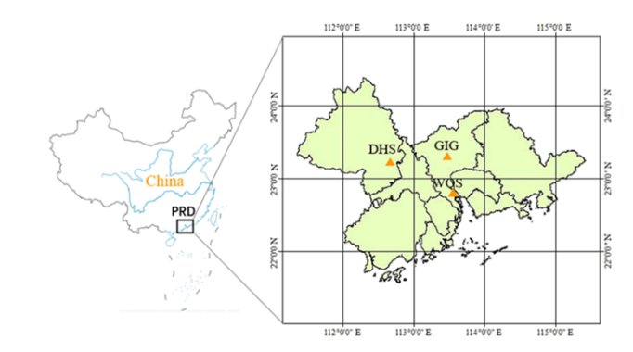
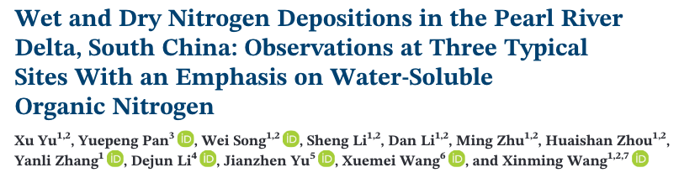
Annual total dissolved N deposition (kg N /ha year·)
Contribution to total N deposition
Water-soluble organic N in PRD is among the highest in the developed regions,
but inorganic nitrogen in the PRD is in the range of IN deposition across China
Proportion of WSON is significantly higher during harvest seasons (enhanced biomass burning)
DHS: subtropical forest
GIG: urban
WQS: rural
urban | rural | forestl
39.8 | 33.8 | 52
NO3- | NH4+ | Water-soluble organic N
26.7-37.8% | 34.6 – 40.9% | 26.1 – 32.3%

Slide 20
Kg N/ha year | urban | rural | forest
Wet N dep | 26.1 | 18.2 | 35.6
dry | 13.7 | 15.6 | 16.4
Average total N deposition is 41.9 kg N/ha year
N dep in PRD comparable to other developed regions in China, but higher than in Europe and America
Wet N deposition highest in spring and summer (high precipitation)
Wet organic N highest in fall. (biomass burning)
From 2008 to 2009, annual NO3- deposition decreased by about 4 kg N /ha

Slide 21
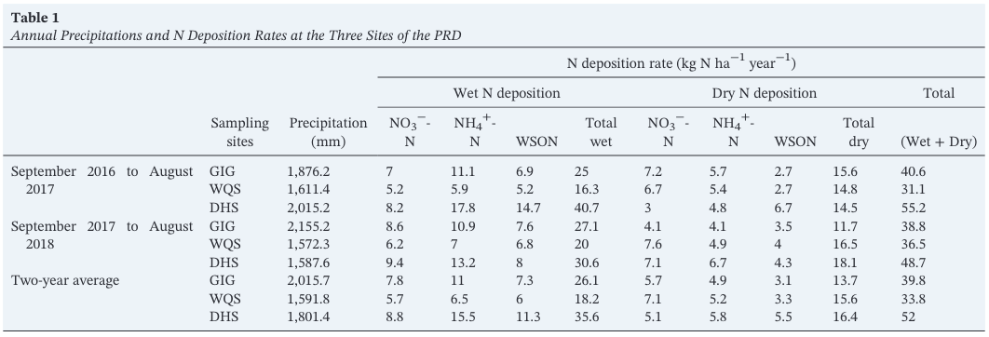
Sept. 2016 - Aug. 2018
Wet N deposition accounted for 54-68% in total N deposition
NOx concentration lower at forest then urban
NH4+ deposition rate higher at urban than rural (more fossil fuel combustion)
Deposition rate of organic nitrogen higher in PRD than in other regions
The deposition rate of WSON in urban Guangzhou was much higher than those at other urban sites, and same for the rural sites

Slide 23
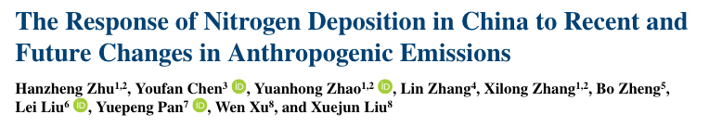
Ecological effects:
NHx deposition: plant diversity
more likely to be toxic to plnt foliar and root
NOy: forest vegetation
agriculture: NH3
combustion NOX
emissions -> non-linear chemistry -> sulfate-nitrate-ammonium
NOx + SO2 -> HNO3 +HSO4
H2SO4 + NH3 -> NH4NO3 + (NH4)2SO4 + NH4HSO4 (preferred)
NH3 & HNO3 -> water- soluble -> reduce N dep at source
NOy begin to decrease after 2010 (NOx emission reduction)
Shift from wet to dry deposition of NHx (reduced SNA formation & SO2 emission)

Slide 24
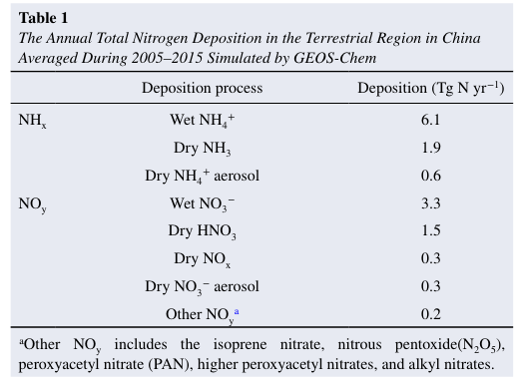
Removal of NHx is dominated by NH4+ (wet)
Removal of NOy is dominated by NO3- (wet)
Dry dep of NH4+ and NO3- aerosols take up less than 6%
Increase in NHx dry dep is due to the increase of NH3 (gas), NH4+ (aerosol) decrease
N dep inter-annual variation do not follow the changes in the corresponding emissions
Linear relationship between changes in N dep and anthro emissions

Slide 25
2005-2015, averages tot_N dep = 14.3 Tg N /yr
66% wet deposition, 61% contributed by NHx
Increase (0.75 Yg N /yr) NH4+ wet dep lead by precipitation
0.39 Tg N / yr increase in NHx dry deposition is dominated by the decrease in SO2 emissions
NOy wet and dry deposition peaked in 2011, following the changes in NOx emissions
Nr deposition show linear relations with emissions of NH3, Nox. SO2
emission policies can reduce NOy deposition, but small effect on NHx deposition
Decrease in NOx and SO2 emissions enhance NHx deposition. → stricter policies in agricultural NH3 emissions

Slide 26
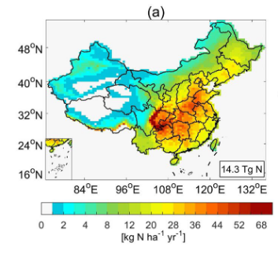
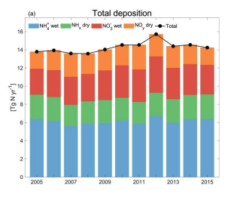
Average tot N dep = 14.3 Tg N /yr
Mainly in southern and eastern parts
Small inter-annual tot deposition variations
Peak in 2012 due to precipitation
 | Deposition (Tg N /yr)
Total Nitrogen deposition | 14.3
NH4+ wet | 6.1
NH3 gas | 1.9
NO3- wet | 3.3
HNO3 gas | 1.5

Slide 27
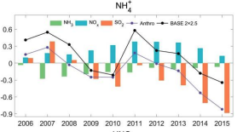
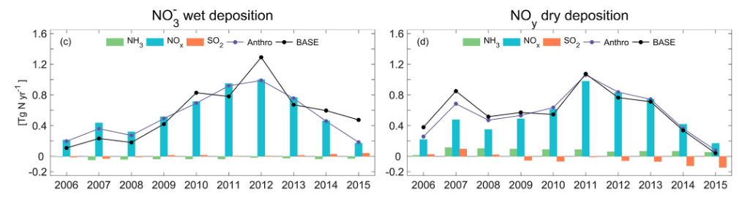
After 2007, decrease in SO2 emissions reduces the formation of NH4+ aerosols, shifting NHx deposition from wet to dry
decrease in SO2 emissions lead to a larger decrease in NH4+ wet deposition than NH3 emission change
SO2 reduction from 2007-2015 lead to a 0.19 Tg N /yr net increase in NHx deposition
The contribution of anthropogenic emissions of NH3 (green), NOx (light blue), and SO2 (red) to the changes in NH4+ wet
 | NO3- wet | NOy dry
2005-2011 | +0.95 Tg N /yr | +0.98
2011-2015 | -0.78 | -0.81
Notes:
Y-axis unit in ppbv

Slide 28
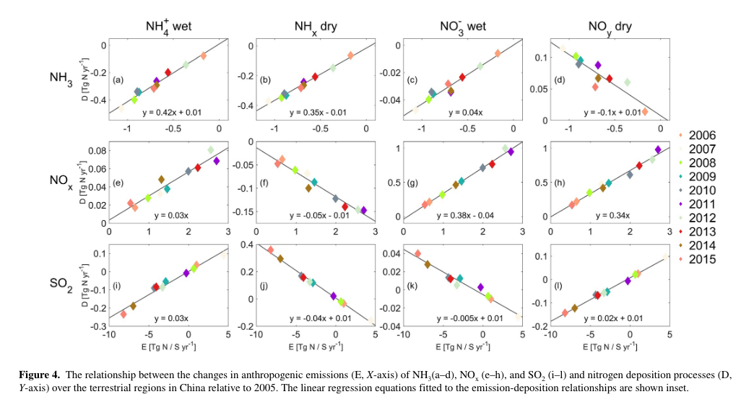
Linear relation between change in emissions and changes in N deposition
1.0 Tg N /yr NH3 emission → 0.42 Tg N /yr NH4+ wet_dep + 0.35 Tg N /yr NHx dey_dep
→ +0.04Tg N /yr NO3- wet_dep + -0.1 Tg N /yr NOy dry_dep
1.0 Tg N /yr NOx emissions → 0.38 Tg N /yr NO3- wet_dep + 0.34 Tg N /yr NOy dry_dep
→ +0.03 Tg N /yr NH4+ wet_dep+ -0.05 Tg N /yr NHx dry_dep
1.0 Tg S /yr SO2 emission → reduce NHx dry_dep by 0.04 Tg N /yr
= 0.03 Tg N /yr NH4+ wet_dep + 0.01 Tg N /yr transport

Slide 30
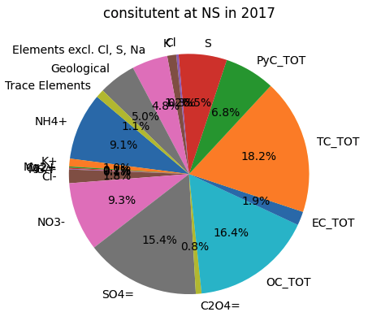
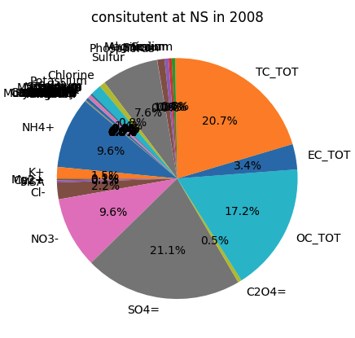

Slide 31
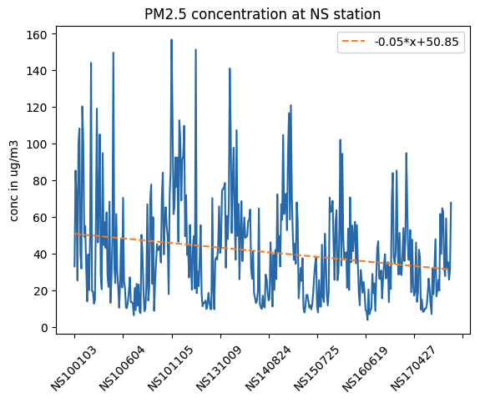
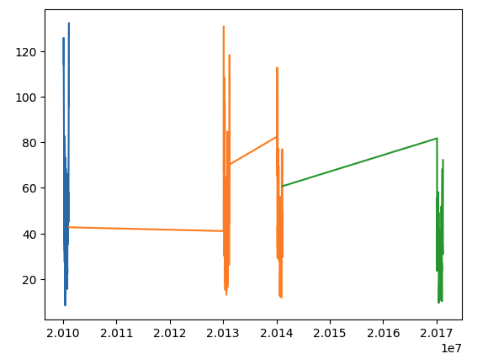

Slide 33
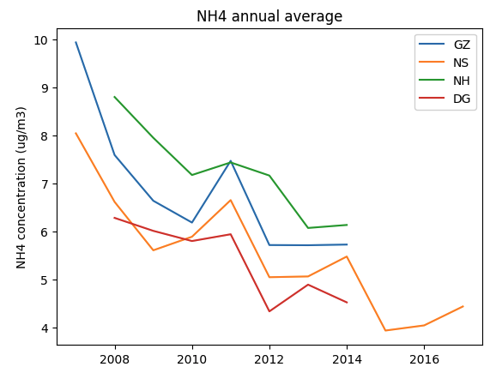
/Users/hrd/Documents/N Dep/PM25Guangdong/PRD NS+GZ 2007-2020/Untitled.ipynb

Slide 34
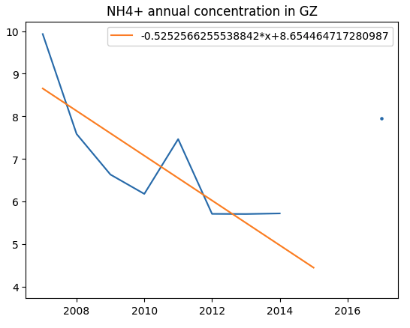
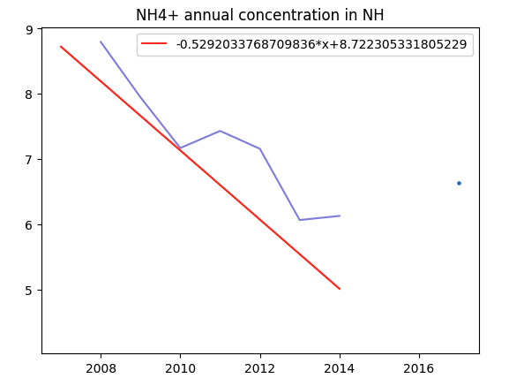
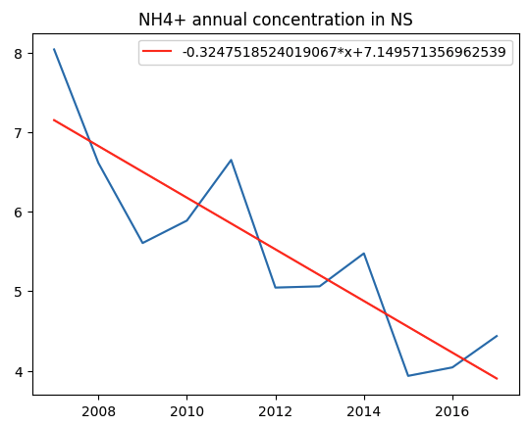
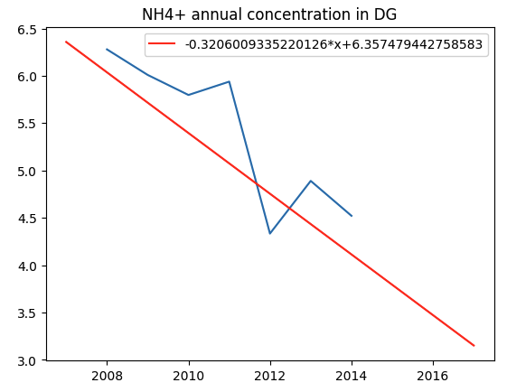

Slide 35
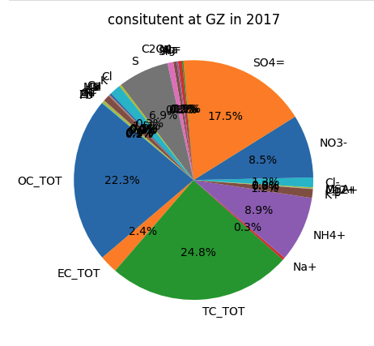
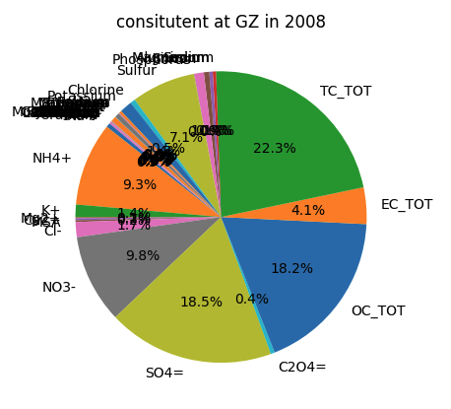

Slide 37
NO3- positive relation with atmos concentration of NO2 and NH3
NH4+ negative relation
paper | doi | concentration

