Slide 1

Emissions, Chemical Transformation, and Deposition of Atmospheric Reactive Nitrogen and its impact on PM2.5 in the Pearl River Delta
Hanrui Duan
2026.09.16
Notes:
Good morning/afternoon, committee members. Today I will present my doctoral dissertation proposal defense on atmospheric reactive nitrogen in the Pearl River Delta. This work addresses a critical transition in regional air quality: the shift from sulfur-dominated to nitrogen-dominated particulate pollution, and the emerging role of ammonia as a control variable for both PM₂.₅ and ozone.”

Slide 2


Contents
Background & Literature Review
Long term trends and composition shifts of emissions in the PRD region
PM2.5 concentration changes and its causes
Conclusions

Slide 3
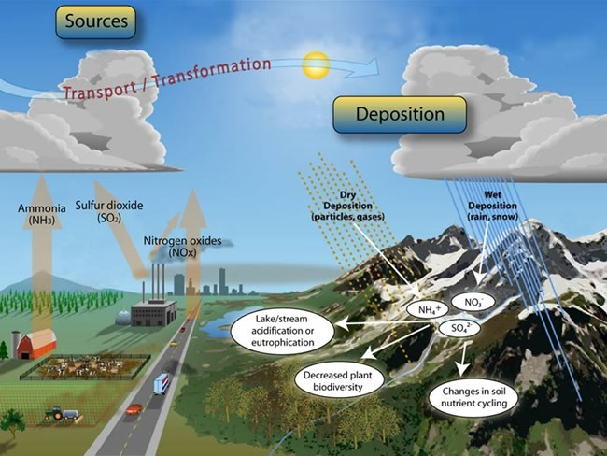
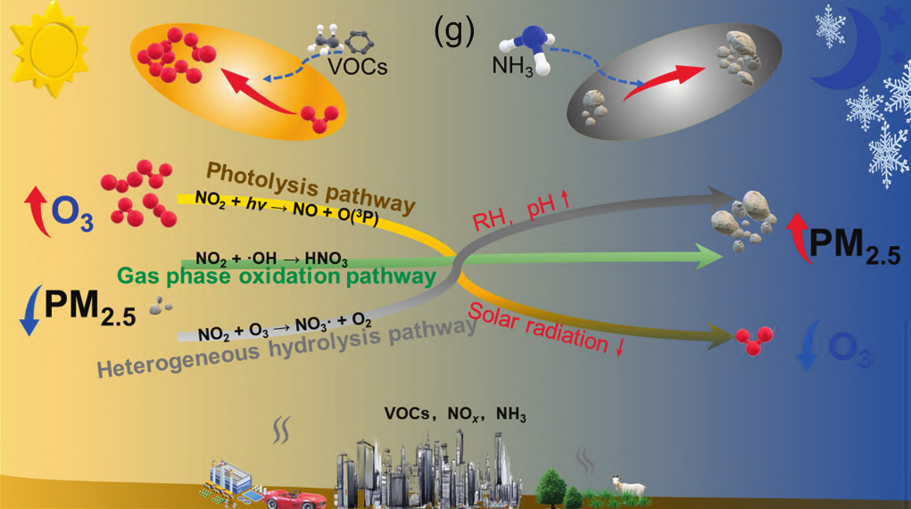
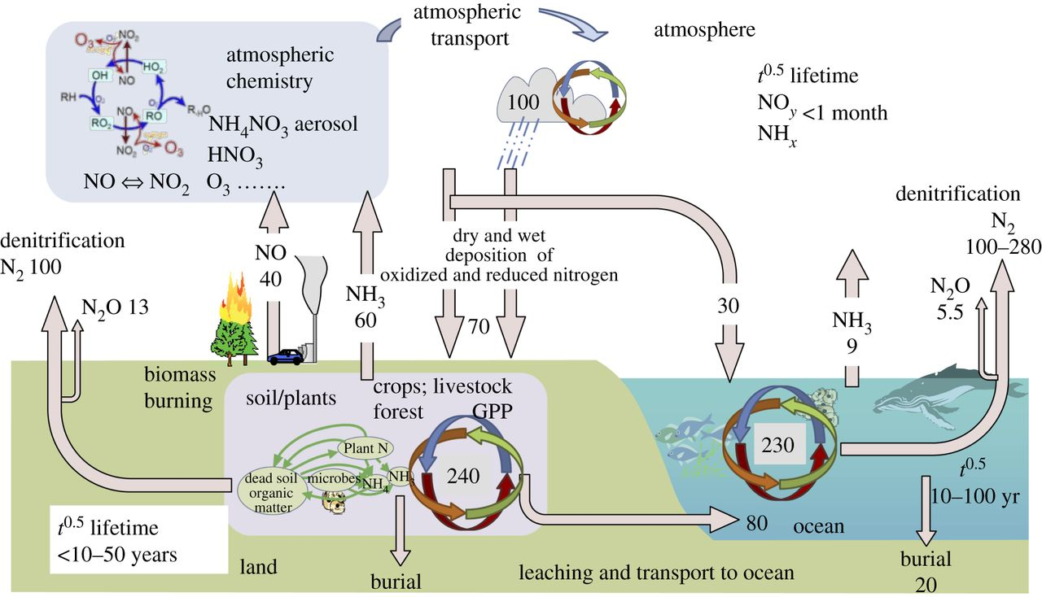
Why Reactive Nitrogen Emissions Matter
Wang, F., et al. 2022)
Fowler et al. (2013)
Reactive nitrogen (Nr) perturbations now profoundly affect air quality, climate systems, human health, and ecosystem integrity.
Alterations to the 21st-century global nitrogen cycle constitute one of the grandest Earth-system challenges, second only to climate change.
Elucidating the emissions, chemical transformation, and deposition of atmospheric Nr—and its feedback on air quality—represents a central frontier in atmospheric chemistry.

Slide 4
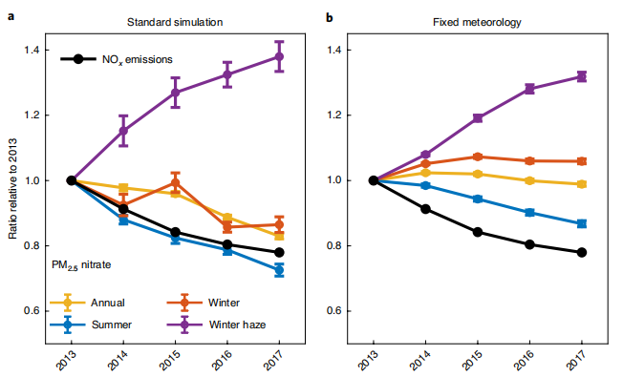
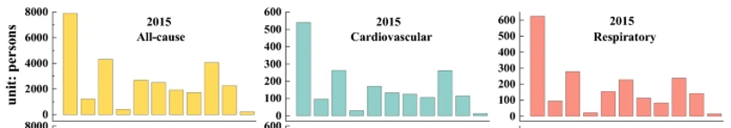
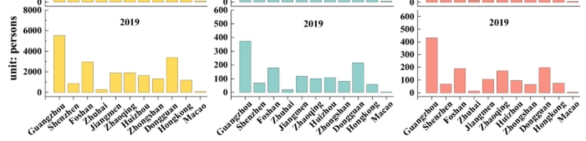
Nitrate Replacing Sulfate as the Dominant PM₂.₅ Component
(Zhao et al. 2024)
(Zhai et al., 2021)
Exposure to PM2.5 lead to premature deaths, cardiovascular and respiratory diseases, decreasing in PM2.5 concentrations can reduce these diseases.
As the world’s largest Nr emitter, China has undergone a two-decade pollution evolution: from SO₂-dominated to NOₓ–NH₃-dominated regimes.
Following substantial SO₂ abatement, particulate nitrate has become the dominant inorganic component of winter haze.
Notes:
（看图说话）
SO2大幅度减排，但冬季雾霾依旧增加-》硝酸盐和二次污染物

Slide 5
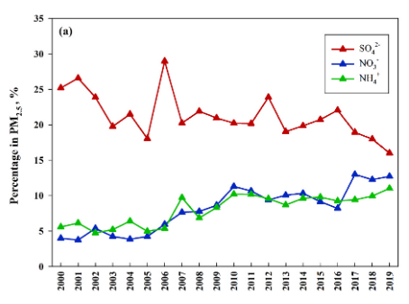
Nitrogen Cycling in the Pearl River Delta (PRD)
2NH₃+H₂SO₄→(NH₄)₂SO₄
￼ NH₃+HNO₃⇌NH₄NO₃
NH₃ is the only abundant alkaline gas in the atmosphere. It reacts with H₂SO₄ and HNO₃ to form (NH₄)₂SO₄ and NH₄NO₃, constituting major PM₂.₅ components.
SO₂ mitigation reduces sulfate, leaving surplus NH₃ available to combine with HNO₃ and forcing nitrate to become the dominant PM₂.₅ species.
Globally, NH₃ remains largely unregulated. In China, NOₓ fell ~38% during 2013–2020, yet NH₃ emissions stayed nearly flat—creating a blind spot for the next stage of PM₂.₅ governance.
Temporal variations in the percentage of SO42− , NO3− , NH4+ in PM2.5 (Adapted from Yan et al., 2020)
Total nitrogen deposition in the PRD is rising, with reduced nitrogen (NHₓ) now accounting for 60–70%, intensifying coastal eutrophication and biodiversity risk.
Nitrate dominates autumn–winter haze. Since SO₂ declined sharply (>50%) after 2013, relative NH₃ excess has made nitrate the primary PM₂.₅ component (25–35% of PM₂.₅ mass).
Notes:
The PRD is not the NCP moved south. As this comparison shows, the PRD’s subtropical, high-humidity environment favors rapid photochemistry, sea-salt interactions, and distinct seasonal cycles. The O₃ paradox here is acute: we cut NOₓ, but O₃ rose because titration was weakened. This tells us that PRD findings cannot be directly transplanted from northern China.
总的氮沉降升高，氨浓度过剩；NO2下降，但是O3升高

Slide 6
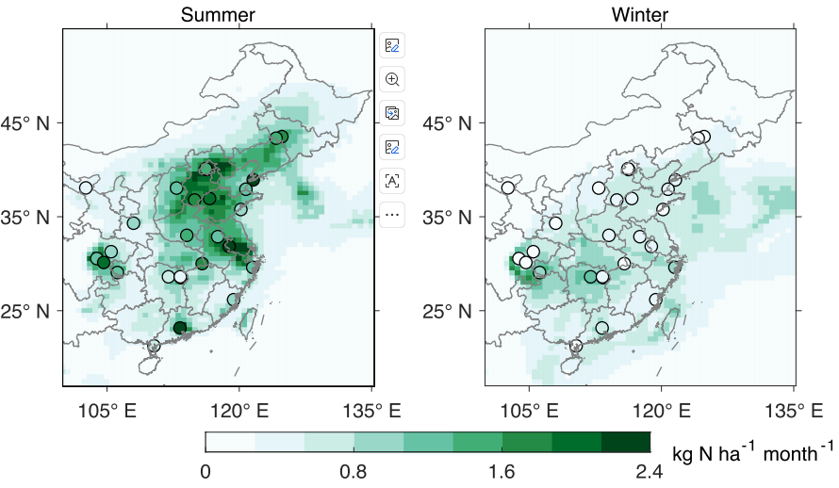
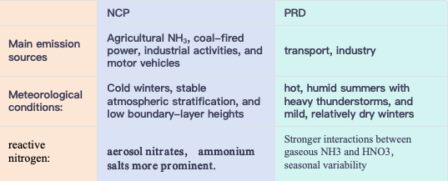
Research Gaps： Critical Gaps in PRD Air Quality Management
comparison between North China Plain (NCP) and Pearl River Delta (PRD)
Spatial distribution of measured (filled circles) and modeled (gridded background) 3-year (2013-2015) averaged summer mean and winter mean nitrate wet deposition fluxes (Zhai et al., 2021).
Geographic bias: Existing NH₃ research concentrates on the North China Plain. The PRD differs fundamentally: subtropical high temperatures and humidity drive extremely active photochemistry and rapid secondary aerosol formation. Yet systematic long-term NH₃ observations in the PRD are virtually absent.
Composition shift: Although PRD PM₂.₅ mass meets standards, its composition has shifted dramatically. Sulfate has fallen, but nitrate now drives autumn–winter haze. The specific mechanism by which excess NH₃ fuels this nitrate enhancement remains unresolved.
O₃–PM₂.₅ ternary coupling: Despite deep NOₓ cuts, O₃ continues to rise. The ternary coupling mechanism of NH₃–NOₓ–VOCs under the latest emission trends is still poorly understood.
Notes:
data gap: we lack long-term NH₃ constraints in the PRD. Second, a mechanism gap: we do not know how the rising NH₃-to-acid ratio thermodynamically forces nitrate formation in this humid subtropical regime. Third, a policy-relevant gap: we cannot yet predict how NH₃ will modulate the nonlinear response of O₃ to NOₓ and VOCs reductions.
for the lack of response of nitrate to NOx emission controls in winter, including the increase of nitrate during winter haze

Slide 7
Research Objectives
To understand the chemical evolution of atmospheric reactive nitrogen in the PRD and its impacts on PM₂.₅ composition, this dissertation is structured around four pillars:
To Detect the long-term evolution, spatial differentiation, and structural transitions of anthropogenic SO₂, NOₓ, and NH₃ emissions in the PRD.
To demonstrate how changes in reactive nitrogen species affect PM₂.₅ chemical composition.
To evaluate atmospheric nitrogen deposition fluxes and their ecological/environmental effects in the PRD.
To project the future emission-reduction scenarios and synergistic PM₂.₅–O₃ control pathways.
Notes:
录屏30:00

Slide 8
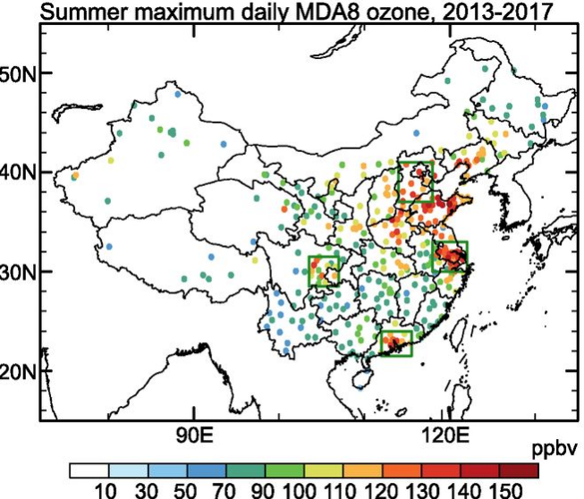
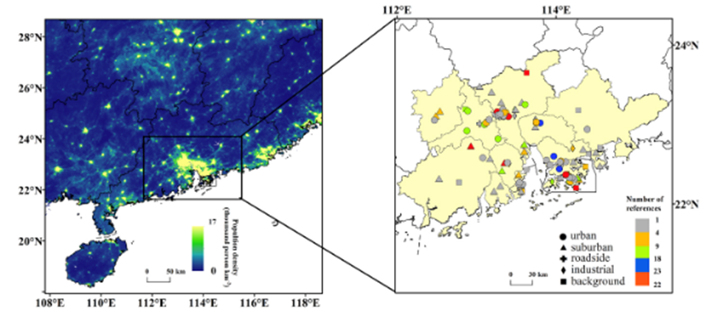
Data and Methodology-Study Area
Feature | Pearl River Delta (PRD) | Yangtze River Delta (YRD) | Beijing–Tianjin–Hebei (BTH)
geographical scope | 21.5°–24°N, 112°–115.5°E | 30°–33°N, 118°–122°E | 37°–41°N, 114°–118°E
Climate Type | Subtropical monsoon climate | Subtropical monsoon climate | Temperate monsoon climate
Annual Temperatur（°C） | 22–23 | 16–18 | 12–14
Annual Precipitatio（mm） | 1600–2000 | 1100–1500 | 500–700
Study area from Li et al., 2019.

Slide 9
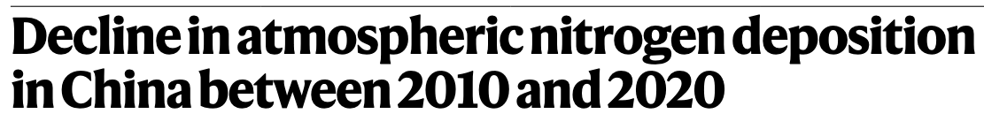
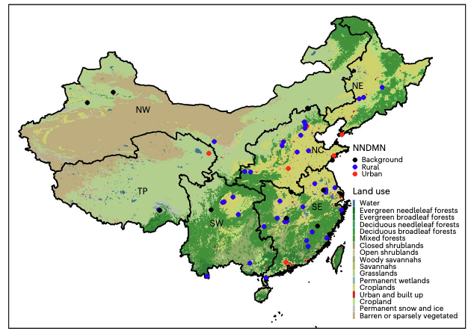



Data and Methodology-Data
Nationwide Nitrogen Deposition Monitoring Network (NNDMN)
Site: Baiyun (23.16°N, 113.27°E)
Period: May 2010–Dec. 2020，monthly
The NNDMN 1.0 database consists monthly mean data on the concentrations of NH₄⁺-N and NO₃⁻-N in precipitation； bulk N deposition fluxes of NH₄⁺-N and NO₃⁻-N, monthly integrated precipitation amount, and the concentrations and dry deposition fluxes of gaseous NH₃, NO₂ and HNO₃, particulate NH₄⁺- and NO₃⁻ for 59 monitoring sites.
Notes:
Grouped by land-use type, the annual average dry deposition (1.9–16.6 kg N ha⁻¹ yr⁻¹ for NH₃, 0.2–16.0 kg N ha⁻¹ yr⁻¹ for HNO₃, 0.2–9.5 kg N ha⁻¹ yr⁻¹ for NO₂, 0.1–11.8 kg N ha⁻¹ yr⁻¹ for particulate NH₄⁺, and 0.2–4.1 kg N ha⁻¹ yr⁻¹ for particulate NO₃⁻) and bulk deposition (2.7–18.9 kg N ha⁻¹ yr⁻¹ for NH₄⁺-N, and 1.5–17.4 kg N ha⁻¹ yr⁻¹ for NO₃⁻-N)
59 monitoring sites

Slide 10

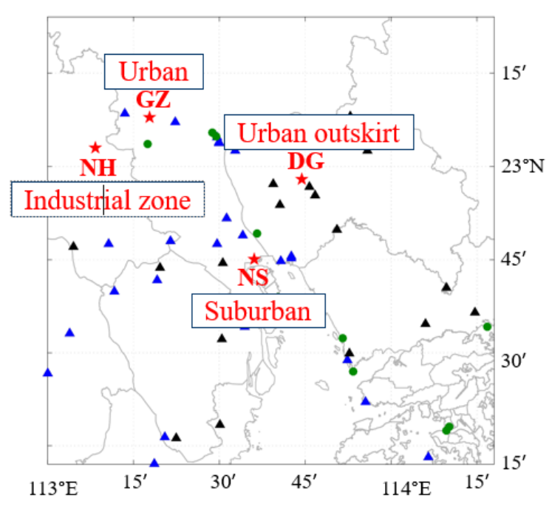
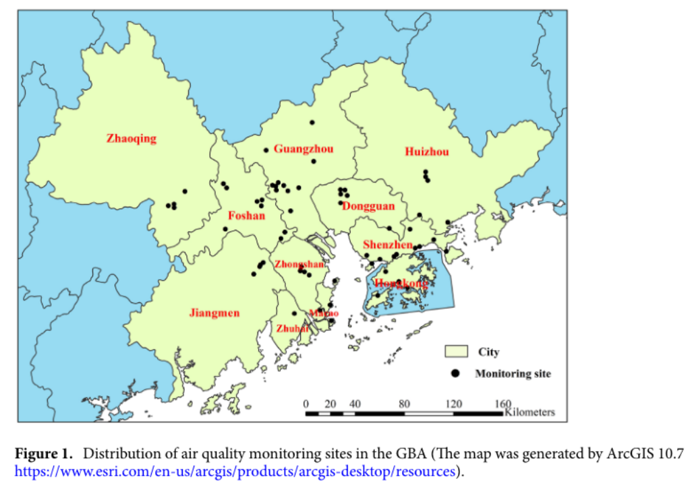
MEE
Data and Methodology
Prof. Jianzheng Yu
PM_{2.5}
SO₄²⁻
NO₃⁻
NH₄⁺
OC
Site | Represent | Period
GZ (Guangzhou) | Urban | 20070724-20171227
NS (Nanshan) | Suburban | 20070724-20171227
NH (Nanhai) | Industrial zone | 20080114-20141227; 2017
DG (Dongguan) | Urban outskirt | 20080706-20141127
PM_{2.5}
SO₂
NO₂
₂₀₁₄₋₂₀₂₂

Slide 11


Long-term Evolution and Structural Transition of SO₂, NOₓ, and NH₃ Emissions in the PRD
Results
Reveal the long-term evolution of anthropogenic reactive nitrogen and precursor emission patterns, source structure transitions, and spatial coupling in the PRD region.
Investigste the long-term changes, sectoral sources, and spatial mismatches of oxidized nitrogen, reduced nitrogen, and sulfer precursors in the PRD region.
Spatiotemporal variation characteristics of NOₓ, SO₂, and NH₃ emissions in China from 1990 to 2023
Spatiotemporal variation characteristics of NOₓ, SO₂, and NH₃ emissions in the PRD region from 1990 to 2023
Evolution of emission source structures for NOₓ, SO₂, and NH₃ in the PRD region from 1990 to 2023
Structural changes in oxidized nitrogen versus reduced nitrogen emissions in the PRD region

Slide 12

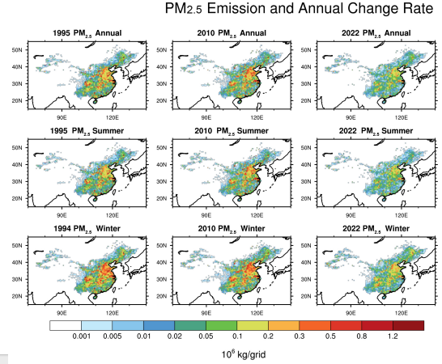
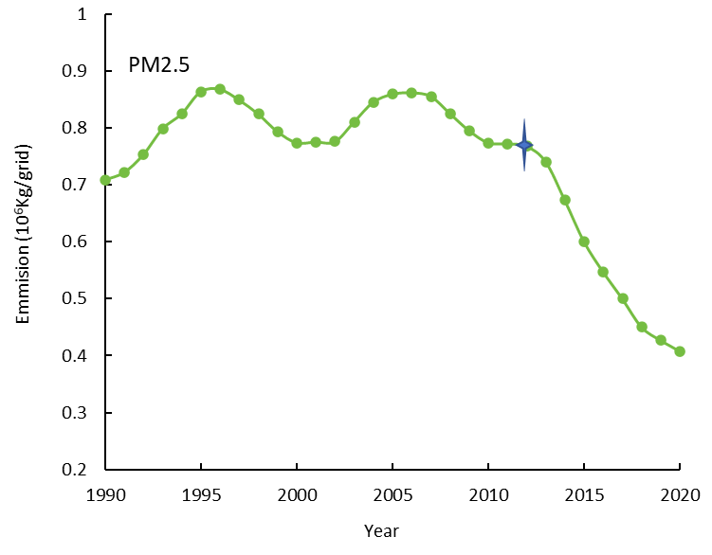
National Spatiotemporal Trends of PM₂.₅ Emissions (1990–2023)
Spatial distribution of annual, summer and winter PM2.5 emission intensity in 1995,2010 and 2022, and the rate of change from 2010 to 2022 in China（106kg/month/grid)）
The annual emission intensity of PM2.5 in China in 1995, 2010, and 2022, respectively.
National PM₂.₅ emission intensity peaked in 2006, declining sharply after 2012 due to strengthened controls.
From 2010 to 2023, PM₂.₅ reductions were concentrated in North China, the Sichuan Basin, the middle–lower Yangtze River, and the PRD.
Notes:
Emission intensity is not identical to ambient concentration because of secondary formation, but the spatial pattern shows where primary control measures have been most effective.

Slide 13
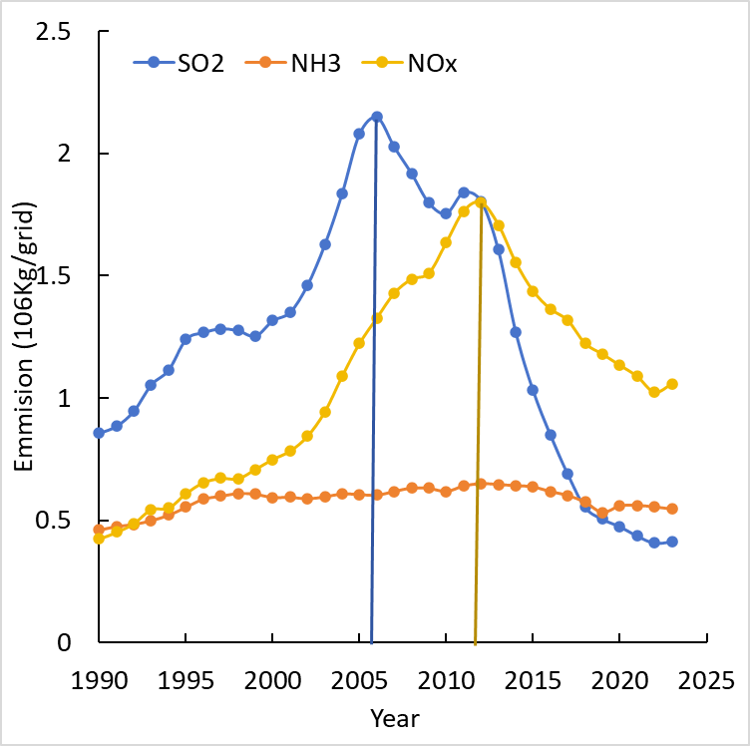
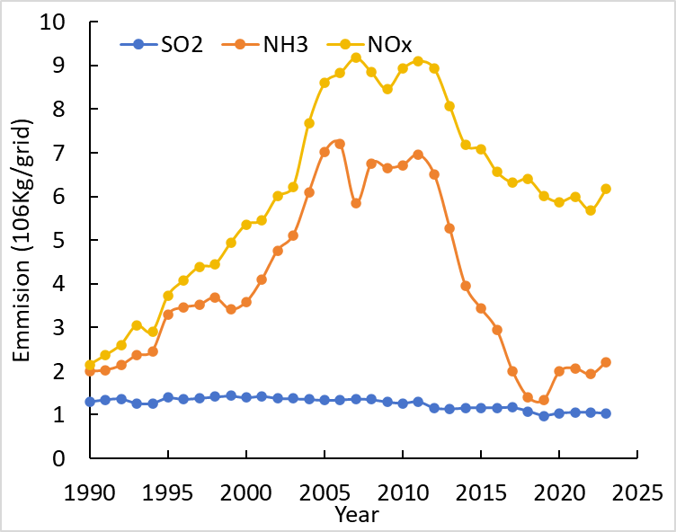
National Spatiotemporal Trends of NOₓ, SO₂, and NH₃ (1990–2023)
The annual emission intensity of NOx, SO ₂, and NH3 in China in 1995, 2010, and 2022.
Changes in average NOx, SO ₂, and NH3 emission intensity in the PRD from 1990 to 2023.
NOₓ and SO₂ emissions exhibited inverted-U trends, peaking in 2006 and 2012, respectively, reflecting energy growth, industrial expansion, and subsequent strengthened emission controls.
NH₃ emissions remained comparatively stable, increasing the relative abundance of NH₃ in the national Nr budget.
PRD NOₓ and SO₂ emissions peaked earlier than the national average—reflecting earlier industrialization and aggressive local governance.
Post-2010, NH₃ intensity weakened in city centers but increased in peripheral agricultural areas (Zhaoqing, Jiangmen), creating a pronounced urban–rural gradient.
Notes:
右图（区域）：The reduced-to-oxidized nitrogen ratio increased; the regional Nr structure shifted from NOₓ-dominance toward enhanced NH₃ importance.
Spatial evolution: from 1990s point-source dominance → 2010 urban-area diffusion → 2022 significantly reduced overall intensity. However, the Guangzhou–Foshan and Shenzhen–Dongguan metropolitan belts remain emission hotspots.

Slide 14
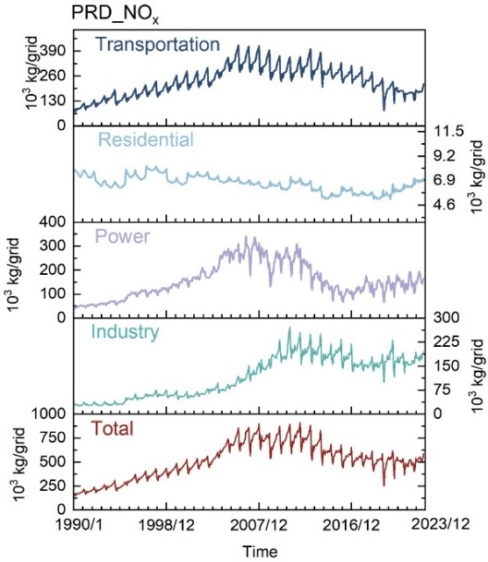
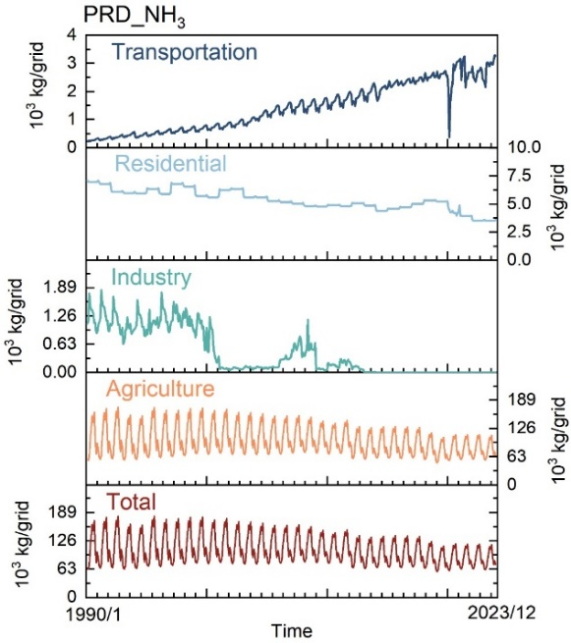
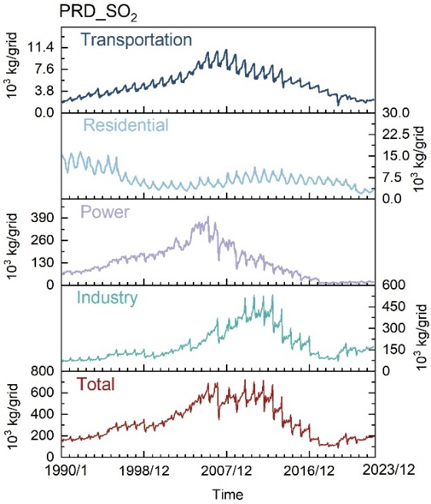
Source-Structure Evolution of NOₓ, SO₂, and NH₃ in the PRD (1990–2023)
Monthly changes in NH3 emission intensity from different sources in the PRD region from 1990 to 2023
Monthly changes in NH3 emission intensity from different sources in the PRD region from 1990 to 2023
Monthly changes in SO2 emission intensity from different sources in the PRD region from 1990 to 2023
Notes:
录屏2:3:05
研究一下这四句画，变成自己的话说出来

Slide 15
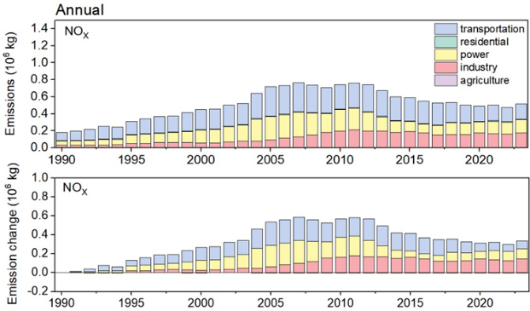
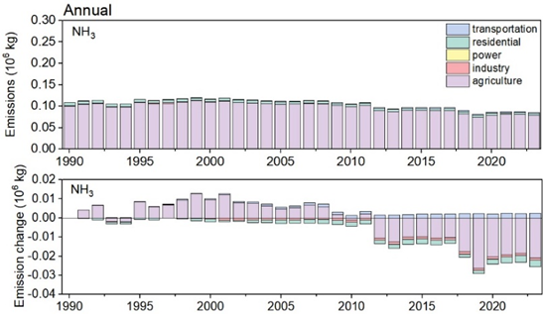
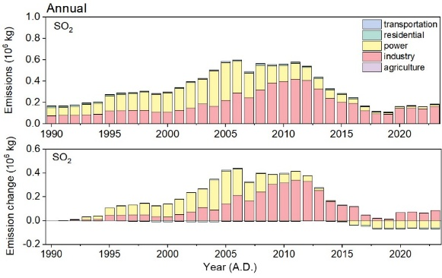
Source-Structure Evolution of NOₓ, SO₂, and NH₃ in the PRD (1990–2023)
Changes in NO_{x} emission intensity from different sources in the PRD from 1990 to 2023, and changes in NO_{x} emission intensity from different sources compared to 1990.
Changes in NH₃ emission intensity from different sources in the PRD from 1990 to 2023, and changes in NH₃ emission intensity from different sources compared to 1990.
Changes in SO₂ emission intensity from different sources in the PRD from 1990 to 2023, and changes in SO₂ emission intensity from different sources compared to 1990.
Changes in emission structure determine the chemical constraint state of the sulfate–nitrate–ammonium system.
NOₓ: Dominated by traffic, power, and industry. Pre-2012 increases were driven by traffic and power; post-2012 declines were also led by traffic (emission-standard upgrades).
NH₃: Agricultural sector dominates (>92% of total). High summer temperatures exacerbate volatilization, causing pronounced summer emission peaks.
SO₂: Early dominance by power and industry. Power-sector SO₂ dropped ~94% from its 2006 peak due to fuel switching and FGD penetration; industrial SO₂ fell 61% from its 2011 peak but now constitutes >87% of the remaining total.

Slide 16
Impacts of Reactive Nitrogen Changes on PM₂.₅ Composition
Spatiotemporal variation characteristics of PM_{2.5} emissions across China
Reveal the long-term evolution characteristics of anthropogenic PM emission patterns, source sturcture transitions in the PRD region. Identify the impacts of long-term changes of reactive nitrogen and sulfer emissions on the compositional shifts in PM_{2.5}. Understand the nonlinear relation between NOx and NH3 variations and PM_{2.5} concentrations.
Spatiotemporal variation characteristics and evolution of emission source structures for PM_{2.5} in the PRD region
Compositional changes of PM_{2.5} in the Pearl River Delta

Slide 17

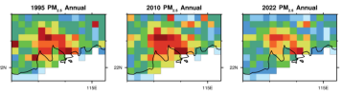
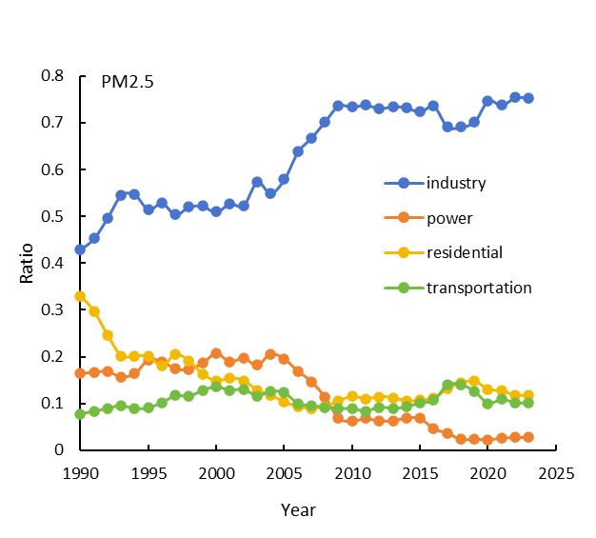

PRD Spatiotemporal Trends and Source-Structure Evolution of PM₂.₅ (1990–2023)
PRD PM₂.₅ emission intensity peaked in 2006, consistent with the national trend.
From 2010 to 2022, overall intensity dropped significantly, yet Guangzhou–Foshan and Shenzhen–Dongguan remain high-emission zones.
Industrial PM₂.₅ share rose from 42% (1990) to 75% (2023), while power and residential shares declined continuously.
Percentage of PM2.5 emissions from different sources in PRD from 1990 to 2023

Slide 18
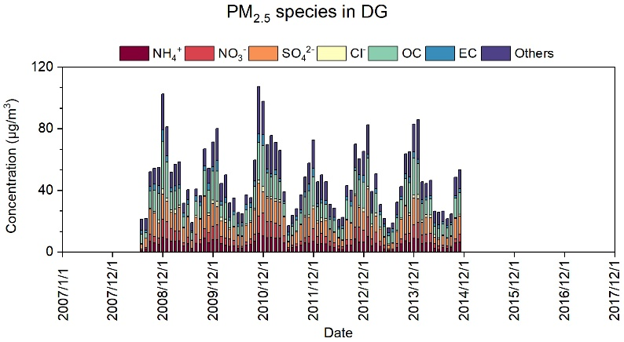
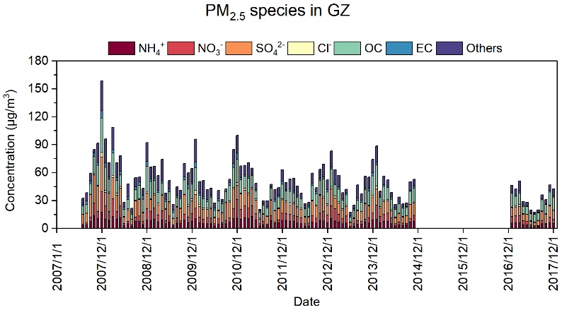
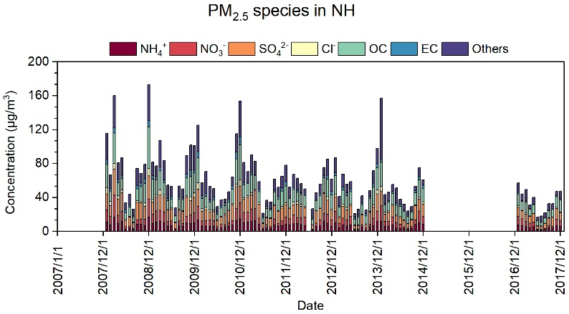
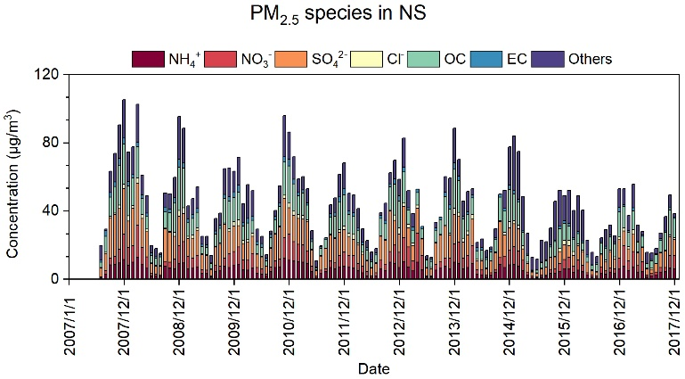
Observational Evidence of PM₂.₅ Component Changes in the PRD (2007–2017)
Industrial sites (NH) recorded the highest concentrations; suburban sites (DG) the lowest.
NH₃ and NH₄⁺ exhibited distinct winter-high, summer-low seasonality.
SNA averaged 43% of PM₂.₅ at DG (up to 50% in summer) and 50% at NH (up to 60% in summer), indicating that summer PM₂.₅ in the PRD is largely driven by secondary inorganic aerosol formation.
Observation sites in PRD region
PM2.5 and species concentration at 4 observation sites from 2007 to 2017 (from Prof. Yu)
Notes:
录频2:5:00
为了揭示PRD PM2.5及其组分的变化，首先利用在广州、NH，NS， DG的观测数据，诊断了2007-2017年PM2.5的变化特征，及其组分变化。
【把重要结果讲出来】季节变化，硫和硝季节的占比
所有站点PM2.5浓度在下降，而且有明显季节变化特征
工业区的浓度比其他地区高
氨、硝酸、硫酸都在下降
SNA是PM2.5主要贡献，《-解决SNA可以解决PM2.5
硫酸在夏天占比比较高，硫酸和硝酸的占比的季节变化相反
SIA越来越重要

Slide 19
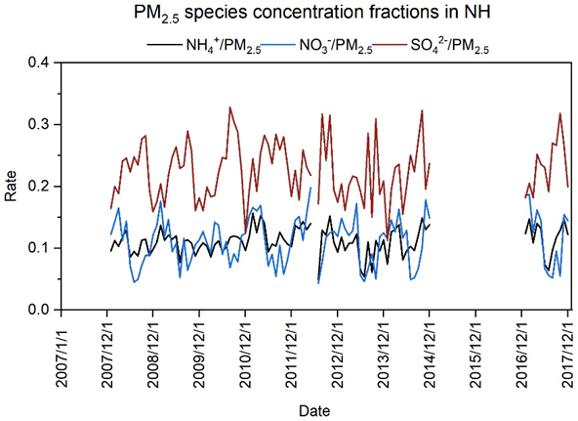
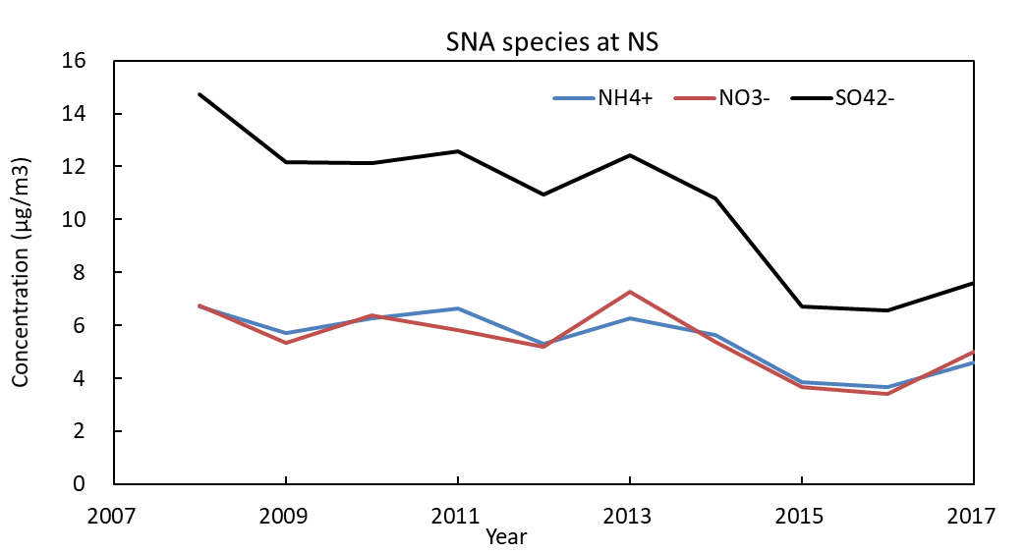
Observational Evidence of PM₂.₅ Component Changes in the PRD (2007–2017)
Seasonal asymmetry: NO₃⁻ contribution was low in summer (~5%) but high in winter (~15%); SO₄²⁻ showed the opposite pattern (summer ~30%, winter ~15%).
SNA/PM ratio from 2007 - 2017 at site NH
annual SNA change from 2007 - 2017 at site NS

Slide 20
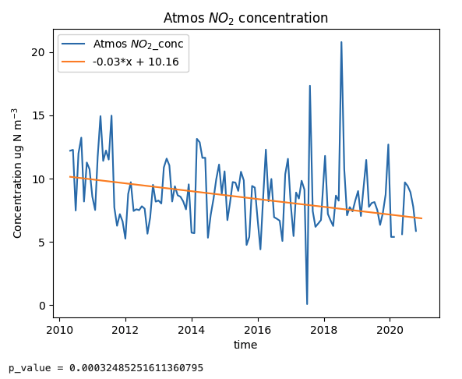
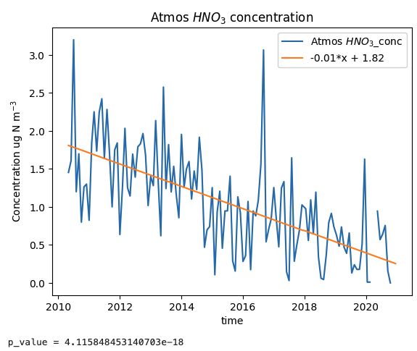
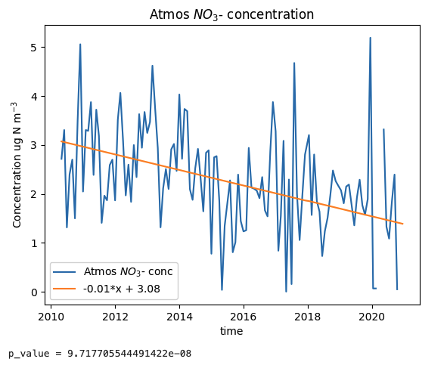
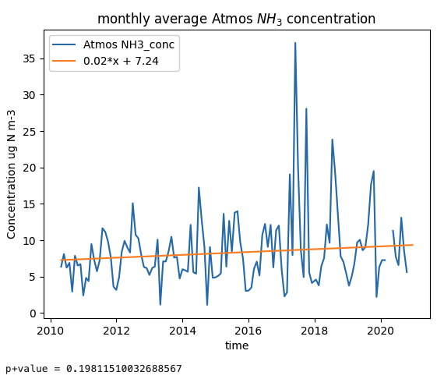
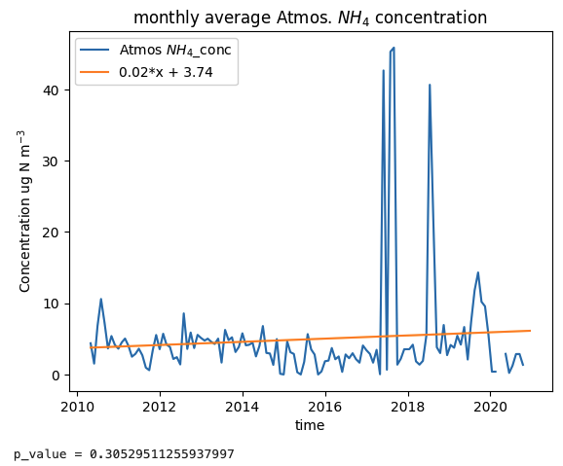
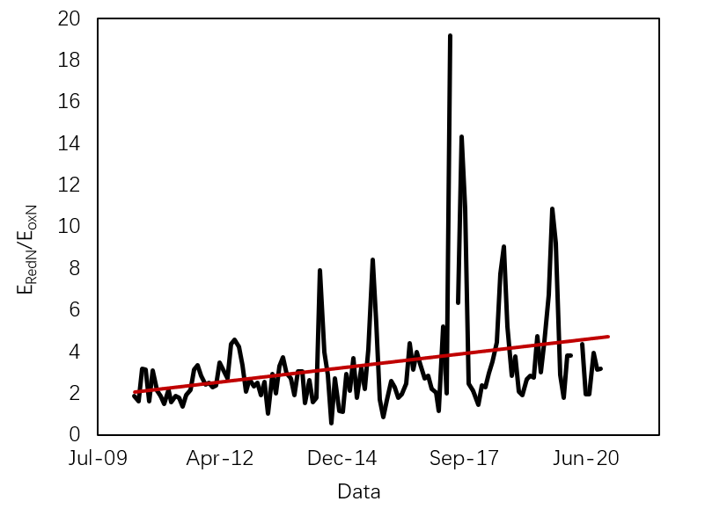

Variation of Atmospheric N concentration at Baiyun station (2010-2020)
Define reduced /oxidized nitrogen molar ratio:
$$R=\frac{{NH}_{y}}{{NO}_{x}}$$
Reduced nitrogen (NH₃, NH₄⁺) concentrations in the PRD continued to increase, while oxidized nitrogen (NOₓ, NO₃⁻) decreased gradually.
The rising ratio of reduced-to-oxidized nitrogen may be fundamentally altering PM₂.₅ composition.
Diagnostic question: As SO₂ and NOₓ continue to decline, has NH₃ become the critical bottleneck preventing further PM₂.₅ reductions?
Notes:
录屏2:13:30
还原氮和氧化氮的比值
在硫酸盐大幅度降低的背景下，活性氮在PM2.5的SIA形成中角色越来越重要。为进一步探讨Nr在PRD PM2.5中的作用，利用NNDMN观测数据，发现在2010-2020年期间，氧化态氮在显著降低，而还原态氮在增加。还原态氮的增加，

Slide 21
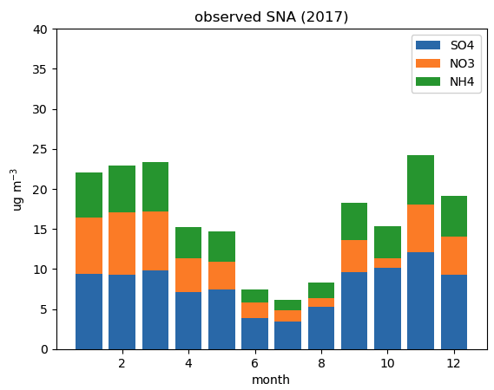
module summer SNA is only about 1/5 of winter SNA

Slide 23
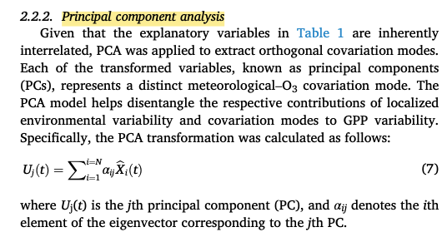
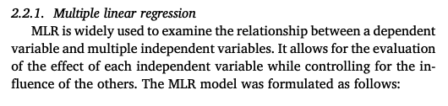
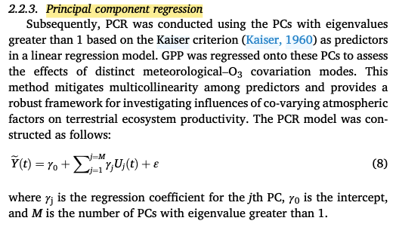
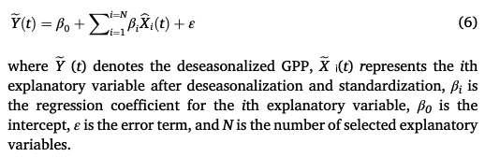
Statistical methods
Multiple linear regression
examine relationship between a dependent variable and multiple independent variables
Principal component analysis
to extractorthogonal covariation modes(distinguishtherespectivecontributionofeachemissionsourcetothtotalemission
Principal component regression
Notes:
MachineLearning

Slide 24
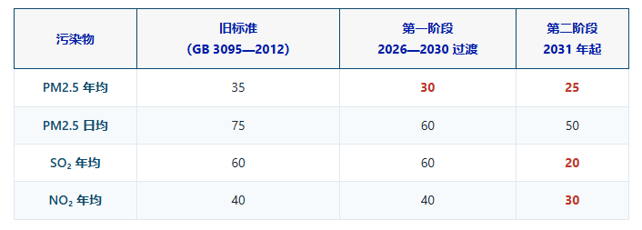
China’s PM₂.₅ Governance Enters a New Stage
µg/m³
March 2026: revised Ambient Air Quality Standards enacted. The Ministry of Ecology and Environment targets Beautiful China 2035 goals and alignment with WHO Interim Target-2 (25 µg m⁻³).
Primary PM controls are now well-defined; secondary inorganic aerosols require synergistic control of NOₓ, VOCs, SO₂, and NH₃, with coordinated governance of PM₂.₅ and O₃.
from https://mp.weixin.qq.com/s/buY5iu-Dq77Vx5nbeK4gDA?scene=1&click_id=1
Notes:
新的环境标准法
研究重点：新法要求下，需要加大对活性氮、PM2.5的研究

Slide 25
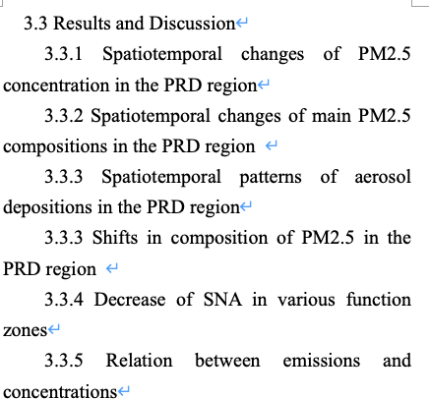
7. Future Work & Expected Outcomes
Key Questions:
Has sulfate decline altered ammonia partitioning, thereby enhancing nitrate formation potential?
How does the oxidized-to-reduced nitrogen emission structure affect secondary aerosol formation, PM₂.₅, and O₃?
What are the atmospheric nitrogen deposition fluxes and their ecological consequences in the PRD?
What future emission-reduction scenarios and PM₂.₅–O₃ synergistic control pathways are optimal for the PRD?
Expected Outcomes:
A closed-loop analysis from emissions → chemical transformation → deposition → policy scenario for PRD reactive nitrogen.
A science-based, region-specific roadmap for transitioning PRD air quality management into the “NH₃-sensitive” era.
Notes:
To conclude, my dissertation will close the loop from emissions to chemistry to deposition to policy. The expected deliverable is not merely a set of papers, but a quantitative roadmap for PRD air quality management—one that explicitly treats reactive nitrogen as the shared currency of PM₂.₅ and O₃ pollution
sensitivityTest
逻辑理顺
讲故事：讲背景，为什么研究活性氮？（活性氮很重要，对XXXX有影响）
在别人的基础上介绍，别人都研究了什么
在前人研究的基础上，还有哪些没结果，gap在哪里
研究目标是什么？research Objective
把模拟的pm变化和观测放一起
新的排放清单下
在新环境，（氨增强的情况下），怎么管理大湾区的活性氮
在哪种排放情景下，可以达成最佳的治理效果（pm和O3都是最优）
会有哪些结果，预期的目标

Slide 27
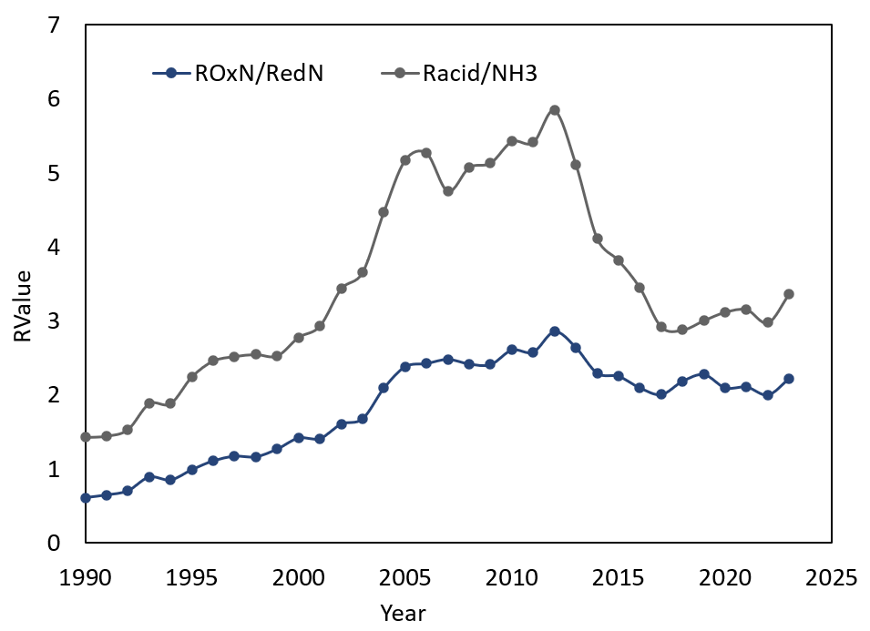


6. Preliminary Results 1.4: Changes in Oxidized vs. Reduced Nitrogen Emission Structure in the PRD
NOₓ, SO₂, and NH₃ collectively determine precursor availability for the sulfate–nitrate–ammonium system.
To compare emissions on a nitrogen-element basis.
Oxidized/Reduced Nitrogen Ratio:
NH₃ preferentially neutralizes the strongest acid, H₂SO₄ (irreversible)：
2NH₃+H₂SO₄→(NH₄)₂SO₄
any remaining NH₃ establishes a semi-volatile equilibrium with HNO₃：
￼ NH₃+HNO₃⇌NH₄NO₃
$$R_{OxN/RedN}=\frac{E_{oxN}}{E_{RedN}}=\frac{E_{NOx}}{E_{NH3}}×\frac{17}{46}$$
Potential Acid Precursor / Ammonia Molar Ratio:
$$R_{acid/NH3}=\frac{2\frac{E_{SO2}}{64}+\frac{E_{NOx}}{46}}{{E_{NH3}}/{17}}$$
Changes in the ratio of oxidized/reduced nitrogen emissions (R_{OxN/RedN}) and oxidized/reduced nitrogen emissions (𝑅_{𝑎𝑐𝑖𝑑∕𝑁𝐻3}) from 1990 to 2023 in PRD
1990–2012: R_{OxN/RedN}​ rose from 0.6 to 2.86 (NOₓ grew faster than NH₃).
2012–2023: R_{OxN/RedN}declined slowly (NOₓ fell faster than NH₃), increasing the relative share of reduced nitrogen.
Racid/NH3​​ declined post-2012, indicating enhanced NH₃ supply relative to acidic precursors.
Hypothesis: As SO₂ and NOₓ decline faster than NH₃, the PRD system is becoming increasingly NH₃-rich. This may elevate nitrate dependence on NOₓ oxidation products, meteorology, and regional transport. This hypothesis will be tested in subsequent chapters via observations and chemical-transport sensitivity experiments.
Notes:
These ratios are the chemical compass of my study. The transition from an acid-limited to an ammonia-rich regime means that thermodynamics increasingly favor particulate nitrate whenever HNO₃ is available. The question is no longer whether we have enough ammonia, but how oxidized nitrogen and meteorology convert that ammonia into aerosol.

Slide 28


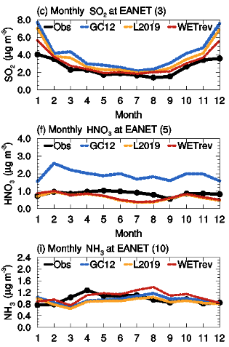
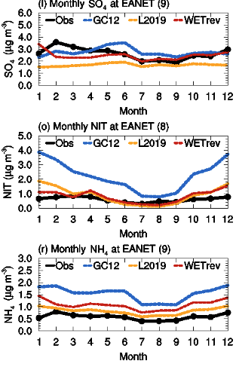
5. Data and Methodology
meteorology: MERRA2
emissions: CEDS; MEIC
resolution: 0.5x0.625 nested grid
simulated time: 2015-2020 monthly
modified settings: DLUO_WETDEP = on
Dataset: Multi-resolution Emission Inventory for China (MEIC).
Period: 1990–2023.
Pollutants: NOx, SO₂, and NH₃.
Spatial scale: Gridded anthropogenic emissions.
Study regions:
◦ Pearl River Delta (PRD);
◦ Beijing–Tianjin–Hebei (BTH);
◦ Yangtze River Delta (YRD).
(Luo et al., 2020)

Slide 29
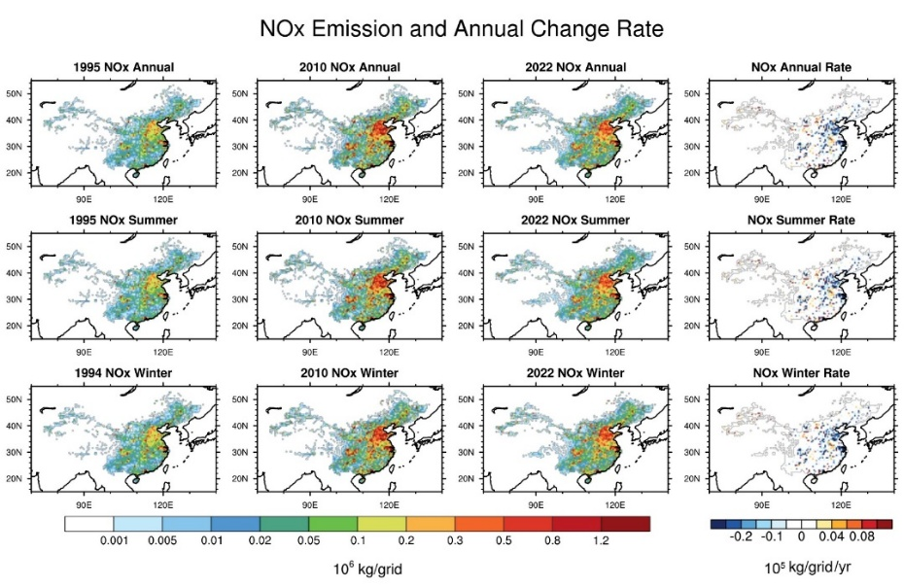

Preliminary Results： National Spatiotemporal Trends of NOₓ, SO₂, and NH₃ (1990–2023)
Spatial distribution of annual, summer and winter NOx emission intensity in 1995,2010 and 2022, and the rate of change from 2010 to 2022 in China（106kg/month/grid)）
The annual emission intensity of NOx, SO ₂, and NH3 in China in 1995, 2010, and 2022.
NOₓ and SO₂ emissions exhibited inverted-U trends, peaking in 2006 and 2012, respectively, reflecting energy growth, industrial expansion, and subsequent strengthened emission controls.
NH₃ emissions, driven by agricultural structure and temperature-dependent volatilization, remained comparatively stable, increasing the relative abundance of NH₃ in the national Nr budget.
Spatial distribution of annual, summer and winter NH3 emission intensity in 1995,2010 and 2022, and the rate of change from 2010 to 2022 in China（106kg/month/grid)）
Notes:
说一下空间变化特征
左上：1990较弱，2010迅速增加
氨的排放和空间分布不一致

Slide 30



6. Preliminary Results 1.2： PRD Spatiotemporal Trends of NOₓ, SO₂, and NH₃ (1990–2023)
Spatial distribution of annual, summer and winter NOx emission intensity in 1995,2010 and 2022, and the rate of change from 2010 to 2022 in PRD（10⁶kg/month/grid)）
Spatial distribution of annual, summer and winter SO2 emission intensity in 1995,2010 and 2022, and the rate of change from 2010 to 2022 in PRD（10⁶kg/month/grid)）
Spatial distribution of annual, summer and winter NH3 emission intensity in 1995,2010 and 2022, and the rate of change from 2010 to 2022 in PRD（10⁶kg/month/grid)）
PRD NOₓ and SO₂ emissions peaked in 2006 and 2005, respectively—earlier than the national average—reflecting earlier industrialization and aggressive local governance.
The reduced-to-oxidized nitrogen ratio increased; the regional Nr structure shifted from NOₓ-dominance toward enhanced NH₃ importance.
Spatial evolution: from 1990s point-source dominance → 2010 urban-area diffusion → 2022 significantly reduced overall intensity. However, the Guangzhou–Foshan and Shenzhen–Dongguan metropolitan belts remain emission hotspots.
Spatial misalignment: Post-2010, NH₃ intensity weakened in city centers but increased in peripheral agricultural areas (Zhaoqing, Jiangmen), creating a pronounced urban–rural gradient. This decoupling provides a coupled-precursor foundation for downwind ammonium nitrate formation.
Changes in average NOx, SO ₂, and NH3 emission intensity in the PRD from 1990 to 2023.
Notes:
录屏2:1:12
揣摩一下这几句话
（图有问题）左下：氨的排放没怎么变，SO2和NOx的排放变化相似

Slide 31


6. Preliminary Results 2.2: PRD Spatiotemporal Trends and Source-Structure Evolution of PM₂.₅ (1990–2023)
Changes in PM2.5 emission intensity from different sources in the PRD from 1990 to 2023, and changes in PM2.5 emission intensity from different sources compared to 1990.
Spatial distribution of annual, summer and winter PM2.5 emission intensity in 1995,2010 and 2022, and the rate of change from 2010 to 2022 in PRD（106kg/month/grid)）
PRD PM₂.₅ emission intensity peaked in 2006, consistent with the national trend.
From 2010 to 2022, overall intensity dropped significantly, yet Guangzhou–Foshan and Shenzhen–Dongguan remain high-emission zones.
Industrial PM₂.₅ share rose from 42% (1990) to 75% (2023), while power and residential shares declined continuously.
Percentage of PM2.5 emissions from different sources in PRD from 1990 to 2023
Notes:
全国，过渡到PRD，过渡到组分变化变化（p25）

Slide 32





Simulated temporal changes

Slide 33
Thanks a lot!

