Slide 1

Reddit as a Window into Ancient Worlds
BY HARRY DZEBA
Notes:
Our team is called 4Csi Consulting and it’s made up of myself, Jess, Joe, Terence, Daniel and Rafique.

Slide 2
Leverage the power of machine learning and natural text processing to recognize topics relevant to researchers’ work
Researchers at a University have to stay current by keeping up with the latest texts published in their field
BACKGROUND
PROBLEM
TASK
With the staggering increase in the amount of info available online, they are finding it increasingly difficult and time-consuming to find all relevant materials that are being published
Notes:
Sentosa Island is managed by Sentosa Development Corporation (SDC for short). One of SDC’s responsibilities is to oversee the day-to-day bus transport operations on Sentosa.
During peak periods, Sentosa faces difficulties meeting the bus demand, with sometimes large numbers of guests queuing up at bus stops. On the other hand, there are also dips in demand when the buses are underutilised.
So, the question we are trying to answer is: how can we forecast the passenger demand for buses to enable SDC to optimize their bus operations in order to achieve better guest satisfaction and operational efficiency?

Slide 3
Start with the history department, as the language used does not change as much as in other disciplines
Train the model to recognize the difference between Ancient Rome and Greece subreddits
Train the model to recognize multiple historic topics
In the final stage, train the model in other academic disciplines
OUR APPROACH
Notes:
To answer this question we prepared for you two recommendations.
The first one is to adopt a data-informed approach to the decision-making process for bus operations. The second one, is to synthesise and visualise the available data so that non-technical users can draw insights to guide them in their daily work.
In the next series of slides we will explain both of these recommendations in more depth.

Slide 4

DATA CLEANING
Find relevant words to input into our model
Scrape Reddit posts
Remove duplicates
Merge, clean, lemmatize
Stop words
Notes:
The first recommendation is data-driven decision-making - and it’s crux is using a model to forecast ridership. That model will be used by Sentosa’s operations team to inform their decision-making with regards to bus frequency and scheduling requirements.

Slide 5
3 key areas of interest:
Rome/Greece common words
60%
Most common words on each subreddit
Is it just a word-search?
Adding stop words
Turn it into a true machine learning
What we uncovered during processing
Notes:
To create our model, we used bus frequency which is the number of trips a bus makes each hour. Multiplying this frequency by the bus capacity gives us the aggregated hourly on board capacity.
To understand the utilization rate of buses, we also need to know how many people would be on board at any one time.
And that is where our model comes in: it forecasts the peak number of people who would be onboard so that the Sentosa team can infer the frequency of buses required to meet demand.

Slide 6
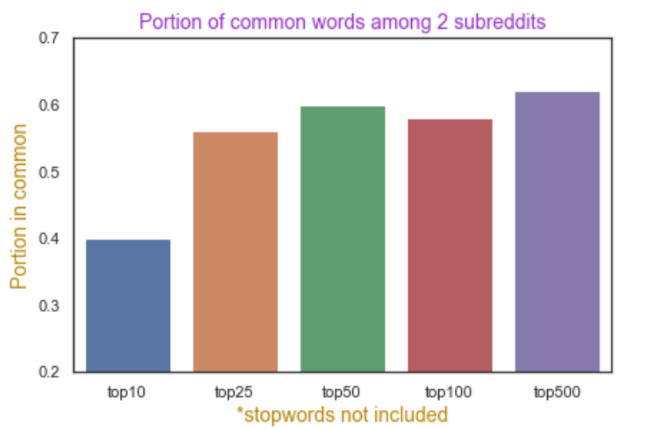
KEY OBSERVATION 1: words in common
Percentage of common frequent words is between 40-60%, depending on how many top words are counted
These lists do not contain common stopwords, so the true percentage is even higher
Notes:
From our key observation , Weekend and Public Holidays have the highest correlation with the peak ridership. Peaked riderships are observed to be at interchanges and not at stops with most attractions. For example
Imbiah , Siloso are Cable Car Station
Beach Station is a bus interchange

Slide 7
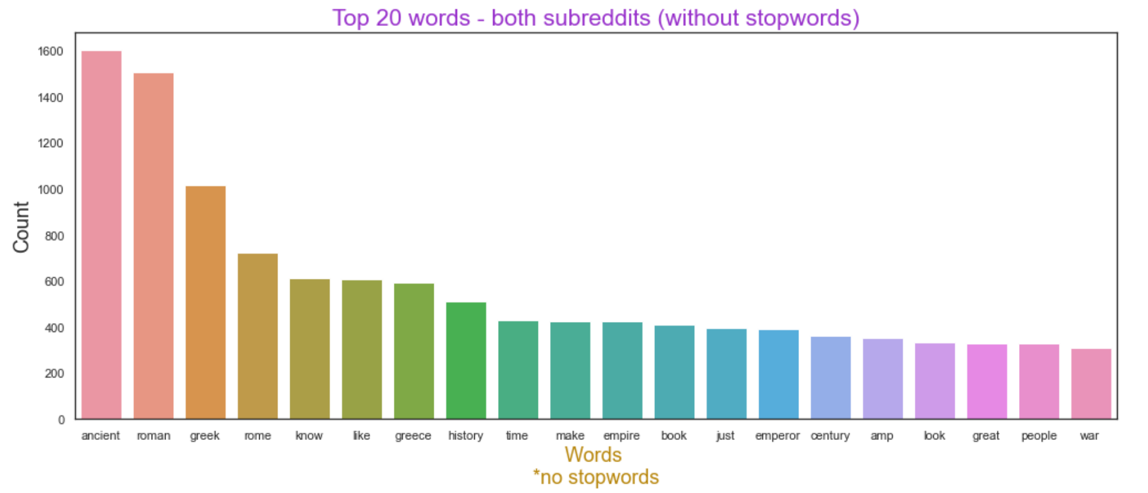
KEY OBSERVATION 2: frequent words
Many of these words like greek, roman, Greece, Rome make it too easy for our model to distinguish the two forums.
We will need to add them to stop words
Notes:
From our key observation , Weekend and Public Holidays have the highest correlation with the peak ridership. Peaked riderships are observed to be at interchanges and not at stops with most attractions. For example
Imbiah , Siloso are Cable Car Station
Beach Station is a bus interchange

Slide 8
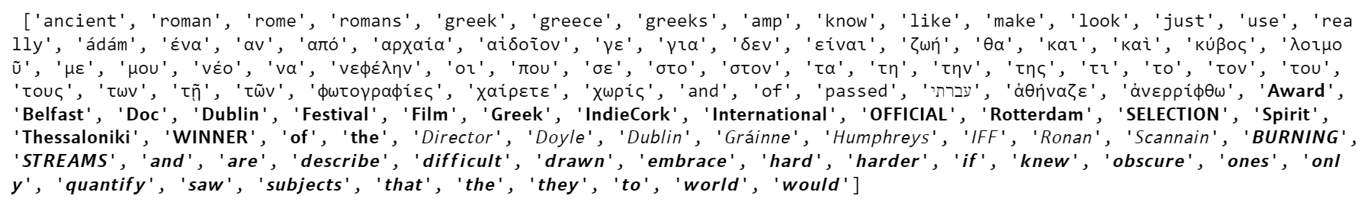
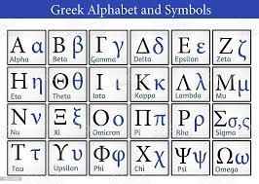
KEY OBSERVATION 3: stop words
On the top of list are some of the ‘easy’ words we excluded
We have another list that doesn’t include Greek-alphabet words
Notes:
From our key observation , Weekend and Public Holidays have the highest correlation with the peak ridership. Peaked riderships are observed to be at interchanges and not at stops with most attractions. For example
Imbiah , Siloso are Cable Car Station
Beach Station is a bus interchange

Slide 9
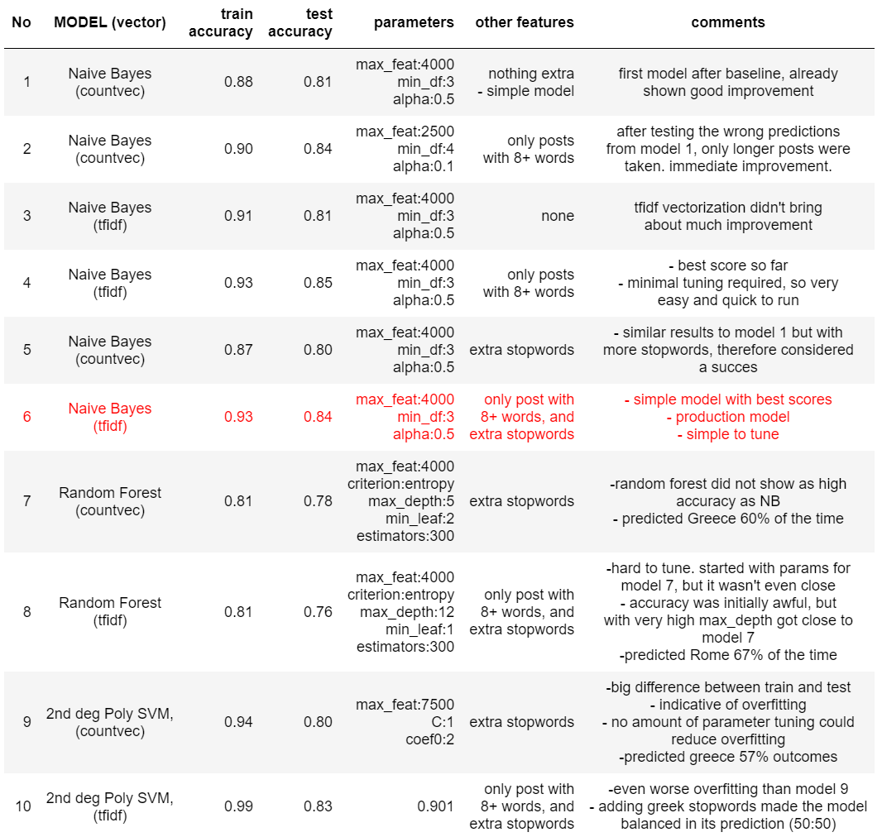
MODELS
Notes:
Imagine we are at Beach Station with an empty bus at 0800hr. There are 10 people waiting to board the bus. So the netflow is 10 and the current peak people onboard is 10.

Slide 10
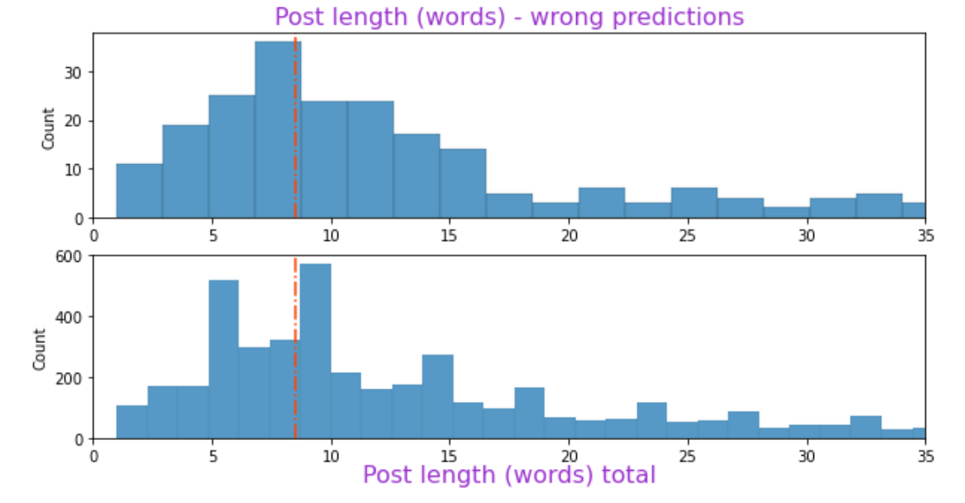
Key Influencer:
Length of posts
Notes:
one of the key factors influencing the number of guests are the holidays.

Slide 11
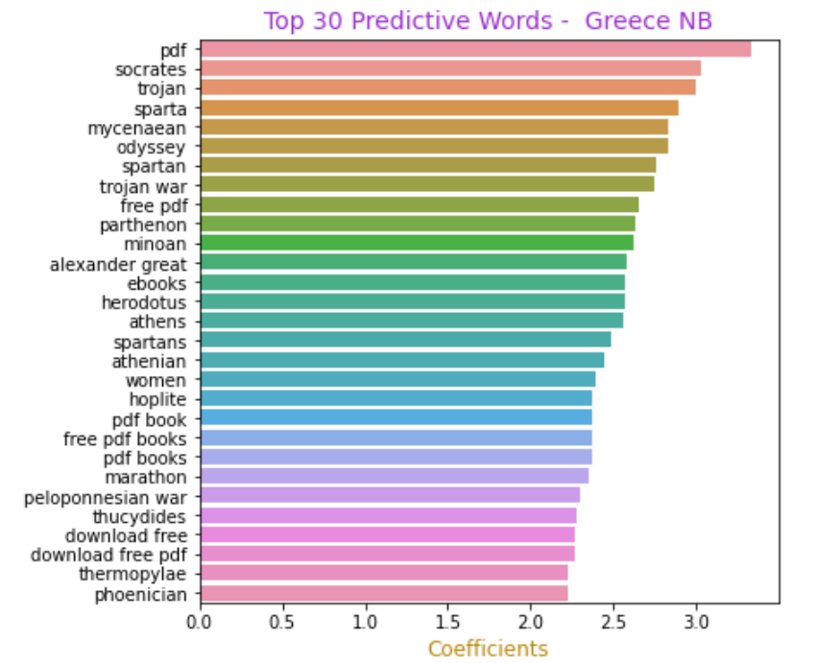
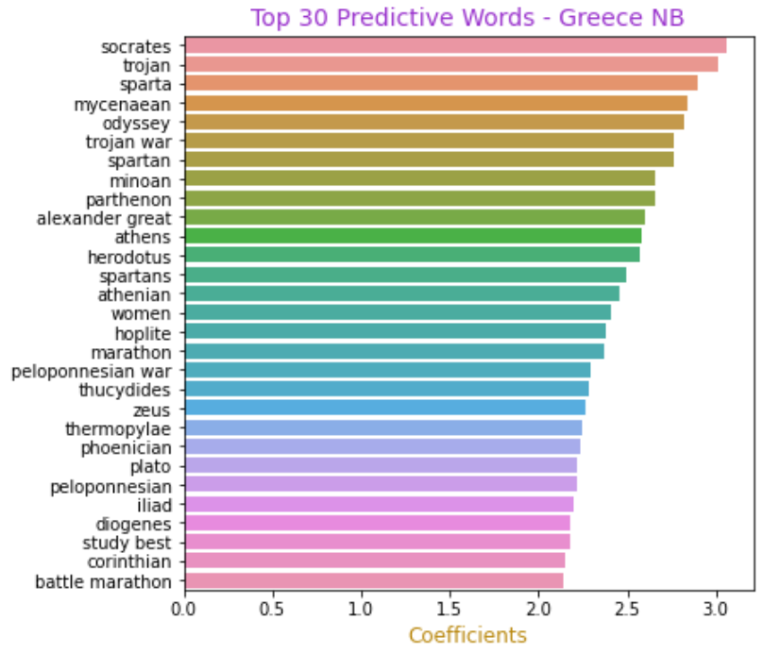
BEFORE AFTER
Naïve Bayes
Generally best performing group of models
NB no 6 was chosen as our production model
Notes:
An overall historical statistics report is able to help users identify the features affecting the number of guests.

Slide 12
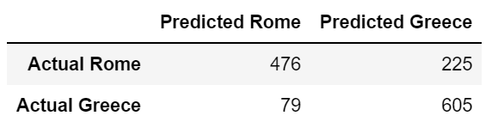
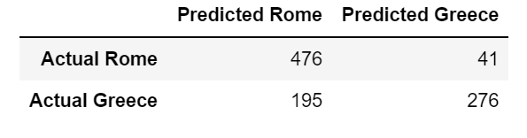
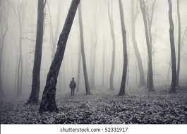
BEFORE AFTER
Random Forest
Scores not as high as NB, but less overfitting (0.81 accuracy on the test set, and 0.78 on train)
Confusion matrix is completely changed after adding more stop words
Notes:
An overall historical statistics report is able to help users identify the features affecting the number of guests.

Slide 13
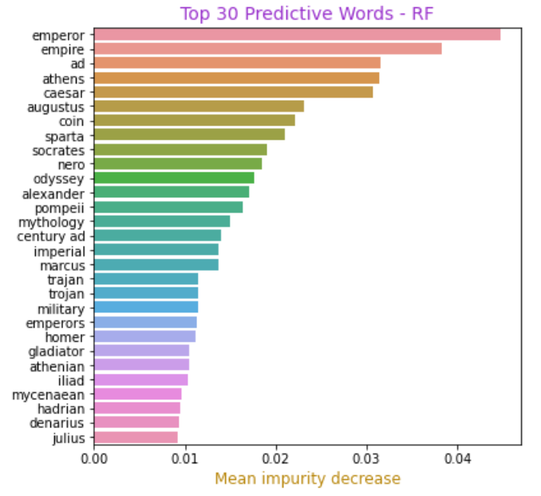
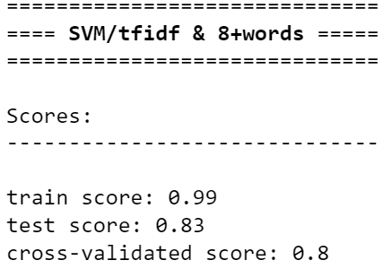
Random Forest Cont’d
Words with the highest predictive value within the model
Support Vector Machine
Very big difference between testing and training data
Require lots of tuning. Unreliable
Notes:
An overall historical statistics report is able to help users identify the features affecting the number of guests.

Slide 14
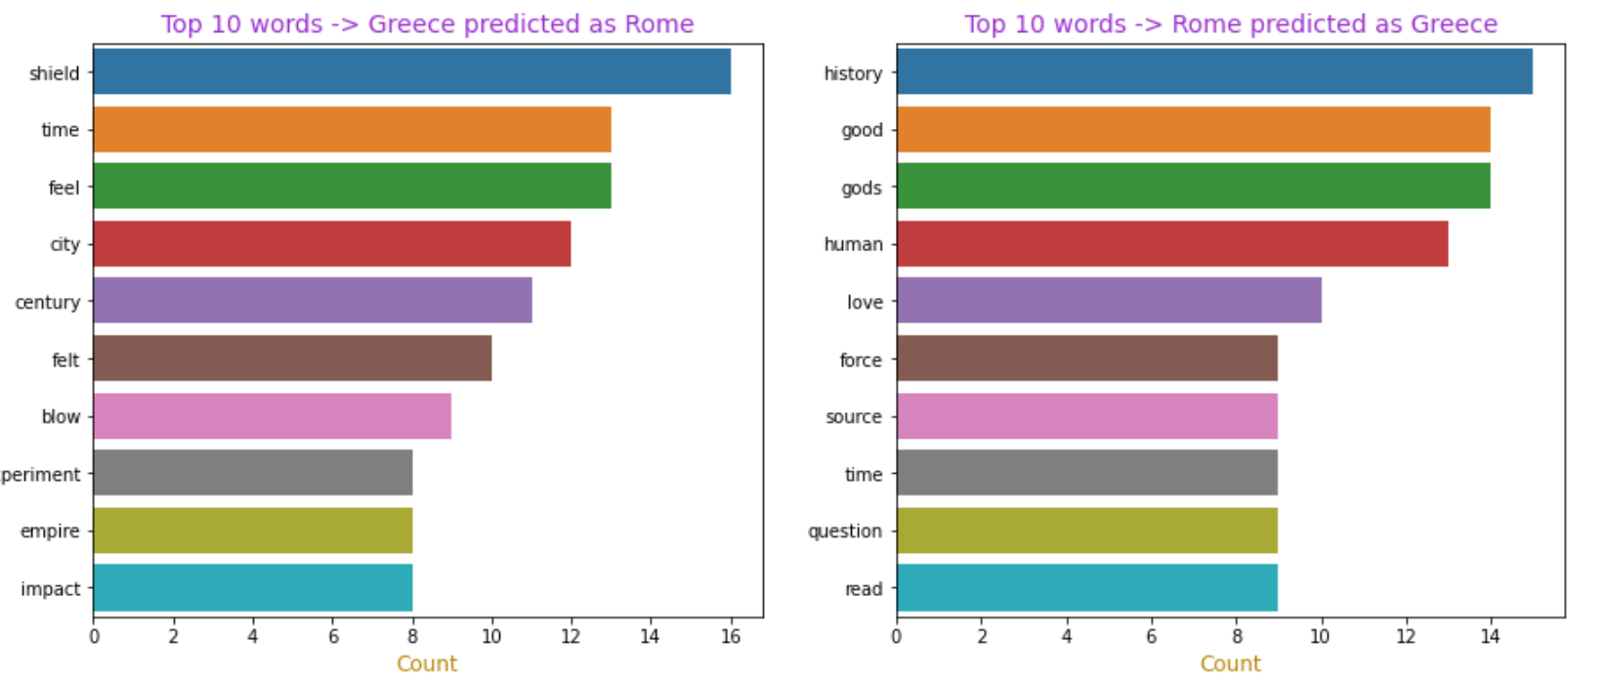
GREECE AND ROME MISCLASSIFIED
Notes:
From this report, we can draw a number of insights.
We can see, for example, that:

Slide 15
CONCLUSIONS
Proper nouns are 75% of our most import words across models
Rome and Greece were similar periods in human history, but they had different political structures, which lend themselves to different words used to describe them
Choosing stop words can make or break model. Input from experts ought to be sought before composing the list
Regularly check for the words that cause predictions to be wrong. Exclude them if they hurt the model performance
Notes:
Now the bus travels from beach station to siloso point at 0807hr, with 10 people from the previous stop. At siloso point, there are 35 people boarding and 8 people alighting, creating a netflow of 27. Now there are 37 people onboard.

Slide 16
MODEL IMPROVEMENTS
Recognition of different alphabets and characters
Have an expert-approved list of stop words
Automate searching for most common words causing wrong predictions, taking them out of predictors list and re-run the model
Notes:
Now the bus travels from beach station to siloso point at 0807hr, with 10 people from the previous stop. At siloso point, there are 35 people boarding and 8 people alighting, creating a netflow of 27. Now there are 37 people onboard.

Slide 17
NEXT STEPS
We envision this entire project to be just the first step in developing internet search for any material that relates to any of the University's academic departments. The next steps are:
Expand the model to more historical topics, work on multiple topics at one time
Configure the model to recognize ‘others’ category
Repeat the process for other academic fields
Notes:
Now the bus travels from beach station to siloso point at 0807hr, with 10 people from the previous stop. At siloso point, there are 35 people boarding and 8 people alighting, creating a netflow of 27. Now there are 37 people onboard.

Slide 18


