Slide 1
FlightLog data analysis
For Yuneec copter:
Blade 350QX, Blade Chroma (both with ST10),
Q500, Typhoon H (480), Typhoon H Plus (520), H920, H920+,
Mantis Q and Yuneec Breeze

Slide 2
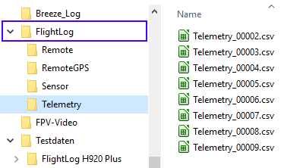
Introduction
FlightLogs are recorded at RC-Controller and get time stamps there.
ST10(+): only on SD-card (under the battery)
ST16: in memory, no SD-card needed
FlightLogs are not only telemetry data but
consists of a data structure:
  Remote
  RemoteGPS
  Sensor (only for ST16)
  Telemetry
Data sets (except Sensor) are stored as
CSV-files (comma-separated values) which are easy readable.

Slide 3
Remote/Remote_xxxxx.csv
Data originated by RC-Controller
Data sets contain sent values from the sticks and switches at the RC-channels
Channel numbers starts with zero (CH0, CH1, …), and represent the channels Ch1 to Chx at the RC-Controller screen (there increment of channel numbers starts with one)
We see values from zero to 4095 (12bit), this is
-150% to +150%, 2048 neutral position,
683 and 3412 represent -100% and +100%.
Some switches have special values (see Q500log2kml user manual, chapter 3.4.1).
Some switches and settings are not seen in channels.

Slide 4
RemoteGPS/RemoteGPS_xxxxx.csv
Data originated by RC-Controller
Data sets contain GPS-data from RC-Controller:
  Coordinates,
  Height over defined reference ellipsoid,
  and accuracy, speed and angle.
The Sensor/Sensors_xxxxx.bin file format is nowhere documented and contain a unknown bit stream. Only sometimes firmware versions are readable.

Slide 5
Telemetry/Telemetry_xxxxx.csv
Data originated by copter and sent down over 2,4GHz backward channel or, sometimes, via 5GHz WLAN to the RC-Controller.
Telemetry data sets contains of sensor data, statistics, HW status info, flight modes and error flags. Examples:
fsk_rssi – Radio signal strength indicator from ZigBee-Receiver chip (probably in dBm).
If there is a zero value then the telemetry was received via 5GHz WLAN (Dual Band Control Redundancy).
altitude - Ascent relative to starting point - from accelerator- and barometer data.
tas (true air speed) – from accelerator data in 3D, computed by X, Y and Z acceleration.
roll, pitch, yaw - from Gyro, Compass and probably also from accelerator.
gps_accH - Horizontal GPS accuracy (HDOP) from GPS chip
HW status values (like motor status, IMU-Status etc.) - bit-by-bit set bytes (8 bit).

Slide 6

Application Q500log2kml
Like application name suggests, intentionally it was made to convert telemetry data to display flight path at map services.
But then, it grow up and the main use case changed to data analysis.
Application was written in Object Pascal, IDE was „Lazarus“
and thus now available for
LINUX, Windows and MAC OS X.
http://www.lazarus-ide.org/

Slide 7
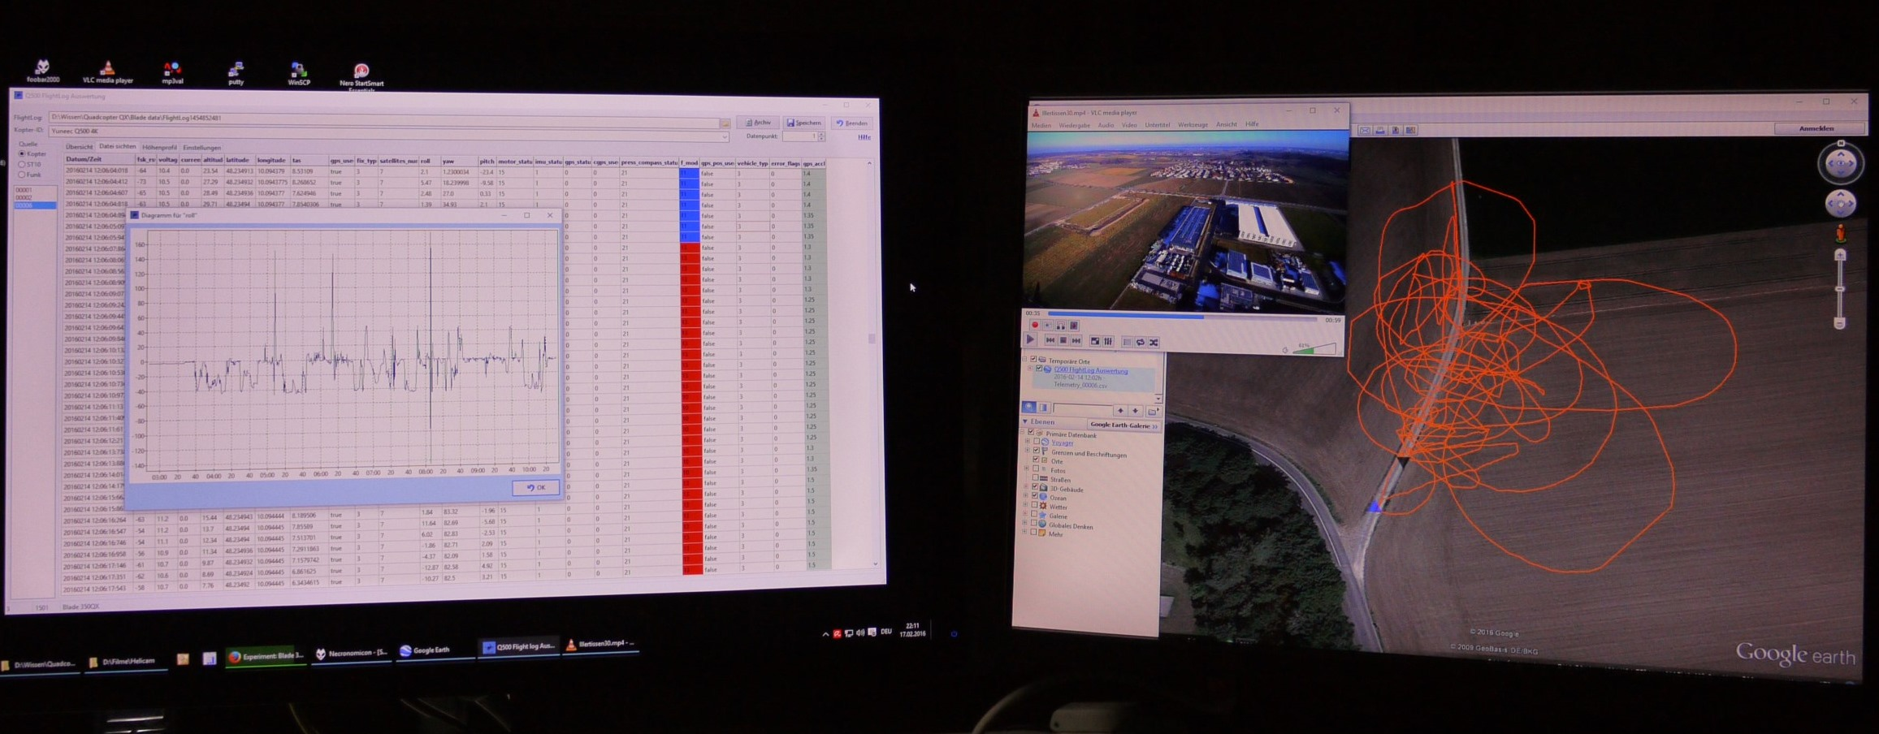
Let’s go to analyze

Slide 8
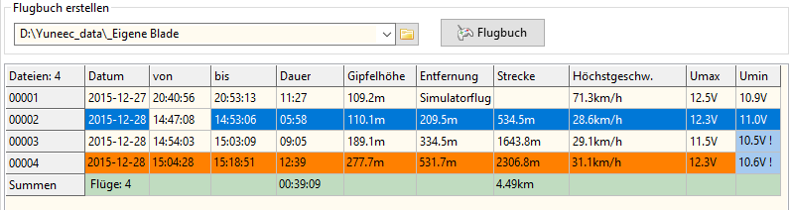
Practice – or: What can we see or guess?
Some values or identifications are based on self-defined thresholds.
For example above the real flight time depending on flight mode. Stopovers will be kept out but flights in one file not rated as extra flight.
Distance and length of trip are computed from GPS coordinates (not accurate because of adding up GPS inaccuracies).

Slide 9
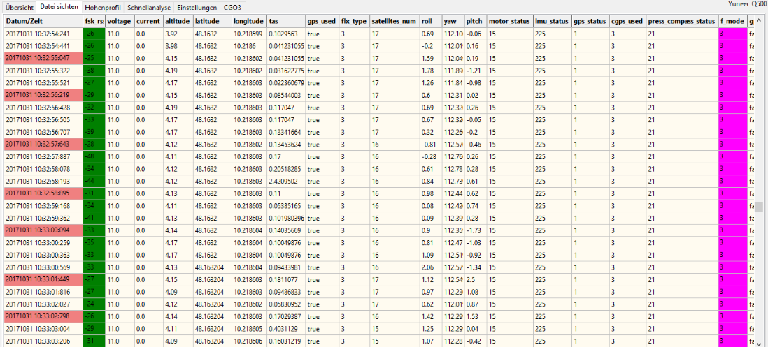
Not guessing yet – or?
The data table in „Display files“ shows FlightLog data as it is in the CSV-files. But the colored indications are based on self-defined thresholds.

Slide 10
Now we are really guessing
Voltage: Conversion to % remaining capacity of flight battery according an algorithm found in ST16 firmware.
Distance to start (click on header lat or lon) from current coordinates and coordinates of the first starting point by Haversine formula (optimized for 100m height and 50. Degree of latitude).
Status bytes: What bit means what is a guess on base of own tests, information from other users and from decompiled firmware parts of ST10/ST16.
The probability if this is right may be between 50 and 100%.
Thresholds what is good, what is bad are to interpret for sure, but tendency is probably right.

Slide 11
Status Bytes
Motor Status: For each motor there is one bit starting with lowest significant bit. 15 is 0F‘h or 1111‘b, means all four motors of a quad are running. 255 means all eight motors are running well, for hexa copter? What..? But it is as it is. It‘s only important to check if there is somewhere a zero bit in the status byte. 251 (1111 1011) means motor 3 failed.
IMU-status and press_compass_status have the same idea. Each sensor has a status bit. Also here, only identified by tests or firmware checks. Not all is confirmed, we have no documentation or support by Yuneec. All I could find out is listed in the user manual (Chapter 3.3).

Slide 12
How to analyze FlightLogs
Load FlightLog as directory structure (do not try to load files). With luck we get all relevant files.
Check what is in the FlightLog (Date, time, crashes etc.) in „Overview“.
Emergency cases are marked with brown color.
Jump to „Display files“ and check suspect files for HW status values and environment data.
Identify problematic intervals and possibly cut out.
Analyze and compare values inside those intervals.

Slide 13
Overview/analyze telemetry
Statistics and histograms:
To get a fast overview what is in, click on the header of the columns. You get histograms or statistics from the values in the related column. Check for suspect values, error flags etc. Hold the cursor on cells in the table to get more information about the value in the cell if available.
Interval – Analysis function:
We can set a interval (number of data sets) and compute ascent or decent, distance and speed over ground for this interval.
Elevation histogram > context menu > cursor on and then select an interval or else click on a line on the table and click on ‘Data analysis’ in context menu.

Slide 14
Cut data intervals in FlightLog files
If you need to compare the system behavior over different files in the FlightLog (Remote, RemoteGPS, Telemetry) then there is a problem with different times in the files because RC-controller and copter do not start and end to record at the same time. RC-controller starts recording when copter still off.
Solution: Cut FlightLog files and remove not important data (i.e. Initialization).
To do this, set start and endpoint in data table by context menu > set start/set end or in elevation histogram > Cursor on am double click on start and end point. Then click Tools > Cut files in main menu.
You will get a new FlightLog data set with the same start and end time in all three files.

Slide 15
Quick analysis – a function to compare something
Tab sheet „Quick analysis“ shows three histograms at the same time to compare data.
It is free select-able what will be displayed over all three FlightLog files. It’s your own thing, what you want to compare.
A fourth histogram can be added by clicking on the header in the data table. It makes sense to select one with computed values which are not available otherwise (like distance to start point at lat/lon).

Slide 16
Typical problems - crash
Channel settings/Motor stop button: CH0 more than 3s at zero, copter will be shut down in the air, f_mode 16 – motor stop, crash.
Abrupt break in telemetry in the air: Maybe battery was not clicked in correctly or contact problem at battery connector (is it hot after flight?) - crash.
Aged flight batteries or contact problems:
Unexpected huge break-down in voltage in case of power consumption visible in voltage histogram. Check against throttle (CH0).

Slide 17
Typical problems - other
A lot of compass calibration errors (one of most probable cases) followed by fly-away.
2,4GHz RC-connection not bound:
fsk_rssi is always zero – strange behavior of the copter during flight, hard to control it.
Stick calibration: CH0 to CH3 not coming back to neutral value 2048 but have another value in middle position. If this cannot be solved by stick calibration then it is a HW error like loose potentiometer.

Slide 18
Downloads
Windows:
http://h-elsner.mooo.com/downloads/q500log2kml_en.zip
LINUX 64bit:
http://h-elsner.mooo.com/downloads/q500log2kml_en.tar.gz
MAC OS X:
http://h-elsner.mooo.com/downloads/q500log2kml_EN.dmg.zip
User manual:
http://h-elsner.mooo.com/mydat/Q500log2kml_en.pdf

