Slide 1

@Bangalore
Neuronal physiology and computation
Coding
Cable theory and computation
Ions and channels
Synapses
Putting it together
Upi Bhalla 6 July 2016

Slide 2
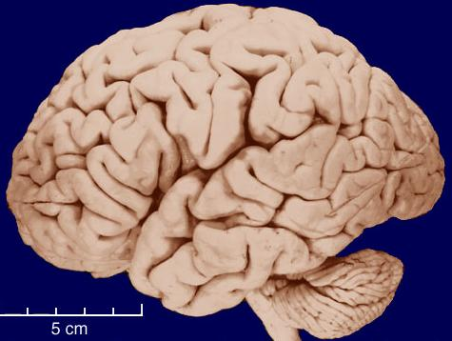
Levels of computation
Behaviour
Systems
Areas
Circuits
Neurons
Dendrites
Synapses
Molecules

Slide 3

Levels of description
Behaviour
g = g_{max} . t/τ_{p} . exp(1-t/τ_{p})
Systems
g = g_{max} . m^{x} . h^{y}
α(V)
1-m
m
Areas
β(V)
Circuits
Neurons
E = RT/zF . ln([out]/[in])
Dendrites
A + B <===> C
dA/dt = – kf.A.B + kb.C
Stochastic forms
Brownian motion
Synapses
Molecules

Slide 4
Coding strategies
Specific
Distributed
Temporal code
Feature space
Feature space
Time

Slide 5
Rate coding
Signal α firing rate
Limitations:
Firing rate >= 0
Firing rate < 100 Hz
Need to average for some time
Integrate and fire neurons
Visual system (traditional)
Value
Time

Slide 6
Interval (spike time) coding
Signal α interval between spikes
Every spike pair conveys information
Limitations:
Not redundant: Any missing spike loses information
Needs nonlinear mechanisms to decode
Equivalent to Rate coding for steady spiking.
Value
Time

Slide 7
Phase coding
Signal α spike time with respect to external phase.
Theta phase in hippocampus
Respiration phase in olfaction
Limitations:
Updates only once per cycle
Value
Time

Slide 8
Neuronal computation
Outputs and synapses
Active dendrites
(Building a neuron)
Computing with neurons
Plasticity and networks inside neurons
Coding
Learning and networks of neurons

Slide 9
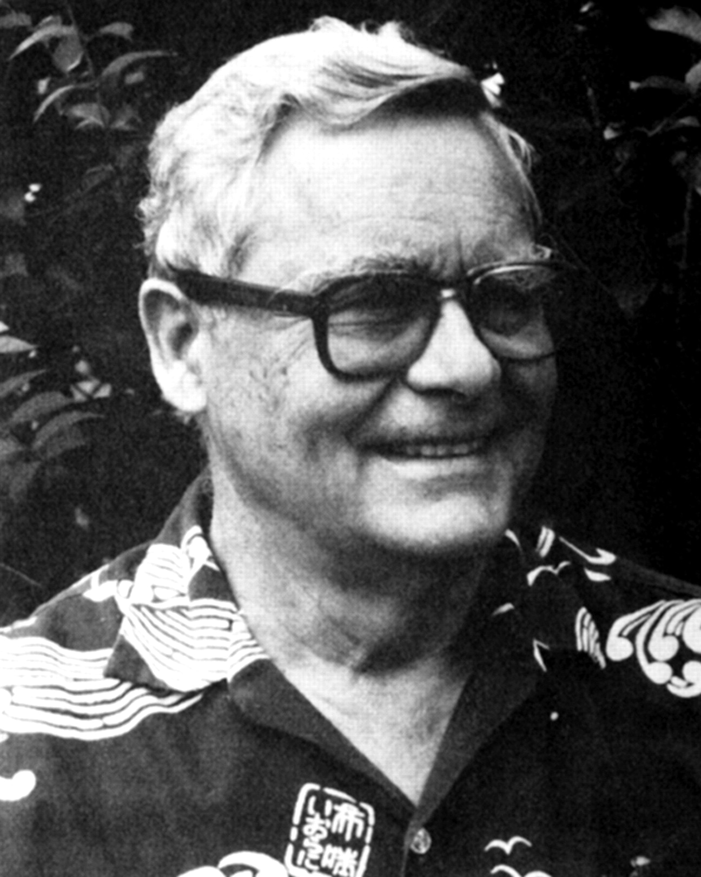
Cable theory
How signals travel along neurons.
Wilfrid Rall

Slide 10
Biophysical detail: Passive/integrate and fire models
Poor conductor
Leaky insulator
Poor conductor

Slide 11
Biophysical detail: Passive/integrate and fire models
Poor conductor
I
Leaky insulator
V
Poor conductor

Slide 12
Cable theory Cable behaviour
Best done numerically
Stimulus propagation
Amplitude: decreases
Shape: smoother
Time: delayed

Slide 13
Summation: simultaneous
Ra + other terms
I
Ra/2
Vm
Rm
Rm
R1
G2
Cm
Cm
Em
E1
E2
Em
Rcell = Rm || Ra + other terms
Vm = -I.R1 + E1 = I.Rcell + Em
So,
E1 – Em = I.(R1 + Rcell)
I = (E1 – Em)/(R1 + Rcell)
Vm = [(E1 – Em)/(R1+Rcell)] . Rcell + Em
Vm.(R1+Rcell) = E1.Rcell + Em.R1
Replace by conductance G = 1/R:
Vm = (E1.G1 + Em.Gm) / (G1 + Gm)
Vm
I
Rcell
R1
Em
E1

Slide 14
Simultaneous Summation Weighted average
Vm = (E1.G1 + E2.G2 + … + Em.Gm) / (G1 + G2 + … + Gm)
What happens when G1 and G2 are on at the same time ?
If E1 = E2, then Vm becomes a bit closer to E1.
If E1 != E2, then Vm is a weighted average of E1, E2, Em.
=> Summation is sub-linear
G1
G2
+
=
E1
E2

Slide 15
Summation in time
Widely spaced: Independent
Closely spaced: Saturating. Note similarity to charging curve

Slide 16
Summation in time
G1
G2
E1
E2
Input 1
Input 2
Sum

Slide 17
Summation in time
G1
G2
E1
E2
Input 1
Input 2
Sum

Slide 18
Summation in space
AP
EPSC
Smoothing,
summation

Slide 19
Summation in space
IPSC
EPSC

Slide 20
Summation in space
IPSC
EPSC
Low local resistance

Slide 21
Summation in space and time
Inputs

Slide 22
Summation in space and time

Slide 23
Analog->digital
Digital
Analog computation
Digital
EPSC
IPSC
Thresholding

Slide 24
Abstract models
Linear weighted sum of inputs,
then nonlinear output function
Oi = F( ΣWijIj )

Slide 25
Integrate-and-fire neuron
Threshold
Output
Rm
Input
Cm
Reset
Vm
Erev
Linear integration of weighted inputs,
thresholding, and resetting

Slide 26
Integrate-and-fire neuron
A
B
Threshold
V
Output
time

Slide 27
Nice linear I/O curve
Output: Firing rate
Input: Total synaptic input or current

Slide 28
@Bangalore
Neuronal physiology and computation
Coding
Cable theory and computation
Ions and channels
Synapses
Putting it together
Upi Bhalla 6 July 2016

Slide 29
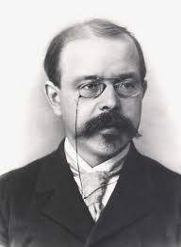
Ion channels Nernst potential
E = RT/zF . ln(c2/c1)
~ 58.log(c2/c1) for univalent ions
Where
E = Nernst potential
R = Gas constant
T = absolute temperature
Z = charge on ion
F = Faraday’s constant
c1 = inside concentration
c2 = outside concentration

Slide 30
Derivation: Qualitative
Ions separated by membrane
Flux via channels
Probability has to balance:
Concentration
EMF
Extracellular
K⁺
K⁺
K⁺
K⁺
K⁺
K⁺
K⁺
K⁺
K⁺
K⁺
Inward: Pout-> in = [K_{out}].Perm
+ + + + + + + + + + + + +
Outward: Pin-> out = [K_{in}].Perm
K⁺
- - - - - - - - - - - - -

Slide 31
Derivation
Boltzmann Eqn:
Probability p that particle is in state 1 or 2, having energy u1, u2
p2/p1 =exp(-(u2 – u1)/kT)
k = Boltzmann constt
T = Absolute temperature
c2/c1 =exp((U1 – U2)/RT)
c1,c2: concentrations
U1, U2: Energies
R: Gas constant
Take natural log:
U1 – U2 = RT.ln(c2/c1)
Since U1 – U2 = energy difference = charge * potential diff = zF.(E1 – E2)
z = ion valence
F = Faraday constant
E = (E1 – E2) = RT/zF.ln(c2/c1)

Slide 32
Implication
E = RT/zF.ln(c_{out}/c_{in})
- At a potential E, the tendency to diffuse out is balanced by the force due to the electric field.
Extracellular
K⁺
V_{out}= 0
c_{out}
+ + + + + + + + + + + + +
K⁺
E
K⁺
K⁺
K⁺
K⁺
V_{in}= E_{ion}
K⁺
c_{in}
- - - - - - - - - - - - -
K⁺
K⁺
K⁺
K⁺

Slide 33
Calculating equilibrium potentials
E = RT/zF.ln(c_{out}/c_{in})
For convenience:
2.3 RT/F ~ 58 mV
Where T = 293 deg. K
So
E ~ 58 log([out]/[in]) mV
Example: Squid giant axon
Na out = 440 mM
Na in = 50 mM
[out]/[in] = 9
E ~ +54 mV.

Slide 34
Some examples: Mammalian skeletal muscle
Ion | Extracell (mM) | Intracell (mM) | [out] / [in] | Eion (mV)
Na+ | 145 | 12 | 12
K+ | 4 | 155 | 0.026
Ca++ | 1.5 | 0.0001 | 15000
Cl- | 123 | 4.2 | 30

Slide 35
Some examples: Mammalian skeletal muscle
Ion | Extracell (mM) | Intracell (mM) | [out] / [in] | Eion (mV)
Na+ | 145 | 12 | 12 | 62
K+ | 4 | 155 | 0.026 | -91
Ca++ | 1.5 | 0.0001 | 15000 | 120
Cl- | 123 | 4.2 | 30 | -85

Slide 36
More examples: Squid giant axon
Ion | Extracell (mM) | Intracell (mM) | [out] / [in] | Eion (mV)
Na+ | 440 | 50 | 9 | 54
K+ | 20 | 400 | 0.05 | -75
Cl- | 560 | 52 | 10.8 | -60

Slide 37
Multiple ion channels: Equivalent circuit
Ra/2
Ra/2
Rm
G1
G2
Cm
Vm
E1
E2

Slide 38
Multiple ions
Simple case: Each channel allows only one ion.
Ohm’s Law
Nernst potential
Difficult case: Multiple ions through same channel
Why not use similar solution ?
Ra/2
Ra/2
Rm
G1
G2
Cm
Vm
E1
E2
G1
G2
E1
E2

Slide 39
Multiple ions
Simple case: Each channel allows only one ion.
Ohm’s Law
Nernst potential
Difficult case: Multiple ions through same channel
Nernst equation assumes equilibrium
Zero net current but each ion flows
Ra/2
Ra/2
Rm
G1
G2
Cm
Vm
E1
E2
G1
G2
E1
E2

Slide 40
Multiple ions: Goldman-Hodgkin-Katz eqns
(PK[K]o + PNa[Na]o + ...)
E = RT/F ln ( ------------------------- )
(PK[K]i + PNa[Na]i + ...)
Where Pion = Permeability for the ion
I = P z^2 EF^2 . ([S]i - [S]o exp (zsFE/RT))
---- ---------------------------
RT (1 - exp (-zsFE/RT))

Slide 41
Implication of GHK equations
Easy to calculate equilibrium (Nernst), hard for non-equilibrium (GHK)
GHK equations are based on several assumptions
Uniform electric field across membrane
Ion flux is proportional to concentration
Ions are independent (do not interfere)

Slide 42
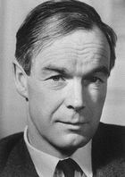
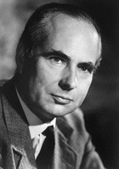
Hodgkin and Huxley channels
From: http://www.swarthmore.edu/NatSci/echeeve1/Ref/HH/index.htm

Slide 43
Biophysical detail: Single-compartment active models
Ra/2
Ra/2
Rm
G1
G2
Cm
Vm
E1
E2

Slide 44
Voltage-gated ion channels: HH formulation overview
g = g_{max} . m^{x} . h^{y}
m, h = fraction of channel gates in open state.
Closed open
(1 – m) m
α, β are functions of V
α, β m∞ , τ_{m}
α
β
α
β

Slide 45
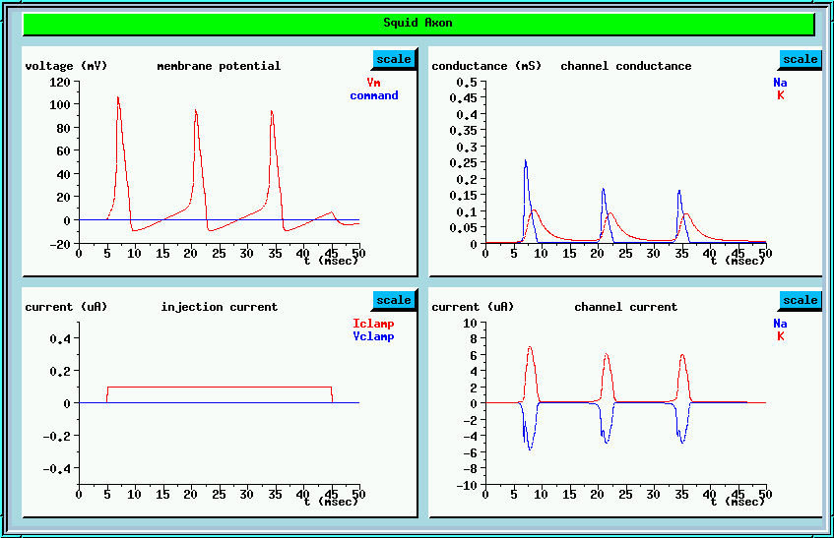
Voltage-gated ion channels

Slide 46
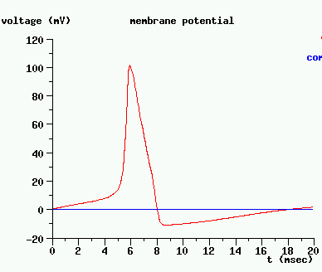
The action potential
Na
Current
Ra/2
Ra/2
Na+K
Rm
GK
GNa
Cm
Vm
EK
ENa
Charge
K
All shut

Slide 47
Studying voltage-gated channels
By definition, opening is a function of voltage
When we use current injection, the cell potential V goes all over the place
Want a way of holding cell at a fixed potential
Voltage clamp
Monitor current, not voltage.

Slide 48
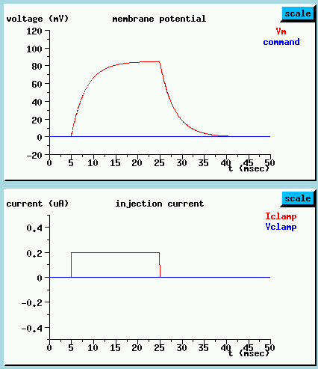
Current clamp
Current
Ra/2
Ra/2
Rm
GK
GNa
Cm
Vm
EK
ENa

Slide 49
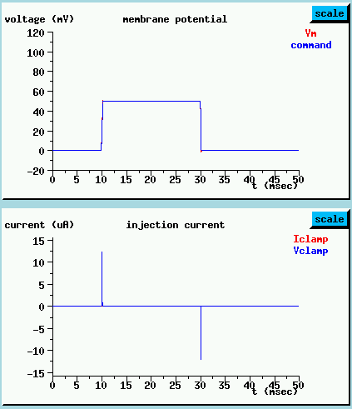
Voltage clamp
Voltage
Ra/2
Ra/2
Rm
GK
GNa
Cm
Vm
EK
ENa

Slide 50
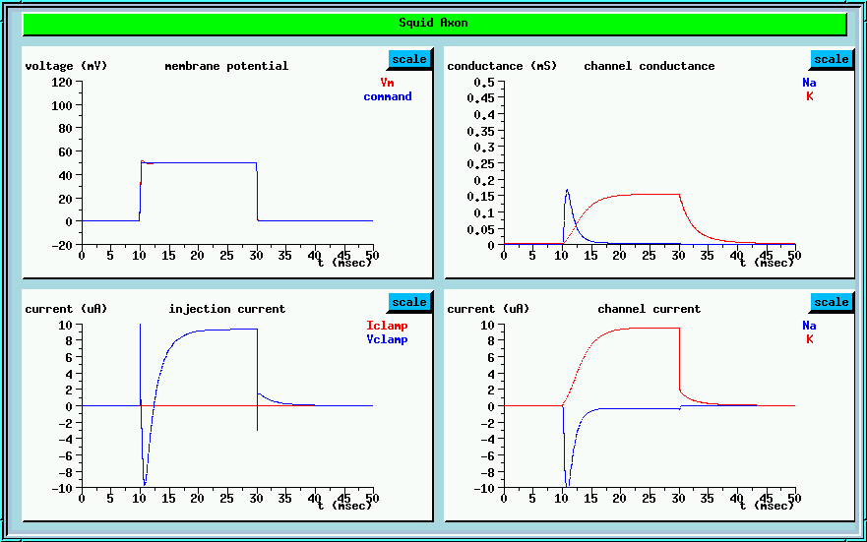
Voltage-clamp with squid (voltage-gated) ion channels

Slide 51
HH model simulation

Slide 52
Kinds of HH channels
Na: Boring. Fast, slow, slow/TTX insensitive
Single big polypeptide, 4 domains of 6 membrane-spanning regions.
Ca: Modest family
Similar structure to Na
K: 4 families, each with lots of members.
4 subunits, each with 6 membrane regions
K Inward Rectifier: 5 families, 2 membrane regions.
Cl: 3 families, multiple members
Unclear topology, possibly 13 hydrophobic domains, 11 of which are in membrane.

Slide 53
Ca channels
Type | Thresh | Speed | Inact
T (tiny, transient) | -50 | Fast | Yes
L (Presyn) (large, long-lasting) | +10 | Slow | No
N (Neuronal) | -20 | Fast | Partial
P | 0 |  | Slow
Q | 0 |  | Slow
R | 0 |  | No

Slide 54
K channels
Name | Description | Function
K, Ik | Delayed rectifier (squid HH) | AP repolarization
KA, IA | Fast Transient, opens after repolarization | Slower firing Linear rate
KCa, IKCa 8 subfamilies. | Ca-activated K channel | Slow AHP Adaptation Pacemaker
KIR 7 subfamilies. | Inward rectifier, Fast | Returns cell to rest Heart

Slide 55
Effects of channels: Firing patterns
2
1
Freq
Current

Slide 56
Building neurons
Ion gradients and reversal potentials
Building a neuron
Kinds of HH channels
Designing an Action Potential
Variations on synapses
Computing with neurons

Slide 57
Designing an AP: Turnon
Na
Steepness
Slow onset:
KA
Threshold: Na

Slide 58
Designing an AP: Turnoff
Na inactivation,
K activation
K activation,
current
Closing time,
Ek

Slide 59
Designing an AP: Hyperpolarising phase
Ca entry through
T or N type Ca channel
-> affects KCa
KA: Opens briefly, then inactivates
Effect of KIR
K: Time-course of AP,
Inactivation (if any)
KCa: Builds up with
more pulses. Slows down repolarization
KIR
Slows down repolarization
Closes when depolarized

Slide 60
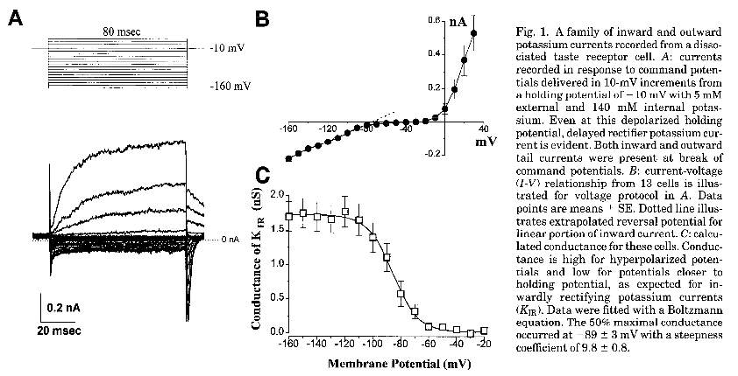
KIR real data
Sung and Herness, Am. J. Physiol, 1996

Slide 61
KA: Timing
Delays next AP
Re-activates Open Inactivates

Slide 62
KA: Fast inactivating Afterhyperpolarization channel
Freq
time
I
Current

Slide 63
Designing an AP: Bursting
[Ca]
V
KCa,
KM (Muscarinic sensitive K channel)

Slide 64
KCa: Calcium-dependent K channel
Freq
time
Spikes
I

Slide 65

KCa
Freq
time
Spikes
I

Slide 66
KM
Muscarinic sensitive: responds to input at mAChR, a second-messenger (G-protein) receptor.
Slow-activating
Non-inactivating
-> So it builds up slowly during a burst, but stays on for a long while (> 40 msec)
Similar effects to KCa

Slide 67
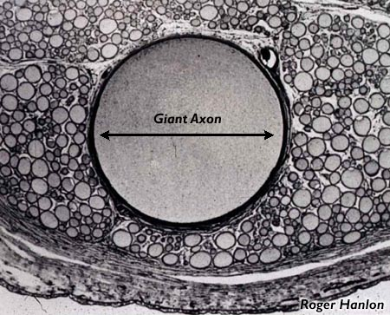
Squid giant axon

Slide 68
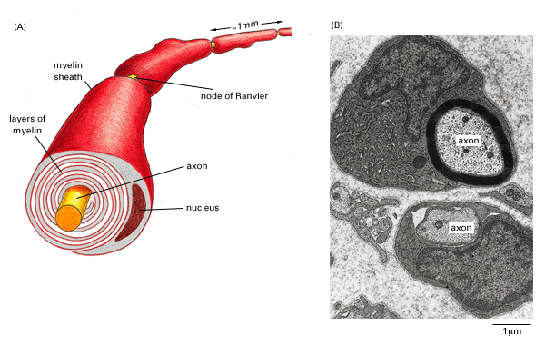
Myelination

Slide 69
Vertebrates vs. invertebrates
0.5 mm
Squid
25 m/sec
500 microns
0.25 mm^2
5000x ATP
Frog
25 m/sec
12 microns
0.0014 mm^2
1x ATP

Slide 70
Why is myelination so good ?
λ = √r_{m}/r_{a}
Ra: Unaffected
Rm: Increased (series resistors)
Transient conductance is better:
Cm: decreased (series capacitors
Metabolism is lower:
No ion channels except at nodes
Passive propagation
Amplification
Saltatory conduction

Slide 71
Failure
Amplification
Saltatory conduction

Slide 72
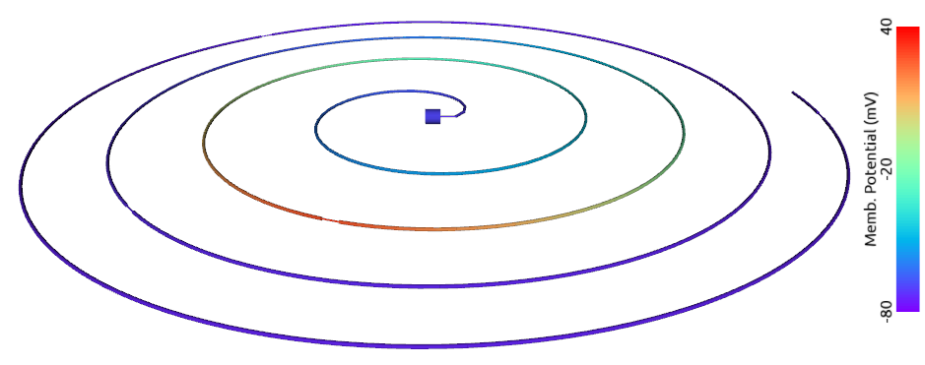
Simulation

Slide 73
@Bangalore
Neuronal physiology and computation
Coding
Cable theory and computation
Ions and channels
Synapses
Putting it together
Upi Bhalla 6 July 2016

Slide 74
Neuronal outputs
Ca

Slide 75
Variations on synapses: Regular
En passant
Axo-somatic
Axo-dendritic

Slide 76
Variations on synapses: Power synapses

Slide 77
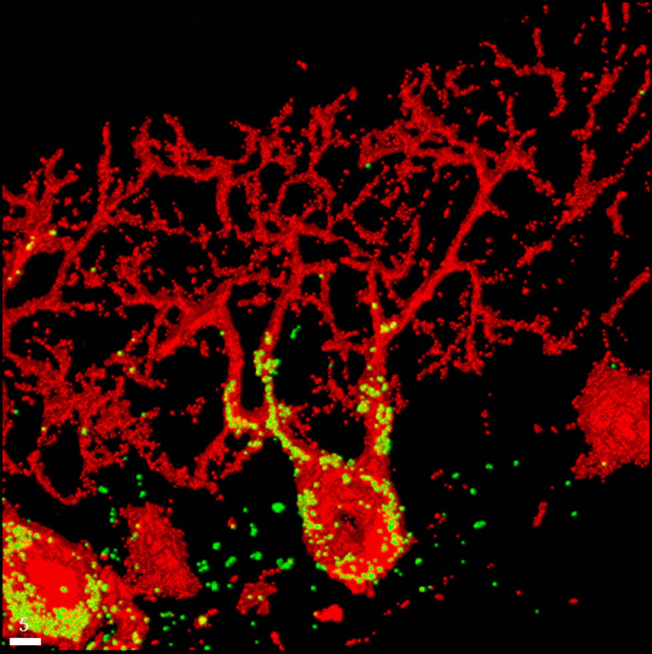
Climbing-fibre input to P-cell
Morara,
Cellular &
Molecular
pharmacology

Slide 78
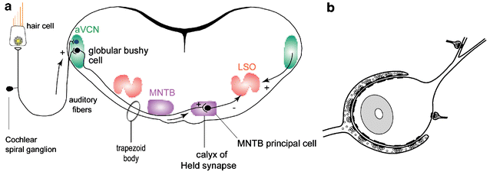
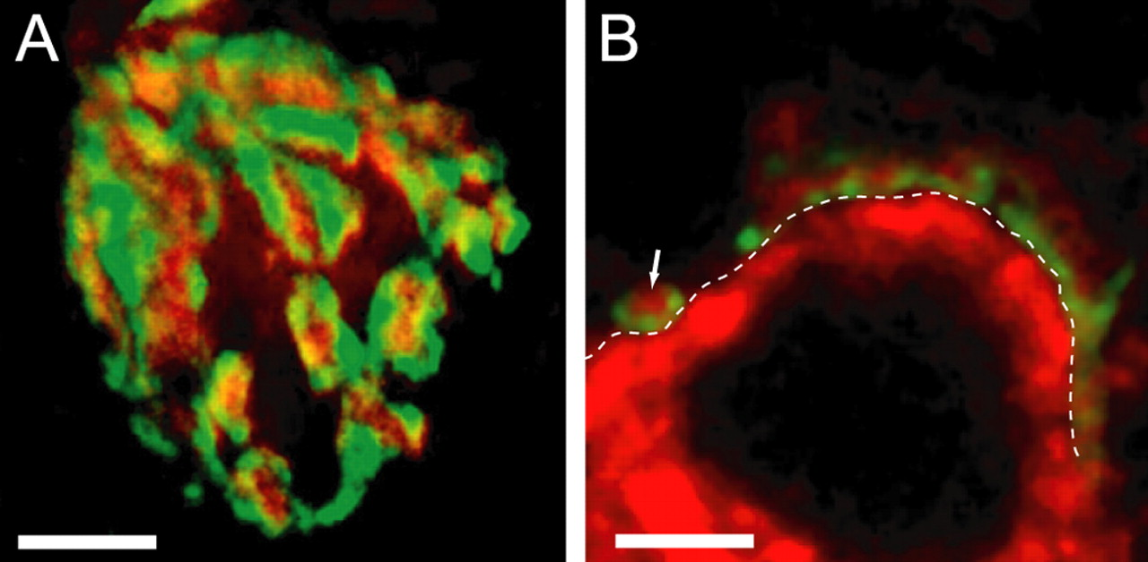
Calyx of Held synapse

Slide 79
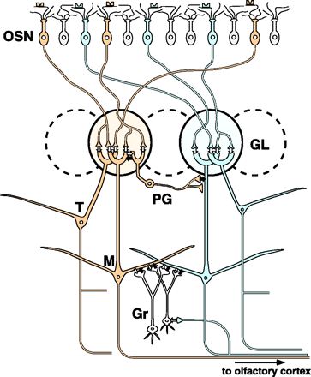
Variations on synapses: Dendro-dendritic
K. Mori et al, Science 286(5440):711-5

Slide 80
Variations on synapses Axo-axonic

Slide 81
Variations on synapses: Gap junctions

Slide 82
Variations on synapses: Broadcasting

Slide 83
Response to inputs is complex
Dendro-dendritic
And gap junctions
Excitatory
Inhibitory
Local Ca
transients
Complex
Local diffusion
2nd messenger
Action potentials in
dendrites
Broadcast
neurotransmitters
Somatic inputs

Slide 84
Neuronal outputs
Dale’s Law:
A cell usually has only one set of transmitters at ALL its outputs
However: Different targets may respond differently to the same transmitter

Slide 85
Response to inputs is complex
Dendro-dendritic
And gap junctions
Excitatory
Inhibitory
Local Ca
transients
Complex
Local diffusion
2nd messenger
Action potentials in
dendrites
Broadcast
neurotransmitters
Somatic inputs

Slide 86
More complex, as usual
Digital synaptic input
Analog
Broadcast,
Diffusive,
Dendro-dentritic
input
Analog summing
Local AP: Digital
Residue of Calcium AP
Analog ?
Summation of local APs:
Analog ?
Influence of back-
propagating AP:
Digital ?
Ephaptic interactions:
Analog ?

