Slide 1
LONG-TERM PLASTICITY I: Spike Timing Dependent Plasticity
Harsha Gurnani, IISc
CAMP 2016

Slide 2
Hebb’s postulate
When an axon of cell A is near enough to excite a cell B and repeatedly or persistently takes part in firing it, some growth process or metabolic change takes place in one or both cells such that A's efficiency, as one of the cells firing B, is increased.

Slide 3
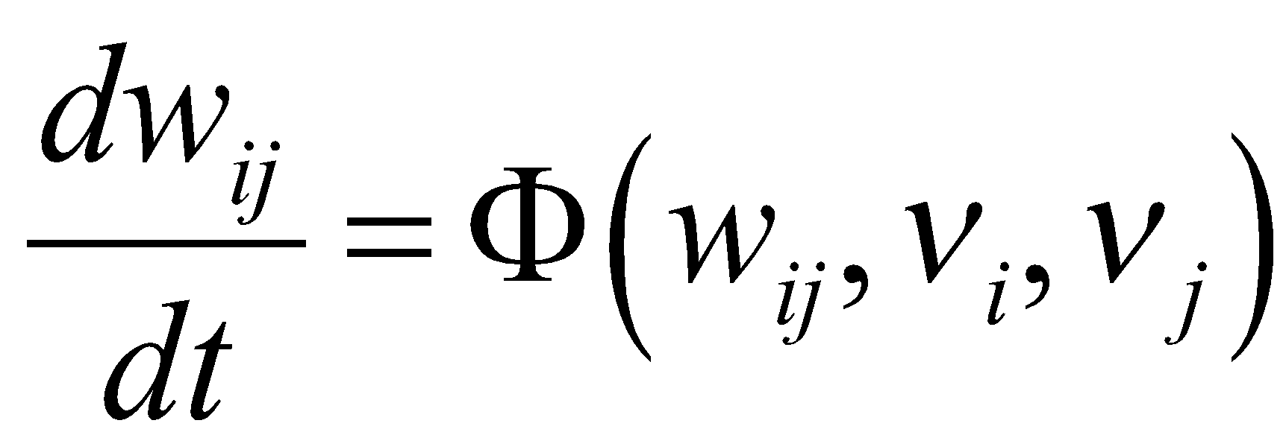
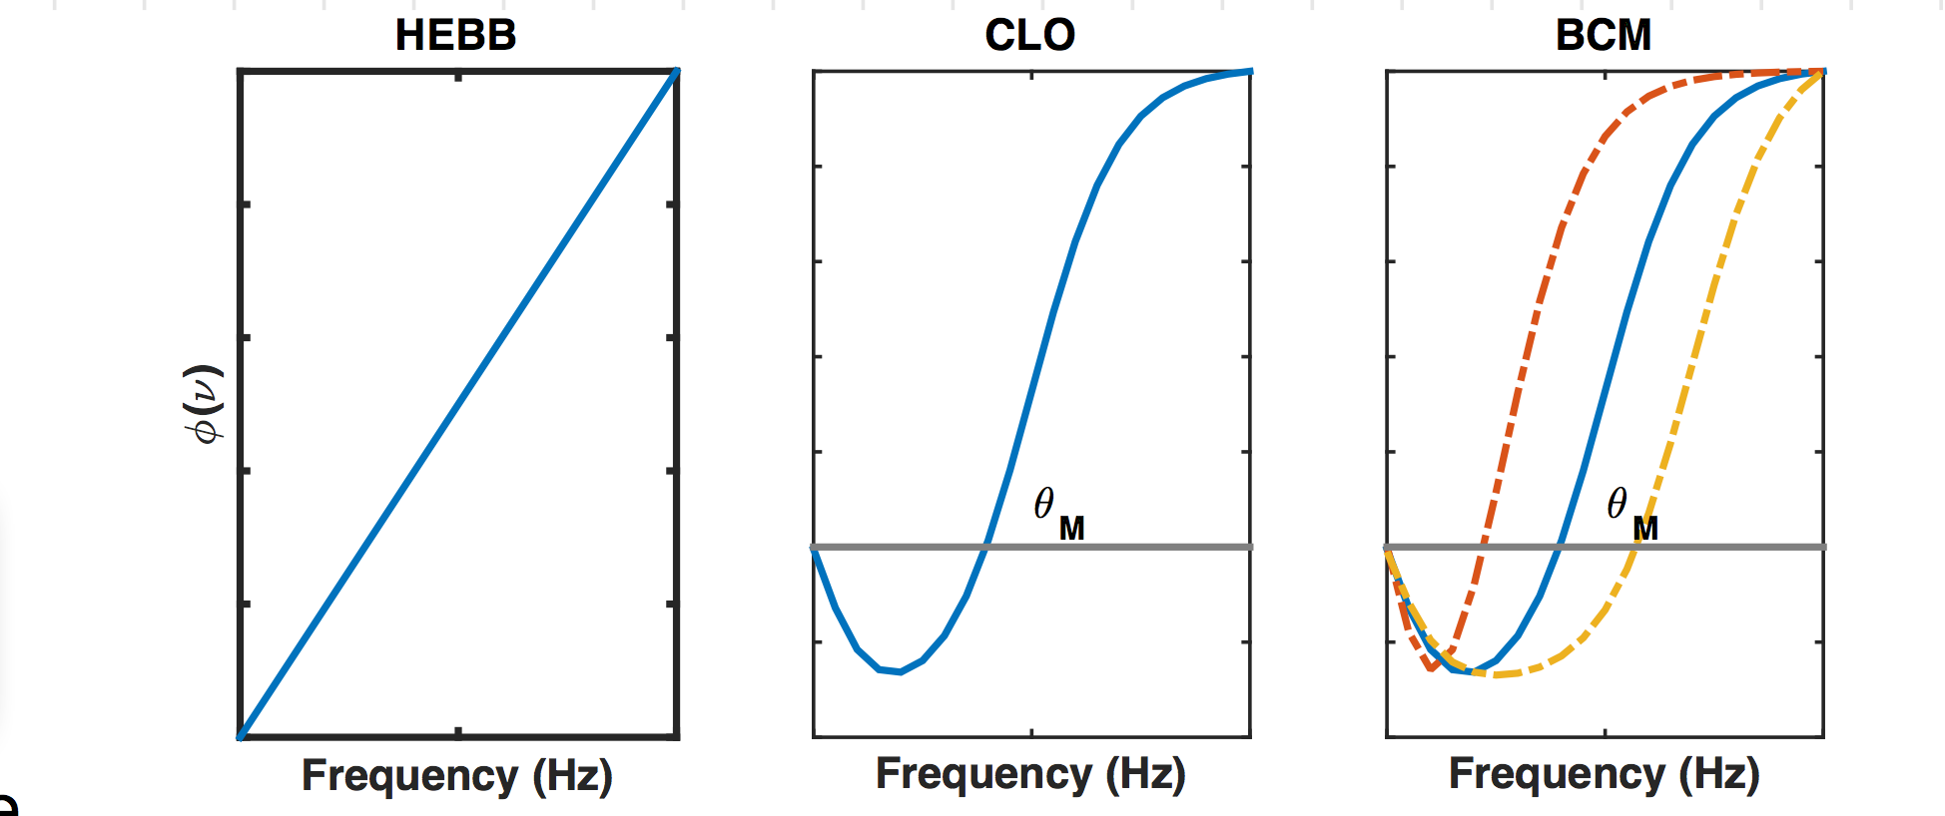
Rate-based synaptic plasticity
Postsynaptic firing rate
Synaptic strength
Presynaptic firing rate

Slide 4
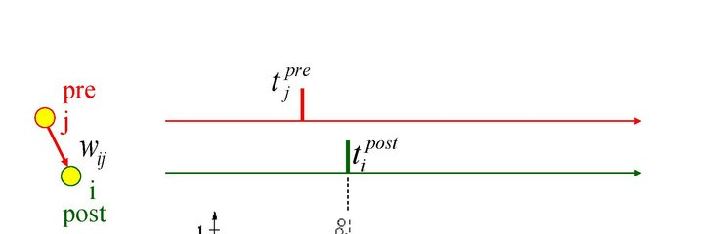
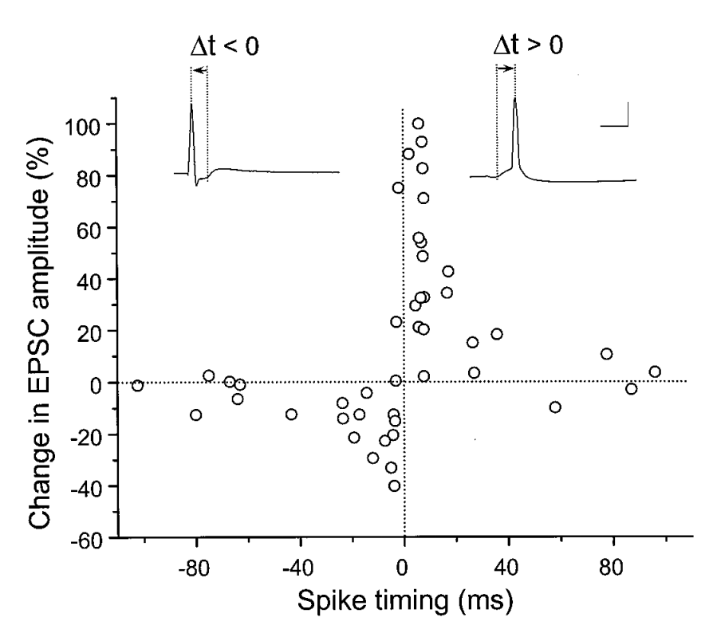
Spike timing dependent plasticity
∆t
Bi and Poo, J. Neuro., 1998

Slide 5
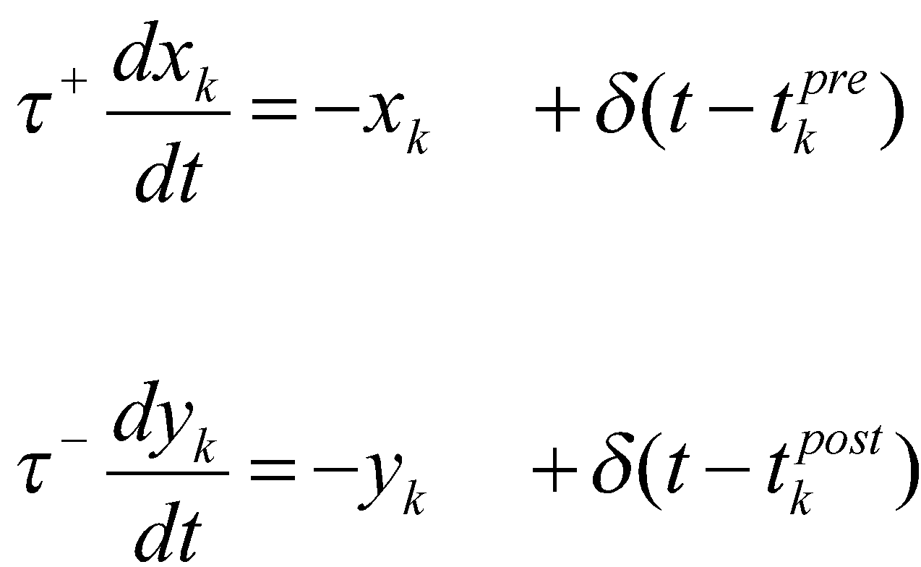
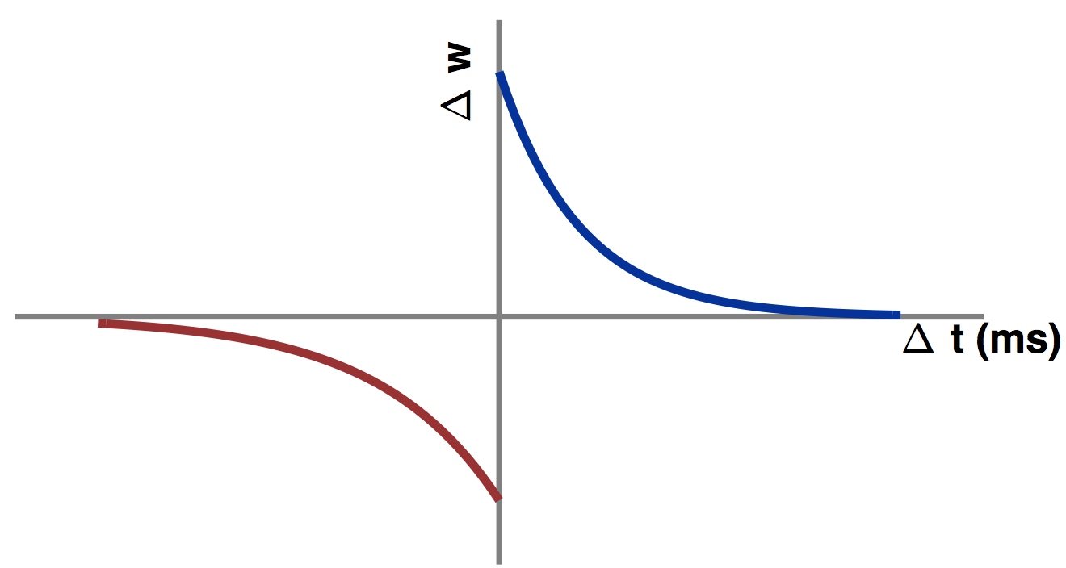
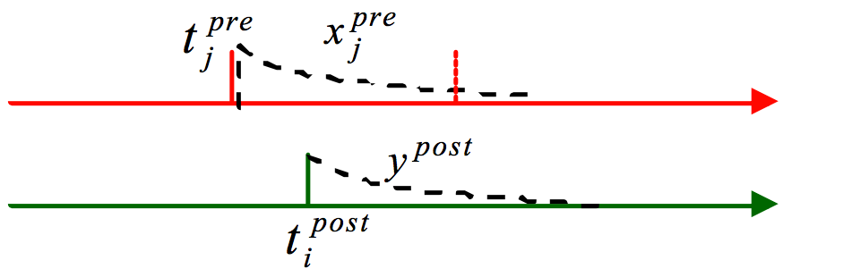
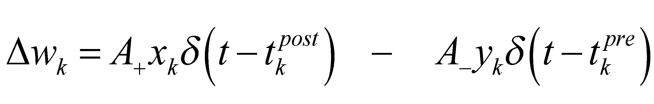
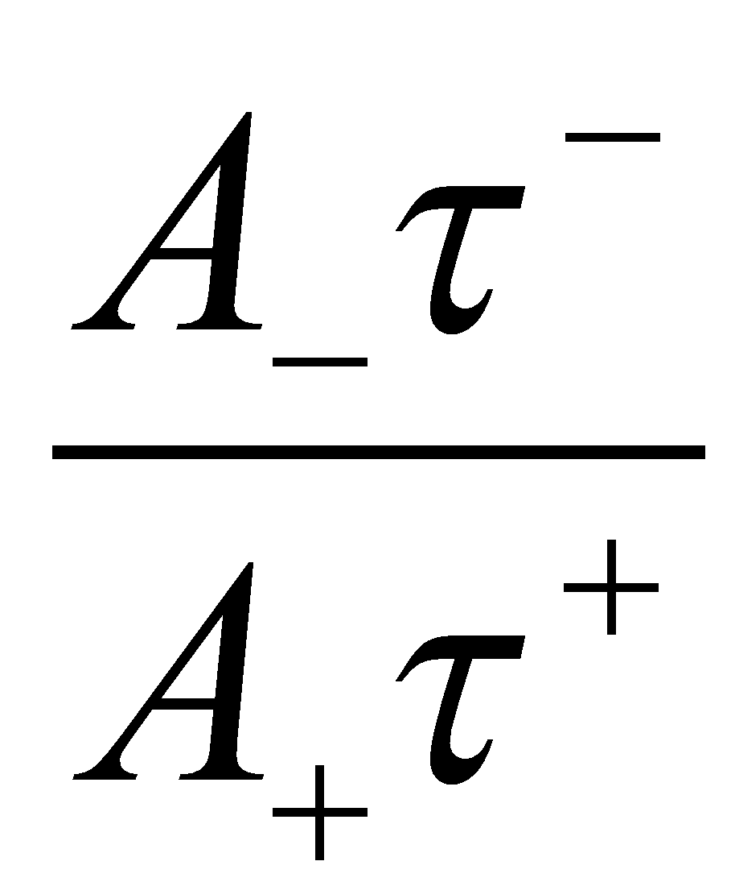
Classic STDP
Weakening: Strengthening =

Slide 6
Implementing STDP
Single postsynaptic neuron with:
1000 excitatory synapses
200 excitatory synapses
Poisson inputs at each synapse
Excitatory synapse undergo STDP
From Song et al, Nature, 2000
Demo 1

Slide 7
Implementing STDP
In the synpase class:
Variables:
synaptic weight w,
Presynaptic trace x, postsynaptic trace y
X and y decay with time constants τ_{pre} and τ_{post}
On pre-synaptic spike:
EPSC at post
Update x
Change weight (and clip at 0, gmax)
On post-synaptic spike:
Update y
Change weight (and clip at 0, gmax)
Apre : increase in presynaptic trace (x)
Apost : increase in postsynaptic trace (y)
∆w = gmax*x*𝞭(t-t_{post}) - gmax*y*𝞭(t-t_{pre})
From Song et al, Nature, 2000
Demo 1

Slide 8
syneqs = '''
gsyn :1
dx/dt = -x/taupre :1
dy/dt = -y/taupost :1
'''
preeqs = '''
ge_post += gsyn
x += Apre
gsyn += -y*gmax
gsyn = clip(gsyn, 0, gmax)
'''
posteqs = '''
y += Apost
gsyn += x*gmax
gsyn = clip(gsyn, 0, gmax)
'''
Synaptic weight gsyn
Presynaptic trace: x
Postsynaptic trace: y

Slide 9
Connecting synapses:
InpE = PoissonGroup(Ne, rates = FRe)
S_exc = Synapses(InpE, NRN, model=syneqs, pre=preeqs, post=posteqs )
S_exc[:,:] = True
S_exc.gsyn[:] = gmax*rand(Ne)
#Initialise uniformly between 0 and gmax
InpI = PoissonGroup(Ni, rates = FRi)
S_inh = Synapses(InpI, NRN, model = ' ', pre = '''gi_post += ginh''')
S_inh[:,:] = True
#All inhibitory synapses are identical. IPSP = ginh

Slide 10
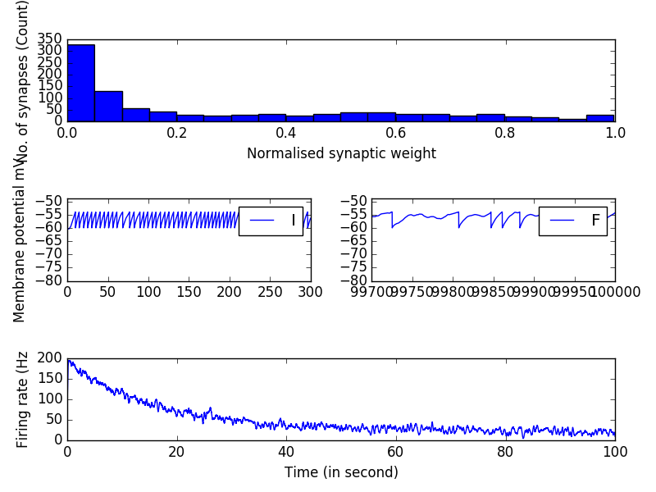
Histogram of synaptic weights
Stabilisation of firing rate

Slide 11
Q: How does final synaptic weight distribution and postsynaptic firing rate vary with:
Excitatory inputs: Firing rate, gmax
Weakening: Strengthening ratio
No. of excitatory and inhibitory synapses (EI ratio)

Slide 12
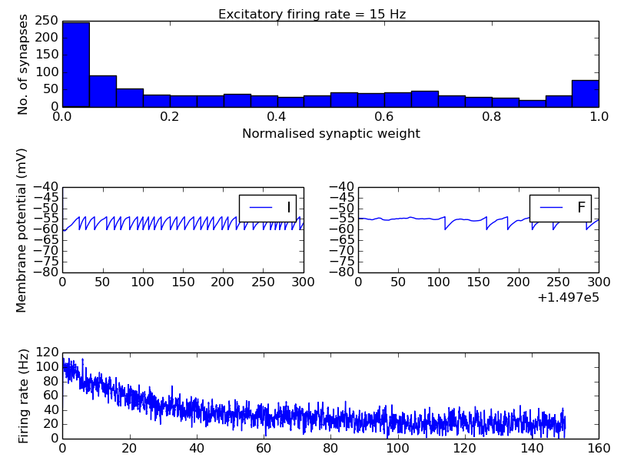
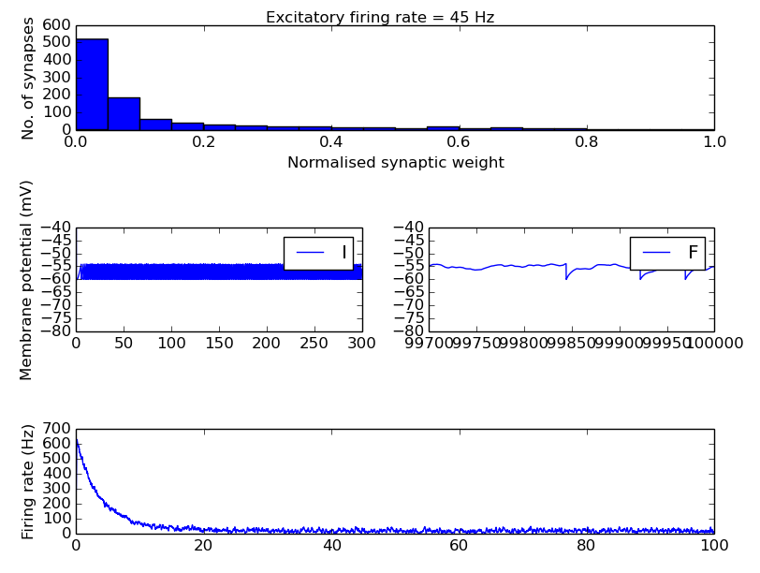
Dependence on excitatory inputs: FRe

Slide 13
Assignment:
Measure mean synaptic weight, and percentage of strong (>0.8*gmax) synapses

Slide 14
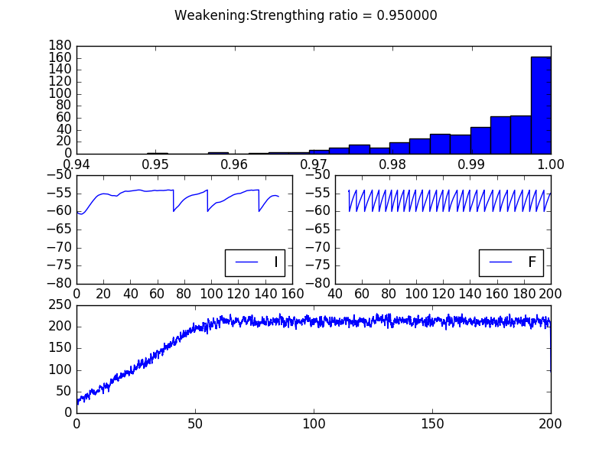
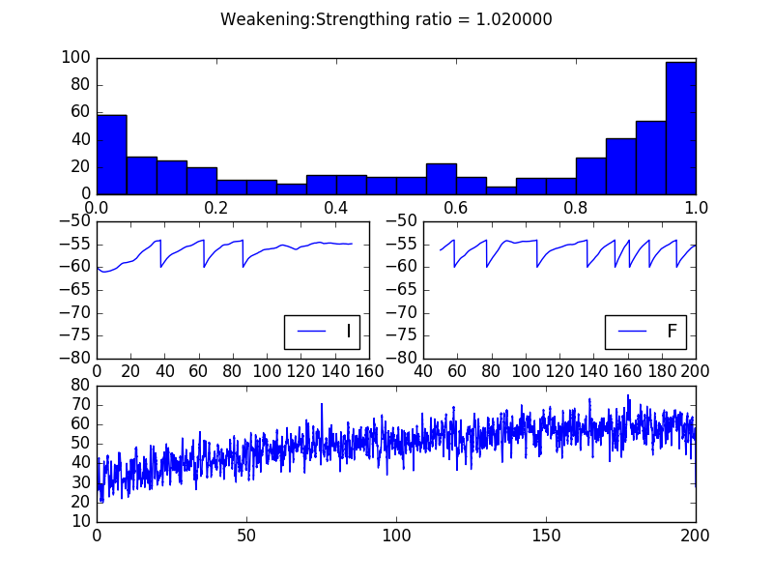
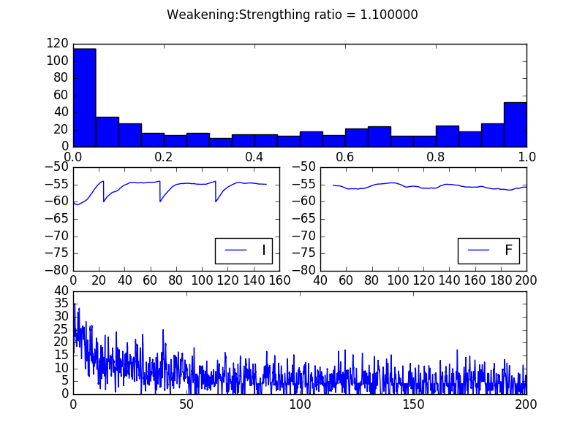
Dependence on ‘Weakratio’

Slide 15
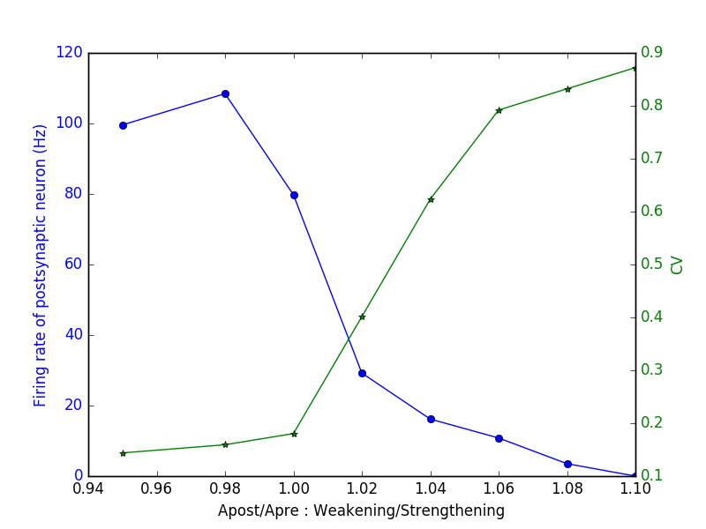
Dependence on ‘Weakratio’

Slide 16
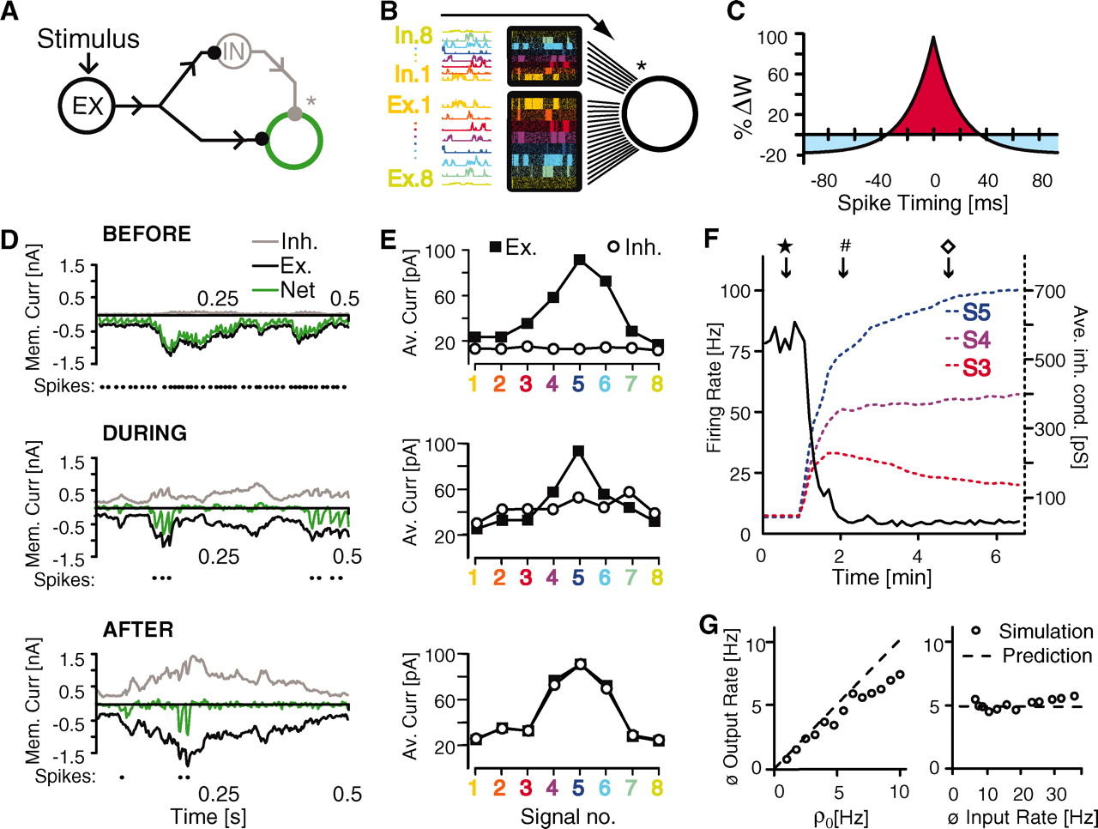
STDP at inhibitory synapses
Single postsynaptic neuron with:
8 signals/groups of synapses
Each group has 100 excitatory,
25 inhibitory synapses
Poisson inputs at each synapse
Signals are correlated within each group
Inhibitory synapses undergo STDP
Every pre-synaptic spike causes a small depression
Pre-post pairing causes potentiation
From Vogels et al, Nature, 2000

Slide 17
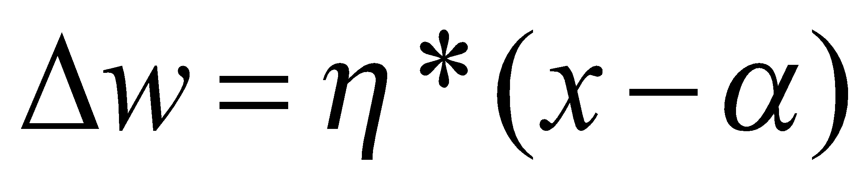
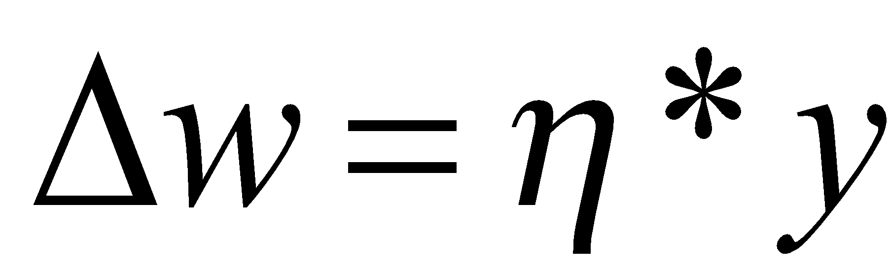
STDP at inhibitory synapses
In neuron group:
Postsynaptic trace x
In the synpase class:
Variables: synaptic weight w,
Presynaptic trace y
On pre-synaptic spike:
IPSC at post
Update y
Change weight :
On post-synaptic spike:
Update x_post
Change weight :
Every pre-synaptic spike causes a small depression
Pre-post pairing causes potentiation
From Vogels et al, Nature, 2000

Slide 18
Generating inputs
8 different signals/groups: Firing rate profiles
Each neuron subgroup has:
1 signal
100 excitatory synapses
25 inhibitory synapses

Slide 19
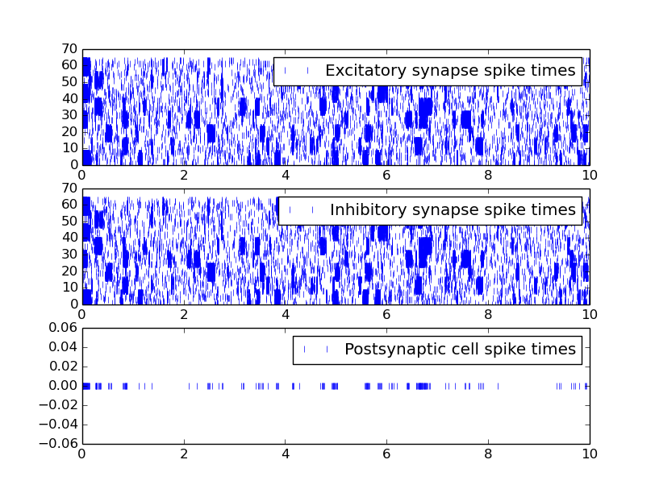

Slide 20
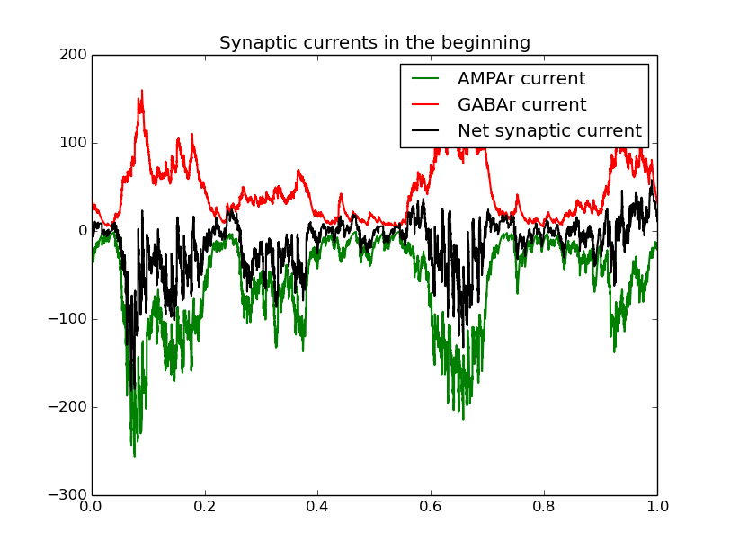
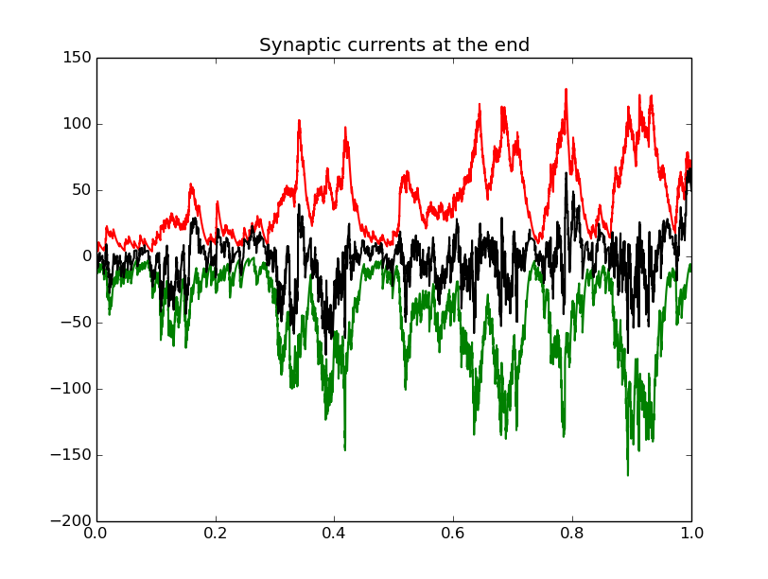
E-I balance

Slide 21
Assignment:
Measure total excitatory and inhibitory current for each signal subgroup.

Slide 22
Also in Vogels 2011:
Inhibitory STDP in recurrent networks
10,000 IF neurons
Initialised at synchronous, high firing rate
Stabilises to low firing, AI state

Slide 23
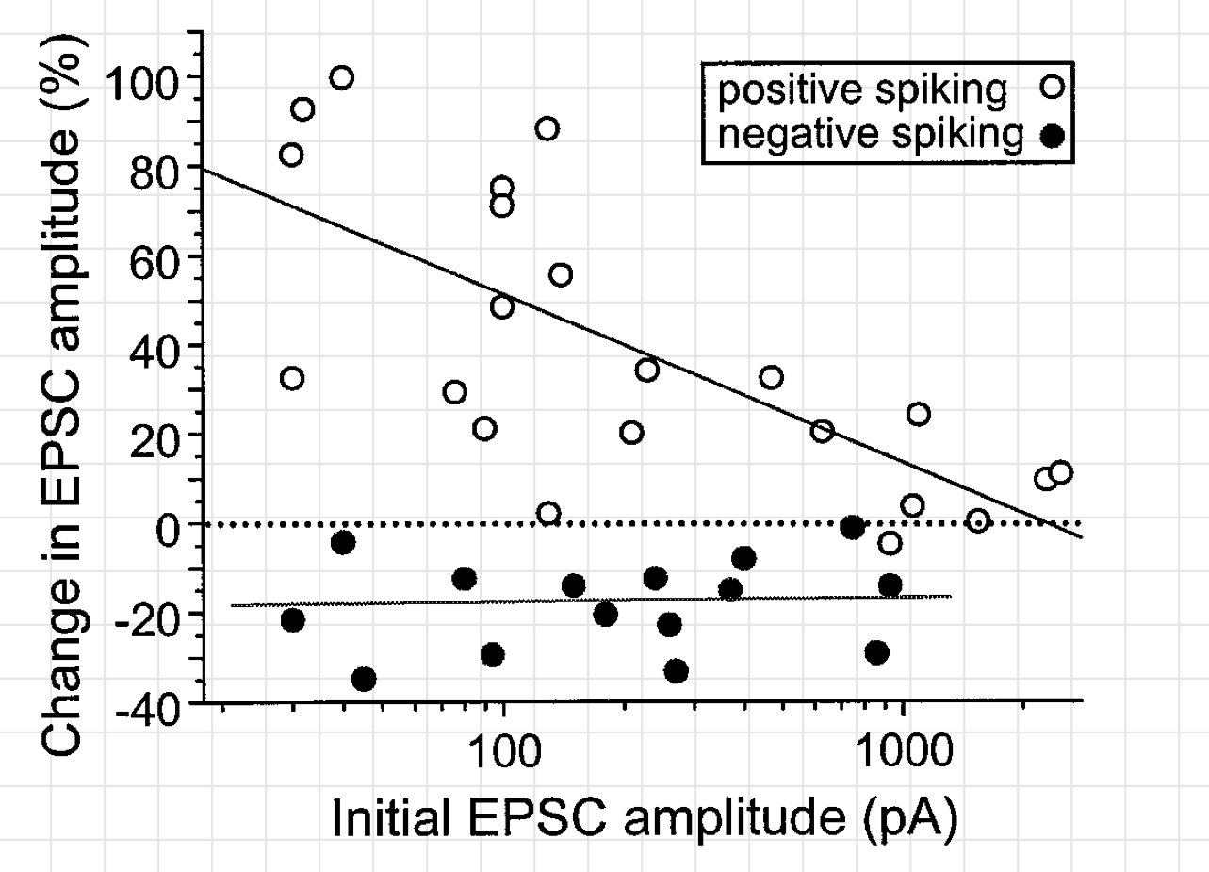
Weight dependence
Bi and Poo 1998

Slide 24
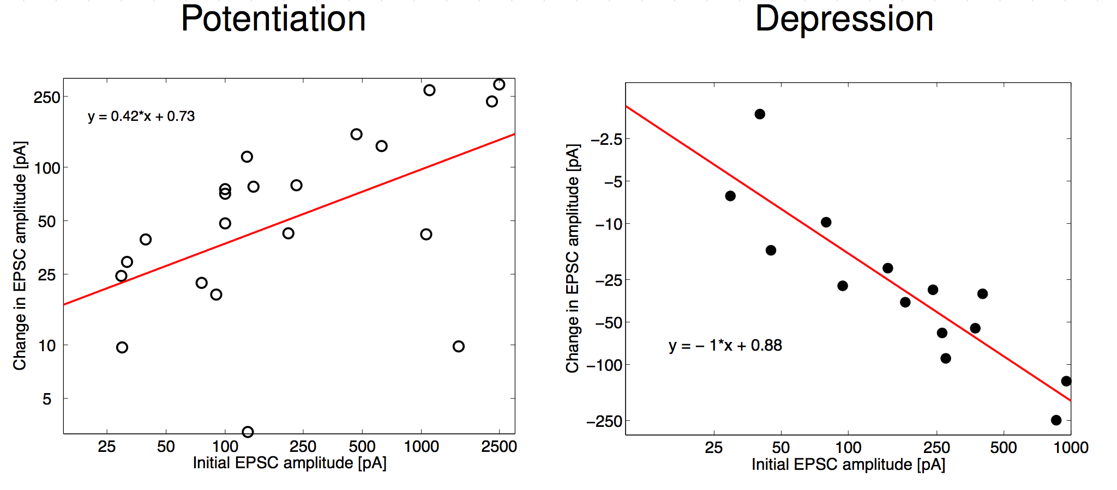
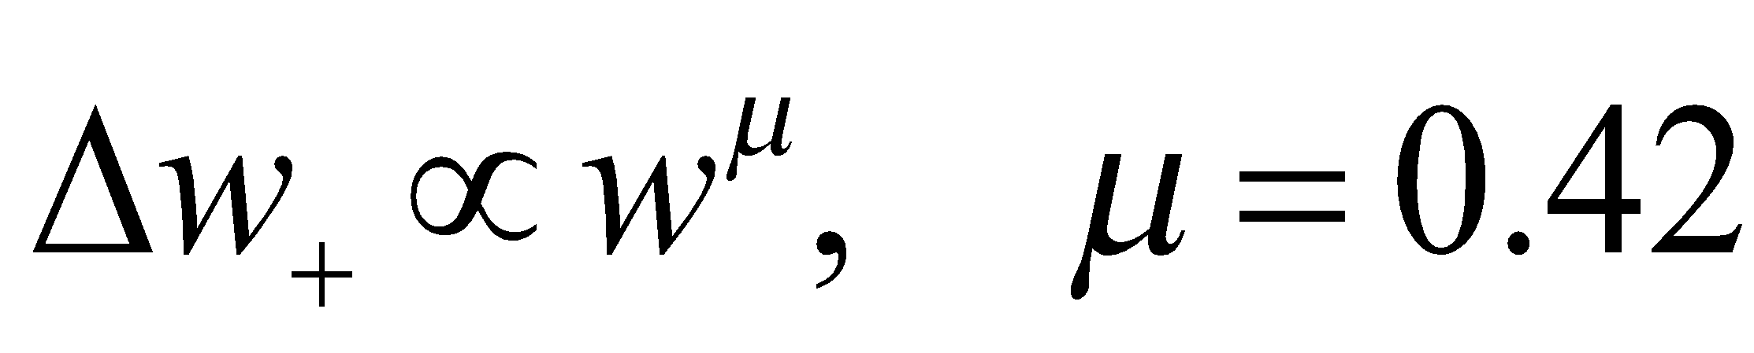
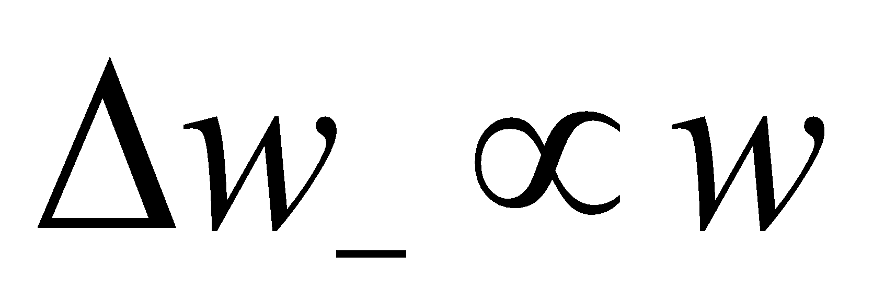
Multiplicative dependence:
Morrison et al., 2007

Slide 25
Assignment: Build multiplicative STDP rule onto Brunel network (2000).
More multiplicative STDP models from:
Guetig et al 2004
Van Rossum et al 2000

Slide 26
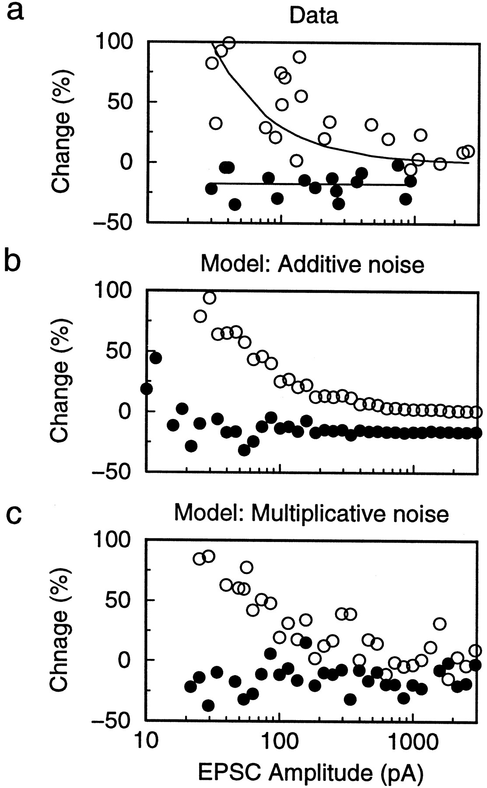
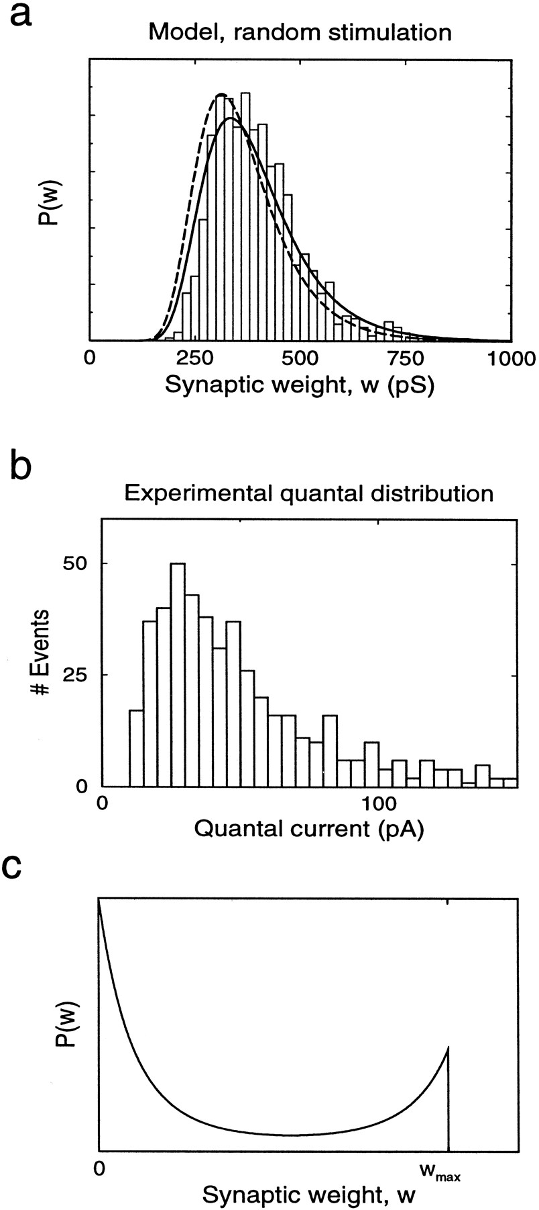
More on synaptic distributions…
With weight-dependence
Without weight-dependence:
Bimodal distribution
Van Rossum et al., J. Neuro., 2000

Slide 27
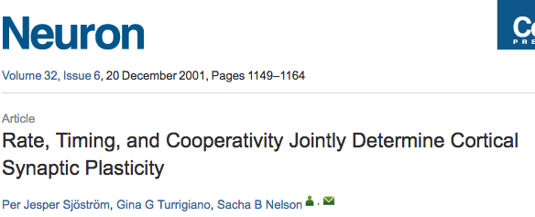
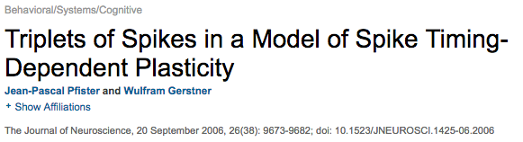
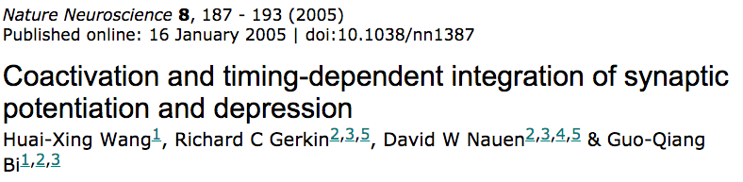
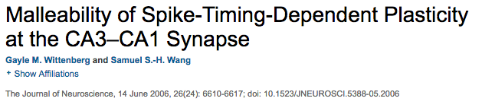
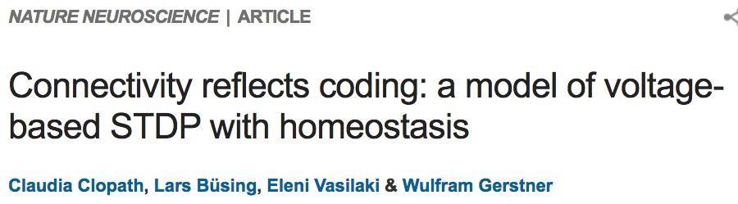
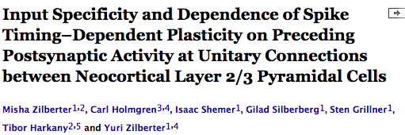
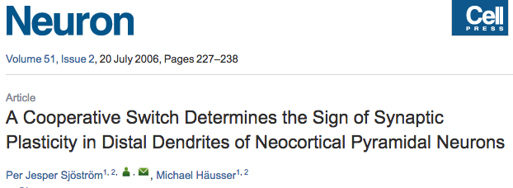

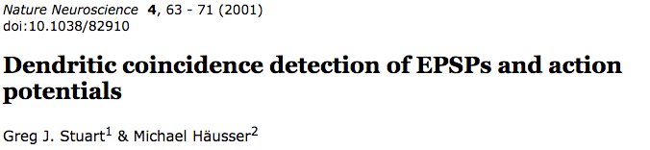
Weight
dependence
Rate-dependence
Multiple spikes (Triplet…)
Synaptic cooperativity
Minimal/detailed models
Mechanistic v/s phenomenological models

Slide 28
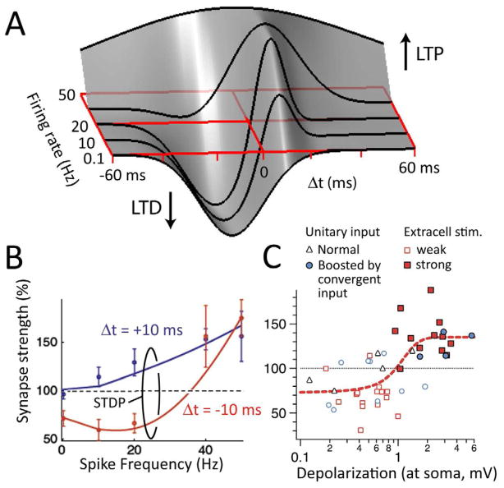
Many models to choose from.. Choose wisely.. And based on data from the modeled system..
Multi-factor plasticity rules
Daniel E. Feldman, Neuron, 2012

