Slide 1
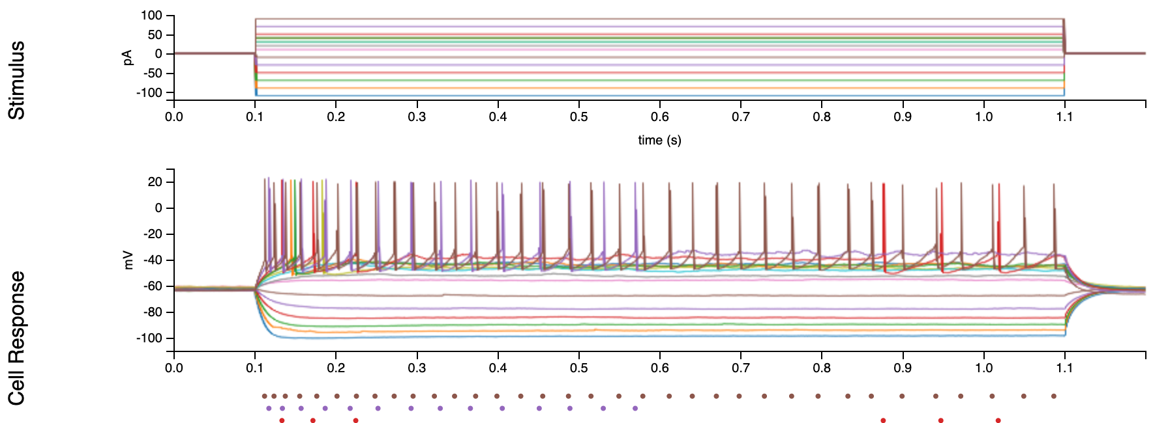
Intracellular Electrophysiology
(figure source: celltypes.brain-map.org)

Slide 2
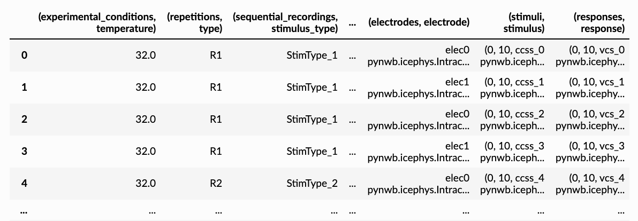
Query Intracellular Electrophysiology Metadata

Slide 3
Intracellular Electrophysiology Data using SweepTable
DEPRECATED

Slide 4
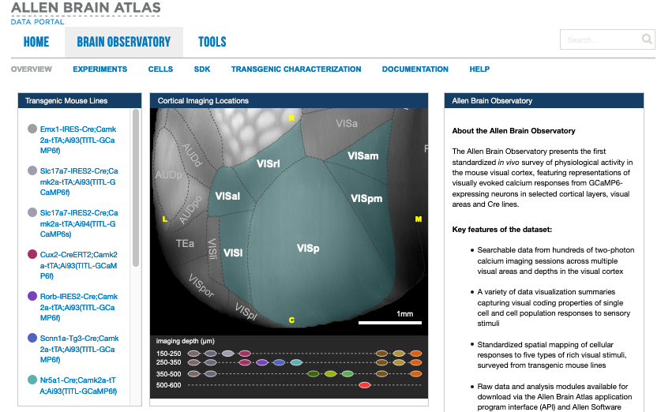
Allen Brain Observatory
(figure source: https://observatory.brain-map.org)

Slide 5
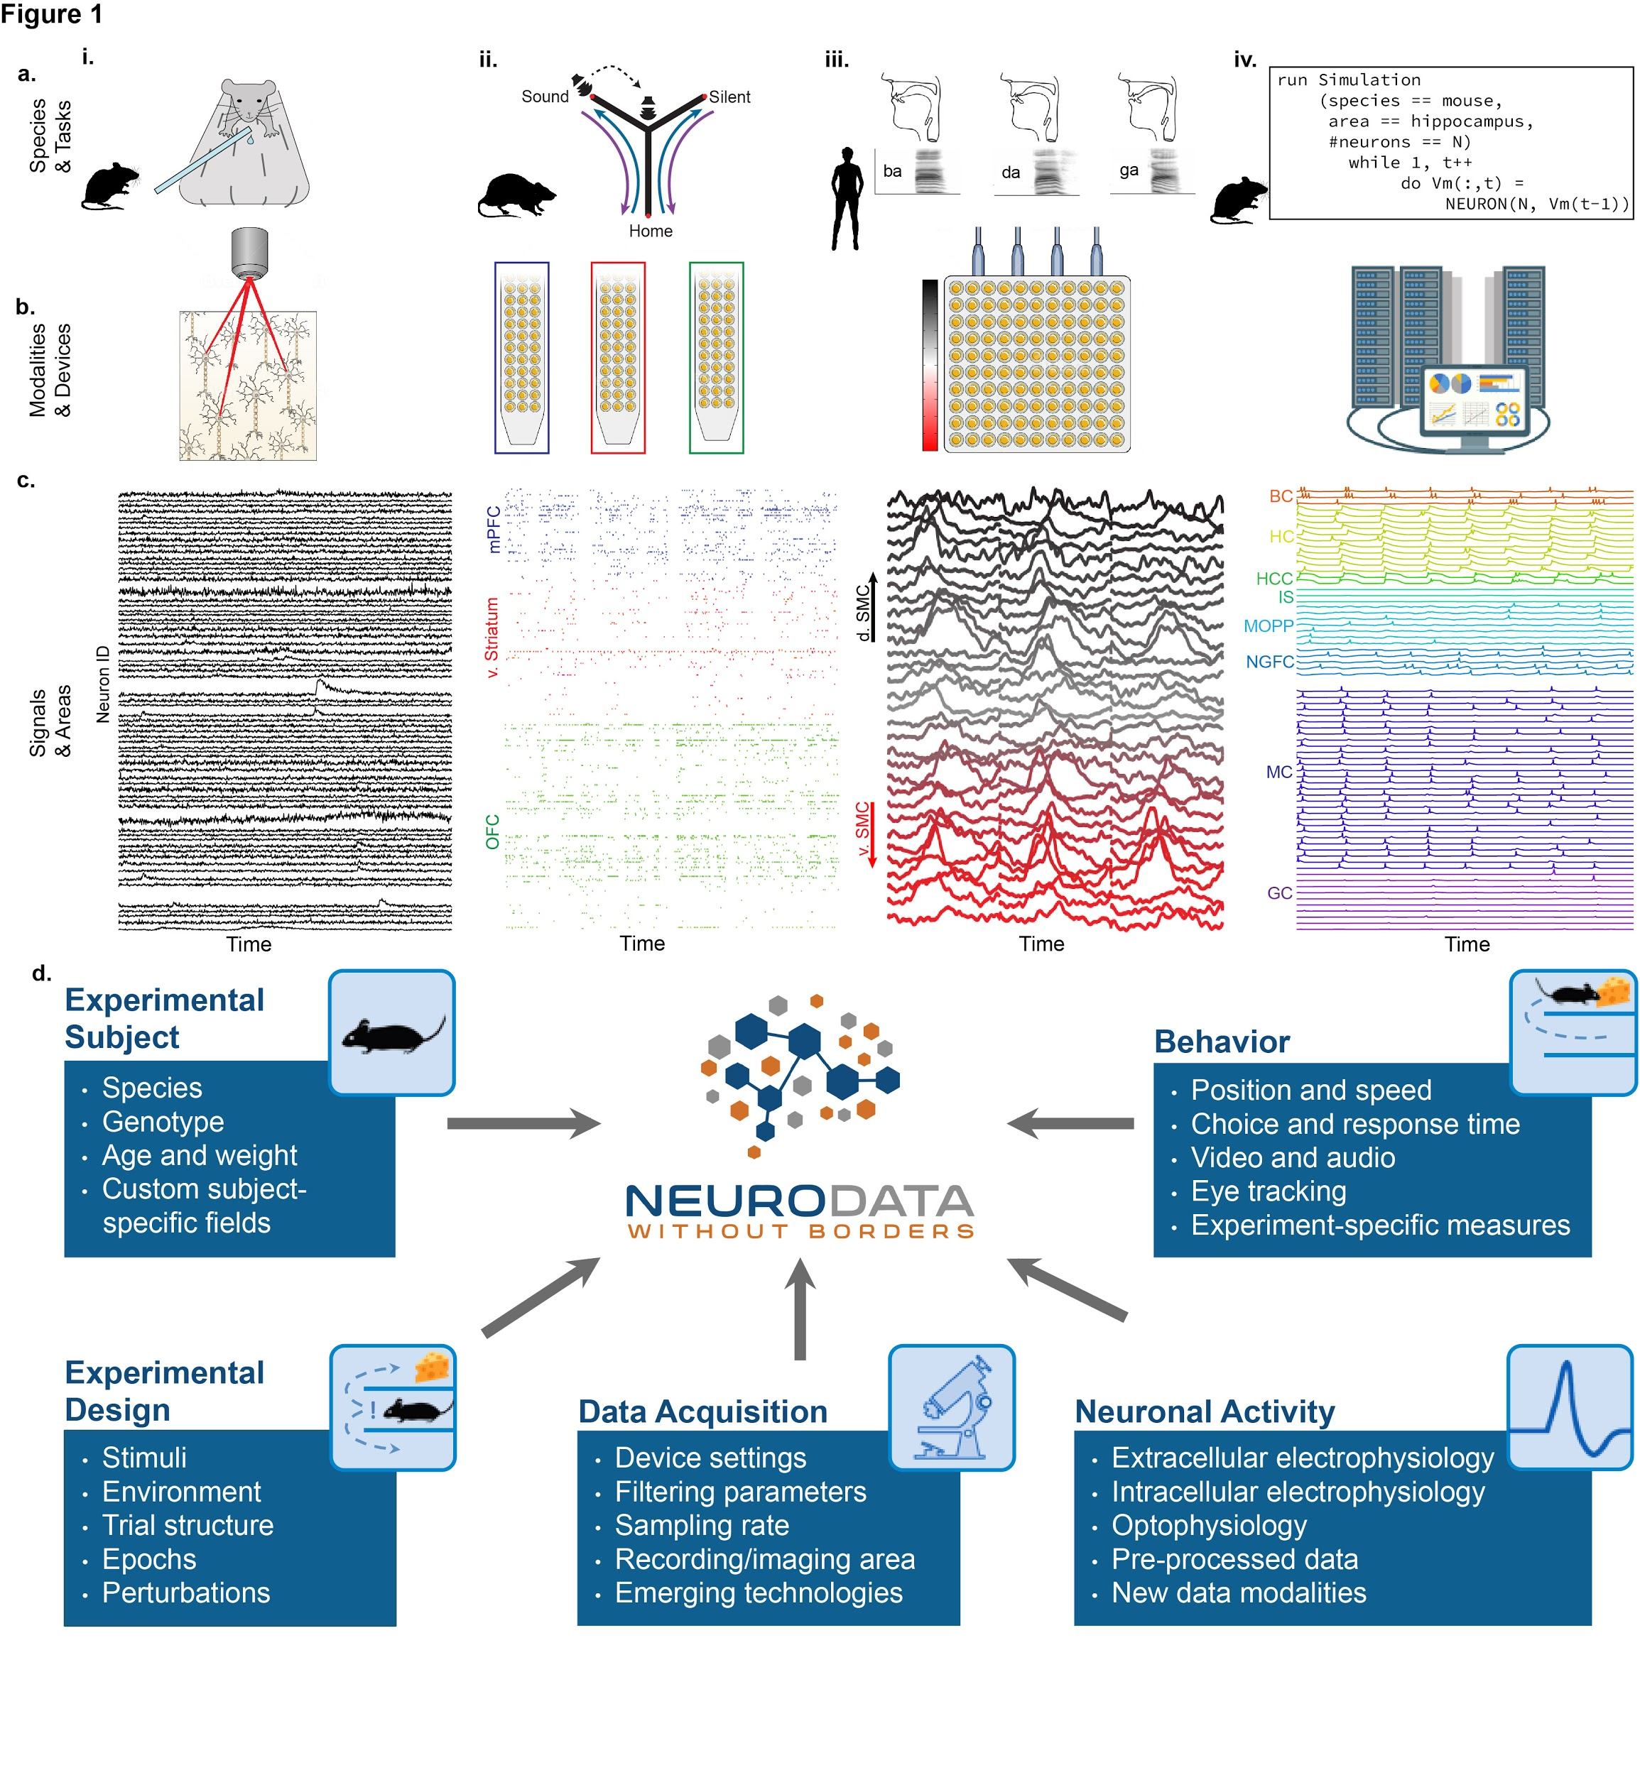
Extracellular Electrophysiology

Slide 6
Calcium Imaging Data

Slide 7
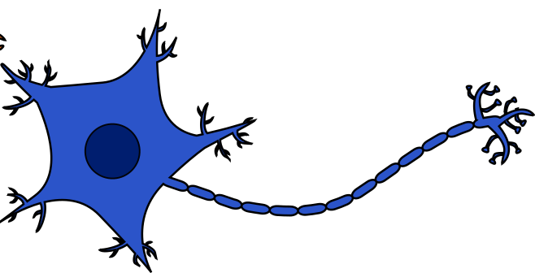
Optogenetics

Slide 8
Iterative Data Write

Slide 9
HDF5 Dataset I/O

Slide 10

Modular Data Storage using External Files

Slide 11
Parallel I/O using MPI
PyNWB
PyNWB
PyNWB
PyNWB
PyNWB
PyNWB
PyNWB
PyNWB

Slide 12
Streaming from an
S3 Bucket
010011101000101011101…

Slide 13
Object IDs in NWB
123e4567-e89b-12d3-a456-426655440000

Slide 14
Annotating Time Intervals
invalid
epoch 1
epoch n
time in seconds

Slide 15

Extending NWB

Slide 16
Adding/Removing Containers from an NWB File
+
-

Slide 17
NWB File Basics

Slide 18
Exploratory Data Analysis with NWB
/scratch

Slide 19

Editing NWB Files

Slide 20
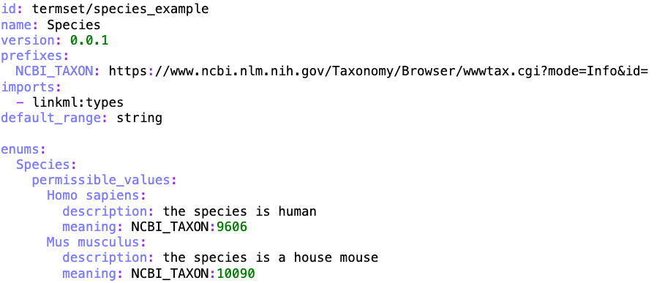

How to Configure Term Validations

