Slide 1
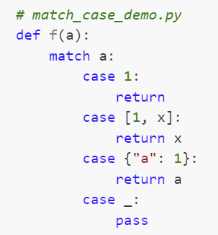
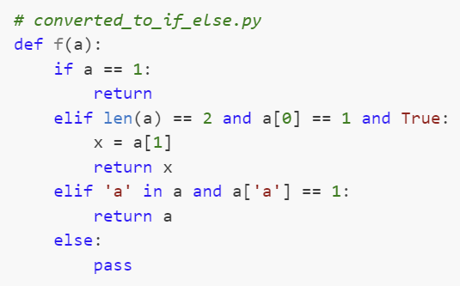
Automatic
Conversion
Code with Match…Case…
(Python >=3.10)
Code with Match…Case…
(Python <=3.9)

