Slide 1


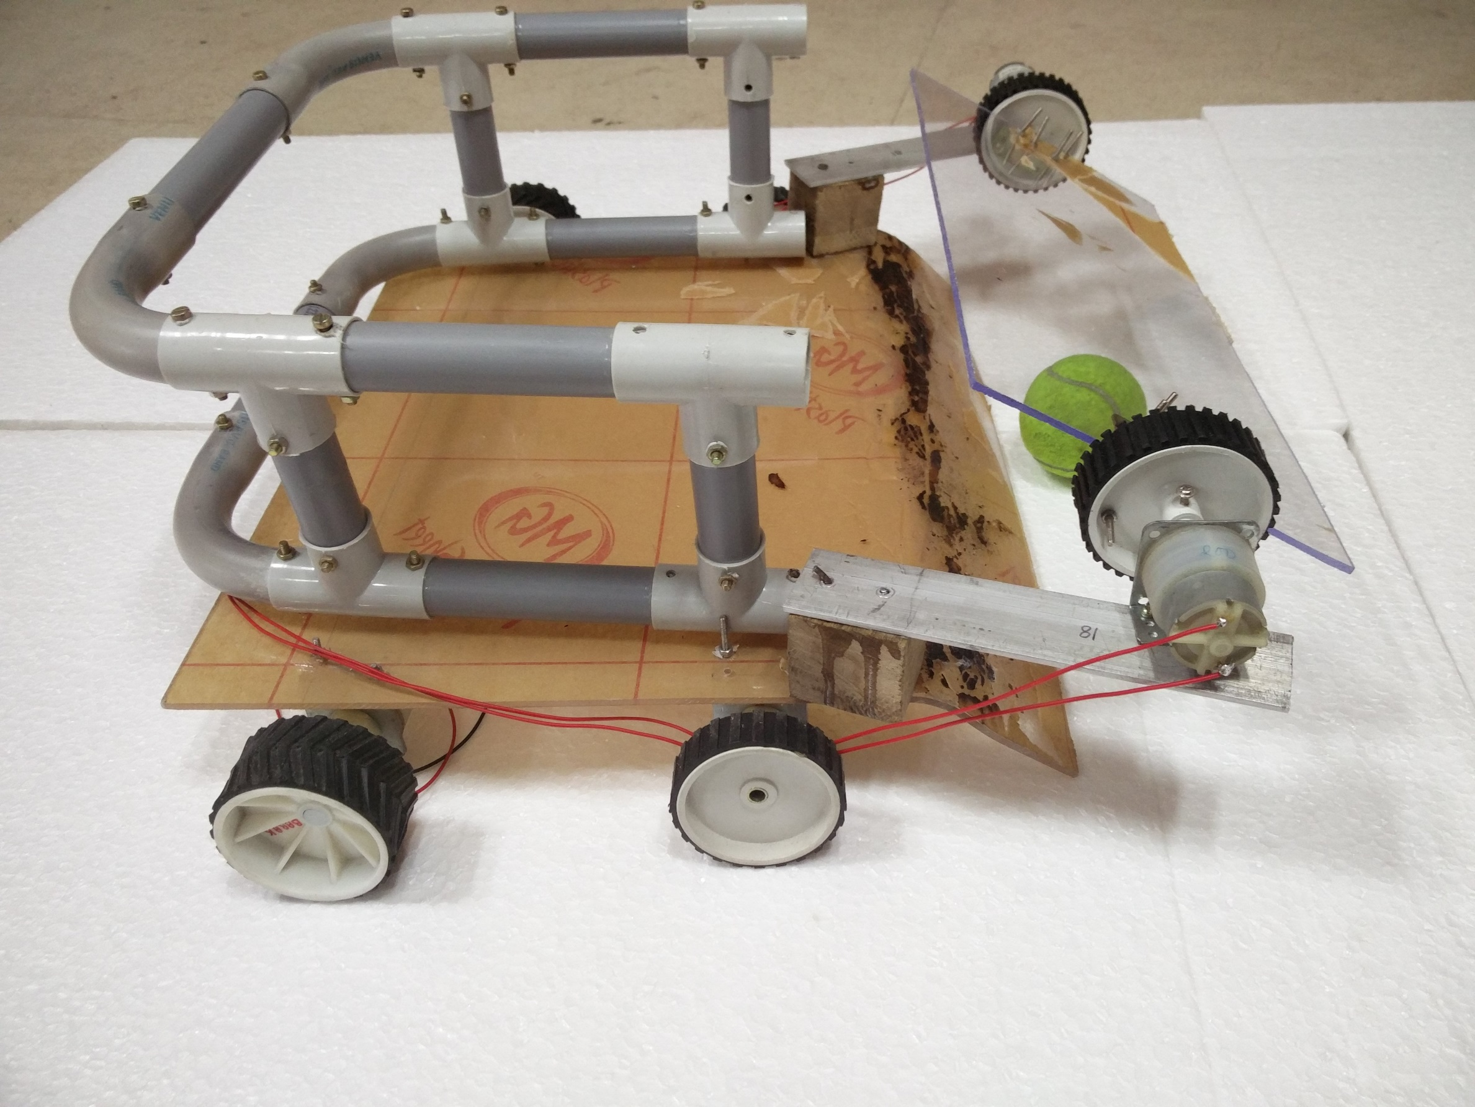
Automated Ball Collector
Students’ Gymkhana Council
Technical Board
IIT Guwahati
b
INTRODUCTION
TRUE TENNIS BUDDY !!
An automated ball collector which once placed in the field would reduce your boring burden of picking the ball .
WORKING
4image processing is used to track the ball and get it’s precise position with the help of PI-cam using OpenCV library .
Coordinates are provided to PI which further commands bot to move towards that location .
Error correcting PID Code is used .
A rotating flap is used as a pick-up mechanism for picking the ball inside the collecting area.
OBJECTIVE
Object detection using pi-cam.
Efficient performance using PID Code.
Accurate pick-up mechanism
Smoother functionality using faster processor like PI
WORKING PRINCIPLES
Capturing of Image
Processing of Image
Signals to micro-controller
Command to Motors
Ball Caught!!
APPLICATION
Design
Efficient in picking up stray balls present in the court without any manual labour .
CONTACT
Avish –avish2806@iitg.ernet.in /7597869996
Himanshu- ranjan11@iitg.ernet.in /9126867051
Mohit- mohitsingh@iitg.ernet.in /9954341554
Archana archana1999@iitg.ernet.in/9127512279
Notes:
<number>

