Slide 1
Characteristics of the proposed approach Hongtao Ren, Marek Makowski
Outline:
- Two illustrative use cases
- Scenarios (instances of the use cases)
- Data structure for interface
- Consuming Web-services
ENRIMA meetings @ IIASA, 7-8 Sep,2011

Slide 2
Simple use cases (energy supply: devices)
Use Case: Upload_devices
Description: upload devices data
User: data manager
Steps:
1. user prepares data on devices
2. user uploads the data
3. user gets confirmation
Use Case: Retrieve_devices
Description: retrieve data on devices
User: operator
Steps:
1. user sends a request for retrieving devices
2. user gets data on devices

Slide 3
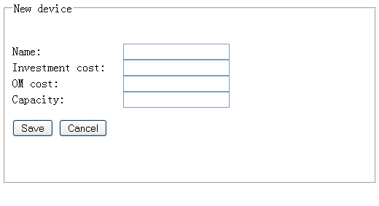
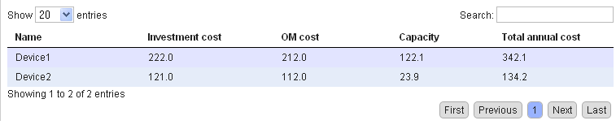
Scenarios (example of GUI)
Upload device(s):
Retrieve devices:

Slide 4
Scenarios (XML docs)
Upload_devices:
<storeDevicesRequest> <device><name>device1</name><inv_cost>222.0</inv_cost><om_cost>212.0</om_cost><capacity>122.1</capacity></device> <device><name>device2</name><inv_cost>121.0</inv_cost><om_cost>112.0</om_cost><capacity>23.9</capacity></device>
</ storeDevicesRequest>
<storeDevicesResponse> OK </ storeDevicesResponse >
Retrieve_devices:
<getDevicesRequest/>
<getDevicesResponse> <device><name>device1</name><inv_cost>221.0</inv_cost><om_cost>212.0</om_cost><capacity>122.1</capacity>device> <device><name>device2</name><inv_cost>121.0</inv_cost><om_cost>112.0</om_cost><capacity>23.9</capacity></device>
</getDevicesResponse>

Slide 5
XML schema
<xs:element name="storeDevicesRequest"> <xs:complexType> <xs:sequence> <xs:element maxOccurs="unbounded" ref="enrima:device"/> </xs:sequence> </xs:complexType> </xs:element> <xs:element name="storeDevicesResponse"> <xs:complexType> <xs:all> <xs:element name="result" type="xs:string" /> </xs:all> </xs:complexType> </xs:element>
<xs:element name="getDevicesRequest" /> <xs:element name="getDevicesResponse"> <xs:complexType> <xs:sequence> <xs:element maxOccurs="unbounded" ref="enrima:device"/> </xs:sequence> </xs:complexType> </xs:element>
<xs:element name="device"> <xs:complexType> <xs:sequence> <xs:element name="name" type="xs:string" /> <xs:element name="inv_cost" type="xs:double"/> <xs:element name="om_cost" type="xs:double"/> <xs:element name="capacity" type="xs:double"/> <!-- <xs:element name="tac" type="xs:double"/> calculated by constructor--> </xs:sequence> </xs:complexType> </xs:element>

Slide 6
Consuming Web-services
Steps:
1. Get definition URL :
http://enrima.iiasa.ac.at/device-ws/deviceService.wsdl
2. Get available operations :
getDevices, storeDevices
3. Get Endpoint :
http://enrima.iiasa.ac.at/device-ws/deviceService/
Clients
GUI : java, javascript (jquery, dojo, etc ), flex
Solvers: C++, Java, Matlab
SOAP testing tools: SOAPUI, Web king, XML spy, etc.
…

Slide 7
DSS layers
WS Domain
Web service
WSDL
Endpoints
DB domain (persistence entities)
Service Adapters
Cross cutting
Data Service
Logging
Transaction management
Security
API
Stateless transactional business logic
Data Access
DAO (complex queries)
ORM Abstraction (CRUD repository)
Java Persistence (generated /maintained by framework)
Database

Slide 8
DSS Web-services
Scenarios XML Files (request, response)
Transparent for clients
Web-Services
Service Adapters
generate
WS- Domain
-Endpoints
WSDL
-Marshalling
-Unmarshalling
-WS/DB domain objects convertors
Adapters
Generate contract
(WSDL file)
Auto-generated java
classes (OXM)
.
.xsd
XML Schema
DB Domain
Auto-generated java
persistence classes ( ORM)
Req
Res
Client
DSS kernel

Slide 9
DSS clients
Web-Services
JAVA
WSDL2JAVA
WS- Domain
Marshalling
Auto-generated java
classes (OXM)
-Endpoints
WSDL
Unmarshalling
WSDL2H, marshaling, unmarshalling
C++
Matlab
Flex, Adobe Air
Ajax calls: (JQuery, Dojo, etc)
Testing tools: SOAPUI, XML spy, etc
…

Slide 10
DSS-kernel (transparent for clients)
DB Domain
DB Repository
Core
API
DB Schema
Auto-generated java
persistence classes
(ORM)
Lazy loading data within
transaction session
Data Access Objects
(DAO)
Manager (security, Access Control Lists, etc)
Services
Aspect(s):
declarative transaction management

Slide 11
Summary
Modularity
Multi-layer
Interface of client through web-services
DB structure changes hidden for clients
XML schema changes decoupled from DB structure

