Slide 1
SMS Client Examples
Hongtao Ren, Marek Makowski
Outline:
Overview of WS
SMS XML schema and WSDL
- Exploring the WS
- C++ client example
- Java client example
ENRIMA Web meeting, 11 Jan, 2012

Slide 2
Overview
Transparent for clients
Web-Services
Service Adapters
WS- Domain
-Endpoints
WSDL
-Marshalling
-Unmarshalling
-WS/DB domain objects convertors
Adapters
Generate contract
(WSDL file)
Auto-generated java
classes (OXM)
.
.xsd
XML Schema
DB Domain
Auto-generated java
persistence classes ( ORM)
Req
Res
Clients: c++, Java, Matlab,soapUI, etc.
DSS kernel

Slide 3
XML schema of SMS
Roles of XML schema:
Defines structure and content of data exchanged between modules (DSS engine, solver, UI)
The basis for WSDL
The basis for interface classes for client application

Slide 4
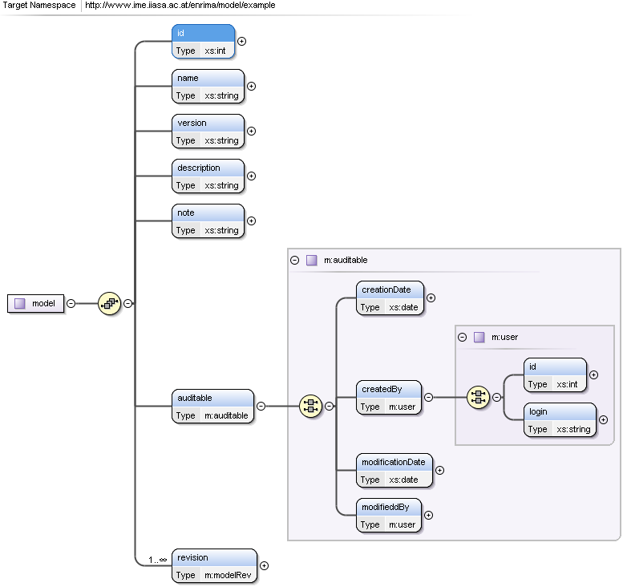
XML schema (SMS example)
The schema is available at:
https://github.com/h-t-ren/enrima-ws-server/blob/master/docs/model.xsd
Documentation of the schema:
https://raw.github.com/h-t-ren/enrima-ws-server/master/docs/model.pdf

Slide 5
A snippet of WSDL
< wsdl:portType name="enrima">
<wsdl:operation name="getModelDescription">
<wsdl:input message="tns:getModelDescriptionRequest“name="getModelDescriptionRequest">
</wsdl:input>
<wsdl:output message="tns:getModelDescriptionResponse" name="getModelDescriptionResponse">
</wsdl:output>
</wsdl:operation>
<wsdl:operation name="saveModelDescription">
<wsdl:input message="tns:saveModelDescriptionRequest" name="saveModelDescriptionRequest">
</wsdl:input>
<wsdl:output message="tns:saveModelDescriptionResponse" name="saveModelDescriptionResponse">
</wsdl:output>
</wsdl:operation>
<wsdl:operation name="getModelList">
<wsdl:input message="tns:getModelListRequest" name="getModelListRequest">
</wsdl:input>
<wsdl:output message="tns:getModelListResponse" name="getModelListResponse">
</wsdl:output>
</wsdl:operation>
</wsdl:portType>
The WSDL is available at:
http://www.ime.iiasa.ac.at/enrima_ws_tst1/enrima.wsdl

Slide 6
Exploring WS
Testing WS is optional but recommended to check:
If the message structure and content fit application domains?
If the operations (functions) fit functional requirement?
If the performance fit non-functional requirements?
Tools
soapUI
Web King
XML spy
…

Slide 7
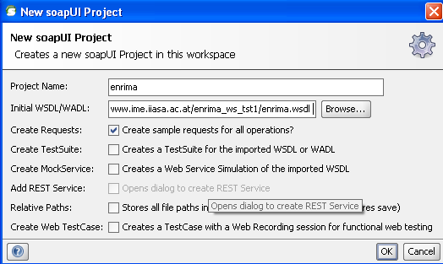
Exploring WS: soapUI (1-2)
1）Download and install soapUI (http://www.soapui.org/)
2）File -> New soapUI project, in the intial WSDL/WADL field, Enter http://www.ime.iiasa.ac.at/enrima_ws_tst1/enrima.wsdl and click OK

Slide 8
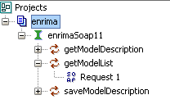
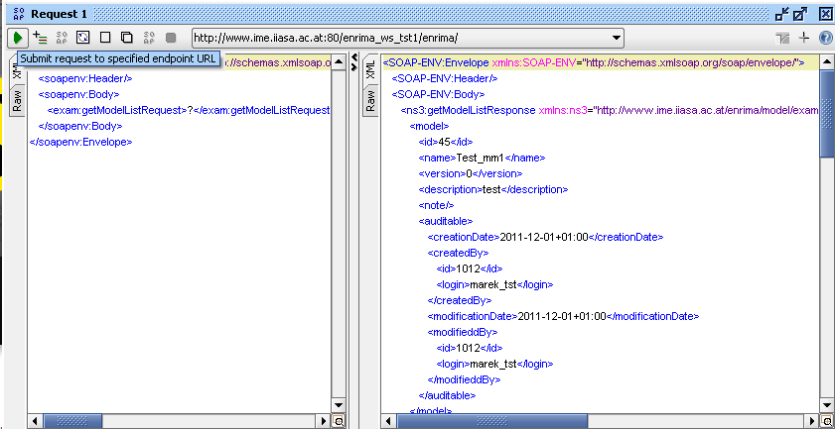
Exploring WS: soapUI (3-4)
3) You should now see that the WSDL was successfully added to the project by seeing the operations in the Web Service in the navigator
4) Click on ‘’getModelList”; double click on “Request 1” and then click the green triangle to submit the request. The result of the response will be shown in the right pane.

Slide 9
A simple C++ client
Download :
- git clone git://github.com/h-t-ren/enrima-ws-gsoap-client.git
or https://github.com/h-t-ren/enrima-ws-gsoap-client , click ‘zip’ icon
Files:
- main.cpp: a simple client, will be replaced by real applications
- stdsoap2.h, stdsoap2.cpp: from gsoap
- soapH.h, soapC.cpp, soapStub.h, soapenrimaSoap11Proxy.h, soapenrimaSoap11Proxy.cpp: generated by gsoap
Compile and run the example:
g++ -o enrima *.cpp
or: g++ -o enrima *.cpp -lsocket -lnsl
./enrima

Slide 10
gSoap (Optional)
About gSoap:
gSoap: The gSOAP toolkit is an open source C and C++ software development toolkit for SOAP/XML Web services and generic (non-SOAP) C/C++ XML data bindings. The toolkit analyzes WSDLs and XML schemas (separately or as a combined set) and maps the XML schema types and the SOAP messaging protocols to easy-to-use and efficient C and C++ code.
You can create files by the following:
1) Download gsoap from http://sourceforge.net/projects/gsoap2/files/gSOAP/, please select gsoap_2.8.3.zip or above
2) Unzip and install gsoap (assume you unzip it to $HOME/gsoap-2.8)
cd $HOME/gsoap-2.8
./configure —prefix=$HOME/gsoap
make & make install
3) Create enrima client test
mkdir tst
cp $HOME/gsoap-2.8 /gsoap/{typemap.dat,stdsoap2.{h,cpp}} tst
4) Generate enrima.h
$HOME/bin/wsdl2h -o enrima.h -t typemap.dat http://www.ime.iiasa.ac.at/enrima_ws_tst1/enrima.wsdl
5) Generate the Client-site *.h & *.cpp files
$HOME/bin/soapcpp2 -C -i enrima.h -I $HOME/gsoap/share/gsoap/import/

Slide 11
Java client
1)Install development environments (JDK 6 or above, Maven 3 or above)
2)Install Git (optional)
3) Download the enrima-ws-java-client example:
git clone git://github.com/h-t-ren/enrima-ws-java-client.git
or https://github.com/h-t-ren/enrima-ws-java-client and click "zip" button
4) Install:
$cd enrima-ws-java-client
$mvn clean install
5) Run tomcat
$cd ui
$mvn tomcat:run
(to stop tomcat: ctrl+c)
6) webpage: http://localhost:8080/enrima-web/

Slide 12
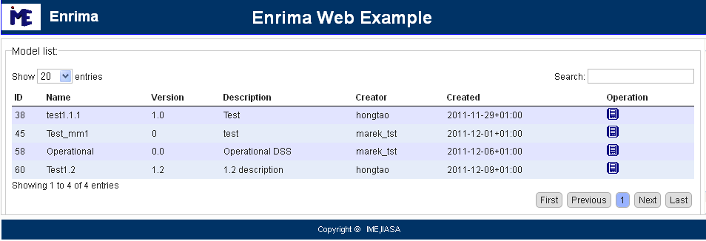
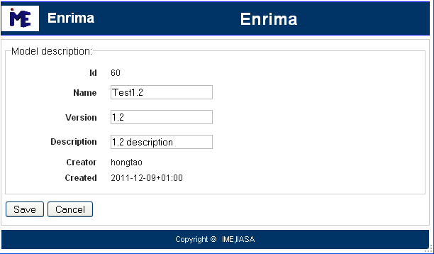
Java client web

Slide 13
Resources and Tools
-XML tutorial: http://www.w3schools.com/xml/default.asp
-XML schema tutorial: http://www.w3schools.com/schema/default.asp
-WSDL tutorial: http://www.w3schools.com/wsdl/default.asp
-soapui: http://www.soapui.org/
-gSoap: http://www.cs.fsu.edu/~engelen/soap.html
-Maven: http://maven.apache.org/
-Git: http://git-scm.com/
-Matlab: http://sipi.usc.edu/manuals/matlab701/techdoc/matlab_external/ch_soap4.html

Slide 14
Summary
Main features:
Modules on heterogeneous platforms (OS, languages)
WS easy to use
- XML knowledge not need,
- Generated C++/Java objects can be embedded into application
In-depth discussion necessary:
- Each module’s requirements for data structure and WS functionality
- Structure of SMS (implies XML schema)
- Effectiveness of WS (and the DW)

