Slide 1
Knowledge discovery in Web3.0 and its application in research communities Hongtao Ren (ver 0.01 draft)

Slide 2
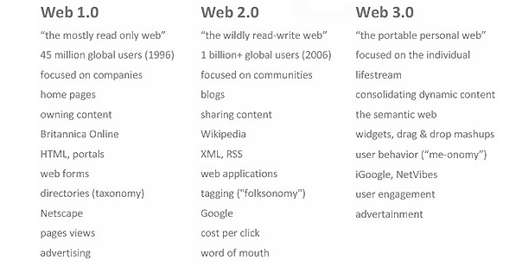

Slide 3
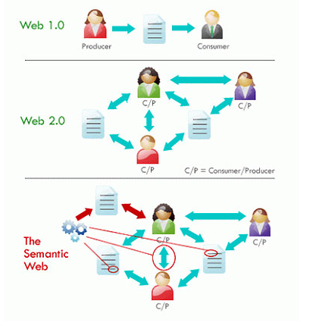

Slide 4
Web3.0
The context of the content defined as data
Capable of reading and understanding content and context
Better satisfy the requests of the people and machine
Capable of filtering the content that of interest to the user

Slide 5
Knowledge management In a research community
Knowledge domain
Knowledge node relations
UserHasFriend
UserBlockUser
UserUploadPublication
UserInGroup
UserHasTag
UserComment_onUser
UserComment_onPublication
UserUpdateStatus
UserHas_permission_OnPublication
UserCreateGroup
GroupHas_permission_On_Publication
PublicationHasAuthor
PublicationHasDocument
PublicationHasTag
PublicationHasComment
PublicationSimilar_ToPublication
Knowledge node types
TagSimilar_ToTag
AuthorSimilar_ToAuthor
…
User
Group
Author
Publication
Document
Tag
Comment
Status

Slide 6
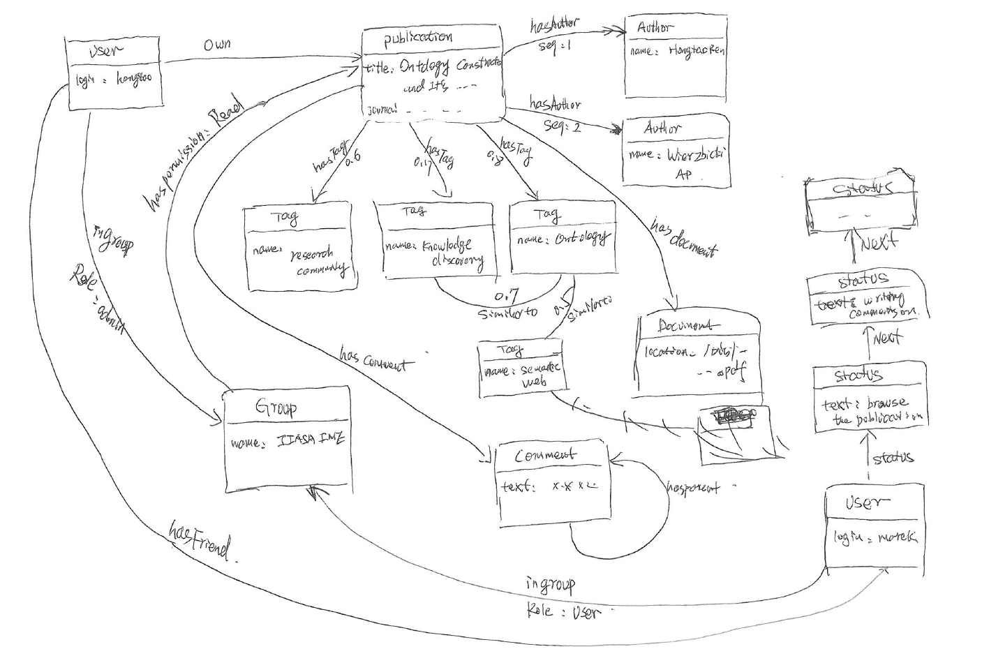
KM:=(N,R)

Slide 7
Challenges
Connectedness: All different types of knowledge node are interlinked and connected
Data size: For example, if we want to store 10 thousand publications, we may need store over 1 million related entities
Semi-structure: Individualization of the knowledge node, the property of the knowledge node should be user definable
Extracts implicit, potentially useful information from the data
Knowledge visualization

Slide 8
Solutions?
NoSQL (Basex,CouchDB,MangoDB, Neo4j)
XML, RDF
Cypher, gremlin
RESTful
Data as a service
HTML5 and CSS3

Slide 9
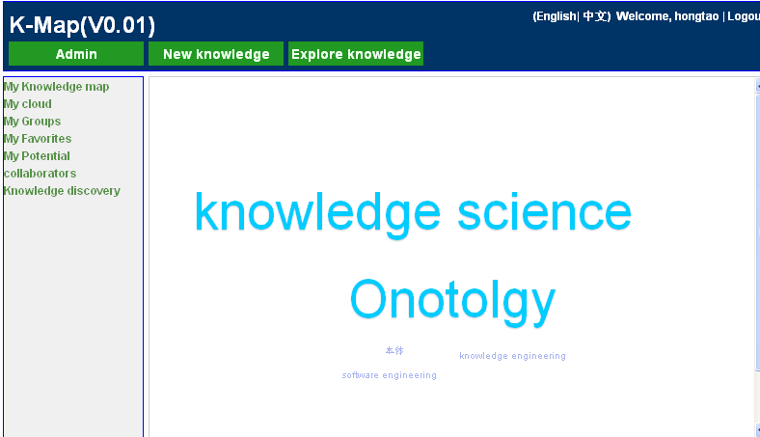
My tags cloud

Slide 10
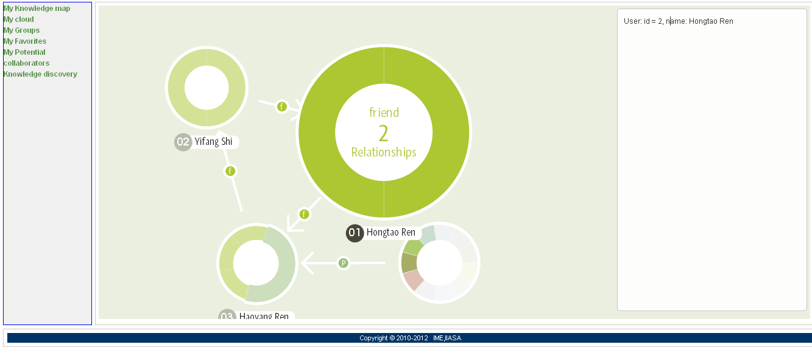
My knowledge map

Slide 11
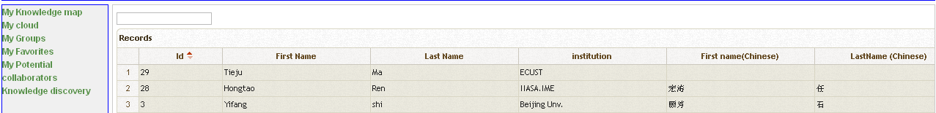
My potential collaborators
@Query (“start user=node :node_auto_index(name=‘haoyang’)
match user->[r:hasTag]<-potential
return potential”)

Slide 12
Knowledge discovery
Find your interested publications owned by your friends of friends of…
Find people who are also interested in your research area
Discover the potential research area
Publications clustering
Authors clustering
Personalized search engine
Event mining

