Slide 1

Web-site for Multiple Criteria Analysis of Discrete Alternatives
'09
Hongtao Ren* Marek Makowski* Janusz Granat **
*International Institute for Applied Systems Analysis
A-2361 Laxenburg, Austria
**National Institute of Telecommunications,Warsaw, and Warsaw University of Technology, Poland

Slide 2
Architecture
Functionality
Demonstration
Technical requirements
Layers and modules
Structure of the data
B/S/D structure:
Browser (the minimum screen resolution is 1024X768):
- Firefox ver. 3
- MS Explorer ver. 6
- Safari
Server (Sun Solaris)
-Container of the MCA (JRE 1.6, Apache Tomcat 6)
-WF(web flow framework by Bartosz Kozlowski)
-Solver (by Marek Makowski)
-User web services (by J.Wojciechowski&H. Ren)
-Bug report & Contact(by J.Wojciechowski&H. Ren)
Database
-Oracle 10g
Web-site for Multiple Criteria Analysis of Discrete Alternatives IME Project, IIASA

Slide 3
Architecture
Functionality
Demonstration
Technical requirements
Layers and modules
Structure of the data
Layers:
-Java persistence layer
-Object-relational mapping abstraction layer
-Data access layer
-Services layer
-Process and integration layer
-Interfaces layer
Modules
-Problem
-Instance
-Analysis
Web-site for Multiple Criteria Analysis of Discrete Alternatives IME Project, IIASA

Slide 4
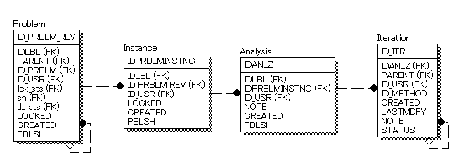
Architecture
Functionality
Demonstration
Technical requirements
Layers and modules
Structure of the data
Data Model of the MCA:
Web-site for Multiple Criteria Analysis of Discrete Alternatives IME Project, IIASA

Slide 5
Architecture
Functionality
Demonstration
Overview
Problem
Instance
Analysis
Overview of MCA functionality (user point of view):
-Large number of alternatives(>1000 alternatives)
-Large number of attributes(>40 attributes)
-Private data space
-Specification of problem, instance, analysis
-Continuation of the analysis
-The user data are stored on MCA server.
Web-site for Multiple Criteria Analysis of Discrete Alternatives IME Project, IIASA

Slide 6
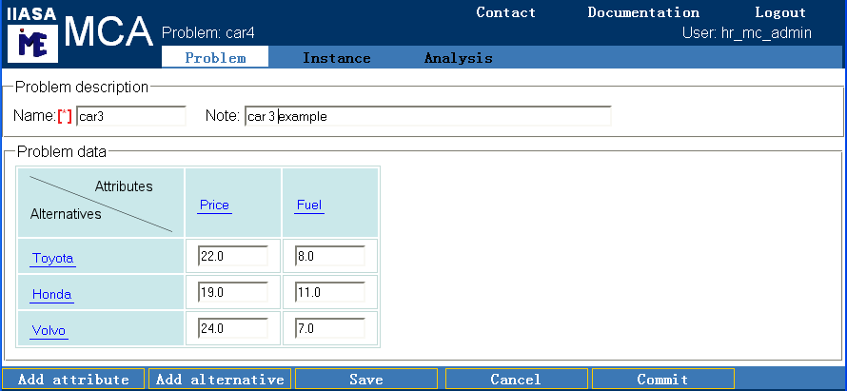
Architecture
Functionality
Demonstration
Overview
Problem
Instance
Analysis
Problem specification:
-Alternatives,indexed by j = 1,...,m
-Attributes,indexed by i = 1,...,n
-Attribute values by qij
Web-site for Multiple Criteria Analysis of Discrete Alternatives IME Project, IIASA
Notes:
Multicriteria problem specification is composed of three parts:
A vector of alternatives, a vector of alternatives and a matrix of attribute values.
in the application, problems are specified and modified through several linked forms.
This figure shows an example with several attributes and alternatives already defined.

Slide 7
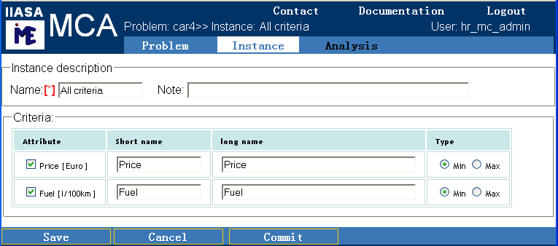
Architecture
Functionality
Demonstration
Overview
Problem
Instance
Analysis
Instance:
-Criteria: an attribute + type (max, min)
-A hierarchy of criteria
Web-site for Multiple Criteria Analysis of Discrete Alternatives IME Project, IIASA

Slide 8
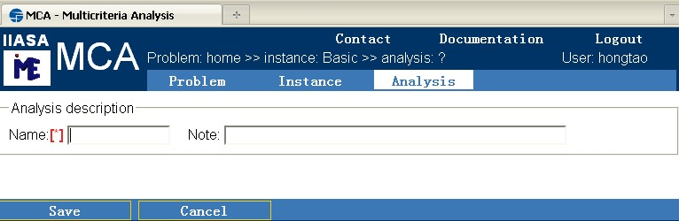
Architecture
Functionality
Demonstration
Overview
Problem
Instance
Analysis
Analysis (Container of iterations):
-Initial iteration (Objective Choice)
-Next iterations: preferences by the user
Web-site for Multiple Criteria Analysis of Discrete Alternatives IME Project, IIASA
Notes:
From the user point of view, a specification of a new analysis is much simpler. one needs to only specify a unique name for the analysis. by clicking the button Save, a new analysis initial iteration is created.

Slide 9
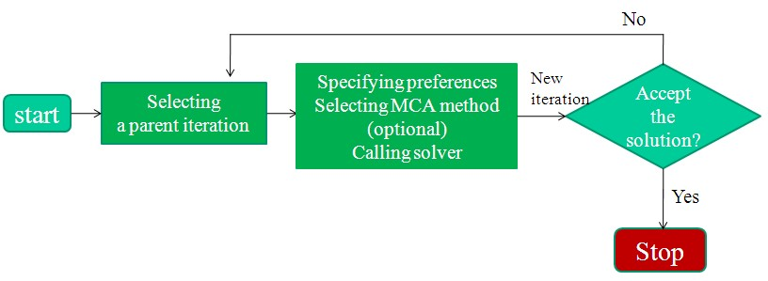
Architecture
Functionality
Demonstration
Overview
Problem
Instance
Analysis
Analysis process:
Web-site for Multiple Criteria Analysis of Discrete Alternatives IME Project, IIASA

Slide 10
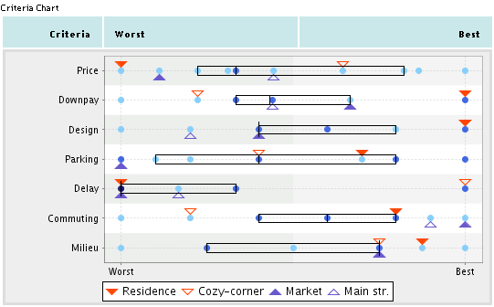
Architecture
Functionality
Demonstration
Overview
Problem
Instance
Analysis
Analysis in the criteria space:
Web-site for Multiple Criteria Analysis of Discrete Alternatives IME Project, IIASA

Slide 11
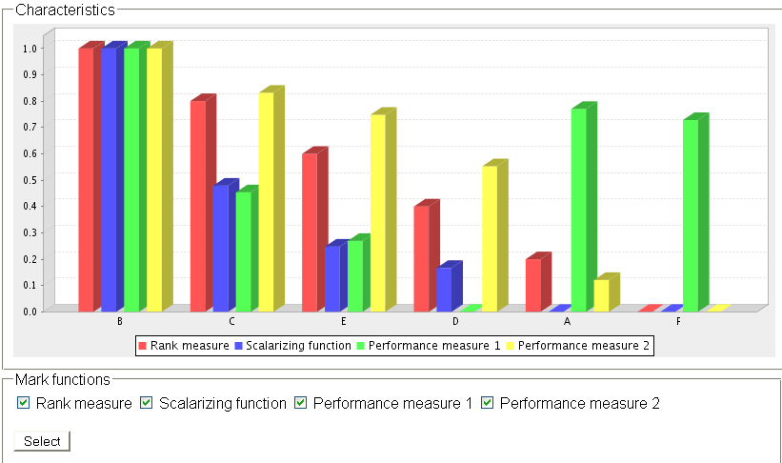
Architecture
Functionality
Demonstration
Overview
Problem
Instance
Analysis
Auxiliary analysis in the alternative space (characteristics)
Web-site for Multiple Criteria Analysis of Discrete Alternatives IME Project, IIASA

Slide 12
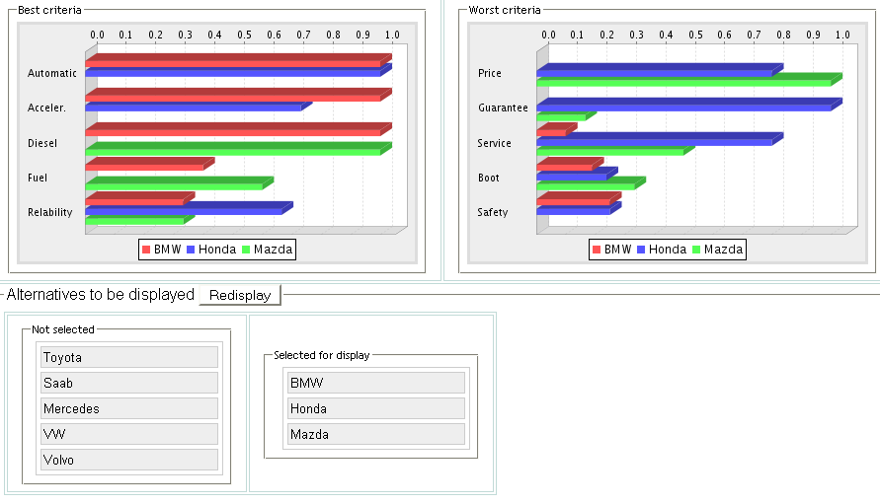
Architecture
Functionality
Demonstration
Overview
Problem
Instance
Analysis
Auxiliary analysis in the alternative space (compare by criteria)
Web-site for Multiple Criteria Analysis of Discrete Alternatives IME Project, IIASA

Slide 13
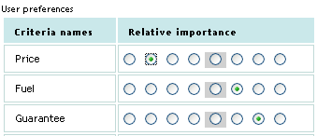
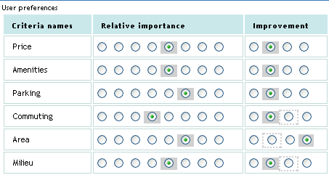
Architecture
Functionality
Demonstration
Overview
Problem
Instance
Analysis
Specification of preferences
Relative importance:
-ignore,
-vastly less important than average,
-much less important than average,
-less important than average,
-average importance,
-more important than average,
-much more important than average,
-vastly more important than average.
selecting criteria for improvement and compromising:
-relax,
-free,
-stabilize,
-improve.
Web-site for Multiple Criteria Analysis of Discrete Alternatives IME Project, IIASA

Slide 14
Architecture
Functionality
Demonstration
Real-time demonstration of the MCA
Access to the MCA is available from
http://www.iiasa.ac.at/~marek
Web-site for Multiple Criteria Analysis of Discrete Alternatives IME Project, IIASA

Slide 15
Architecture
Functionality
Demonstration
Conclusions:
-Any-time any-where type of access
-Private data space
-Continuation of analysis
-Free to use to research and education purpose
Future development:
-Target criteria
-Aspiration/Reservation
-MCMA
Web-site for Multiple Criteria Analysis of Discrete Alternatives IME Project, IIASA

