Slide 1
Git & GitExtension
Presenter: Hoanh Tran 9/2/2017

Slide 2
Agenda
What is Git.
Why Git.
How to & Git commands.
Git bash shell & GitExtension
Live Demo

Slide 3
What is Git?
Started in 2005 by Linux Torvalds for Linux.
Distributed Software Configuration Management (SCM)
Open Sourced.
Repositories - GitHub, BitBucket, Atlassian Stash.

Slide 4
Why use Git?
Hierarchial
developers push(checkin) to a subsystem level repo.
Subsystem level pushed to a main repo
Distributed
Developer push the code to his/her own repo.
Integrator choose and pull (checkout) developers’ repos into an official repo.
Offline Support
Work in disconnected environment.

Slide 5
Why use Git? (cont)
Ease of Backup
Clone the repo and burn into a DVD.
Support Centralize SCM
Support single repository similar to CVS, SubVersion, ClearCase.

Slide 6

Centralized Software Configuration
Management (SCM)
workstation
Working copy
checkout
Remote Repo
checkin

Slide 7
Distributed Software Configuration
Management (SCM)
workstation
Working copy
git pull
Remote Repo (github, bitbucket)
git add
Local Repo
git fetch
Staging
git commit
git push

Slide 8
GIT Terminology
GIT | Centralized SCM
pull fetch | check out
push commit | check in
branch | branch
merge | merge
stash | NA
rebase | NA

Slide 9
How to use Git?
Windows:
Download msysgit at https://git-for-windows.github.io/
Current version 2.14.1.
C:\Program Files\Git2.13.3\bin\bash.exe
Linux:
sudo apt-get install git-core

Slide 10
How to use Git? (cont)
Git Client provides Graphical View
Windows:
GitExtension v2.50 https://sourceforge.net/projects/gitextensions/
Tortoise GIT v2.5
https://tortoisegit.org/
Linux:
gitk
git-gui
SmartGit

Slide 11
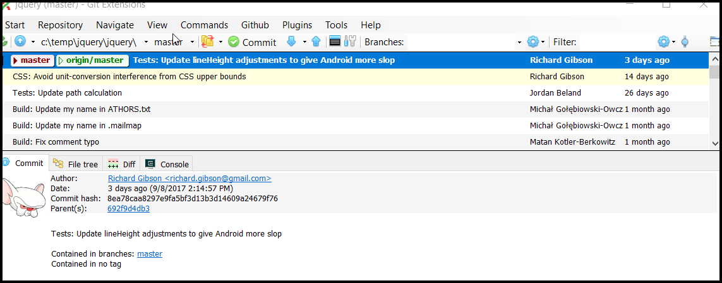
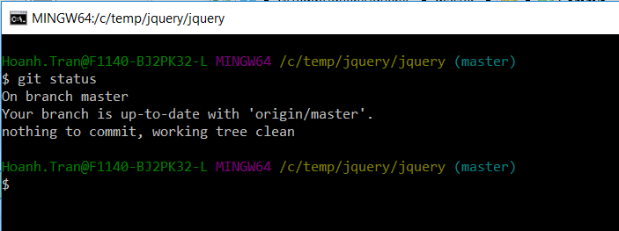

How to use Git? (cont)
GitExtension
git commands
Git bash

Slide 12
How to use Git?
Some simple commands
Create local repo
Checkin
Push to remote
Check out
Create branch
Merge
Delete branch

Slide 13
Live Demo

Slide 14
1
Create an empty remote repo on github
clone remote repo
edit a readme.txt and check in (using gitext)
Edit readme.txt and checkin (using git bash)
Show commits
push to remote
view on github.
2
Show edit readme.txt to create few commits. Show collapse of commits.
Show checkout of old commit 2 commits ago, then force commit to undo the 2 newer commits
Make bad commits, then can revert back to master using reset.

Slide 15
3
Create branch
Add a test.java with couple of commits and push to remote.
Clone the same repo and update readme.txt and push to master.
On 1st repo, do a pull and merge master to branch. Show the loop.
Undo the merge and show a rebase master to branch and show the “straight line”. Undo the rebase.
Check out master and merge branch to master.

Slide 16
4
Create commit on master and do a stash
Do some update on master and commit and push
Pop the stash.

Slide 17
Conclusion
Discussion of Git
GitExtension git client.
Centralized vs Distributed SCM

