Slide 1
Git & GitExtension
Presenter: Hoanh Tran 9/2/2017

Slide 2
Agenda
What is Git.
Why Git.
How to & Git commands.
Git bash shell & GitExtension
Live Demo

Slide 3
What is Git?
Started in 2005 by Linux Torvalds for Linux.
Distributed Software Configuration Management (SCM)
Open Sourced.
Repositories - GitHub, BitBucket, Atlassian Stash.

Slide 4
Why use Git?
Hierarchial
developers push(checkin) to a subsystem level repo.
Subsystem level pushed to a main repo
Distributed
Developer push the code to his/her own repo.
Integrator choose and pull (checkout) developers’ repos into an official repo.
Offline Support
Work in disconnected environment.

Slide 5
Why use Git? (cont)
Ease of Backup
Clone the repo and burn into a DVD.
Support Centralize SCM
Support single repository similar to CVS, SubVersion, ClearCase.

Slide 6

Centralized Software Configuration
Management (SCM)
workstation
Working copy
checkout
Remote Repo
checkin

Slide 7
Distributed Software Configuration
Management (SCM)
workstation
Working copy
git pull
Remote Repo (github, bitbucket)
git add
Local Repo
git fetch
Staging
git commit
git push

Slide 8
GIT Terminology
GIT | Centralized SCM
pull fetch | check out
push commit | check in
branch | branch
merge | merge

Slide 9
How to use Git?
Windows:
Download msysgit at https://git-for-windows.github.io/
Current version 2.14.1.
C:\Program Files\Git2.13.3\bin\bash.exe
Linux:
sudo apt-get install git-core

Slide 10
How to use Git? (cont)
Git Client provides Graphical View
Windows:
GitExtension v2.50 https://sourceforge.net/projects/gitextensions/
Tortoise GIT v2.5
https://tortoisegit.org/
Linux:
gitk
git-gui
SmartGit

Slide 11
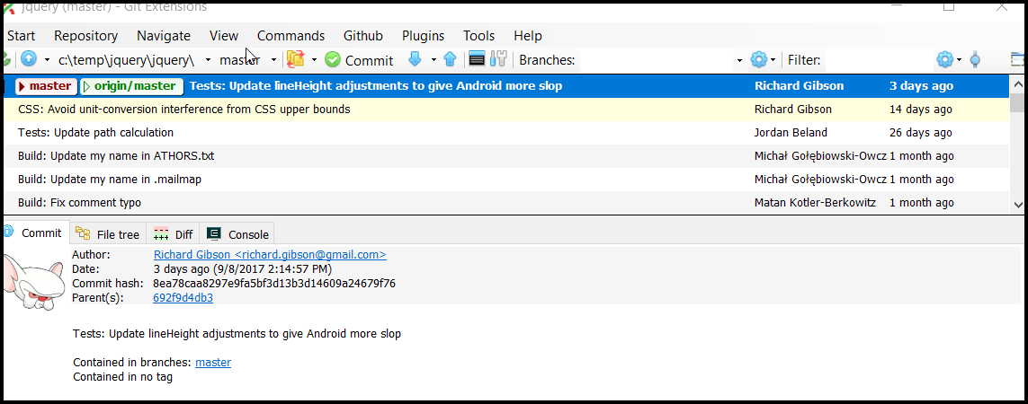
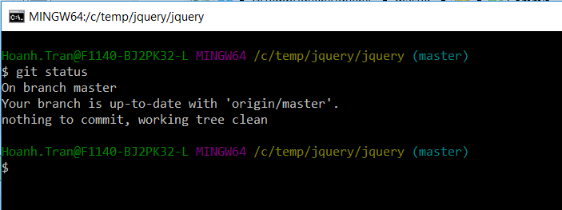

How to use Git? (cont)
GitExtension
git commands
Git bash

Slide 12
How to use Git?
Some simple commands

Slide 13
Live Demo

Slide 14
Conclusion
Live-Server:
auto browser reload
Developer does not leave IDE
Browser-Sync:
Improve multi-browser testing.
Not 100% mature
JSON Server:
Quickly mock REST APIs
Allow UI and Service to be develop in parallel

