Slide 1
Web Page Performance Improvements
Presenter: Hoanh Tran 12/10/2017

Slide 2
Agenda
Discuss a dozen techniques to improve web app performance
Consolidate JS and CSS
Enable Keep-Alives
Sprite Images
CDN
Minify JS & CSS
Text Compression
Image Compression & Formatting

Slide 3
8. Move CSS to <HEAD> section
9. Load optimized image early.
10. Defer loading non-essential JS (AMD,
SystemJS)

Slide 4
Benefits
Prevent users from leaving the page prematurely.
Improve user experience (UX)
Case Study from Google 2006:
* A page delay of 1 sec can hurt UX.
* 10 search results/page is most optimal
* 30 search results/page resulted in 20%
drop in traffic and revenue.
This is b/c an extra 1/2 second to load.

Slide 5
1. Consolidate JS and CSS
Angular.js
Jquery.js
Bundle.js
Bootstrap.js
Bootstrap.css
Myapp.css
Bundle.css
JSTree.css

Slide 6
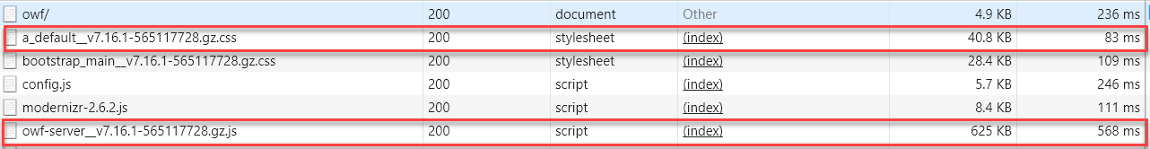
Consolidate JS and CSS (cont)
OWF Source Directory: owf\web-app\js\*
 | Pre-optimization | Optimized (concatenation, minified) | Further Optimized (gzip)
# of HTTP requests | 500 | 1 | 1
Size (MB) | 5.5MB | 2.7MB | 0.6MB

Slide 7
2. Enable Keep-Alives
Use the same TCP connection to serve several resources such as HTML, CSS, JS, images.
Very useful for slow network as TCP connection is expensive.
Keep-alive is enabled using the "Connection: Keep-Alive" HTTP header.
Apache Web Server configuration
# # KeepAlive: Whether or not to allow persistent connections (more than # one request per connection). Set to "Off" to deactivate. # KeepAlive On

Slide 8
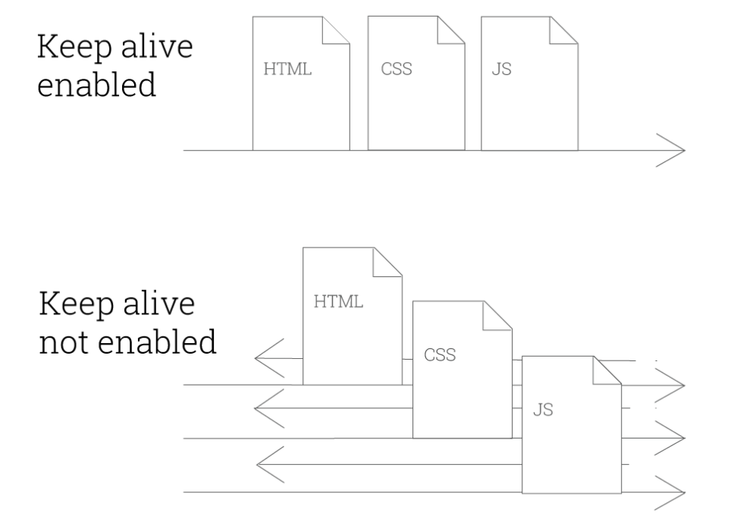
3. Enable Keep-Alives (cont)

Slide 9




3. Sprite Images
Bundle-sprites.png
mexico.png
usa.png
canada.png

Slide 10
Sprite Images (cont)
Reduce bandwidth usage from 3 HTTP requests to 1 request.
.usa { display: inline-block; background: url(‘usa.png')
.canada { display: inline-block; background: url(‘canada.png')
.mexico { display: inline-block; background: url(‘mexico.png')
<div class=‘usa’>
1 request
3 requests
With Sprites
.usa, .canada, .mexico
{ display: inline-block; background: url(‘sprites.png') no-repeat; overflow: hidden; text-indent: -9999px; text-align: left; }
.usa { background-position: -0px -0px; width: 246px; height: 130px; }
.canada { background-position: -0px -130px; width: 241px; height: 124px; }
.mexico { background-position: -0px -254px; width: 238px; height: 142px; }

Slide 11
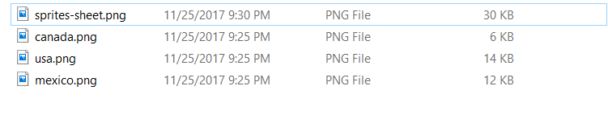
Sprite Images (cont)
Final sprite image is usually smaller resulting in faster load time.
1 request of 30KB – saving 2KB
3 requests total 32KB

Slide 12
Sprite Images (cont)
How to generate sprite sheet.
http://css.spritegen.com
https://spritepad.wearekiss.com/
NodeJS node-sprites

Slide 13
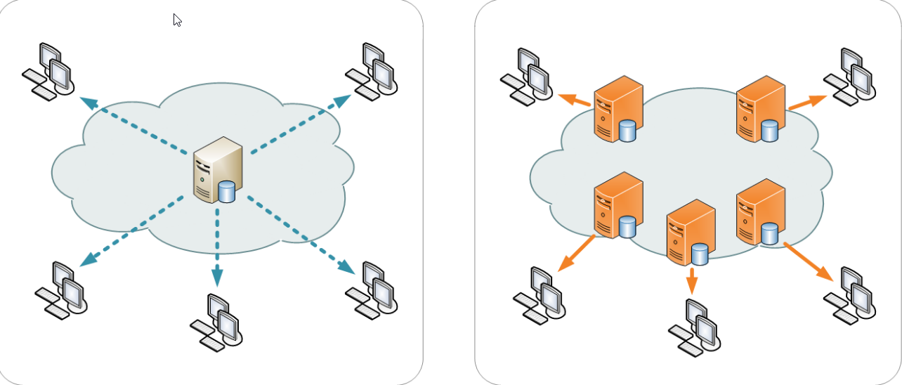
4. Content Delivery Network (CDN)
CDN address latency issue by serving static resources (eg CSS, JS, HTML, images) from servers closer to users.

Slide 14
Content Delivery Network (cont)
Allow browser to cache resources if all resources come from the same domain (eg http://acme.com/cdn)
Without CDN
Widget1: http://acme.com/widget1/image1.png
Widget2: http://acme.com/widget2/image1.png
With CDN
Widget1: http://acme.com/cdn/image1.png
Widget2: http://acme.com/cdn/image1.png (browser caches this request)

Slide 15
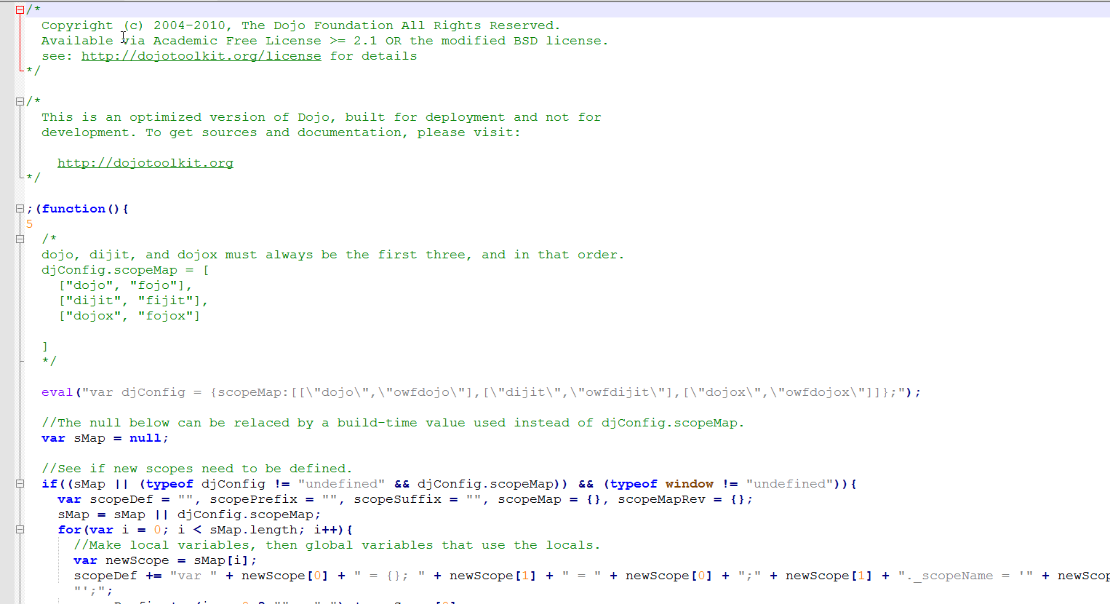
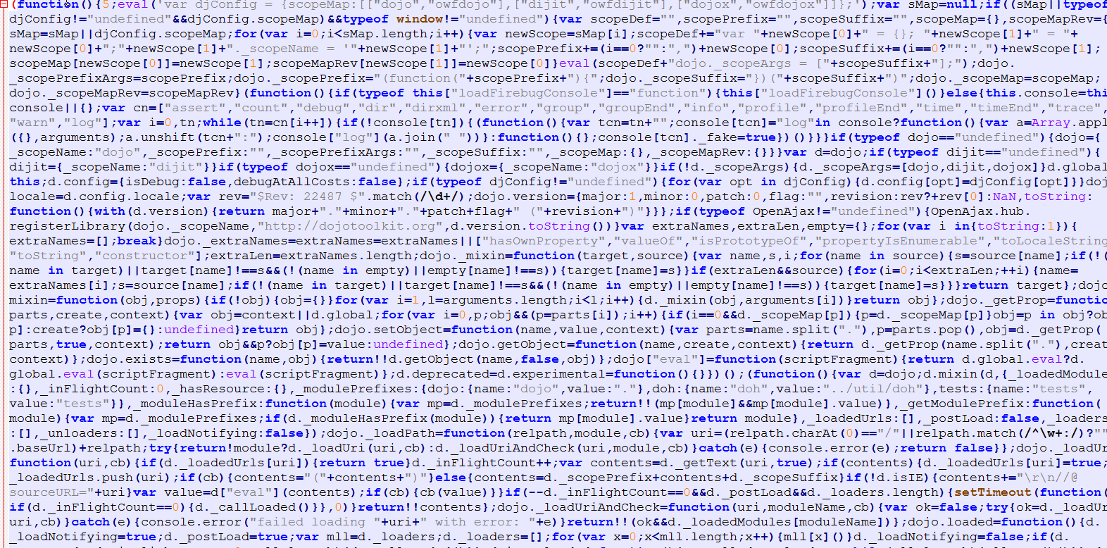
5. Minify JS & CSS
Eliminates nonessential characters (eg newline, spaces, tabs, comments)
Saving 20-40% in size reduction.
owf-server.js (5.3MB)
owf-server.min.js (2.6MB) – 50% reduction

Slide 16
6. Compression Text
Compression of text-bases HTTP response (e.g. JS, CSS, JSON, HTML)
Reduce response as much as 70% as the cost of compression at server and decompression as browser.
gzip (Lempel-Ziv coding), deflate (zlib), br (Brotli algorithm), compress (Lempel-Ziv-Welch)
HTTP Request:
Accept-Encoding: gzip, deflate
Browser
Web Server
HTTP Response:
Content-Encoding: deflate, gzip

Slide 17
7. Image Compression & Format
Choose format that minimize size w/out degrading quality.
Poorly chosen high-res image results in wasted bandwidth, processing time and cache space.
Photos – JPEG, PNG (larger size)
Low complexity – GIF (smaller size – use
in thumbnail pic)
Line Art - SVG

Slide 18
8. Move CSS to <HEAD> section
Enable progressive rendering.
Prevent browser from rendering HTML component twice.
Prevent page “flickering” when CSS is at the bottom.
Prevent viewing of “poor layout” on slow network and page with lots of content.

Slide 19
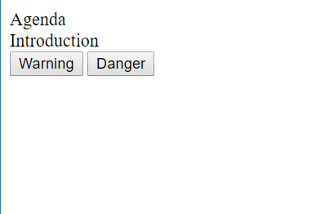

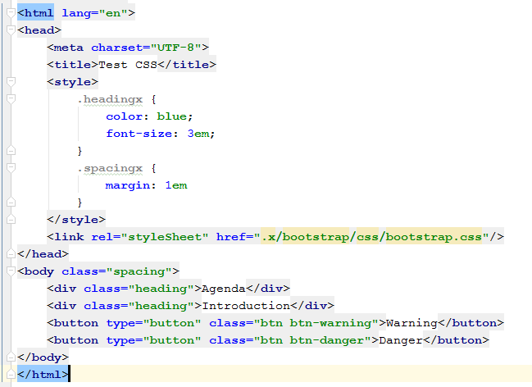
Move CSS to <HEAD> section (cont)
CSS at bottom
CSS at top

Slide 20
9. Load optimized image early.
For image-intensive page, ensure main images are optimized (eg gif or jpeg) and load quickly.
1-sec load time translates to users spend 20% more on the page.
8-sec load time means users will leave the blank page.
Remedy: using loading spinner for progress.

Slide 21
10. Defer loading non-essential JS (Async Module Definition (AMD), CommonJS, RequireJS, SystemJS)
Load only needed JS up front.
eg. Don’t need to load Drag & Drop JS
until user intiate DnD operation.
Reduce number <script> tags to prevent up-front loading of scripts.
Used by Dojo, ExtJS, Angular2, etc.

Slide 22
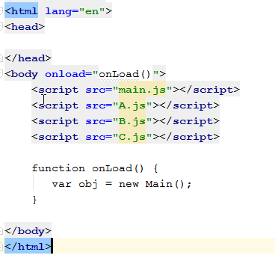
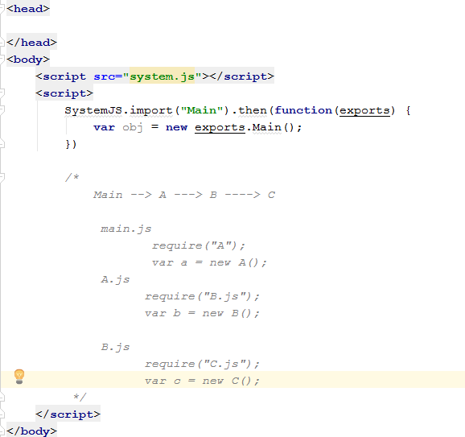
Defer loading non-essential JS (cont)
Loading JS up front
Dynamic Module Loading

Slide 23
Conclusion
Discuss 10 items that, as an aggregate, will improve page load time

