Slide 1
Productivity with NodeJS Modules
Presenter: Hoanh Tran 4/28/2017

Slide 2
Agenda
Live Server Node Module
Browser Synch Node Module
JSON Server Node Module

Slide 3
Live-Server

Slide 4
Live-Server
Motivation:
Automatic reload web page when CSS, JS or HTML changes.
View changes without leaving your IDE.
Saving 1 to 2 mouse clicks. 100 reloads translate to 6 min each day.
Saving 22 days if you write SW for 40 years.

Slide 5
Live-Server (cont)
Prerequisite & Installation:
NodeJS (https://nodejs.org)
Install live-server
npm install --save-dev live-server (preferred)
npm install -g live-server (global installed)
Set PATH to node_modules/.bin folder
live-server -v

Slide 6
Live Demo

Slide 7
Live-Server (cont)
Execution:
Open Command Prompt
cd to directory of webapp
live-server --entry-file=./app/Game.html --port=9124
All <script> and CSS <link> is relative to location of Game.html
<link href="/css/app.css" rel="stylesheet">
<script src="/app.js"></script>

Slide 8
Live-Server (cont)
.live-server.json:
Configuration via file instead of command line.
{
"port": 8181,
"open": true,
"file": "Game.html",
"logLevel": 2
}
Run “live-server” w/out any arguments.

Slide 9
Live-Server (cont)
Execution Options:
--entry-file: launch non-index.html
--port: use different port from 8080. Useful when running >1 live-server instances.

Slide 10
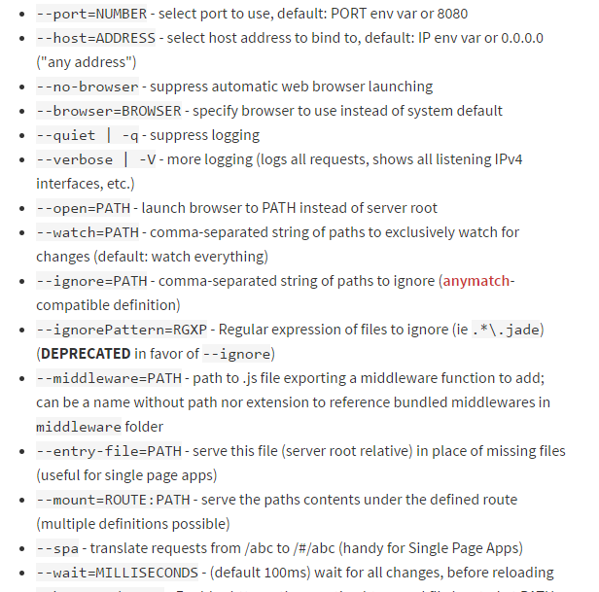
Live-Server (cont)

Slide 11
The Take Away
Use live-server
to save browser refresh button clicks
Never leave your text editor or IDE.
Improve productivity by saving few minutes per day.

Slide 12
Browser Sync

Slide 13
Browser Sync
Motivation:
Similar to Live-Server
Added ability to synchronize user interaction between browsers
Useful for multi-browser, multi-form factor, mobile testing.

Slide 14
Browser Sync (cont)
Prerequisite & Installation:
NodeJS (https://nodejs.org)
Install browser sync
npm install --save-dev browser-sync (preferred)
npm install -g browser-sync (global installed)
Set PATH to node_modules/.bin folder
browser-sync --version

Slide 15
Brower Sync (cont)
Supports
Left click
Scrolling
Form entry
Not Support
Right click for context menu
Complex UI (eg grid, tree)
Not fully mature yet!

Slide 16
Live Demo

Slide 17
Brower Sync (cont)
Execution:
Open Command Prompt
cd to directory of the webapp.
browser-sync start --server --files "**/*"
--index ./app/Game.html
--browser chrome
--browser firefox
--browser iexplore
All <script> and CSS <link> is relative to location of Game.html
<link href="/css/app.css" rel="stylesheet">
<script src="/app.js"></script>

Slide 18
Brower Sync (cont)
Execution Options:
--index: launch non-index.html
--port: use different port from 3000. Useful when running >1 browser sync instances.

Slide 19
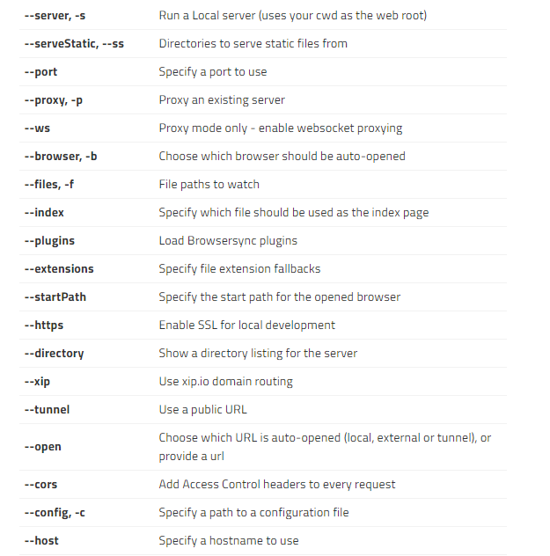
Brower Sync (cont)

Slide 20
JSON Server

Slide 21
JSON Server
Motivation:
Rapidly mock up REST end points.
Full support for CRUD operations.
Allows UI development prior to backend development.
Adheres to Richardson Maturity Model (RMM) Level 2

Slide 22
JSON Server (cont)
Prerequisite & Installation:
NodeJS (https://nodejs.org)
Install Json server
npm install --save-dev json-server (preferred)
npm install -g json-server (global installed)
Set PATH to node_modules/.bin folder
Json --version

Slide 23
JSON Server (cont)
JSON data file:
{
resource1 : [ { item1…}, { item2…},… ],
resource2 : [ { item1…}, { item2…} ,… ]
…
}
* Each item is JSON and must has a unique “id”
property.
{ id: 123, name: “xyz”, phone: “123-456” }

Slide 24
JSON Server (cont)
C – POST
http://host:port/resources
BODY: json to add
R – GET
http://host:port/resources
http://host:port/resources/id
U – PUT
http://host:port/resources/id
BODY: json to update
D – DELETE
http://host:port/resources/id

Slide 25
Live Demo

Slide 26
Conclusion
Live-Server:
auto browser reload
Developer does not leave IDE
Browser-Sync:
Improve multi-browser testing.
Not 100% mature
JSON Server:
Quickly mock REST APIs
Allow UI and Service to be develop in parallel

