Slide 1
Git & GitExtension Brownbag
Presenter: Hoanh Tran 10/2/2017

Slide 2
Agenda
What is Git.
Why Git.
How to & Git commands.
Git bash shell & GitExtension
Live Demo

Slide 3
What is Git?
Started in 2005 by Linux Torvalds for Linux.
Distributed Software Configuration Management (SCM)
Open Sourced.
Repositories - GitHub, BitBucket, Atlassian Stash.

Slide 4
Why use Git?
Hierarchial
developers push(checkin) to a subsystem level repo.
Subsystem level pushed to a main repo
Distributed
Developer push the code to his/her own repo.
Integrator choose and pull (checkout) developers’ repos into an official repo.
Offline Support
Work in disconnected environment.

Slide 5
Why use Git? (cont)
Ease of Backup
Clone the repo and burn into a DVD.
Support Centralize SCM
Support single repository similar to CVS, SubVersion, ClearCase.

Slide 6

Centralized Software Configuration
Management (SCM)
workstation
Working copy
checkout
Remote Repo
checkin

Slide 7
Distributed Software Configuration
Management (SCM)
workstation
Working copy
git pull
Remote Repo (github, bitbucket)
git add
Local Repo
git fetch
Staging
git commit
git push

Slide 8
GIT Terminology
GIT | Centralized SCM
pull fetch | check out
push commit | check in
branch | branch
merge | merge
stash | NA
rebase | NA
cherry pick | NA

Slide 9
How to use Git?
Windows:
Download msysgit at https://git-for-windows.github.io/
Current version 2.14.1.
C:\Program Files\Git2.13.3\bin\bash.exe
Linux:
sudo apt-get install git-core

Slide 10
How to use Git? (cont)
Git Client provides Graphical View
Windows:
GitExtension v2.50 https://sourceforge.net/projects/gitextensions/
Tortoise GIT v2.5
https://tortoisegit.org/
Linux:
gitk
git-gui
SmartGit

Slide 11
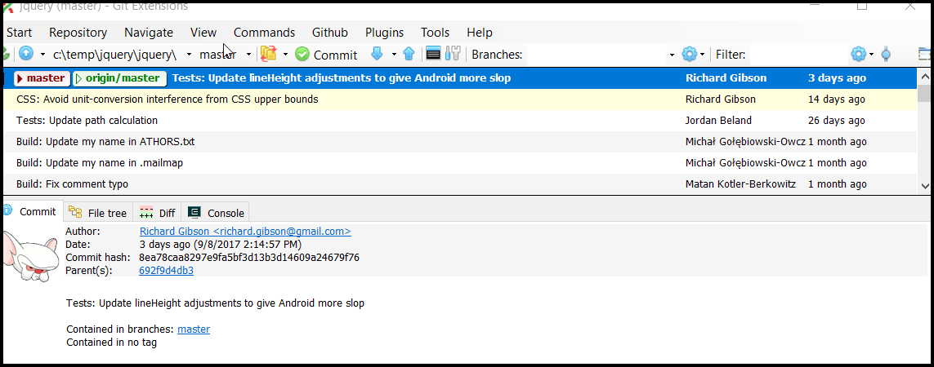
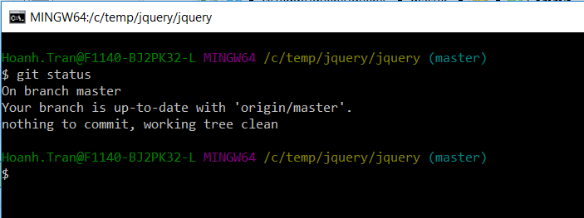

How to use Git? (cont)
GitExtension
git commands (https://git-scm.com/docs)
Git bash

Slide 12
Live Demo
Scenario 1: Creating a new project workflow:
Scenario 2: Using Git to work offline for existing
subversion project
Scenario 3: Remote branch for reset.
Scenario 4: Stash push/pop
Scenario 5: Clone Jquery repo

Slide 13
Conclusion
Discussion of Git
GitExtension git client.
Centralized vs Distributed SCM

