Slide 1
Web Page Performance Improvements
Presenter: Hoanh Tran 11/10/2017

Slide 2
Agenda
Discuss a dozen techniques to improve web app performance
Consolidate JS and CSS
Enable Keep-Alives
Sprite Images
CDN
Minify JS & CSS
Text Compression
Image Compression & Formatting

Slide 3
8. Move CSS to <HEAD> section
9. Load optimized image early.
10. Defer loading non-essential JS (AMD, SystemJS)
11. Use Ajax for Progressive Loading
12. Enable Cache Timeout.
13. Use Progress Indicator
14. Benchmark & load testing

Slide 4
1. Consolidate JS and CSS
Angular.js
Jquery.js
Bundle.js
Bootstrap.js
Bootstrap.css
Myapp.css
Bundle.css
JSTree.css

Slide 5
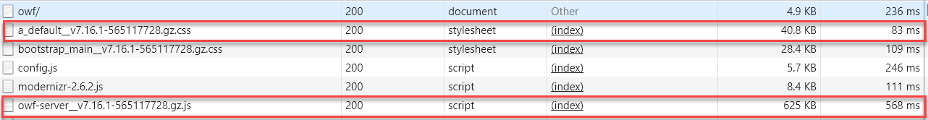
Consolidate JS and CSS (cont)
OWF Source Directory: owf\web-app\js\*
 | Pre-optimization | Optimized (concatenation, minified) | Further Optimized (gzip)
# of HTTP requests | 500 | 1 | 1
Size (MB) | 5.5MB | 2.7MB | 0.6MB

Slide 6
2. Enable Keep-Alives
Use the same TCP connection to serve several resources such as HTML, CSS, JS, images.
Very useful for slow network as TCP connection is expensive.
Keep-alive is enabled using the "Connection: Keep-Alive" HTTP header.
Apache Web Server configuration
# # KeepAlive: Whether or not to allow persistent connections (more than # one request per connection). Set to "Off" to deactivate. # KeepAlive On

Slide 7
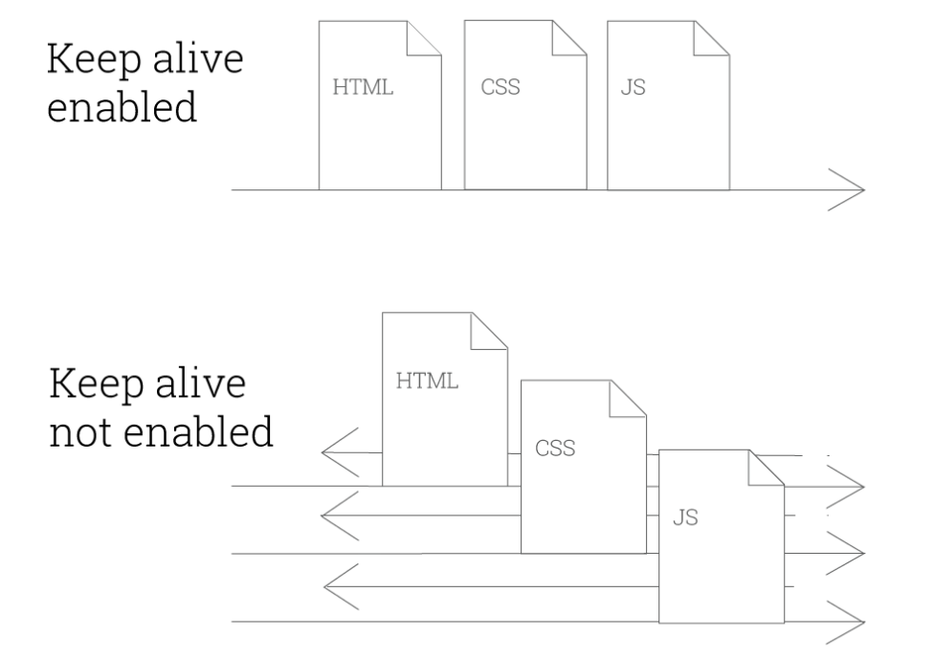
3. Enable Keep-Alives (cont)

Slide 8




3. Sprite Images
Bundle-sprites.png
mexico.png
usa.png
canada.png

Slide 9
Sprite Images (cont)
Reduce bandwidth usage from 3 HTTP requests to 1 request.
.usa { display: inline-block; background: url(‘usa.png')
.canada { display: inline-block; background: url(‘canada.png')
.mexico { display: inline-block; background: url(‘mexico.png')
<div class=‘usa’>
1 request
3 requests
With Sprites
.usa, .canada, .mexico
{ display: inline-block; background: url(‘sprites.png') no-repeat; overflow: hidden; text-indent: -9999px; text-align: left; }
.usa { background-position: -0px -0px; width: 246px; height: 130px; }
.canada { background-position: -0px -130px; width: 241px; height: 124px; }
.mexico { background-position: -0px -254px; width: 238px; height: 142px; }

Slide 10
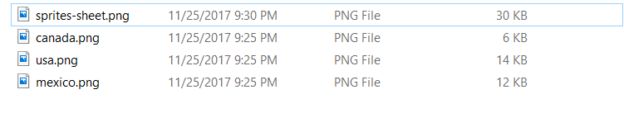
Sprite Images (cont)
Final sprite image is usually smaller resulting in faster load time.
1 request of 30KB – saving 2KB
3 requests total 32KB

Slide 11
Sprite Images (cont)
How to generate sprite sheet.
http://css.spritegen.com
https://spritepad.wearekiss.com/
NodeJS node-sprites

Slide 12
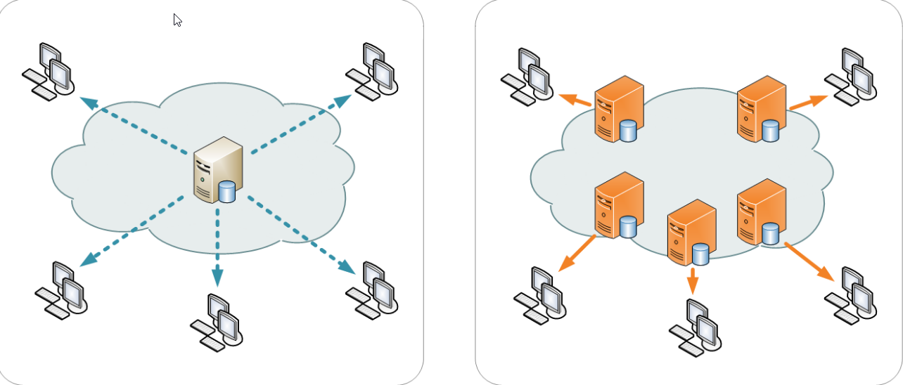
4. Content Delivery Network (CDN)
CDN address latency issue by serving static resources (eg CSS, JS, HTML, images) from servers closer to users.

Slide 13
Content Delivery Network (cont)
Allow browser to cache resources if all resources come from the same domain (eg http://acme.com/cdn)
Without CDN
Widget1: http://acme.com/widget1/image1.png
Widget2: http://acme.com/widget2/image1.png
With CDN
Widget1: http://acme.com/cdn/image1.png
Widget2: http://acme.com/cdn/image1.png (browser caches this request)

Slide 14
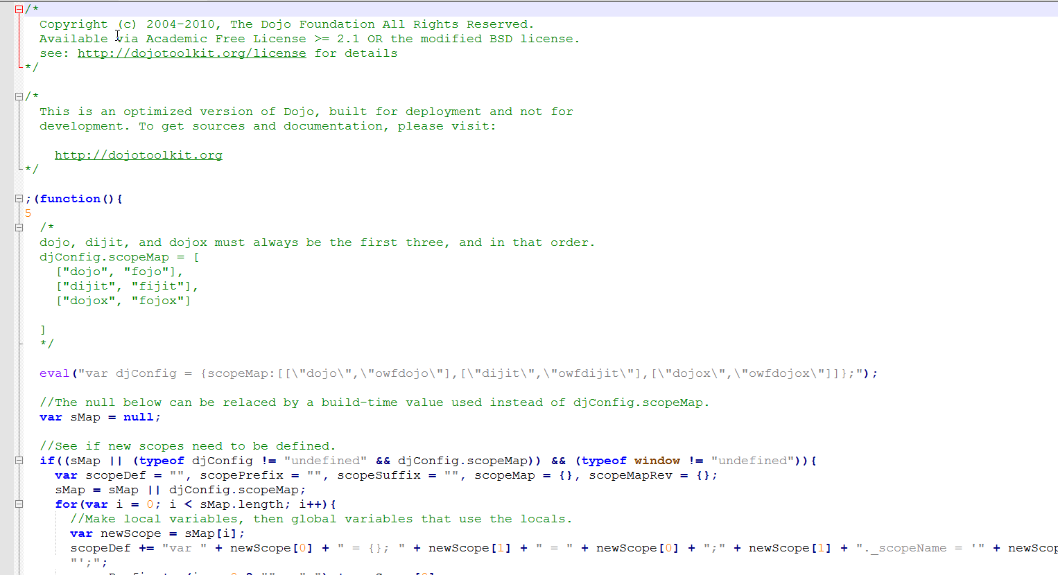
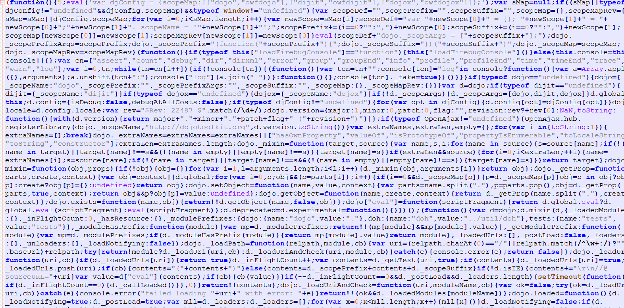
5. Minify JS & CSS
Eliminates nonessential characters (eg newline, spaces, tabs, comments)
Saving 20-40% in size reduction.
owf-server.js (5.3MB)
owf-server.min.js (2.6MB) – 50% reduction

Slide 15
6. Compression Text
Compression of text-bases HTTP response (e.g. JS, CSS, JSON, HTML)
Reduce response as much as 70% as the cost of compression at server and decompression as browser.
gzip (Lempel-Ziv coding), deflate (zlib), br (Brotli algorithm), compress (Lempel-Ziv-Welch)
HTTP Request:
Accept-Encoding: gzip, deflate
Browser
Web Server
HTTP Response:
Content-Encoding: deflate, gzip

Slide 16
7. Image Compression & Format
Choose format that minimize size w/out degrading quality.
Poorly chosen high-res image results in wasted bandwidth, processing time and cache space.
Photos – JPEG, PNG (larger size)
Low complexity – GIF (smaller size – use
in thumbnail pic)
Line Art - SVG

Slide 17
8. Move CSS to <HEAD> section
Enable progressive rendering.
Prevent browser from rendering HTML component twice.
Prevent page “flickering” when CSS is at the bottom.
Prevent viewing of “poor layout” on slow network and page with lots of content.

Slide 18
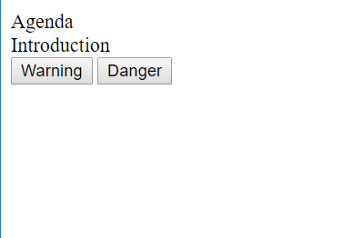

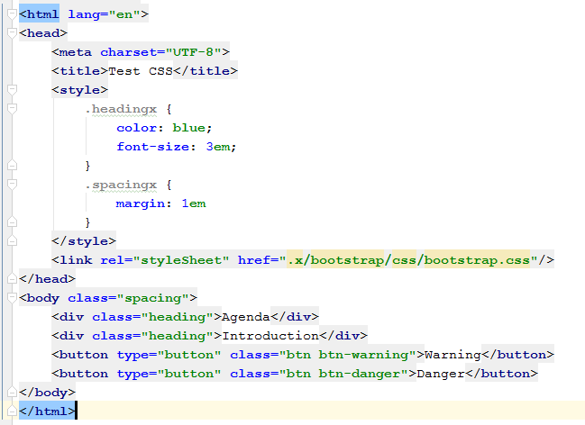
Move CSS to <HEAD> section (cont)
CSS at bottom
CSS at top

Slide 19
9. Load optimized image early.
For image-intensive page, ensure main images are optimized (eg gif or jpeg) and load quickly.
1-sec load time translates to users spend 20% more on the page.
8-sec load time means users will leave the blank page.
Remedy: using loading spinner for progress.

Slide 20
10. Defer loading non-essential JS (AMD, SystemJS)

Slide 21
Conclusion
Live-Server:
auto browser reload
Developer does not leave IDE
Browser-Sync:
Improve multi-browser testing.
Not 100% mature
JSON Server:
Quickly mock REST APIs
Allow UI and Service to be develop in parallel

