Slide 1
More With LESS
Presenter: Hoanh Tran 12/5/2015

Slide 2
Agenda
CSS Pain.
Why LESS?
Grunt & LESS compiler

Slide 3
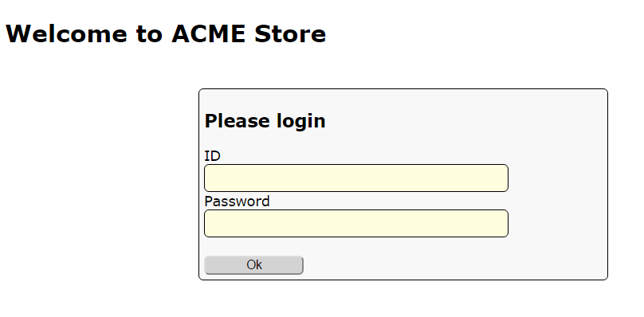
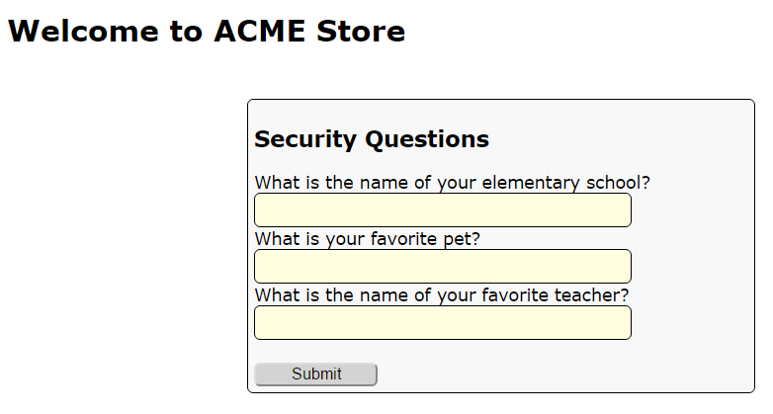
Demo App

Slide 4
CSS Pain
Style duplication – violation of DRY principle.
Magic number & lack of color names.
No support for mathematic calculation.
Cascading issues

Slide 5
Style duplication
#my-ok-button {
background: #FEFEFE;
font-size: 18px;
width: 20px;
}
#my-cancel-button {
background: #FEFEFE;
font-size: 18px;
width: 30px;
border-radius: 5px;
-moz-border-radius: 5px;
-webkit-border-radius: 5px;
}

Slide 6
Magic number & color name?
#my-ok-button {
background: #FEFEFE; /* important color */
font-size: 18px; /* important font */
}
#my-cancel-button {
background: #EEEEEE; /* unimportant color */
font-size: 15px; /* unimportant font */
}

Slide 7
No Support for Calculation
#my-ok-button {
background: #FEFEFE;
font-size: 18px;
width: 20px;
}
#my-cancel-button {
background: #FEFEFE;
font-size: 12px; /* must be 2/3 that of ok-
button */
width: 30px; /* must be 1.5 that of ok-
button */
}

Slide 8
Cascading Issues
<form id=“my-form”>
<div>
<label>Name</label>
<input type=text></input>
</div>
<div>
<label>Age</label>
<input type=text></input>
</div>
</form>
#my-form {
width: 200px;
background: #00FFFF;
margin: 5px;
}
#my-form input {
border-radius 5px;
}
#my-form div {
border: 1px;
}
#my-form label {
padding: 10px;
}

Slide 9
Code Demo

Slide 10
LESS to the rescue.
.less
.less
.css
.less
LESS Compiler

Slide 11
LESS Variables
@error-color: #FF0000;
@warn-color: #FFFF00;
LESS Comments
/* */
//
Code Demo

Slide 12
LESS Function
@

Slide 13
LESS Operations
@

Slide 14
LESS Built-in Functions
@

Slide 15
LESS Mix-in
@

Slide 16
LESS Built-in Functions
“Function”
Alias for more than 1 rules.

Slide 17
xx?
xx

