Slide 1
More With LESS
Presenter: Hoanh Tran 12/5/2015

Slide 2
Agenda
CSS Pain.
Why LESS?
Grunt & LESS compiler

Slide 3
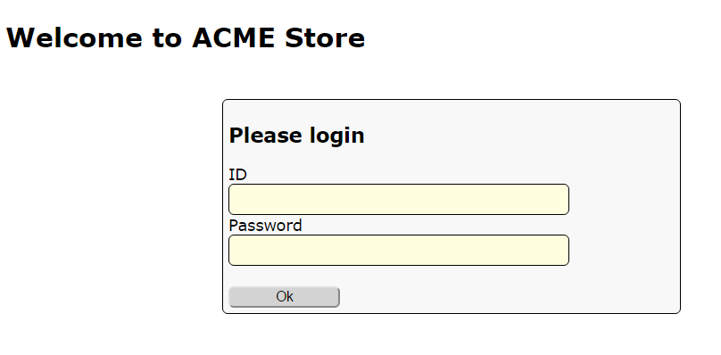
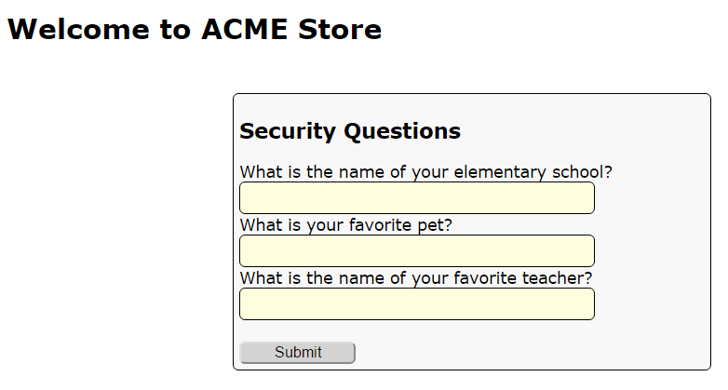
Demo App

Slide 4
CSS Pain
Style duplication – violation of DRY principle.
Magic number & lack of color names.
No support for mathematic calculation.
Cascading issues

Slide 5
Style duplication
#my-ok-button {
background: #FEFEFE;
font-size: 18px;
width: 20px;
}
#my-cancel-button {
background: #FEFEFE;
font-size: 18px;
width: 30px;
border-radius: 5px;
-moz-border-radius: 5px;
-webkit-border-radius: 5px;
}

Slide 6
Magic number & color name?
#my-ok-button {
background: #FEFEFE; /* important color */
font-size: 18px; /* important font */
}
#my-cancel-button {
background: #EEEEEE; /* unimportant color */
font-size: 15px; /* unimportant font */
}

Slide 7
No Support for Calculation
#my-ok-button {
background: #FEFEFE;
font-size: 18px;
width: 20px;
}
#my-cancel-button {
background: #FEFEFE;
font-size: 12px; /* must be 2/3 that of ok-
button */
width: 30px; /* must be 1.5 that of ok-
button */
}

Slide 8
Cascading Issues
<form id=“my-form”>
<div>
<label>Name</label>
<input type=text></input>
</div>
<div>
<label>Age</label>
<input type=text></input>
</div>
</form>
#my-form {
width: 200px;
background: #00FFFF;
margin: 5px;
}
#my-form input {
border-radius 5px;
}
#my-form div {
border: 1px;
}
#my-form label {
padding: 10px;
}

Slide 9
Code Demo

Slide 10
LESS to the rescue.
.less
.less
.css
.less
LESS Compiler

Slide 11
LESS Basics
Variables
@error-color: #FF0000;
@my-fonts: Times Roman, sans serif;
Comments
/* */
//
@import “other.less”
merge other .less files into single files for quicker download

Slide 12
LESS Basics (cont)
Operation
font-size: 5px + 4;
color: #00FFFF / 4;
Built-in Functions
color: lighten( #0F0F0F, 10%);
color: darken( @error-color, 10%);
color: saturate( @error-color, 10%);
color: fadein( @error-color, 10%);
color: fadeout( @error-color, 10%);
// Math
@pi: round(3.1456)

Slide 13
LESS Basics (cont)
Built-in Functions
@top: ceil(3.1456)
@bottom: floor(3.1456)
@my-width: percentage(0.15); // 15%

Slide 14
Code Demo

Slide 15
LESS Function
@

Slide 16
LESS Operations
@

Slide 17
LESS Built-in Functions
@

Slide 18
LESS Mix-in
@

Slide 19
LESS Built-in Functions
“Function”
Alias for more than 1 rules.

Slide 20
xx?
xx

