Slide 1
More With LESS
Presenter: Hoanh Tran 12/5/2015

Slide 2
Agenda
CSS Pain.
Why LESS?
Grunt & LESS compiler

Slide 3
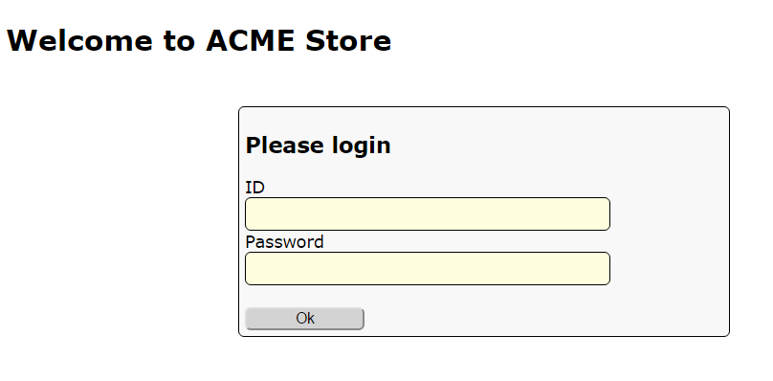
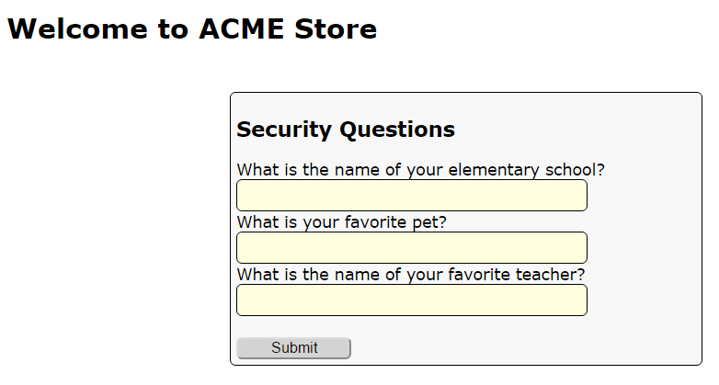
Demo App

Slide 4
CSS Pain
Style duplication – violation of DRY principle.
Magic number & lack of color names.
No support for mathematic calculation.
Cascading issues

Slide 5
Style duplication
#my-ok-button {
background: #FEFEFE;
font-size: 18px;
width: 20px;
}
#my-cancel-button {
background: #FEFEFE;
font-size: 18px;
width: 30px;
}

Slide 6
Magic number & color name?
#my-ok-button {
background: #FEFEFE; /* important color */
font-size: 18px; /* important font */
}
#my-cancel-button {
background: #EEEEEE; /* unimportant color */
font-size: 15px; /* unimportant font */
}

Slide 7
No Support for Calculation
#my-ok-button {
background: #FEFEFE;
font-size: 18px;
width: 20px;
}
#my-cancel-button {
background: #FEFEFE;
font-size: 12px; /* must be 2/3 that of ok-
button */
width: 30px; /* must be 1.5 that of ok-
button */
}

Slide 8
Cascading Issues
<form id=“my-form”>
<div>
<label>Name</label>
<input type=text></input>
</div>
<div>
<label>Age</label>
<input type=text></input>
</div>
</form>
#my-form {
width: 200px;
background: #00FFFF;
margin: 5px;
}
#my-form input {
border-radius 5px;
}
#my-form div {
border: 1px;
}
#my-form label {
padding: 10px;
}

Slide 9
xx?
xx

