Slide 1
Set & Logic Yue

Slide 2

Outline
Set
Definitions
Ordered pair
Logic
Boolean algebra
CNF DNF
Truth Tree
Maybe next time:
inference rule; induction(prove); functional language; logic and type; Russel paradox
Anything marked with
is an exact topic

Slide 3
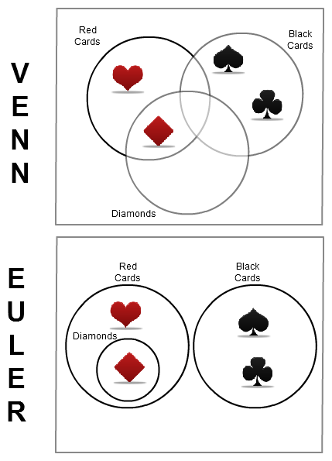
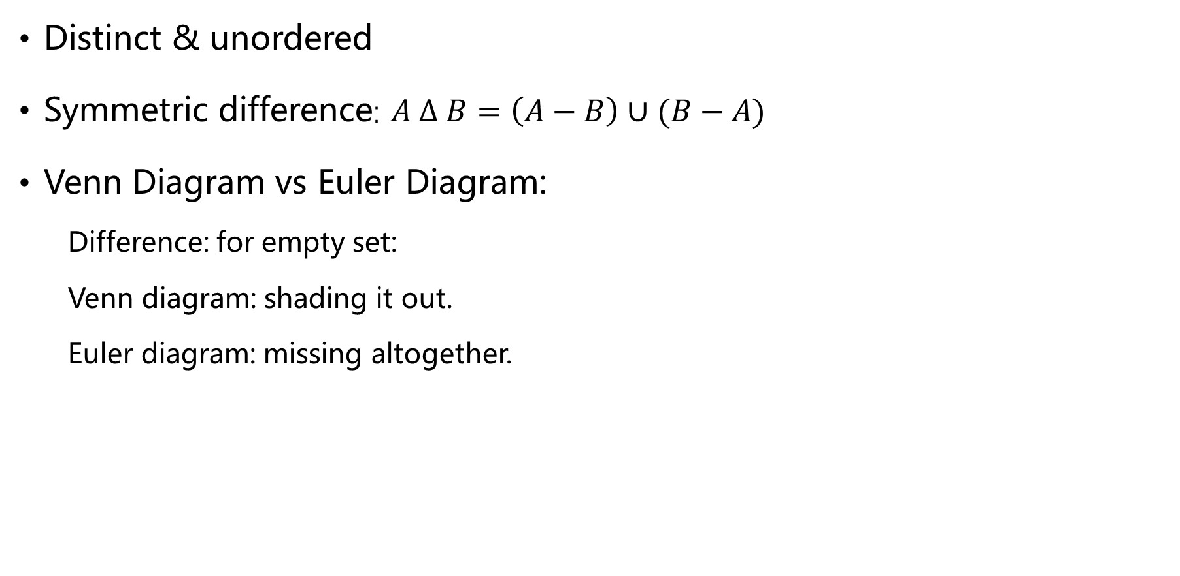
Set
Distinct & unordered
Symmetric difference: $A ∆ B=\left(A−B\right)∪(B−A)$
Venn Diagram vs Euler Diagram:
Difference: for empty set:
Venn diagram: shading it out.
Euler diagram: missing altogether.
Notes:
证明考虑变量是否和已知量一样

Slide 4
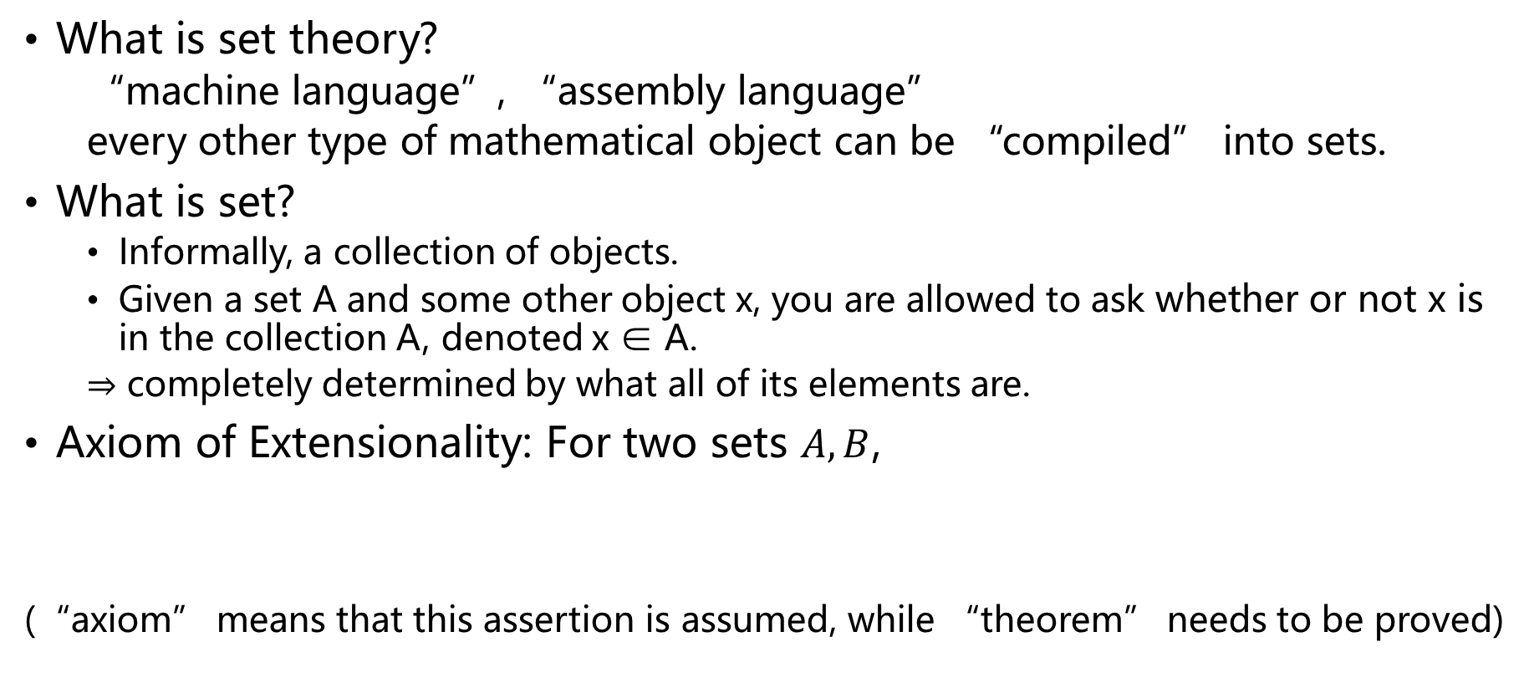
Set Theory
What is set theory?
“machine language”, “assembly language”
every other type of mathematical object can be “compiled” into sets.
What is set?
Informally, a collection of objects.
Given a set A and some other object x, you are allowed to ask whether or not x is in the collection A, denoted x ∈ A.
⇒ completely determined by what all of its elements are.
Axiom of Extensionality: For two sets $A, B$,
(“axiom” means that this assertion is assumed, while “theorem” needs to be proved)

Slide 5
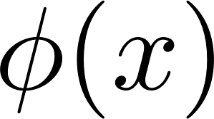
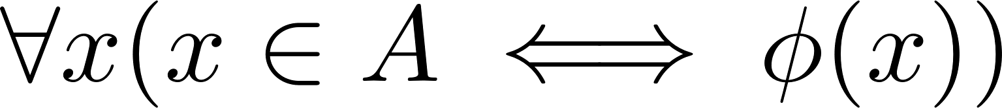


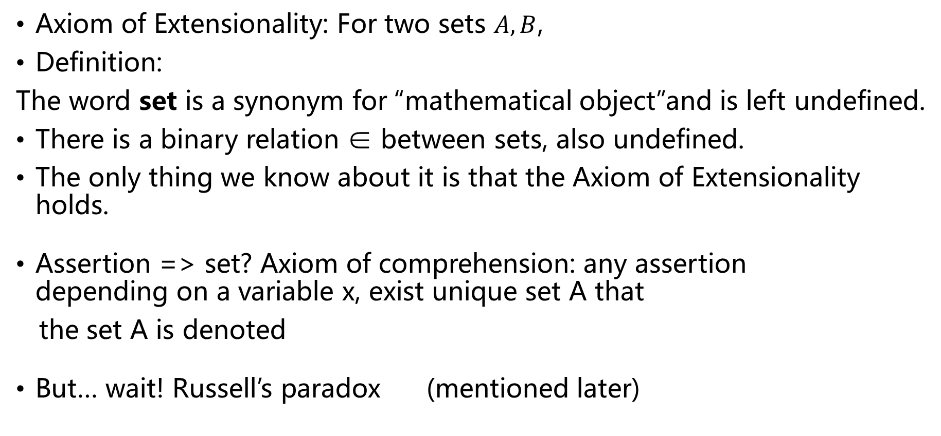
Naïve Set Theory
Axiom of Extensionality: For two sets $A, B$,
Definition:
The word set is a synonym for “mathematical object”and is left undefined.
There is a binary relation ∈ between sets, also undefined.
The only thing we know about it is that the Axiom of Extensionality holds.
Assertion => set? Axiom of comprehension: any assertion depending on a variable x, exist unique set A that
the set A is denoted
But… wait! Russell’s paradox (mentioned later)

Slide 6
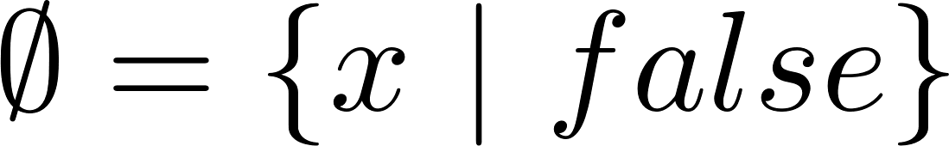

Subset, powerset, union, intersection
For two sets A, B,
For a set X, its powerset:
Union:
Intersection:
Empty set:
is undefined –why? Same definition would yield the entire universe (Vacuous true)

Slide 7
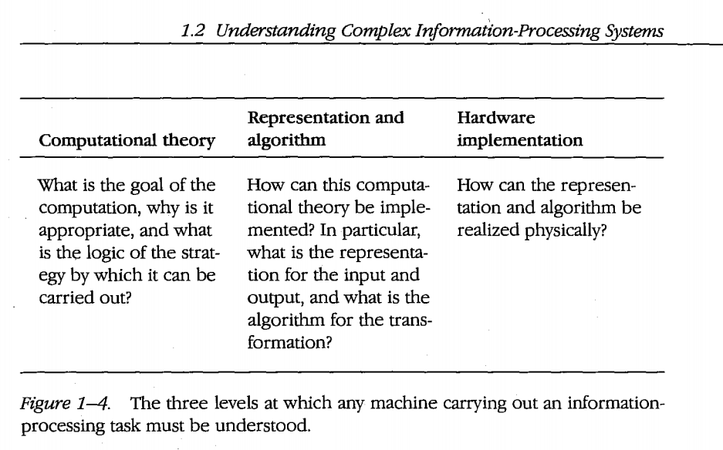
Ordered pair & Cartesian Product
The process of “compiling” other types of commonly used mathematical objects into sets goes as follows:
Object → axioms (capture everything we need to know when using this type of object in mathematical practice) → “encode” into sets, → prove the desired axioms from the set theory axioms.
might be many reasonable “encodings”.
Marr’s levels of explanation →
“encode” here
For ordered pairs, we need to know two things about them in practice:
For any mathematical objects x, y, there is another object called the pair (x, y).
The only feature of an ordered :
MATH 2030J (4 unread) | Piazza QA

Slide 8
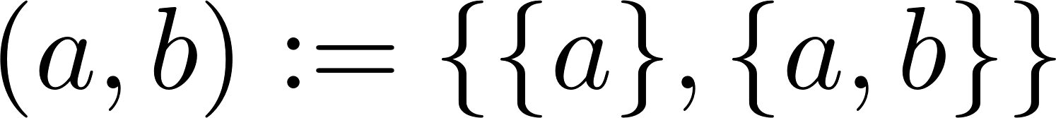
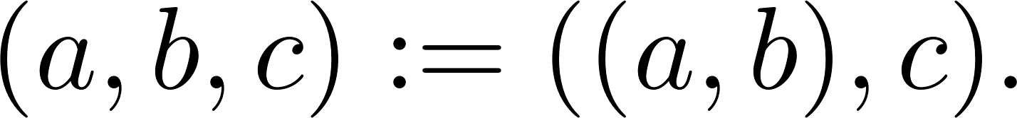
Ordered pair & Cartesian Product
Kuratowski’s definition:
Property:
Valid encode:
Ordered triple
n-tuple
Cartesian Product
For two classes X, Y , their Cartesian product is

Slide 9
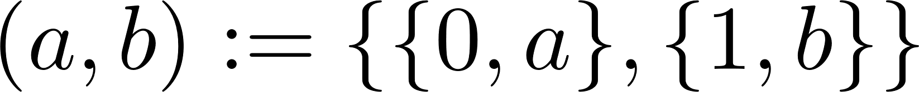
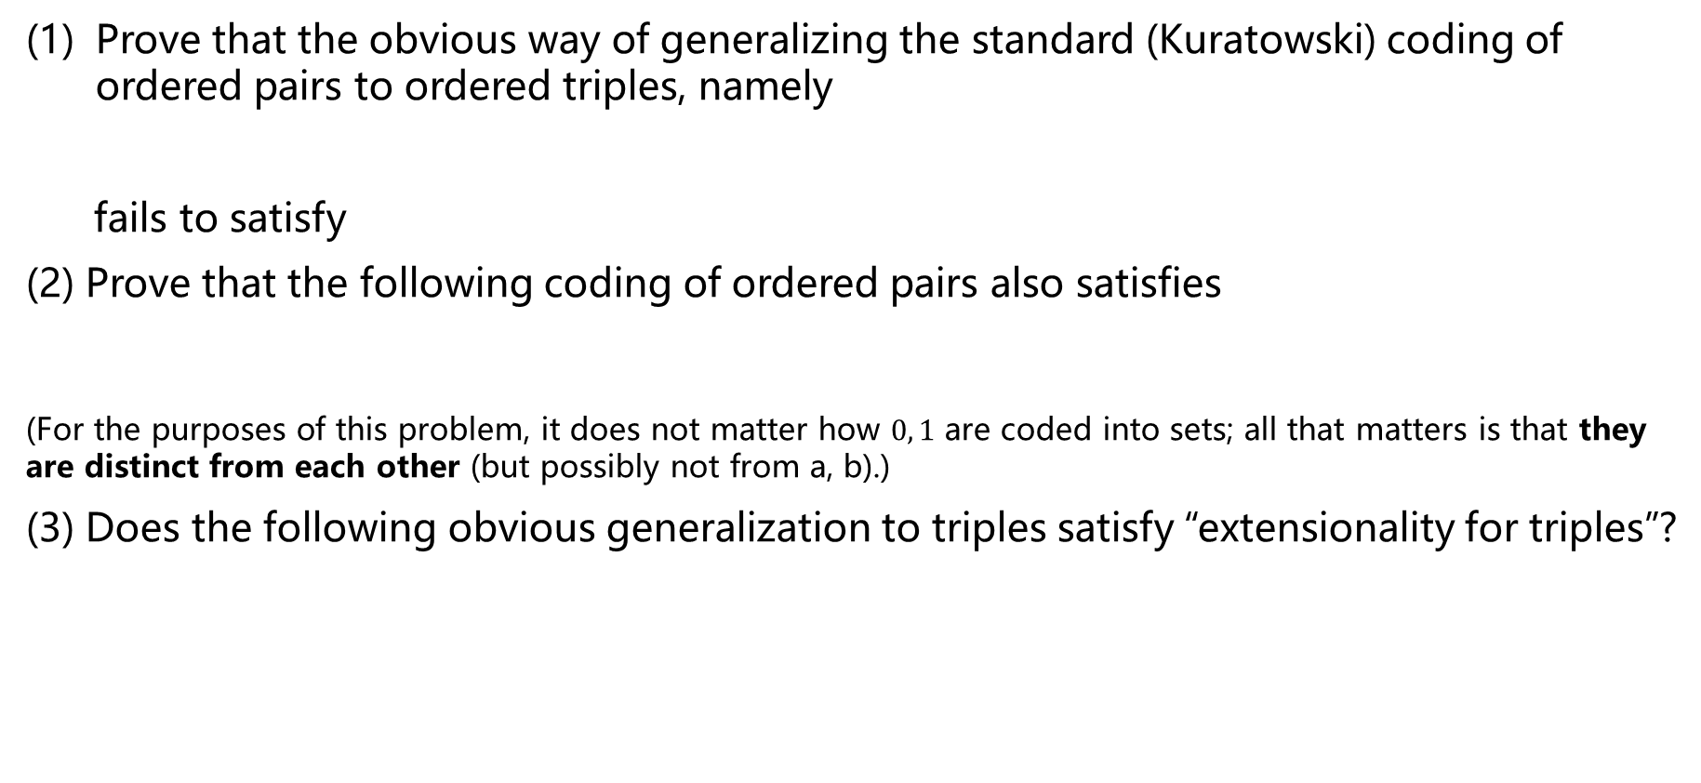
Exercise
Prove that the obvious way of generalizing the standard (Kuratowski) coding of ordered pairs to ordered triples, namely
fails to satisfy
(2) Prove that the following coding of ordered pairs also satisfies
(For the purposes of this problem, it does not matter how $0, 1$ are coded into sets; all that matters is that they are distinct from each other (but possibly not from a, b).)
(3) Does the following obvious generalization to triples satisfy “extensionality for triples”?

Slide 10
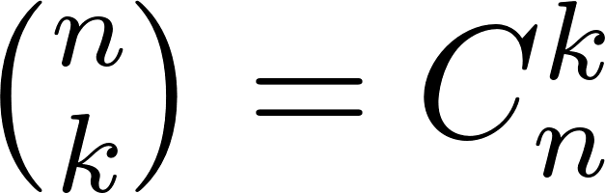
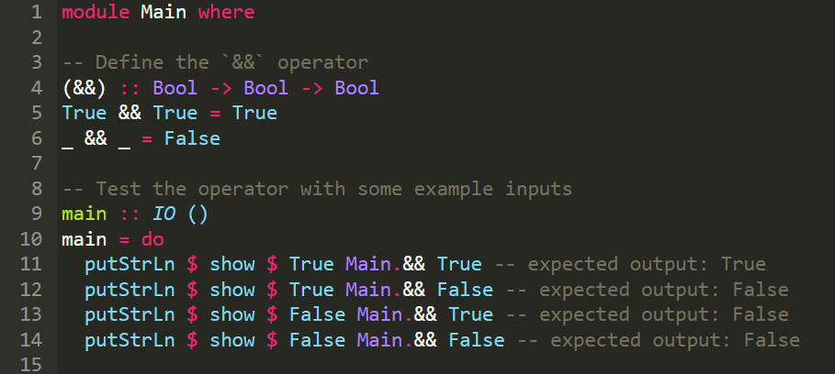
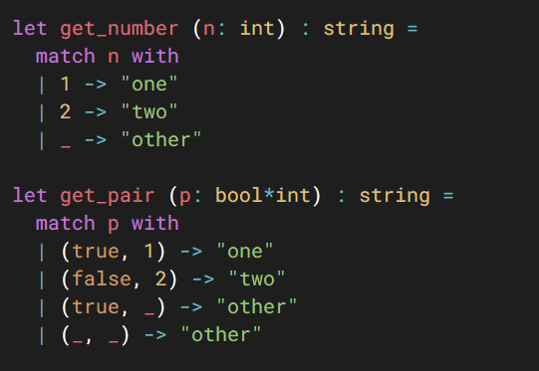

Haskell
Notation:
Pattern matching
Type annotation
All possible patterns
Haskell Playground
OCaml Playground
I will introduce more about functional programming language when we meet the topic of induction

Slide 11
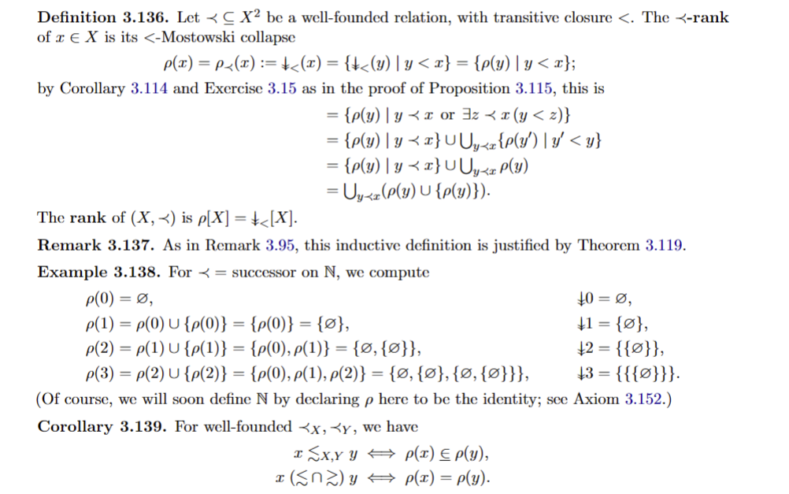
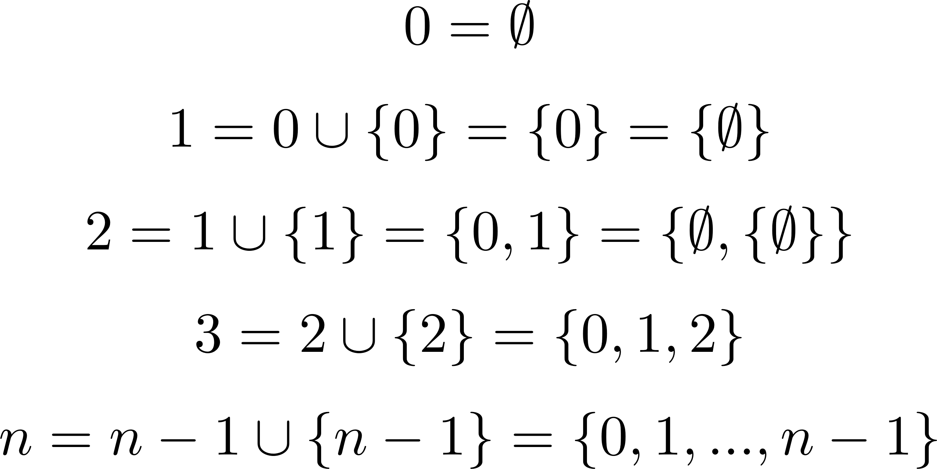
Natural numbers
Five Peano axioms:
0 is a natural number.
Every natural number has a successor which is also a natural number.
0 is not the successor of any natural number.
If the successor of x equals the successor of y, then x equals y.
The axiom of induction: If a statement is true of 0, and if the truth of that statement for a number implies its truth for the successor of that number, then the statement is true for every natural number.
def1
def2

Slide 12
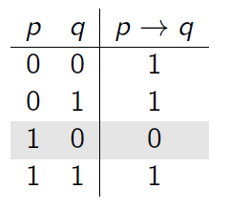
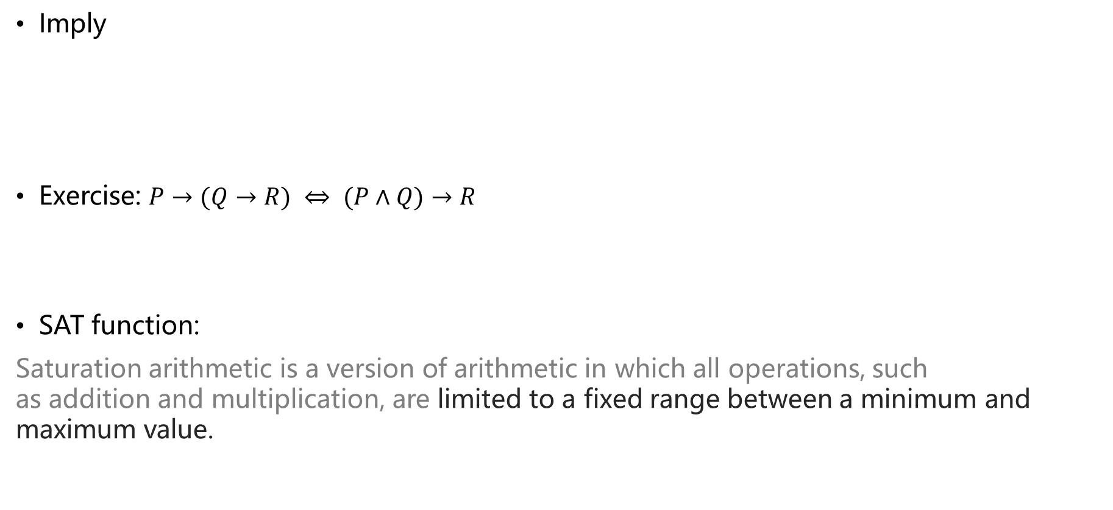
Logic
Imply
Exercise: $P→(Q→R) ⇔ (P∧Q)→R$
SAT function:
Saturation arithmetic is a version of arithmetic in which all operations, such as addition and multiplication, are limited to a fixed range between a minimum and maximum value.
Notes:
a Boolean algebra is a non-empty set A, together with two binary operations ∧ and ∨ (on A), a unary operation ′′, and two distinguished elements 0 and 1, satisfying the following axioms [...]. There are several possible widely adopted names for the operations ∧,∨, and ′′. We shall call them meet, join, and complement (or complementation), respectively. The distinguished elements 00 and 11 are called zero and one.

Slide 13

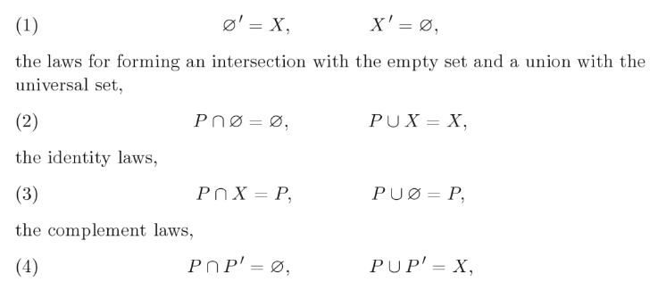
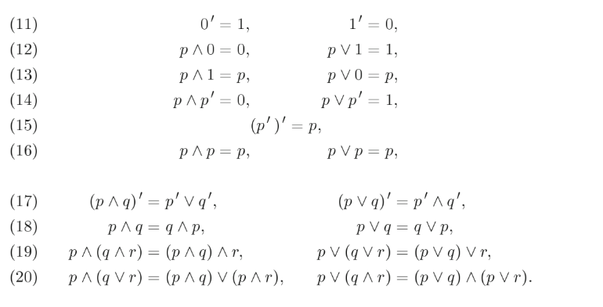
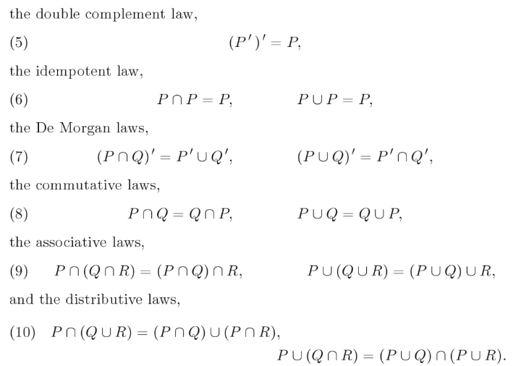

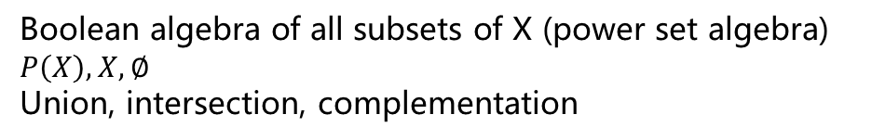
Boolean algebra of all subsets of X (power set algebra)
$$P\left(X\right), X, ∅$$
Union, intersection, complementation
Boolean algebra
Non-empty set $A$, distinguished element 0 and 1
$${, }^{′} (¬)$$
Introduction to Boolean Algebras
Paul Halmos , Steven Givant

Slide 14


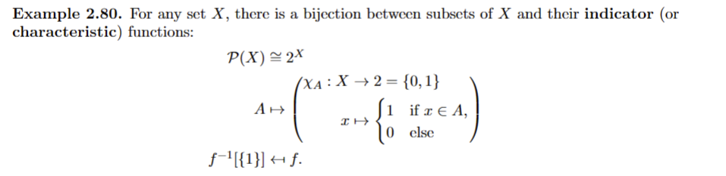
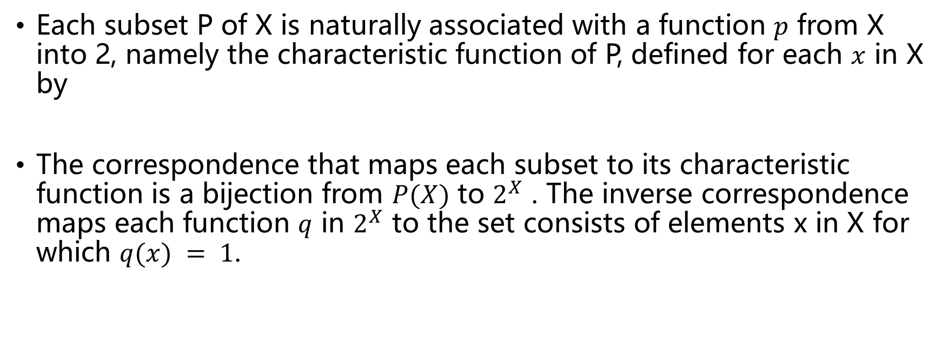
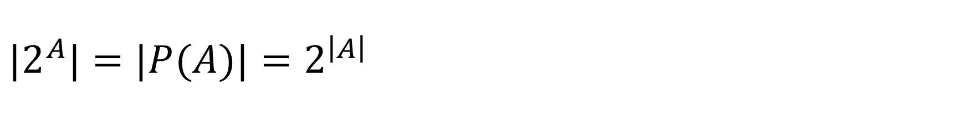
$$|2^{A}|=|P(A)|=2^{\left|A\right|}$$
Each subset P of X is naturally associated with a function $p$ from X into 2, namely the characteristic function of P, defined for each $x$ in X by
The correspondence that maps each subset to its characteristic function is a bijection from $P(X)$ to $2^{X}$ . The inverse correspondence maps each function $q$ in $2^{X}$ to the set consists of elements x in X for which $q(x) = 1$.

Slide 15
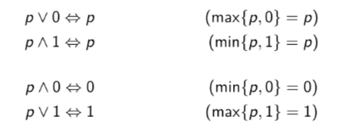

In slides,
but wait, what is max/min here? What is the order? Note the 0 and 1 are just bool value but not numbers
$∩ ∪$& max min
For sets, either one of the equations P ∩ Q = P and P ∪ Q = Q is equivalent to the inclusion P ⊆ Q. This observation motivates the introduction of a binary relation ≤ in every Boolean algebra; we write p ≤ q or q ≥ p in case p ∧ q = p, or, p ∨ q = q.

Slide 16

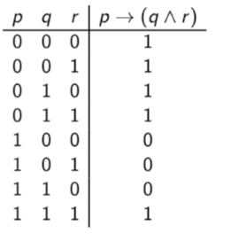
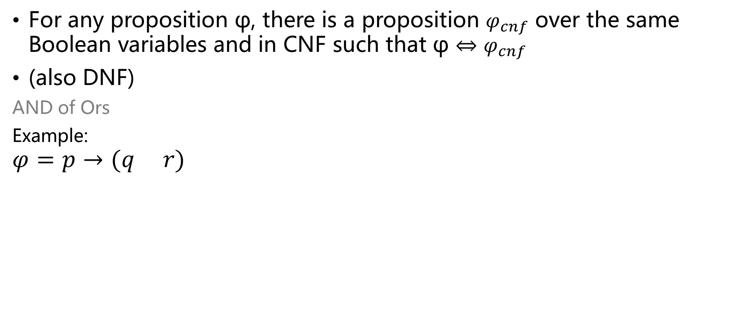
CNF DNF
For any proposition φ, there is a proposition $φ_{cnf}$ over the same Boolean variables and in CNF such that φ ⇔ $φ_{cnf}$
(also DNF)
AND of Ors
Example:
$$φ=p→(q r)$$

Slide 17
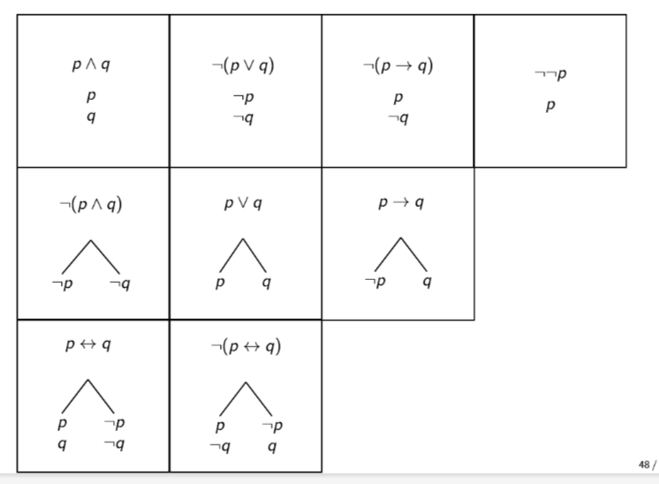
Truth Trees(with only logic operator)
The truth tree method tries to systematically derive a contradiction from the assumption that a certain set of statements is true.
Infers which statements are forced to be true under this assumption.
When nothing is forced, then the tree branches into the possible options
All branches close => the original statement cannot be false => tautology
• A sentence belongs to every branch below it.
• You can close a branch if a statement and its negation both belong to that branch
.• A branch is finished if all of its decomposable statements have been decomposed

Slide 18
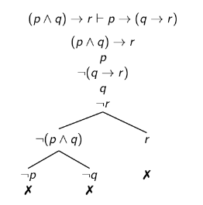
See the example in slides

Slide 19
Procedure：
At the ‘root’ of the tree(negation of what you think is tautology), write down all statements that you try
Decompose according to the rules until you have a finished open branch or until all branches close.
– If there is a finished open branch, then that means that it is possible for all statements at the root of the tree to be true.
– If all branches close, then it is not possible for statements at the root of the tree to be true.
Exercise: prove

Slide 20
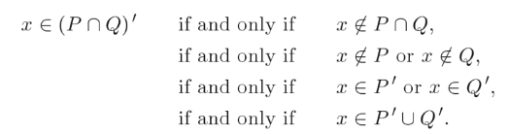
Proving methods
Truth table
Logic/set definitions
Truth tree
Inference rule (next time)

Slide 21
End QAQQ&A

Slide 22
Reference
Umich MATH 582 notes and hw1
Introduction to Boolean Algebras, Paul Halmos , Steven Givant
https://link.springer.com/book/10.1007/978-0-387-68436-9
Truth Trees (rpi.edu)

