Slide 1
Set & Logic Yue

Slide 2

Outline
Truth tree for first order logic
Inference rule/Natural Deduction Rules
Logic and type
Russel paradox
Anything marked with is an exact topic

Slide 3
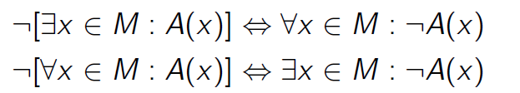
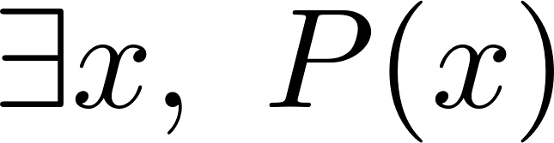

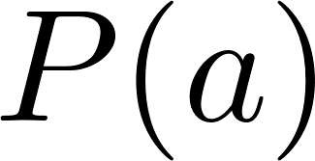
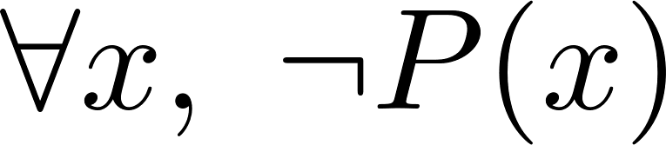
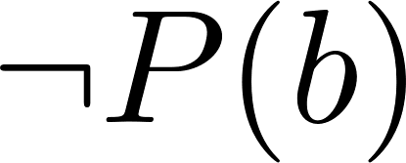
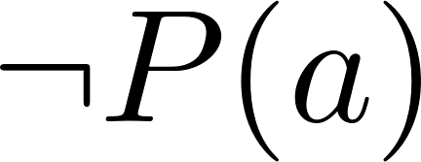
Truth tree for first order logic
Simplify:
How to use:
: exist that P(a) is true, while is a new constant symbol here
should use a new variable each time,
as we don’t know what is, only know exists
: can choose arbitrary x. but…how to choose? Is true, but useless
“Delay” the choose! (create contradictory)
Notes:
证明考虑变量是否和已知量一样

Slide 4
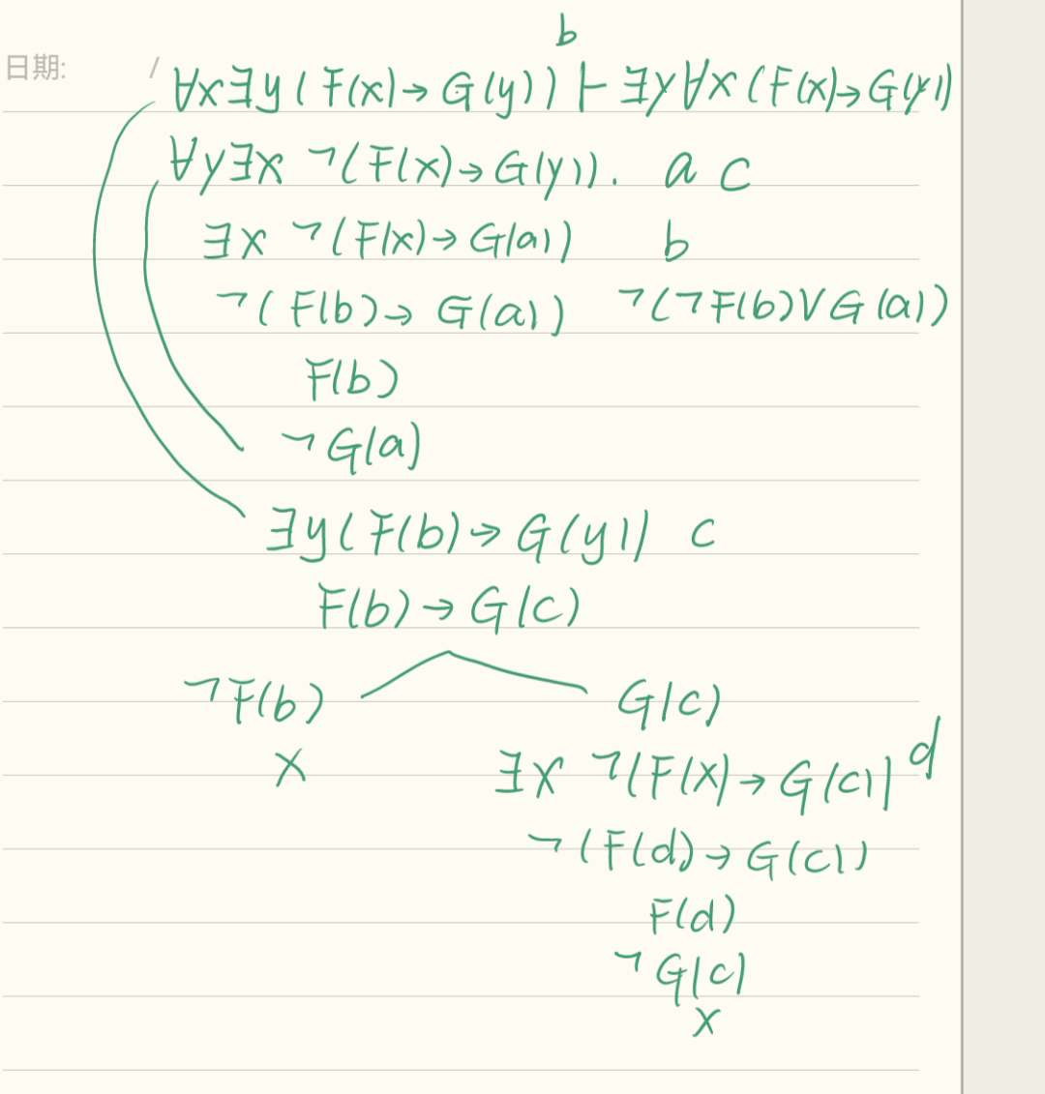
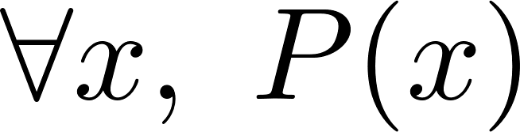
Example
Prove:
note: can be reused
Notes:
证明考虑变量是否和已知量一样

Slide 5
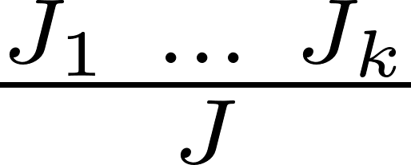


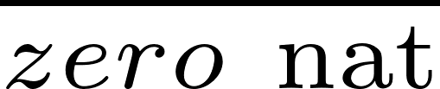
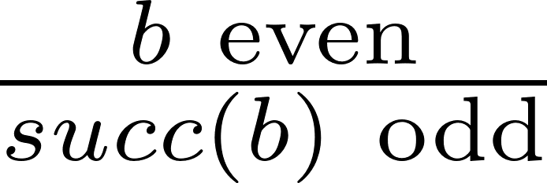
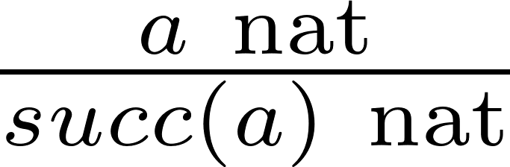
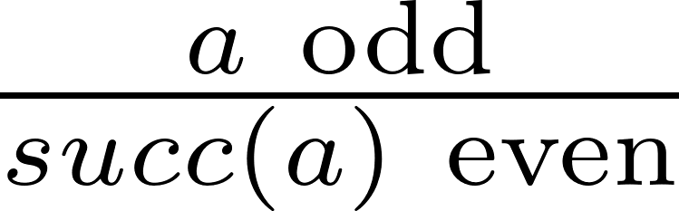
Inference rule
premises are sufficient for the conclusion
it is not necessary that the premises hold
Premises of the rule
Conclusion
Examples: an inductive definition of nat(natural number)
Examples: a simultaneous inductive definition of even and odd
Notes:
证明考虑变量是否和已知量一样

Slide 6



Inference rule
First-order propositional logic captures the essence of hypothetical reasoning by way of the
hypothetical judgement
which species how to derive that a proposition A is true if we assume, without proof, the truth of
a finite set of propositions
We call the propositions in the “hypotheses” or “assumptions”.
Notes:
证明考虑变量是否和已知量一样

Slide 7










Classical Propositional Logic
Assumption
Conjunctions
Absurdities
Disjunctions
Implication
Axiom of the Excluded Middle
only in classical logic, not in constructive logic

Slide 8




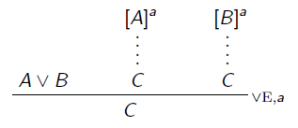
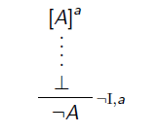

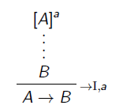

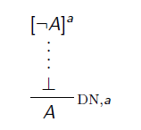
Natural Deduction Rules
What is the small “a”?
Tags for assumptions!
Assumption
Conjunctions
Absurdities
Disjunctions
Implication
Axiom of the Excluded Middle
only in classical logic, not in constructive logic
Interesting fact: these two can not derive each other

Slide 9
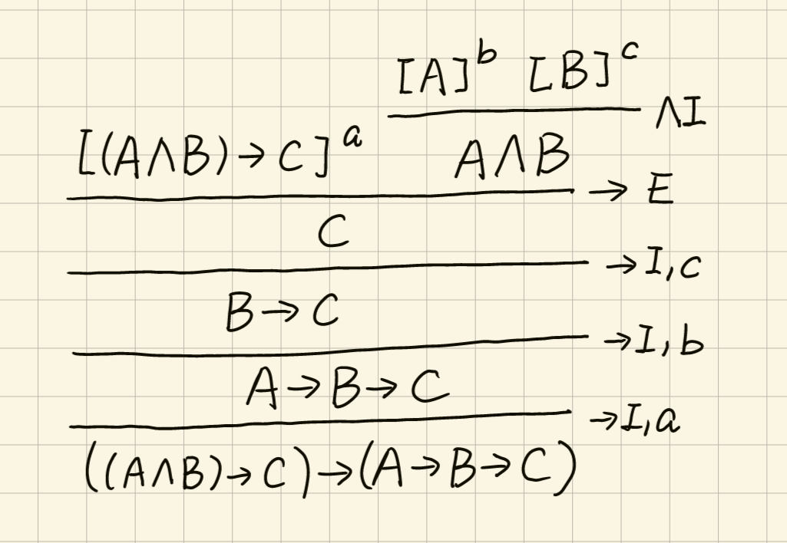
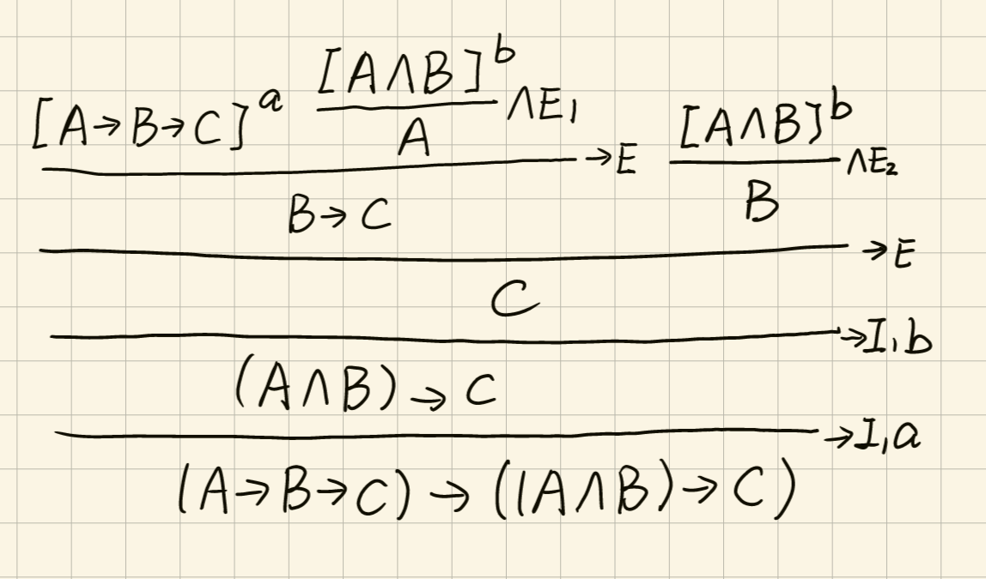
Example
Prove: and
Notes:
证明考虑变量是否和已知量一样

Slide 10
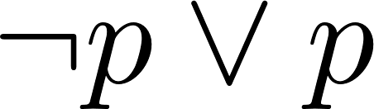
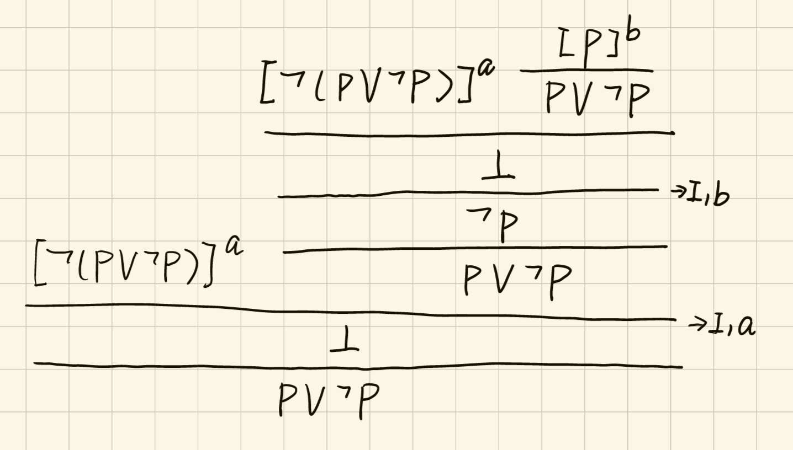


Example
Prove:
This is the axiom in classical logic
While here we use
Namely, and are equivalent
you can’t prove this without this axiom
Axiom of the Excluded Middle
only in classical logic, not in constructive logic
Notes:
证明考虑变量是否和已知量一样

Slide 11
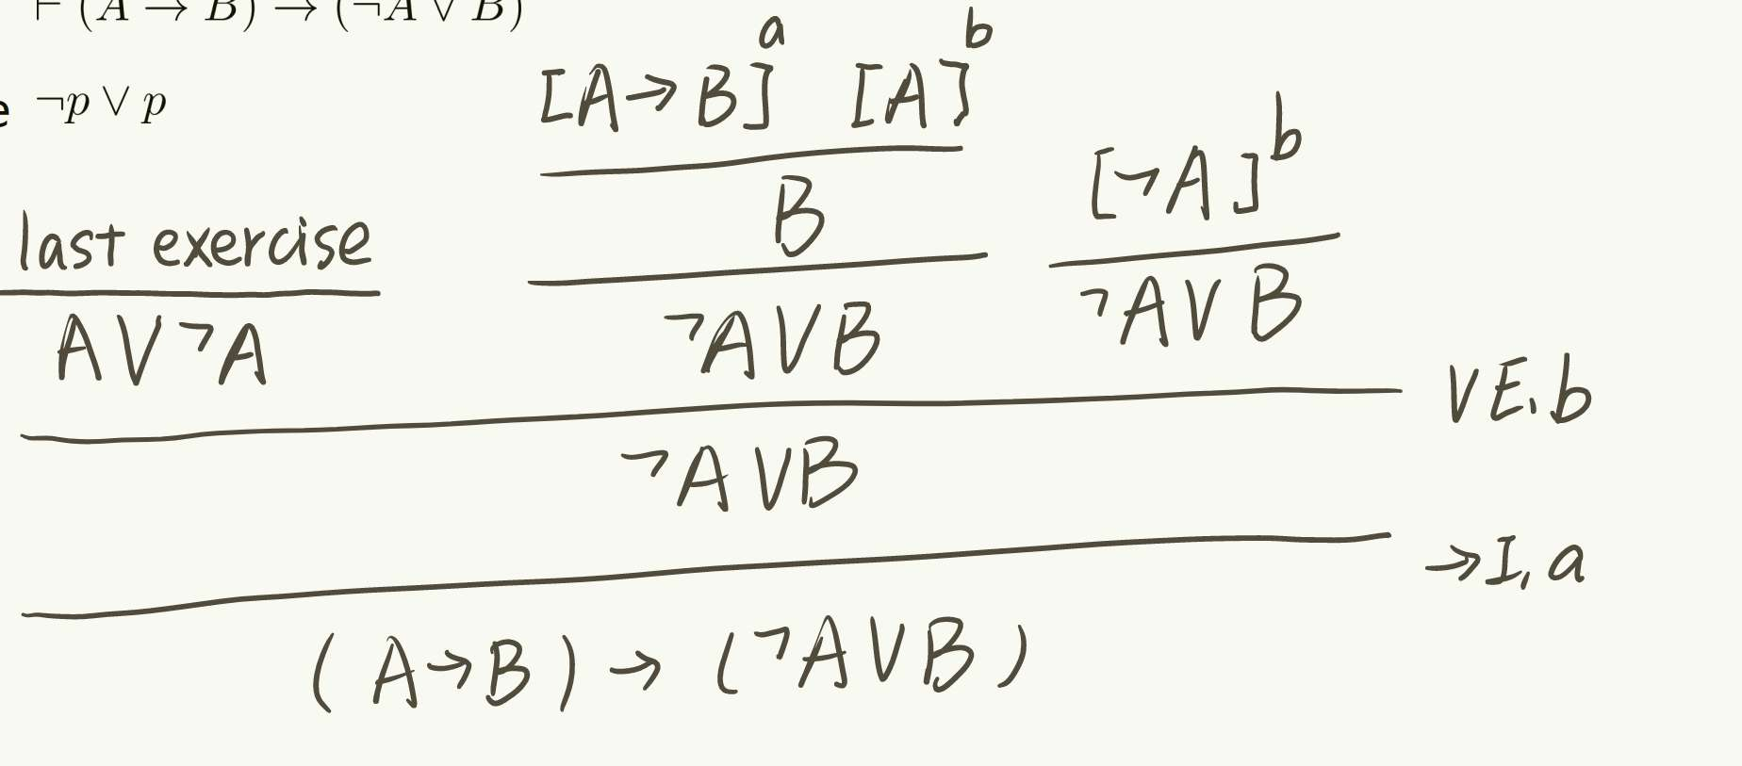
Example
Prove:
Hint: use
Notes:
证明考虑变量是否和已知量一样

Slide 12
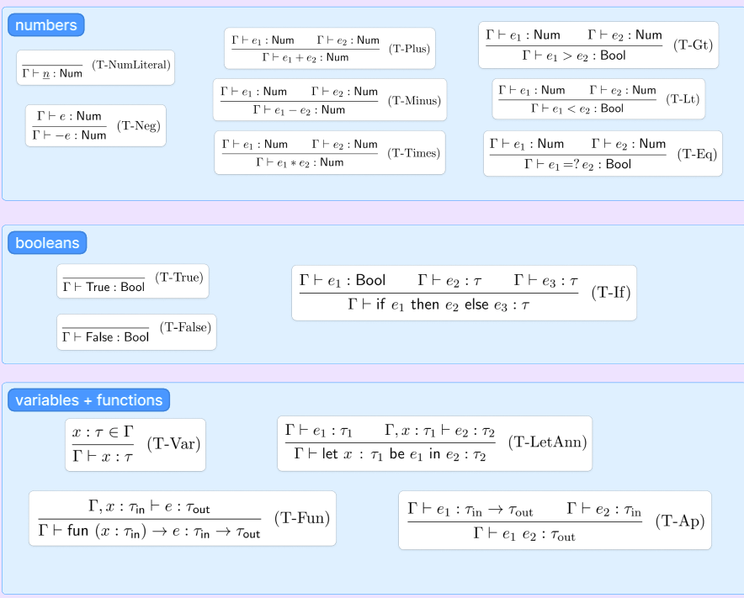

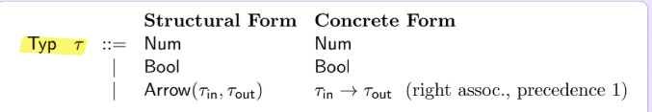
Logic and type
expression
is a mapping from variables to types. We will write it as a sequence of typing assumptions, written
type

Slide 13
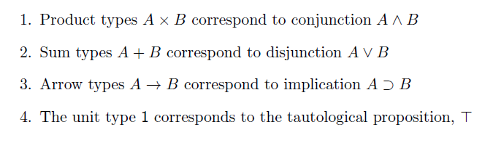


Logic and type
E.g.
Remember we have just proved that
function $f(x, y)=x+y$ has type Num -> Num-> Num
fun x -> fun y -> x+y & fun (x, y) -> x+y

Slide 14
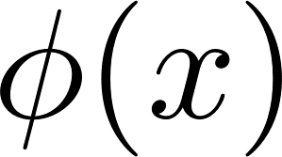
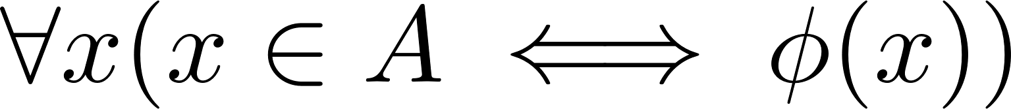
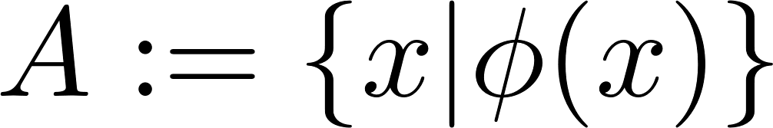
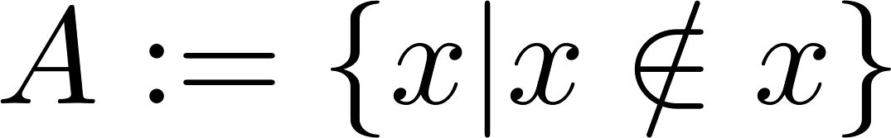
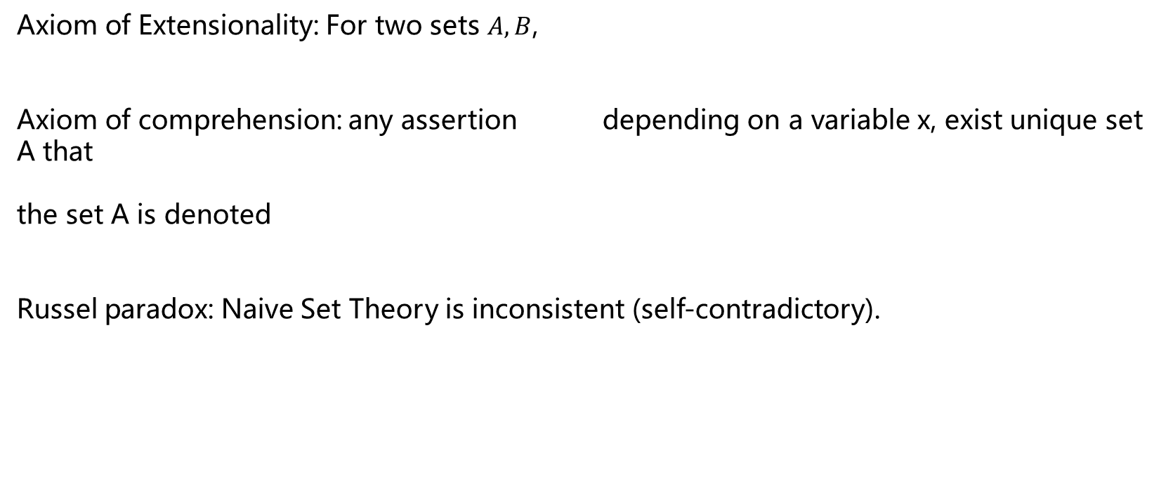
Russel paradox
Axiom of Extensionality: For two sets $A, B$,
Axiom of comprehension: any assertion depending on a variable x, exist unique set A that
the set A is denoted
Russel paradox: Naive Set Theory is inconsistent (self-contradictory).

Slide 15
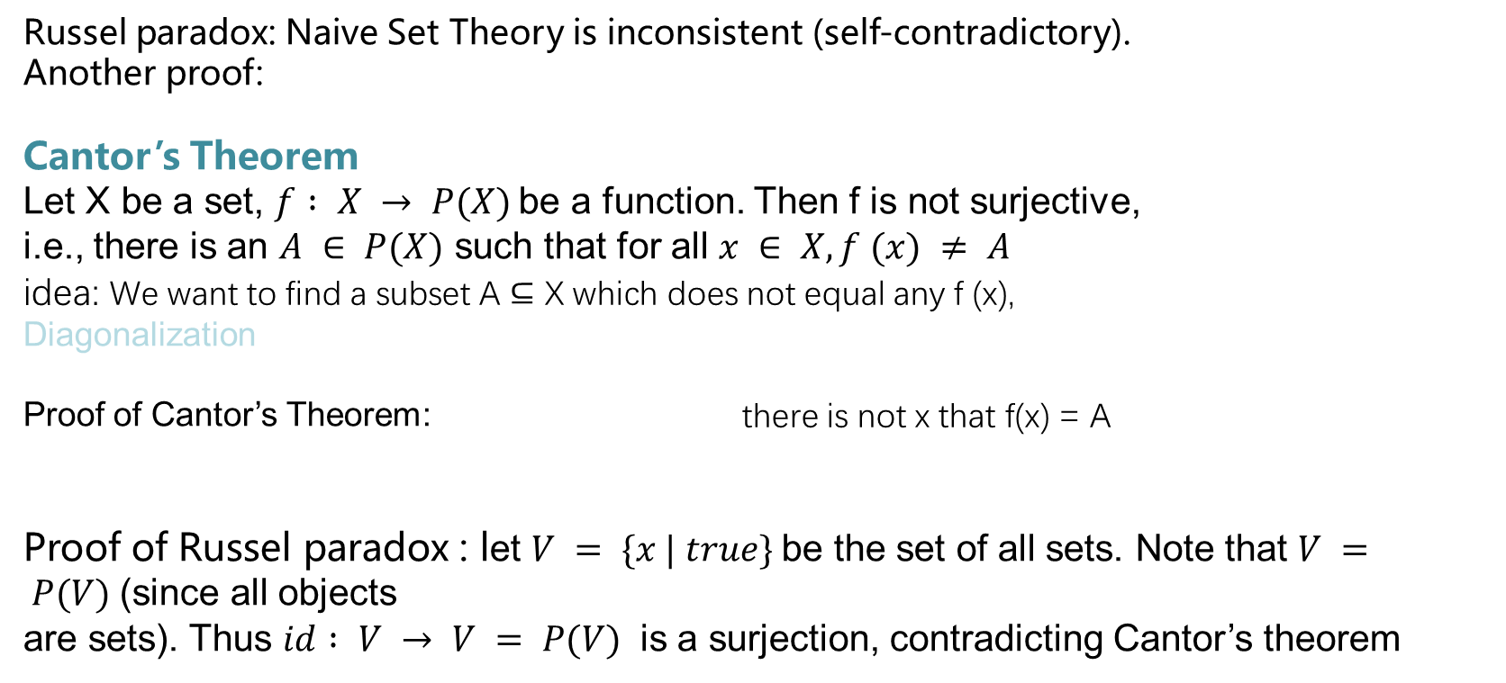
Russel paradox
Russel paradox: Naive Set Theory is inconsistent (self-contradictory).
Another proof:
Cantor’s Theorem
Let X be a set, $f : X → P(X)$be a function. Then f is not surjective, i.e., there is an $A ∈ P(X)$ such that for all $x ∈ X, f (x) ≠ A$ idea: We want to find a subset A ⊆ X which does not equal any f (x),
Diagonalization
Proof of Cantor’s Theorem: there is not x that f(x) = A
Proof of Russel paradox : let $V = \{x | true\}$be the set of all sets. Note that $V = P(V)$(since all objects are sets). Thus $id : V → V = P(V)$ is a surjection, contradicting Cantor’s theorem

Slide 16
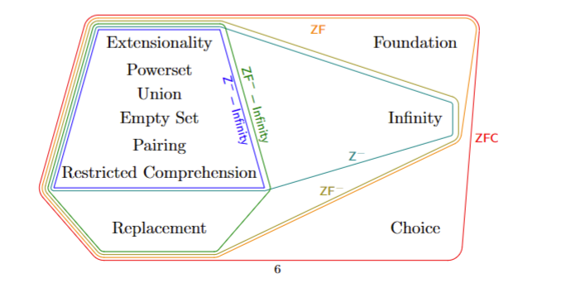
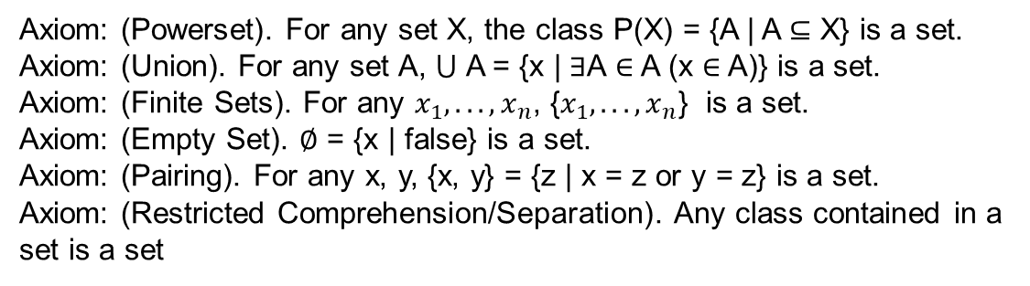
Russel paradox
Russel paradox: Naive Set Theory is inconsistent (self-contradictory).
Solution:
The most common way: restrict the Axiom of Comprehension so that only “sufficiently small” classes form sets. => The theory ZF−-infinity
A class is an informal collection {x | φ(x) } defined by a property φ(x)
Axiom: (Powerset). For any set X, the class P(X) = {A | A ⊆ X} is a set. Axiom: (Union). For any set A, ⋃ A = {x | ∃A ∈ A (x ∈ A)} is a set. Axiom: (Finite Sets). For any $x_{1}, . . . , x_{n}$, {$x_{1}, . . . , x_{n}$} is a set. Axiom: (Empty Set). ∅ = {x | false} is a set. Axiom: (Pairing). For any x, y, {x, y} = {z | x = z or y = z} is a set. Axiom: (Restricted Comprehension/Separation). Any class contained in a set is a set
Gödel’s incompleteness theorem. find a complete and consistent set of axioms for all mathematics is impossible

Slide 17
End QAQQ&A

Slide 18
Reference
Umich MATH 582 notes
Umich EECS490 HW6
Practical Foundation for Programming Language, Robert Harper

