Slide 1
Relation
Yue
2023/6/7

Slide 2

Outline
Relation & Function
Injective & surjective
Equivalence Class
Quotient set
– take quotient space as an example
Anything marked with is an extra topic

Slide 3

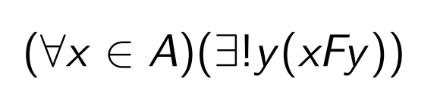


Relation & Function
Relation: subset of a Cartesian product
Elements in relation: ordered pairs
Function: some special relations
Ordered pair(Kuratowski): For any x, y, let $(x, y) := \{\{x\}, \{x, y\}\}.$
For two classes X, Y , their Cartesian product is $X × Y := \{(x, y) | x ∈ X \& y ∈ Y \}$
A set (or class) R is a binary relation if each of its elements is an ordered pair (x, y), in which case we write $x R y : \left(x, y\right)∈ R.$
e.g.: $∈ = \{(x, y) | x ∈ y\}.$
$$domain(R) := \{x | ∃y ((x, y) ∈ R)\}, range(R) := \{y | ∃x ((x, y) ∈ R)\}.$$
A relation f is a function if for each x in domain(f), there exist unique y such that x f y, we denote this y by f(x).
If f is a function, domain(f) = X, and range(f) ⊆ Y , then we say that f is a function from X to Y , denoted f : X → Y , and call Y a codomain of f.
$$Y^{X} := \{f | f is a function X→ Y \}.$$

Slide 4






Function
e.g.: remember cardinality of X: $2^{X}$
$for each subset A⊆X, f: X→2=\{0, 1\}$, $f\left(x\right)=\left\{\begin{aligned}0, x A \\ &1, x A\end{aligned}\right.$
For two functions $f, g : X → Y$, we have $f=g ∀x∈ X (f(x) = g(x))$
Partial function: $domain f⊆A$ Total function: $domain f=A$
Inverse:
Composition
Restriction(a restriction on domain)
Image of A under F

Slide 5
Injection & Surjection
Given a function F : A → B, with dom F = A and im(F) ⊂ B,
Injective/one-to-one:
Surjective/onto: im(F)=B
Bijective: injective & surjective

Slide 6
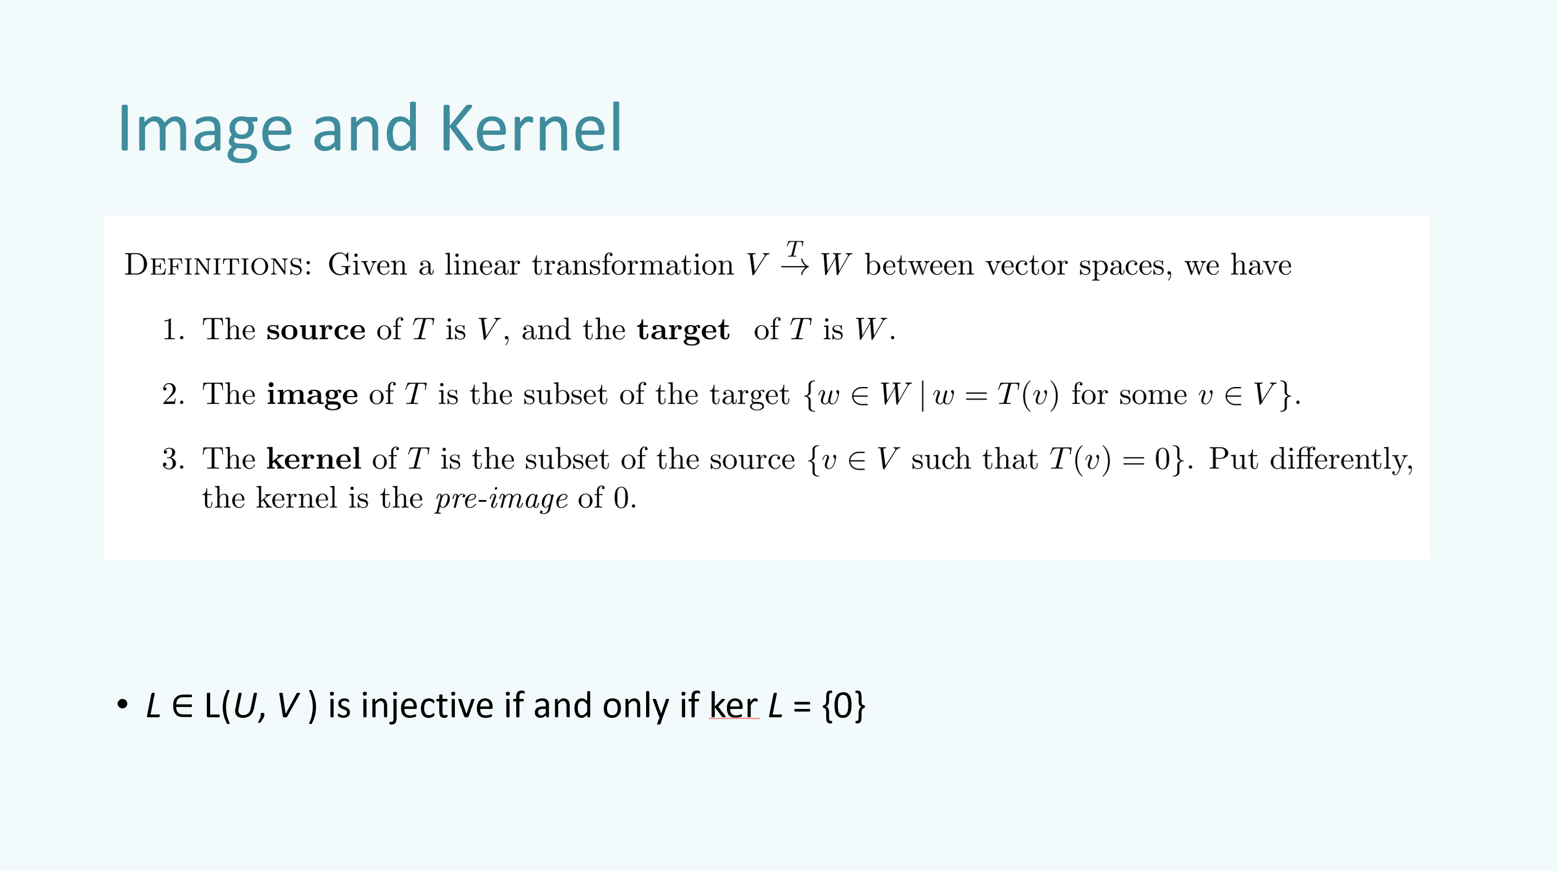

Slide 7

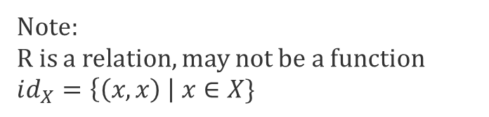
Exercise
Note:
R is a relation, may not be a function
$$id_{X}=\left\{\left(x, x\right) \right| x∈X\}$$
Let R ⊆ X × Y be a binary relation.
(a) What does $R^{−1}◦R⊆id_{X}$mean?
(b) What does $R^{−1}◦R⊇id_{X}$mean?
(c) Prove that R is a function X → Y iff $R^{−1}◦R ?? id_{X}$and $R◦R^{−1} ?? id_{Y}$, where each ?? is either ⊆ or ⊇ (which?).
(d) Conclude that for a function $f:X→Y , f^{−1}:Y→X$is also a function iff $∀y∈Y ∃!x∈X(f(x)=y),$i.e., f is a bijection.

Slide 8
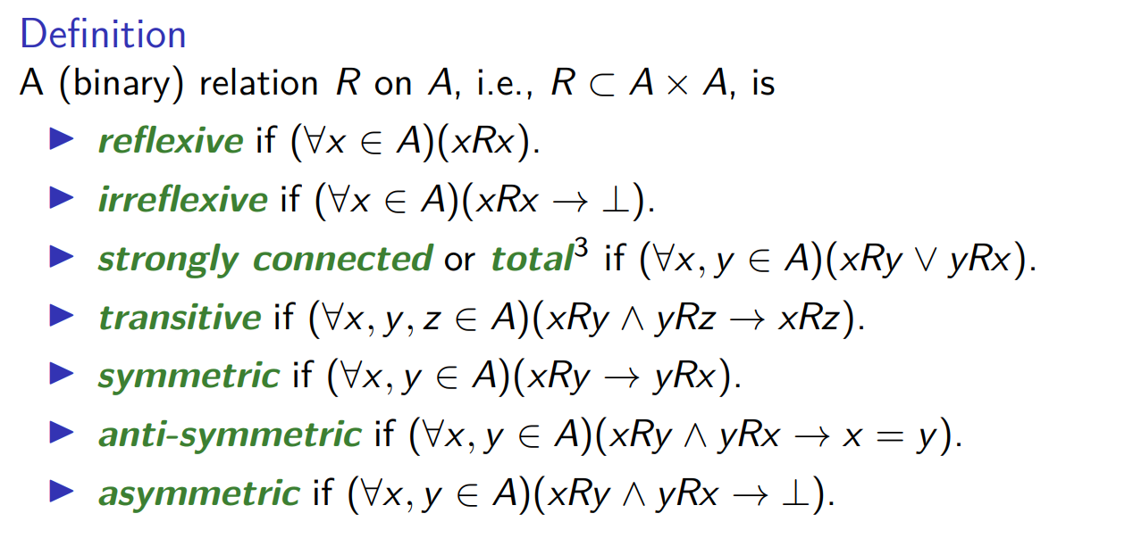



Properties of relations
Partial order:
non-strict: reflexive, antisymmetric, transitive
strict: reflexive, antisymmetric, transitive
Total order:
partial order + total(any two can be compared)
e.g., divisibility, subset relation are not total order
Equivalence relation:
reflexive, symmetric, transitive
e.g.,$=,≡, isomorphism$
Let X be an arbitrary set, and define the set operator T on X2 by
T(A) := {(x, x) | x ∈ X} ∪
{(y, x) | (x, y) ∈ A} ∪
{(x, z) | (x, y),(y, z) ∈ A}.
Then A ⊆ X2 is T-closed iff A is an equivalence relation on X
T-closed: T(A) ⊆ A

Slide 9



Equivalence class
Definition: for equivalence relation R on A,
Theorem:
e.g., Congruence Classes Mod N partition the integers into exactly N nonoverlapping subsets of ℤ.
i.e., for a positive integer N , $Z_{N}$ is the set of congruence classes of integers modulo N
e.g.: equivalence relation defined by congruence modulo 5
${\left[0\right]}_{5}=\left\{0, 5, −5, 10, −10, …\right\}$is a equivalent class
${\{\left[0\right]}_{5}, {\left[1\right]}_{5}, {\left[2\right]}_{5}, {\left[3\right]}_{5}, {\left[4\right]}_{5}$} is a partition of ℤ
Quotient set ℤ/R= ${\{\left[0\right]}_{5}, {\left[1\right]}_{5}, {\left[2\right]}_{5}, {\left[3\right]}_{5}, {\left[4\right]}_{5}$}
For partition you need to prove:
$$1. ∀\left[a\right],\left[b\right]∈\text{Π}\text{, }\left[a\right]= \left[b\right]or \left[a\right]∩\left[b\right]=∅$$
$$2. union of all elements is the whole set i.e., ∀a∈A, ∃\left[a\right]∈\text{Π} \text{that} \text{a}∈[a]$$

Slide 10
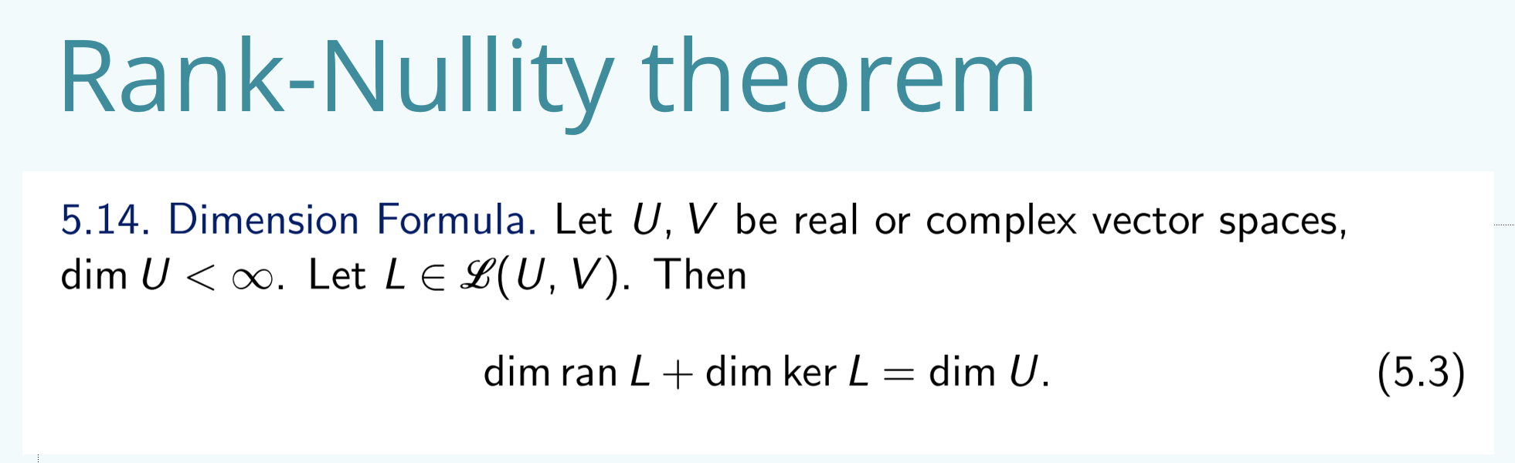
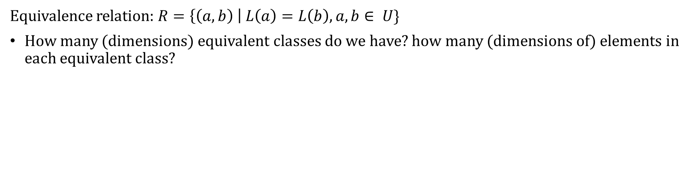
Exercise
Equivalence relation: $R=\left\{\left(a, b\right) \right| L\left(a\right)=L\left(b\right), a,b∈ U\}$
How many (dimensions) equivalent classes do we have? how many (dimensions of) elements in each equivalent class?

Slide 11
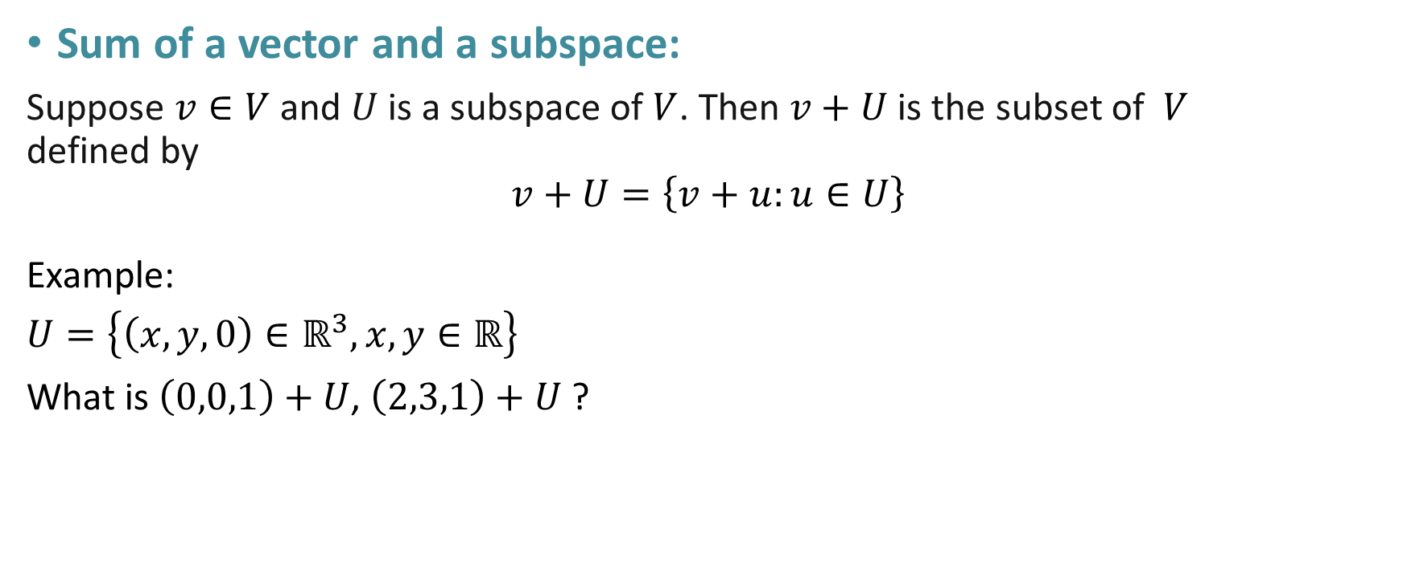
Quotients of vector spaces
an example
from my VV214 RC
Sum of a vector and a subspace:
Suppose $v∈V$ and $U$ is a subspace of $V$. Then $v+U$is the subset of $V$ defined by $$v+U=\left\{v+u:u∈U\right\}$$
Example:
$$U=\left\{\left(x,y,0\right)∈ℝ^{3}, x,y∈ℝ\right\}$$
What is $\left(0,0,1\right)+U$, $\left(2,3,1\right)+U$ ?

Slide 12
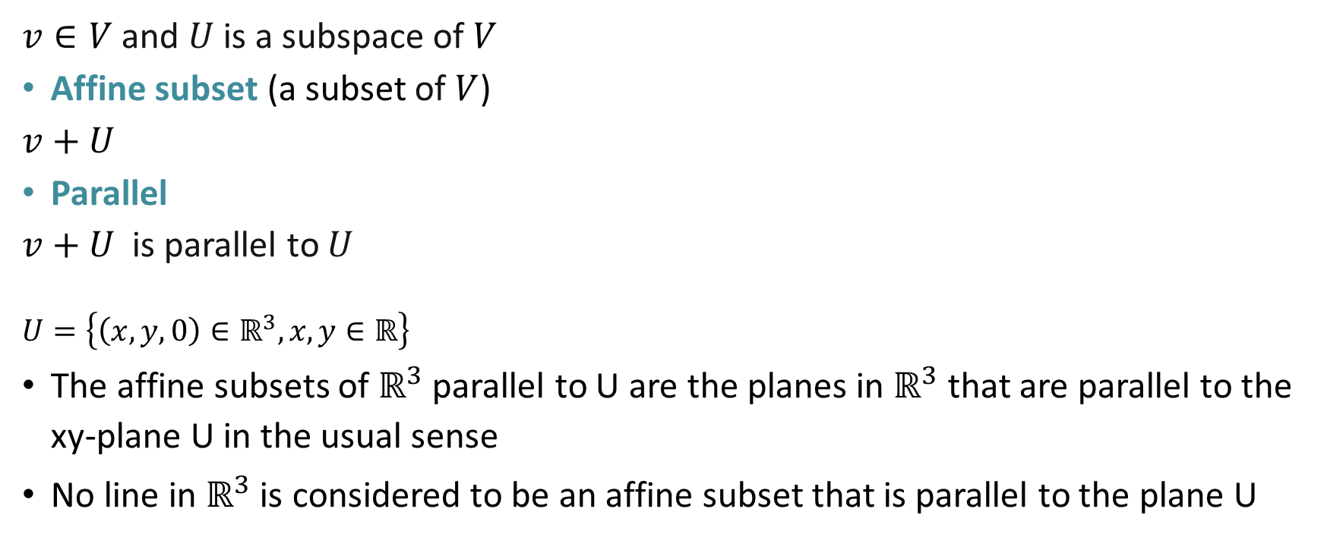
Quotients of vector spaces
an example
$v∈V$ and $U$ is a subspace of $V$
Affine subset (a subset of $V$)
$v+U$
Parallel
$v+U$ is parallel to $U$
$$U=\left\{\left(x,y,0\right)∈ℝ^{3}, x,y∈ℝ\right\}$$
The affine subsets of $ℝ^{3}$ parallel to U are the planes in $ℝ^{3}$ that are parallel to the xy-plane U in the usual sense
No line in $ℝ^{3}$ is considered to be an affine subset that is parallel to the plane U

Slide 13
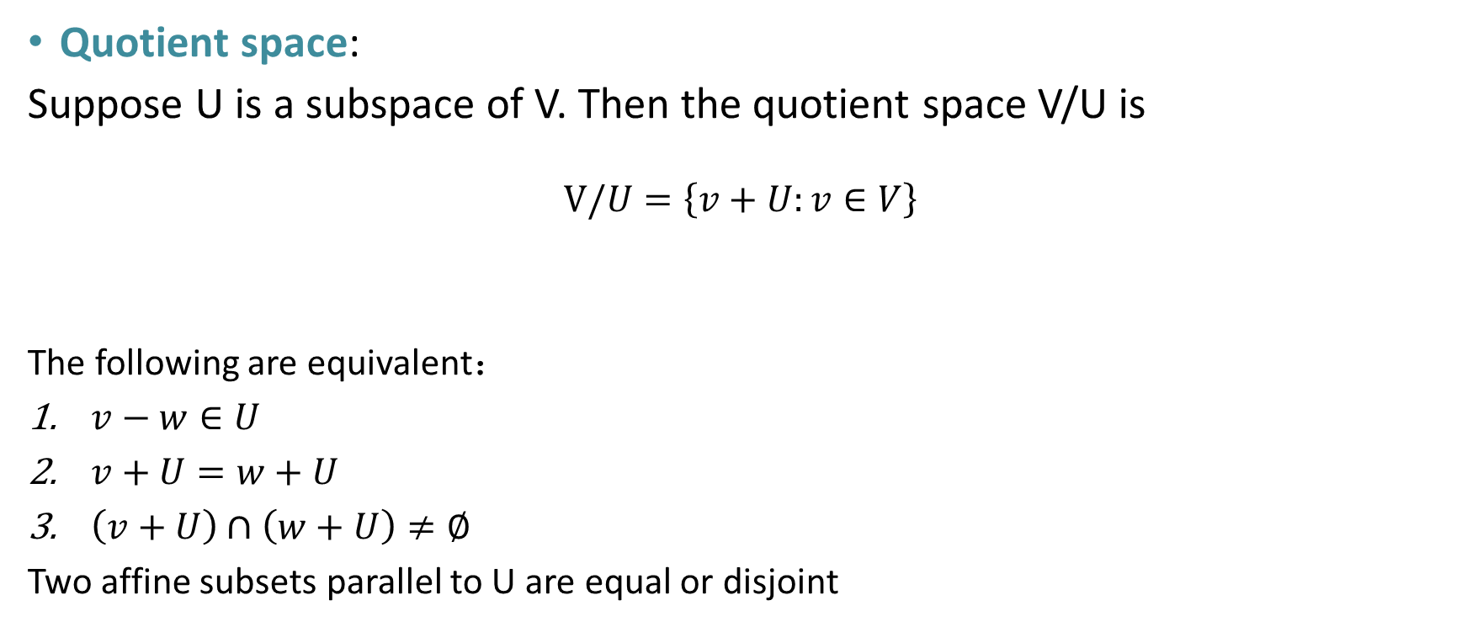
Quotients of vector spaces
an example
Quotient space:
Suppose U is a subspace of V. Then the quotient space V/U is
$$V/U=\left\{v+U:v∈V\right\}$$
The following are equivalent：
$v−w∈U$
$v+U=w+U$
$\left(v+U\right)∩\left(w+U\right)≠∅$
Two affine subsets parallel to U are equal or disjoint

Slide 14
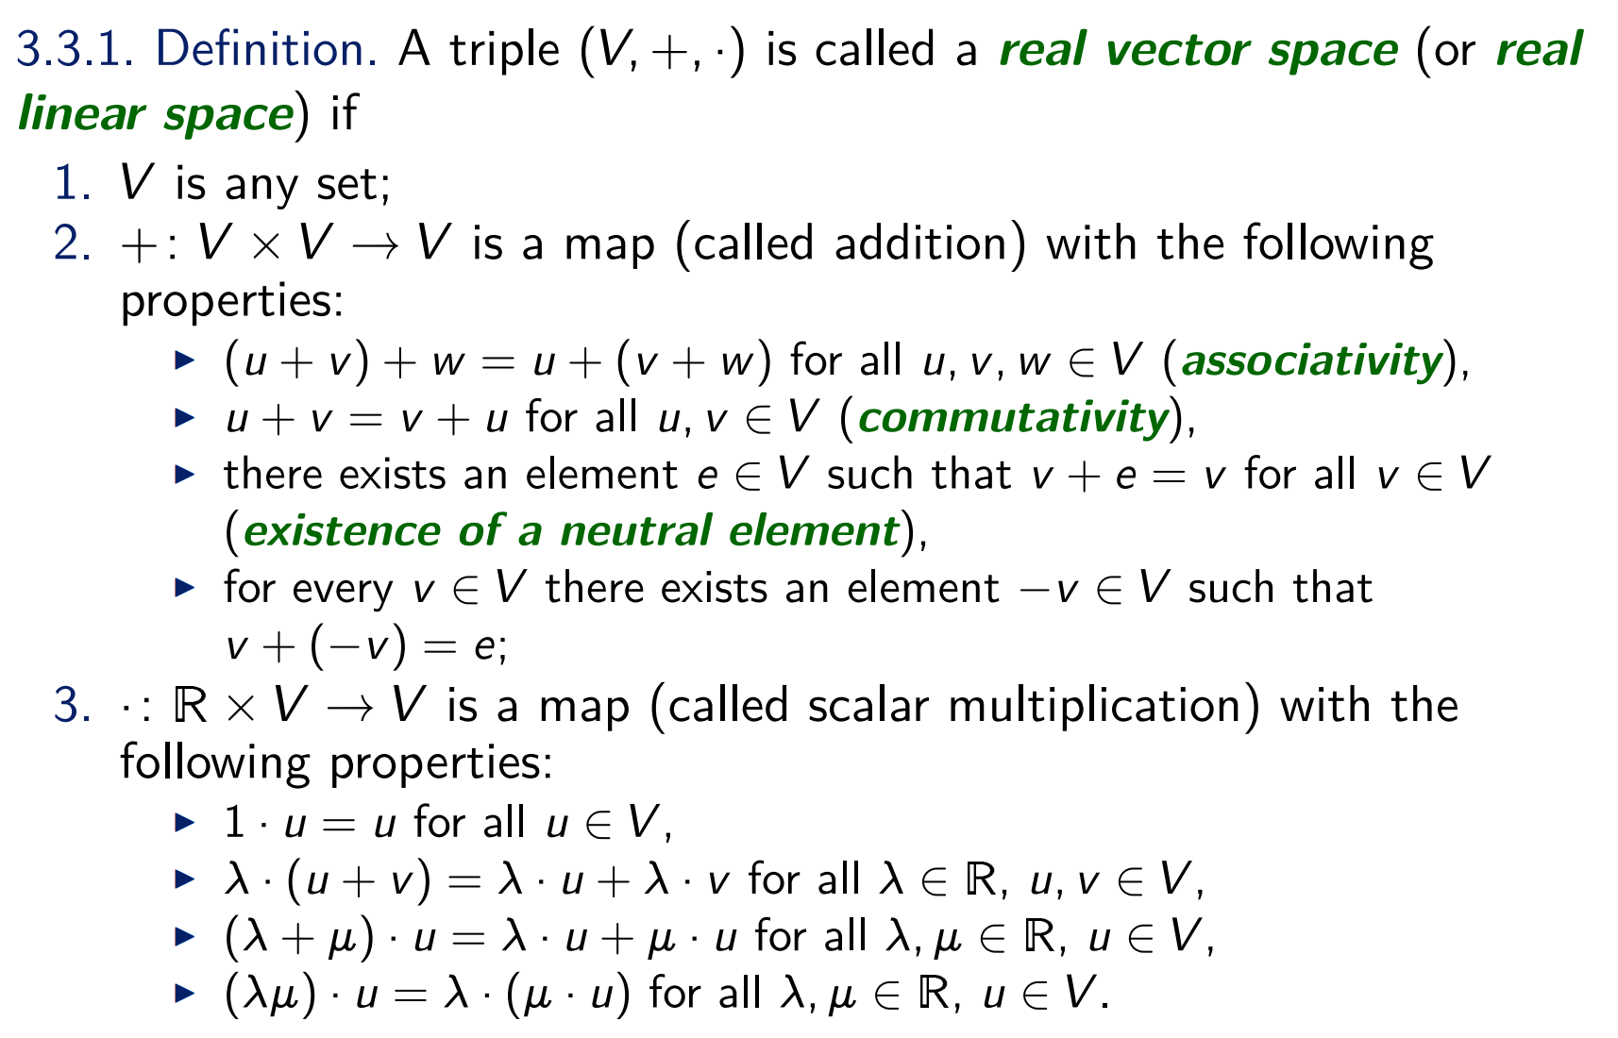
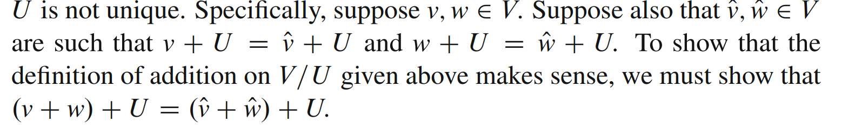
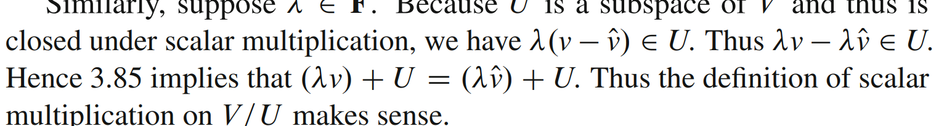
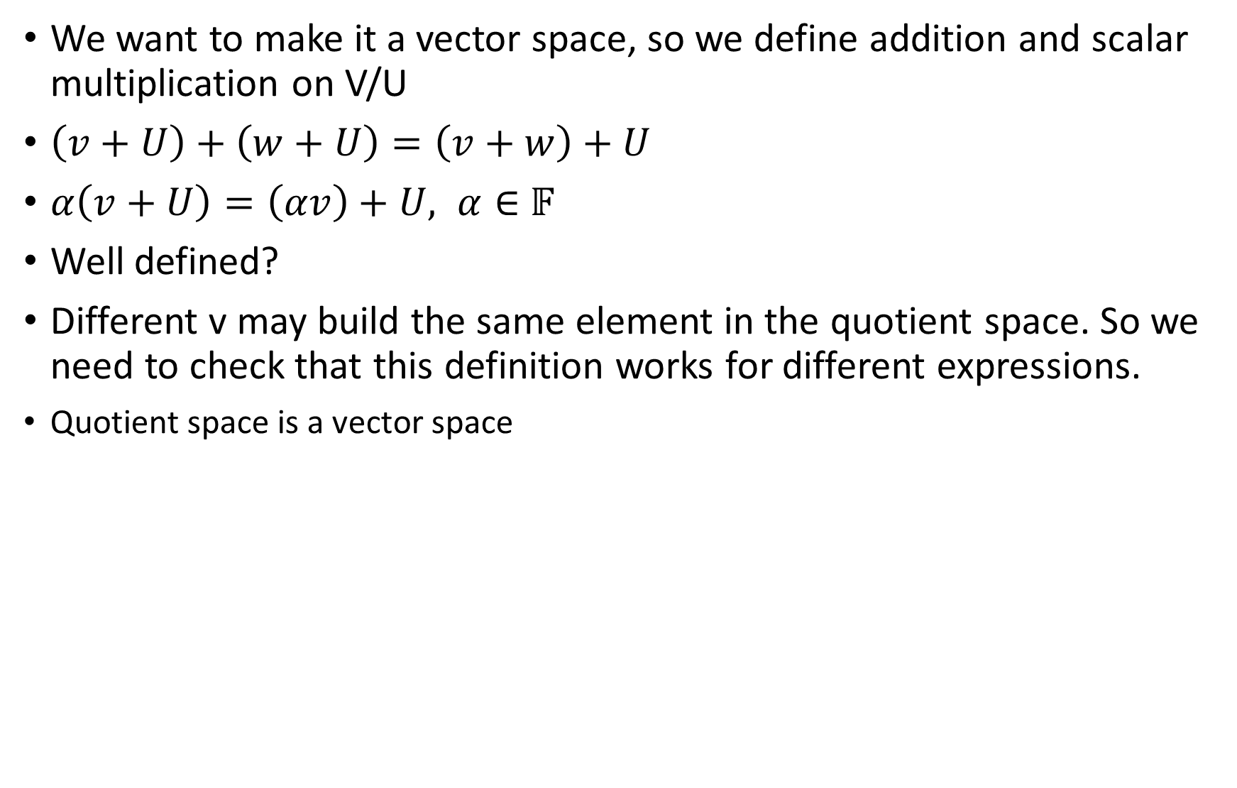
Quotients of vector spaces
an example
We want to make it a vector space, so we define addition and scalar multiplication on V/U
$\left(v+U\right)+\left(w+U\right)=\left(v+w\right)+U$
$α\left(v+U\right)=\left(αv\right)+U, α∈$ 𝔽
Well defined?
Different v may build the same element in the quotient space. So we need to check that this definition works for different expressions.
Quotient space is a vector space

Slide 15

Quotients of vector spaces
an example
We want to describe the dimension of V/U
Quotient map$π$:
$$π\left(v\right)=v+U$$
$π$ is a linear map
Dimension of a quotient space:
$$dim V/U=\dim{V}−\dim{U}$$
$$Ker π=U, ran π=V/U$$

Slide 16

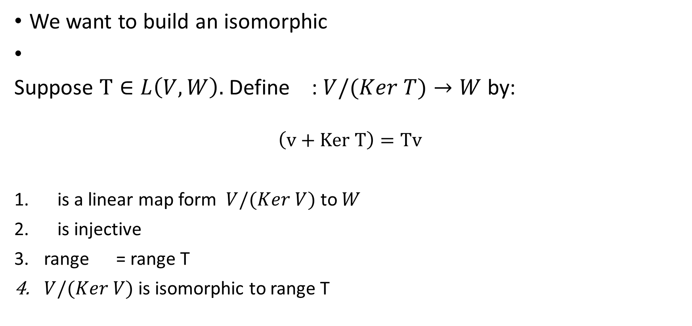
Quotients of vector spaces
an example
We want to build an isomorphic
Suppose $T∈L\left(V,W\right).$ Define : $V/(Ker T)→W$ by:
$$\left(v+Ker T\right)=Tv$$
is a linear map form $V/(Ker V)$ to $W$
is injective
range = range T
$V/(Ker V)$ is isomorphic to range T
Notes:
Work for different v

Slide 17
End QAQQ&A

Slide 18
Reference
Umich MATH 582 notes
Sheldon Axler. “Linear algebra done right”

