Slide 1
Big ‘O’… & Partial Order Yue

Slide 2
Outline
Asymptotic notation
Master Method
Partial Order basic

Slide 3
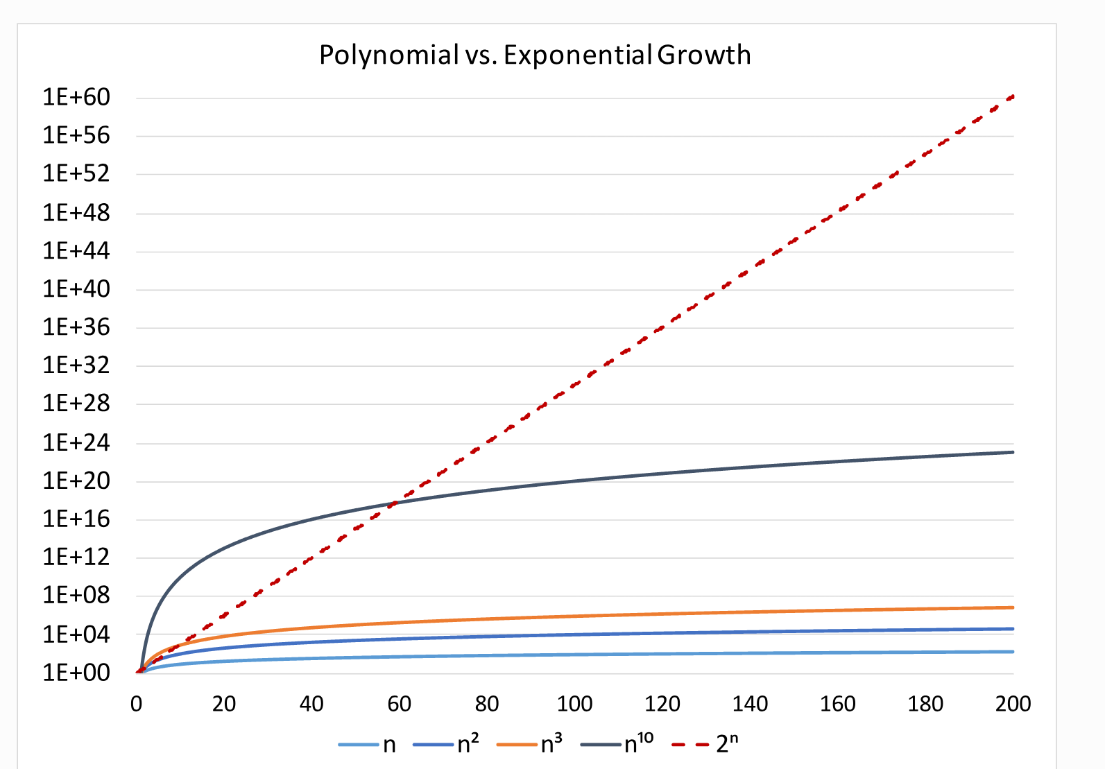
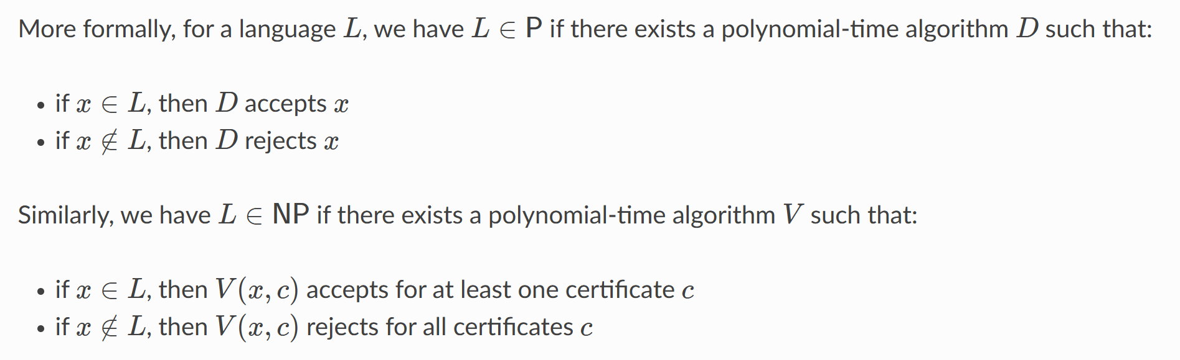
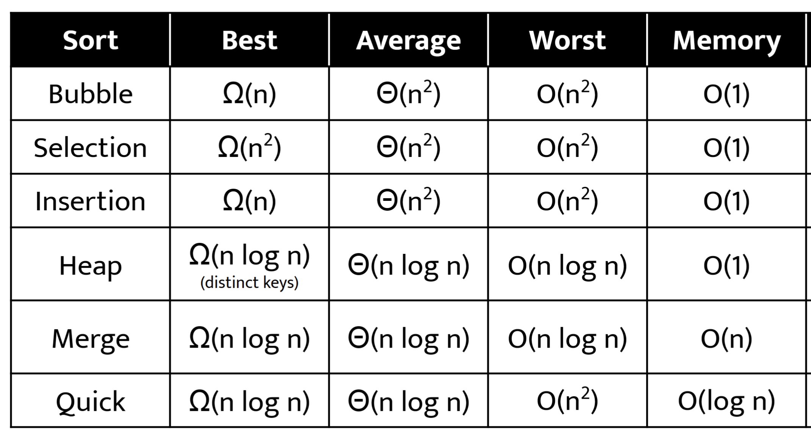
Asymptotic Notation
Application examples:
P & NP
Sorting algorithm
Notes:
证明考虑变量是否和已知量一样

Slide 4
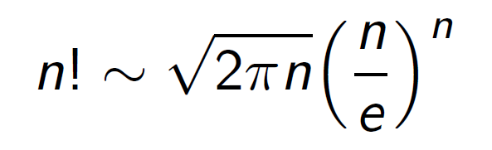
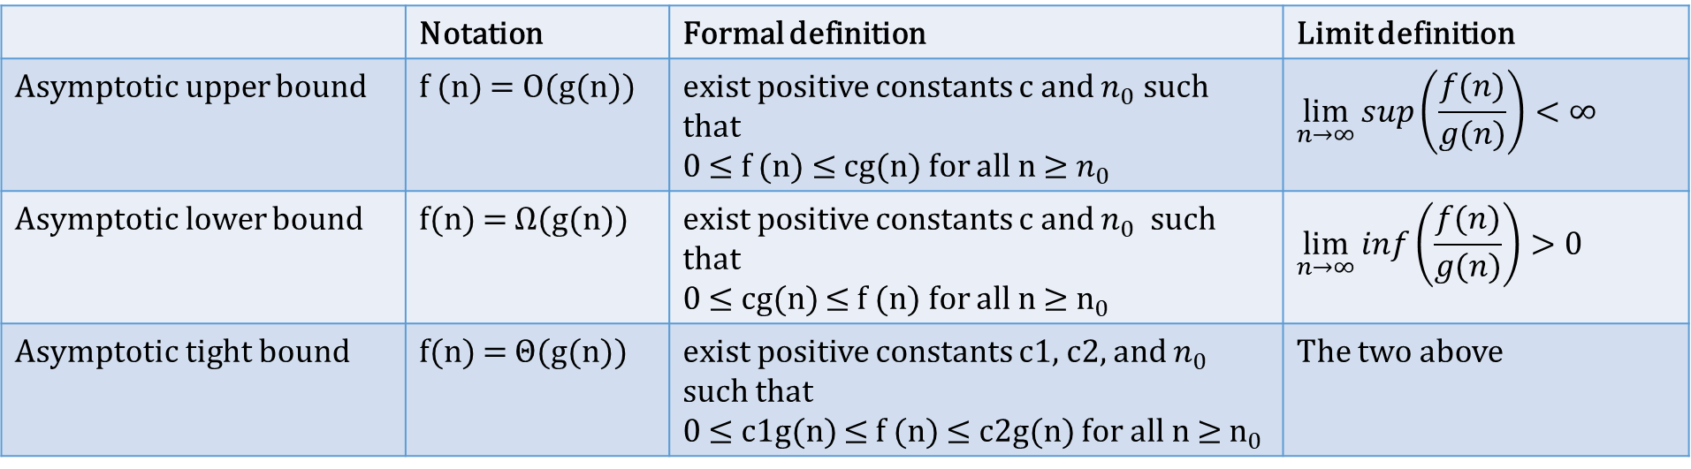
Definition
 | Notation | Formal definition | Limit definition
Asymptotic upper bound | f (n) = O(g(n)) | exist positive constants c and $n_{0}$ such that 0 ≤ f (n) ≤ cg(n) for all n ≥ $n_{0}$ | $$\lim_{n→∞}{{sup\left(\frac{f(n)}{g(n)}\right)<∞ }^{}}$$
Asymptotic lower bound | f(n) = Ω(g(n)) | exist positive constants c and $n_{0}$ such that 0 ≤ cg(n) ≤ f (n) for all n ≥ $n_{0}$ | $$\lim_{n→∞}{{inf\left(\frac{f(n)}{g(n)}\right)>0 }^{}}$$
Asymptotic tight bound | f(n) = Θ(g(n)) | exist positive constants c1, c2, and $n_{0}$ such that 0 ≤ c1g(n) ≤ f (n) ≤ c2g(n) for all n ≥ $n_{0}$ | The two above
Stirling approximation:
Notes:
证明考虑变量是否和已知量一样

Slide 5
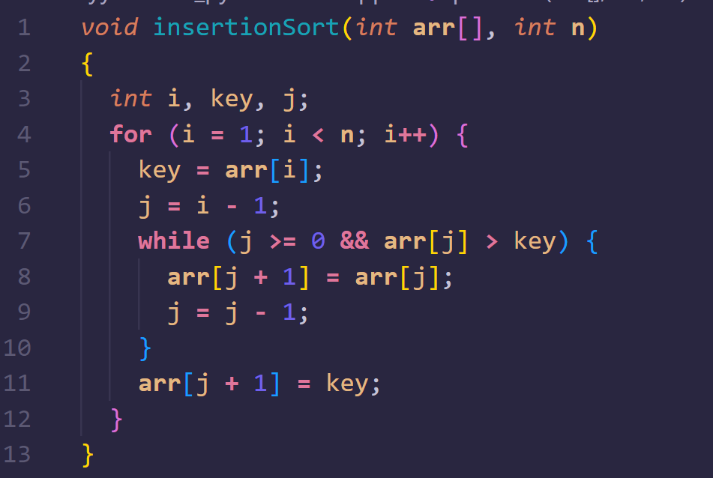
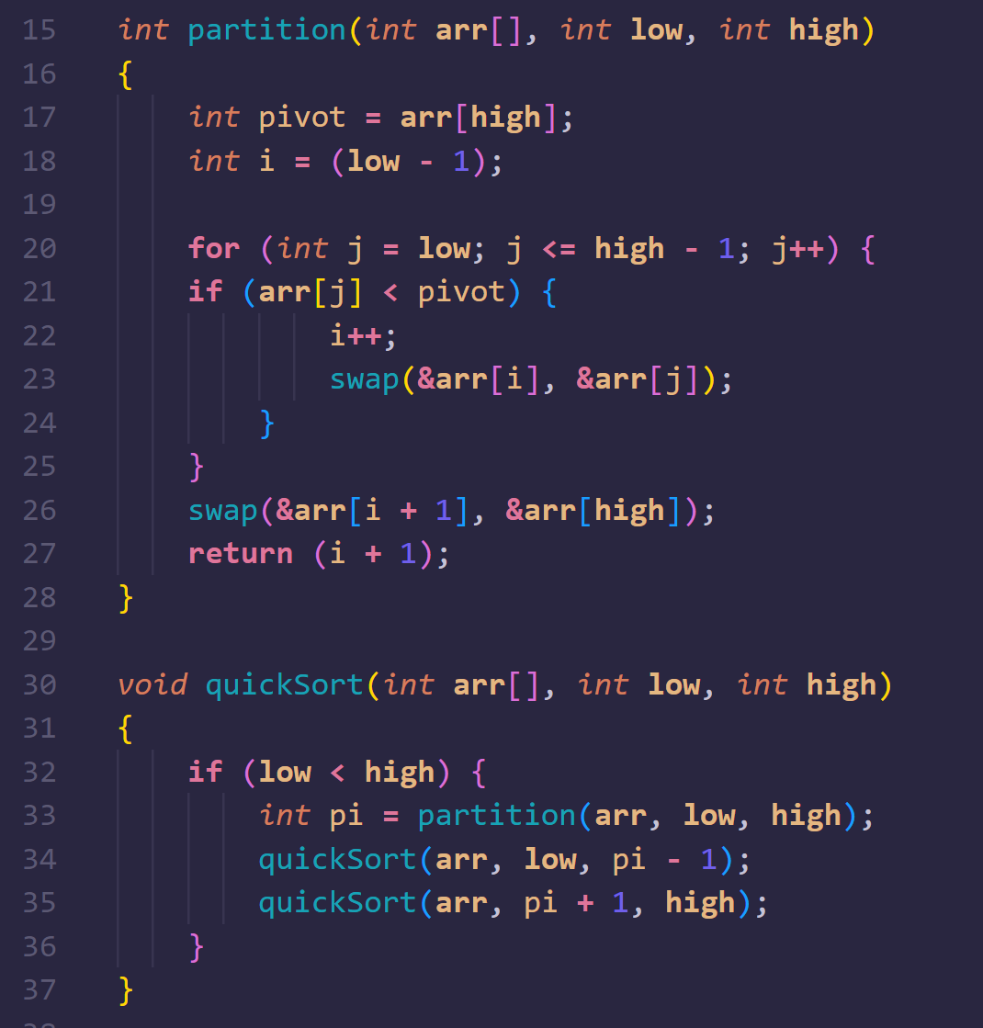

What’s the time complexity of the following algorithm?
Notes:
证明考虑变量是否和已知量一样

Slide 6
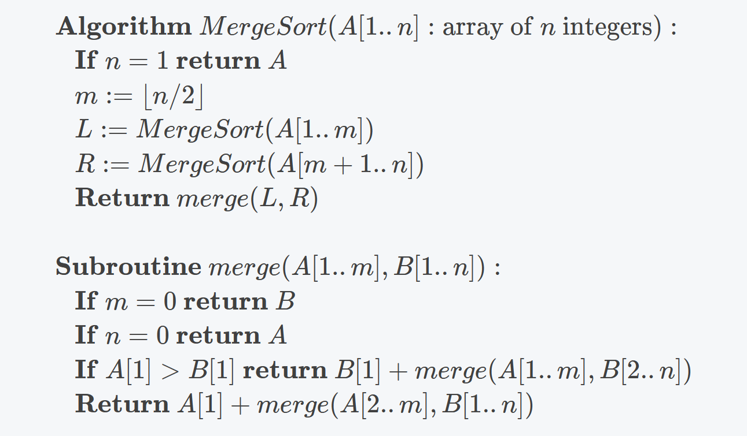
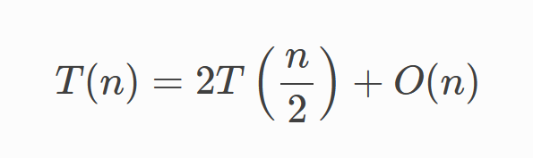
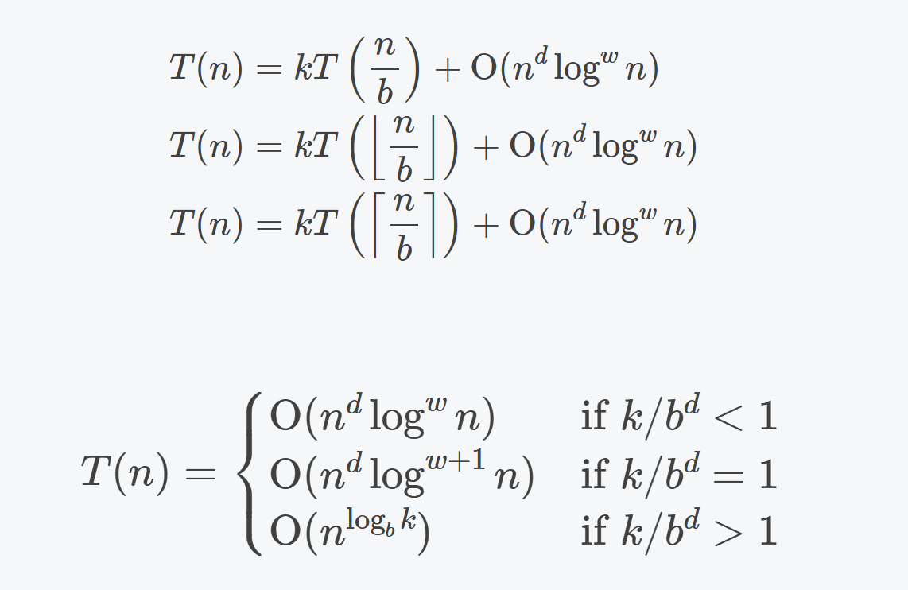
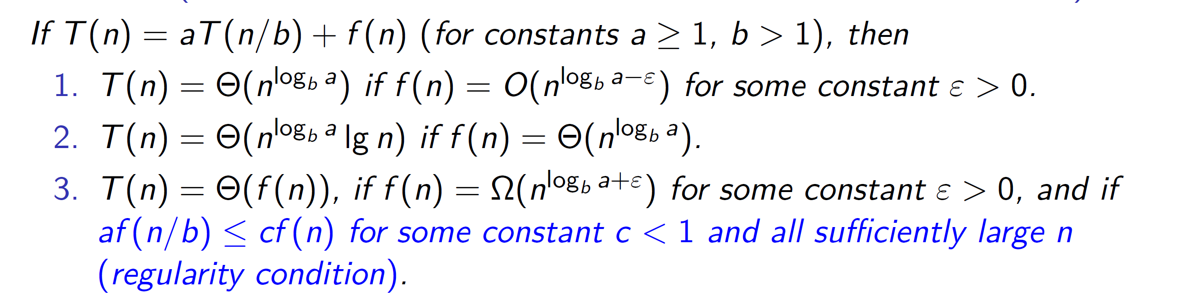
Master Theorem
What’s the complexity of merge sort?
Special case:

Slide 7
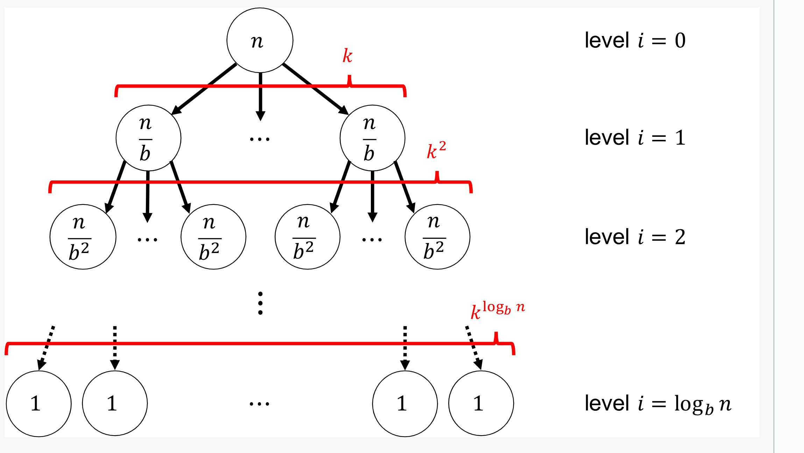
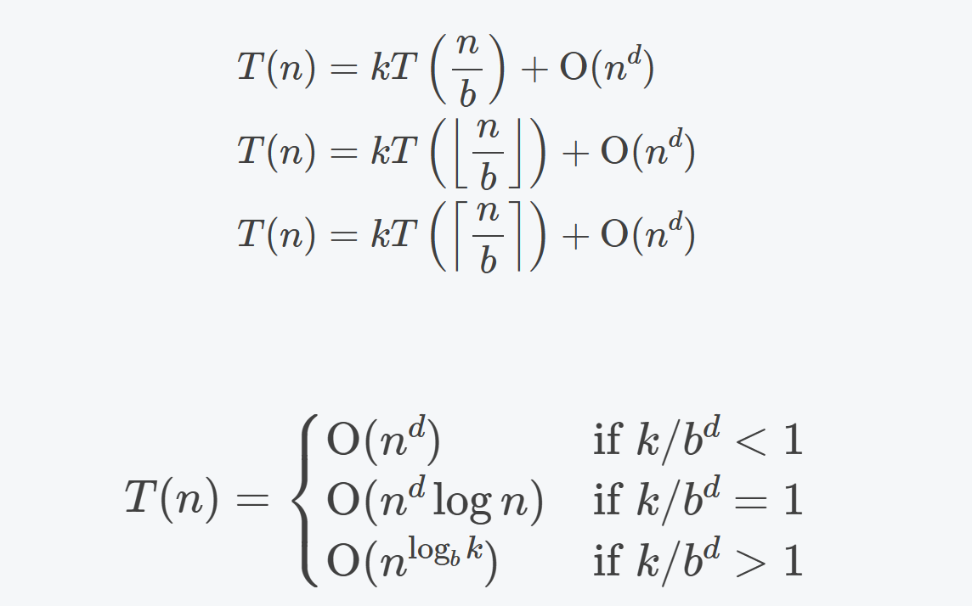
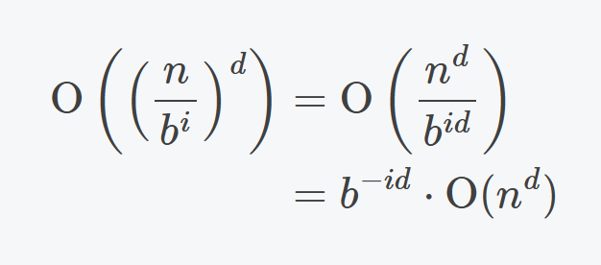
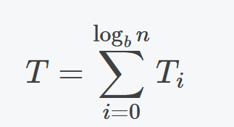
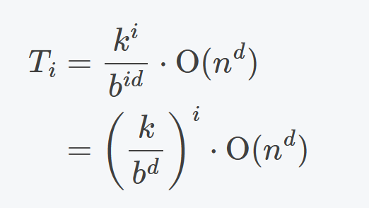
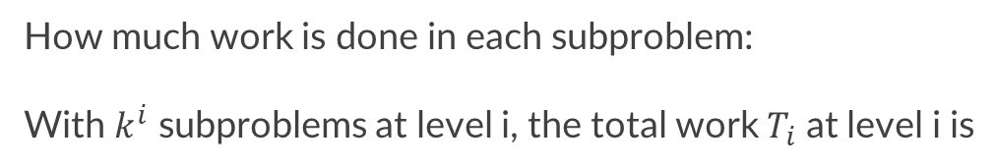
Divide and conquer
“分而治之”
How much work is done in each subproblem:
With $k^{i}$ subproblems at level i, the total work $T_{i}$ at level i is

Slide 8


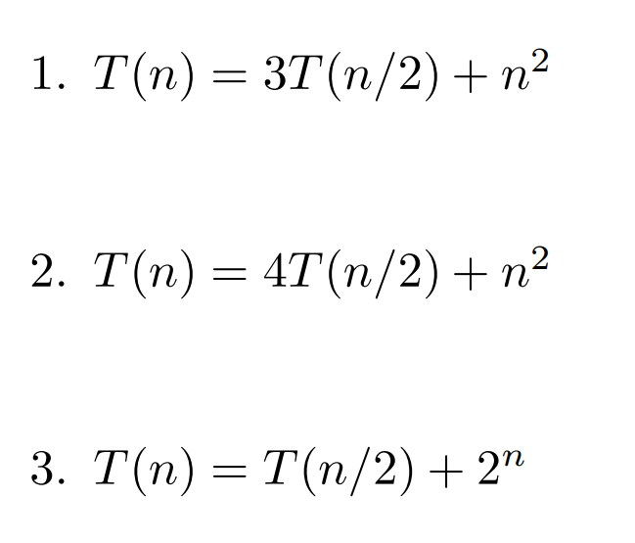
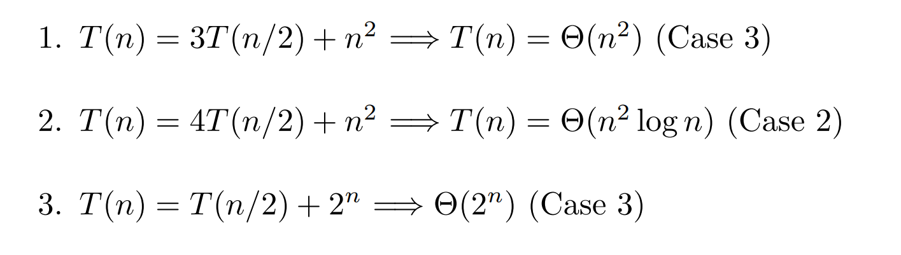

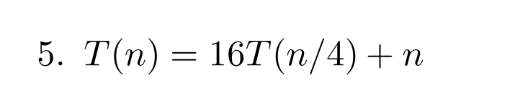
Examples
Answer:
Notes:
Appendix — Foundations of Computer Science 0.3 documentation (eecs376.github.io)

Slide 9


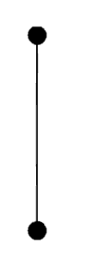

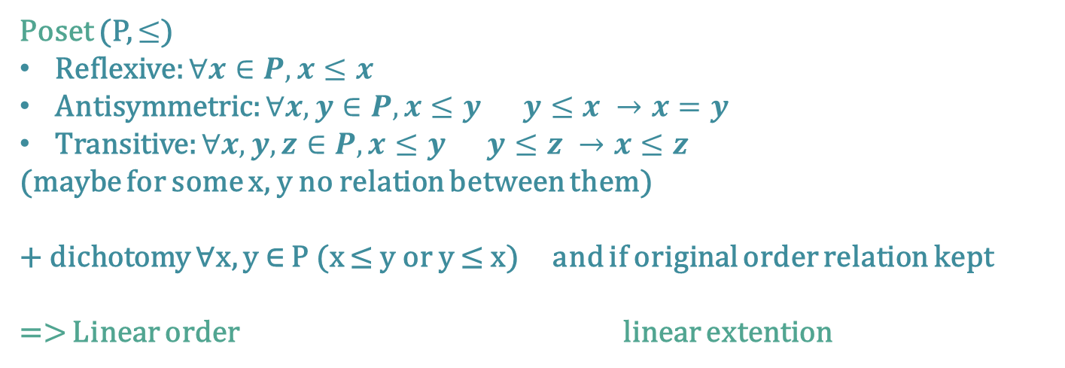
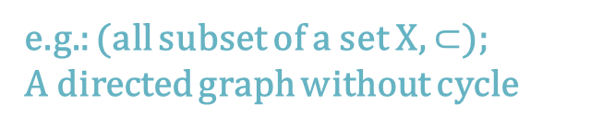
Partial Order
Poset (P, $≤$)
Reflexive: $∀x∈P, x≤x$
Antisymmetric: $∀x,y∈P, x≤y y≤x →x=y$
Transitive: $∀x,y,z∈P, x≤y y≤z →x≤z$
(maybe for some x, y no relation between them)
+ dichotomy ∀x, y ∈ P (x ≤ y or y ≤ x) and if original order relation kept
=> Linear order linear extention
e.g.: (all subset of a set X, $⊂$);
A directed graph without cycle
y cover x
x
x
Minimal/maximal: no larger/smaller element (may not unique)
Comparable with every element
Minimum/maximum(unique if exist)
y
y

Slide 10
Example
We naturally order the numbers in Am={1,2,...,m} with “less than or equal to,” which is a partial ordering. We define an ordering, ⪯ on the elements of Am×An by
(a,b)⪯(a′,b′) ⇔ a≤a′ and b≤b‘
1. Prove that ⪯ is a partial ordering on Am×An.
2. Draw the Hasse diagrams for ⪯ on A2×A2, A2×A3
3. What is the minimal element? What is the minimum element?
Set L={3,5,7,15,35,45,105}
(L, |(divisibility)) is a poset
What is the minimal element? What is the minimum element?
Notes:
证明考虑变量是否和已知量一样

Slide 11
End QAQQ&A

Slide 12
Reference
Umich EECS376 Notes

