Slide 1
Graph Yue

Slide 2
Outline
Chain
Graph basic
Connectivity

Slide 3
Chain & Antichain
Chain: a subset of comparable elements (a complete graph)
Antichain: a subset of incomparable elements
Maximal: can’t be extended
Maximum: max length
Height: maximum size of chain
Width: maximum size of antichain
Notes:
证明考虑变量是否和已知量一样

Slide 4
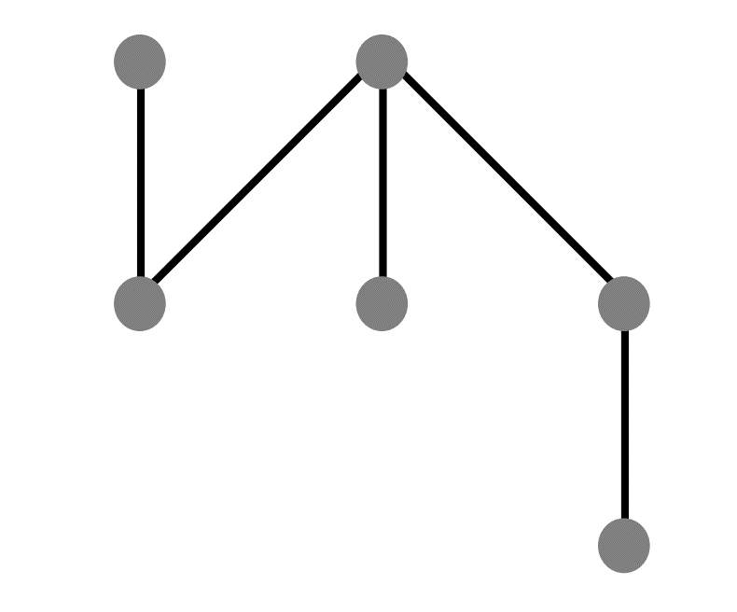
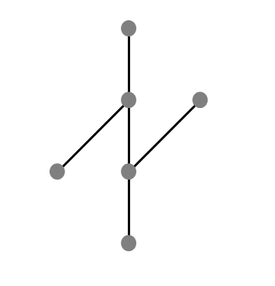
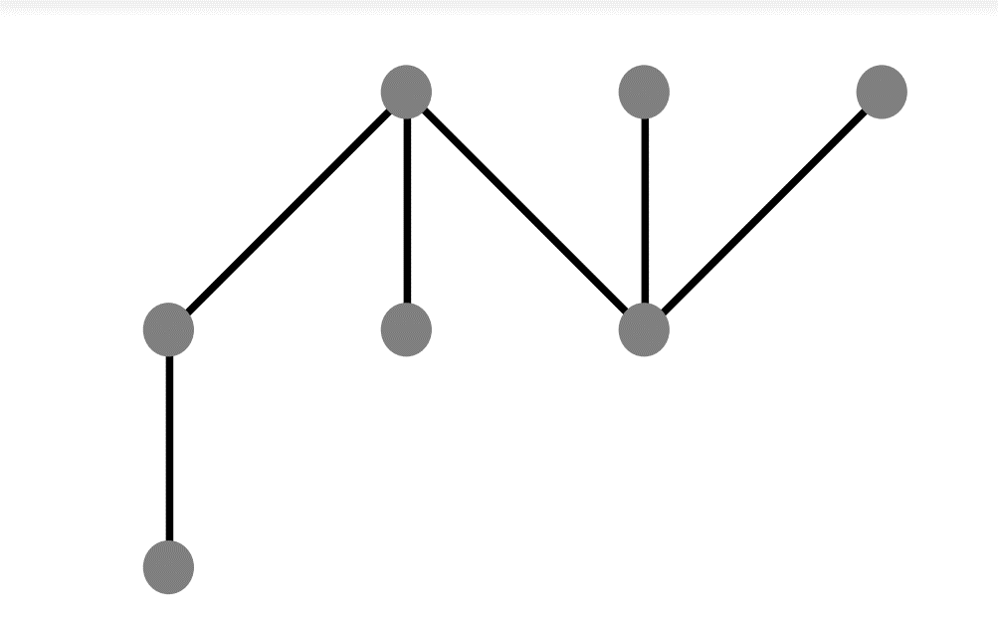
Dilworth’s Theorem
k: least integer that P is a union of k chains
m: size of largest antichain of P
Dilworth Theorem: k=m
“dual”:
k: least integer that P is a union of k antichains
m: size of largest chain
Mirsky’s Theorem: k=m
Example:
width of the graph on the right?
Given a finite poset, would removing a maximal chain decreases the width of the poset?
Notes:
证明考虑变量是否和已知量一样

Slide 5
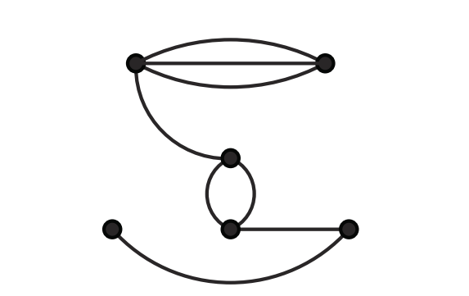
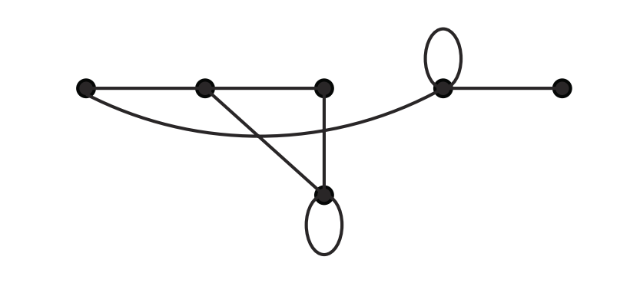

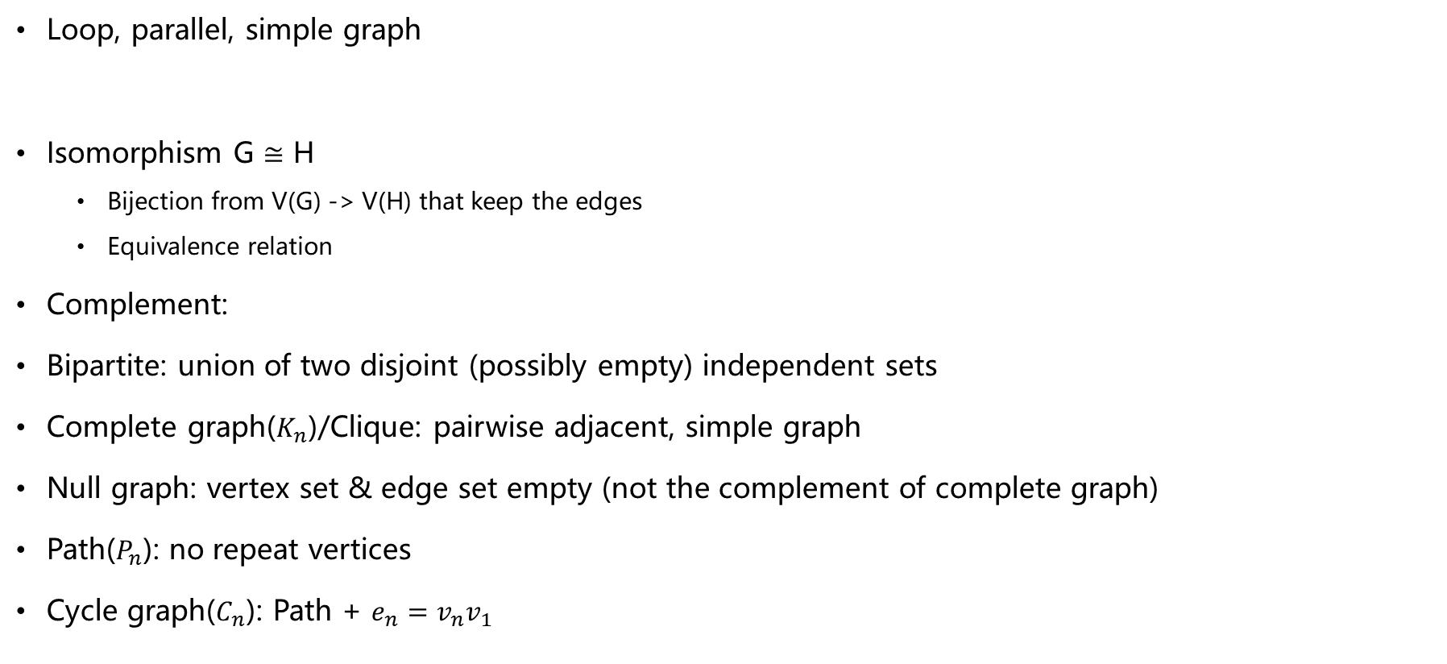
Basic Graph Definitions
Loop, parallel, simple graph
Isomorphism G $≅$ H
Bijection from V(G) -> V(H) that keep the edges
Equivalence relation
Complement:
Bipartite: union of two disjoint (possibly empty) independent sets
Complete graph($K_{n}$)/Clique: pairwise adjacent, simple graph
Null graph: vertex set & edge set empty (not the complement of complete graph)
Path($P_{n}$): no repeat vertices
Cycle graph($C_{n}$): Path + $e_{n}=v_{n}v_{1}$
Notes:
证明考虑变量是否和已知量一样

Slide 6
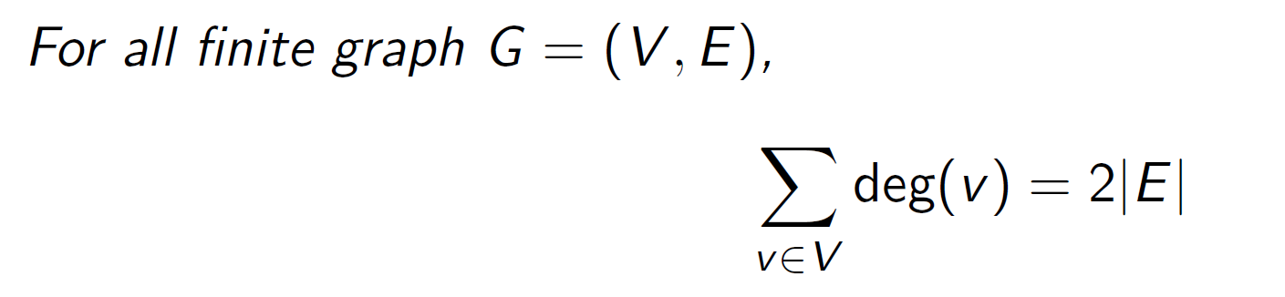
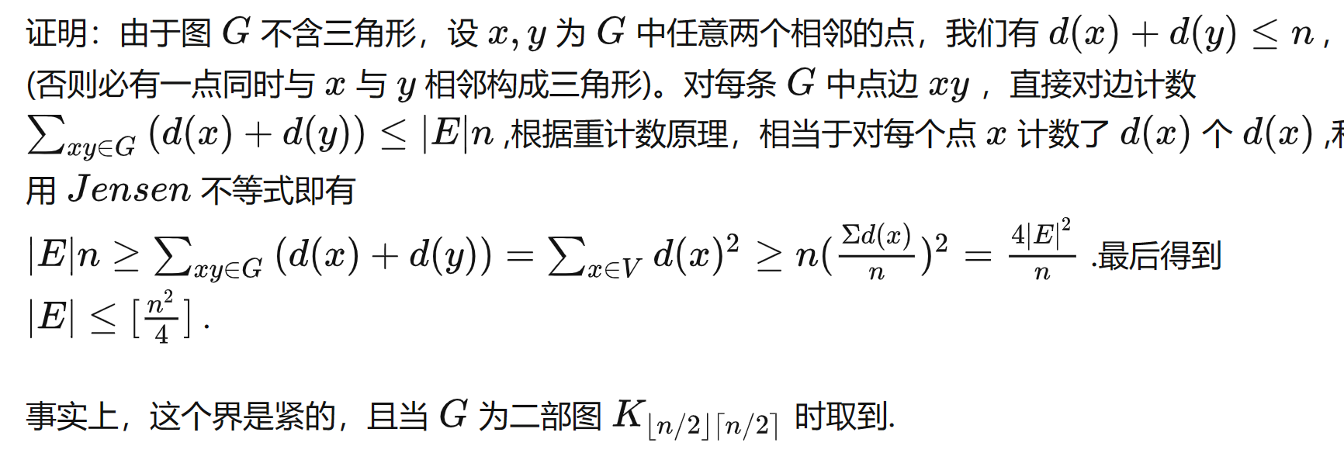

Double Counting
Relation between Degree & Edge
Handshaking lemma
Exercise:
In any graph with at least two nodes, there are at least two nodes of the same degree
Is it true that a finite graph having exactly two vertices of odd degree must contain a path from one to the other? Give a proof or a counterexample.
Another example(extra content):
Mantel's Theorem: For a simple graph G containing no triangles, |V(G)|=n, what is the maximum number of edges G can have?
Notes:
证明考虑变量是否和已知量一样

Slide 7
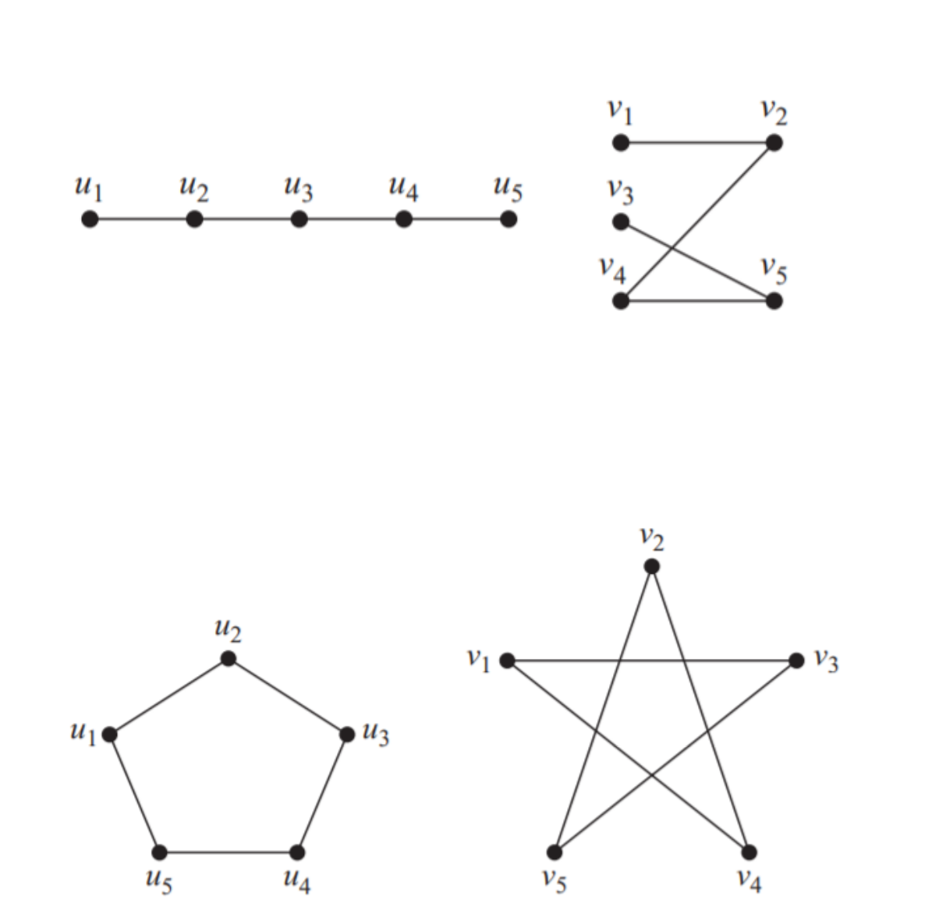
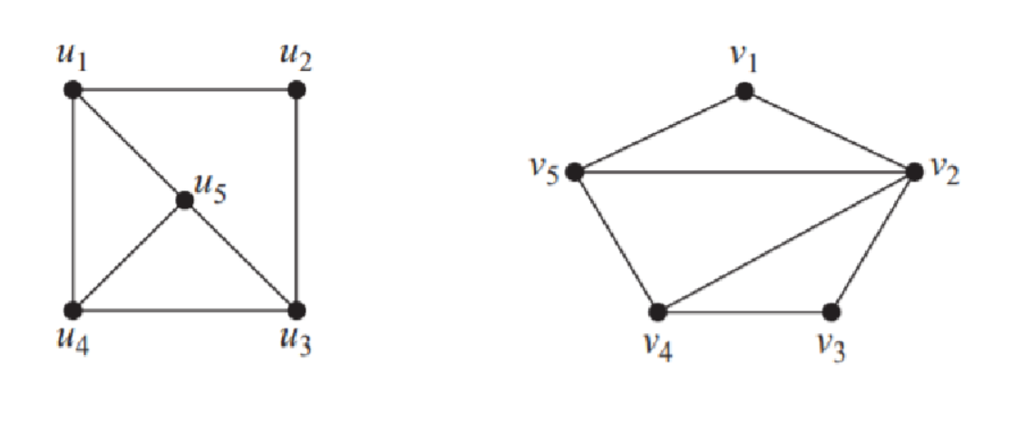
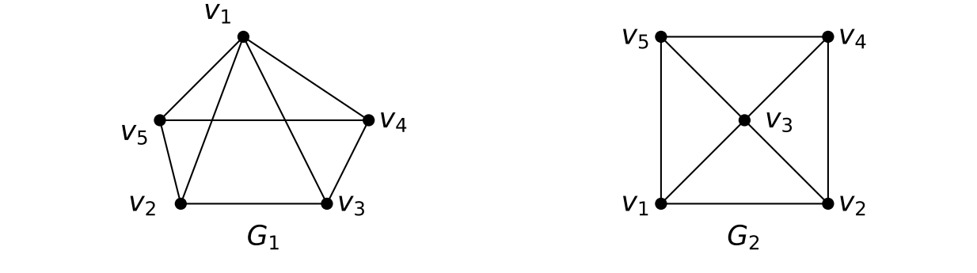
Determine whether the given pairs of graphs are isomorphic
Notes:
VE203_Worksheet7.pdf

Slide 8
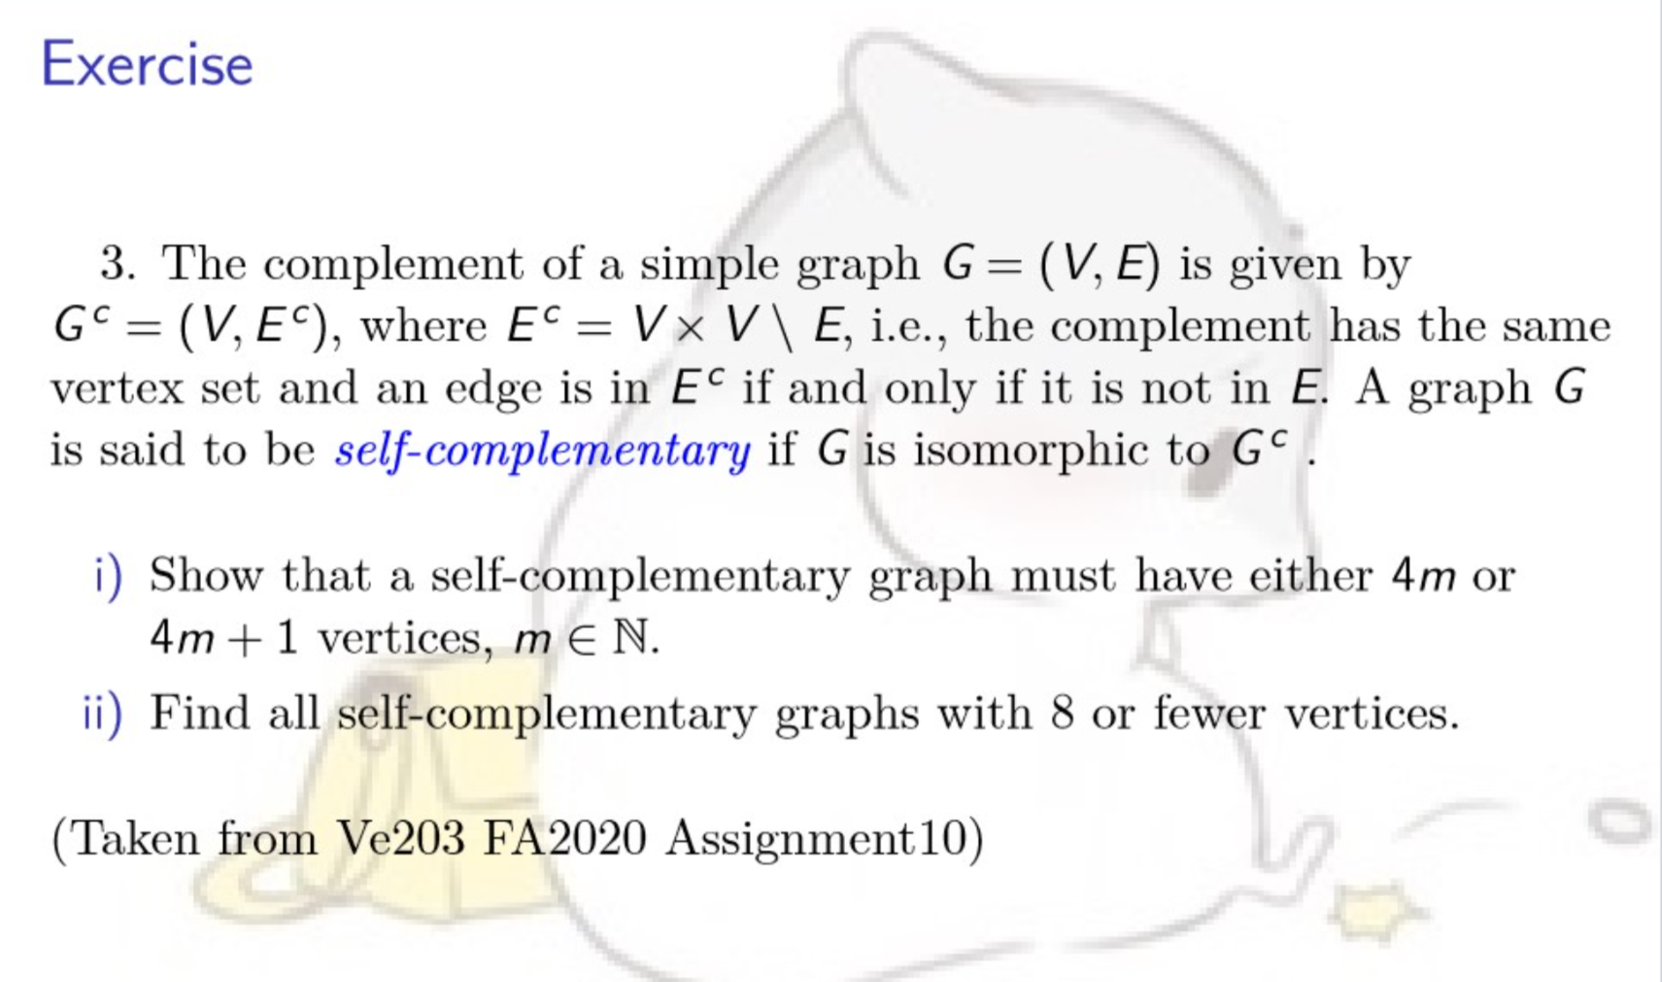

Slide 9
Suppose you have a party of six people. Each pair of people are either friends (they know each other) or strangers (they do not).
Theorem: Any such party must have a group of three mutual friends (three people who all know one another) or three mutual strangers (three people, none of whom know any of the others)
Theorem: Consider a 6-clique where every edge is colored red or blue. The graph contains a red triangle or a blue triangle
Theorem (Ramsey’s Theorem): For any natural number n, there is a smallest natural number R(n) such that if the edges of an R(n)-clique are colored red or blue, the resulting graph will contain either a red n-clique or a blue n-clique.
Out proof: n=3, R(n)<=6
Notes:
https://web.stanford.edu/class/archive/cs/cs103/cs103.1184/lectures/11/Small11.pdf

Slide 10

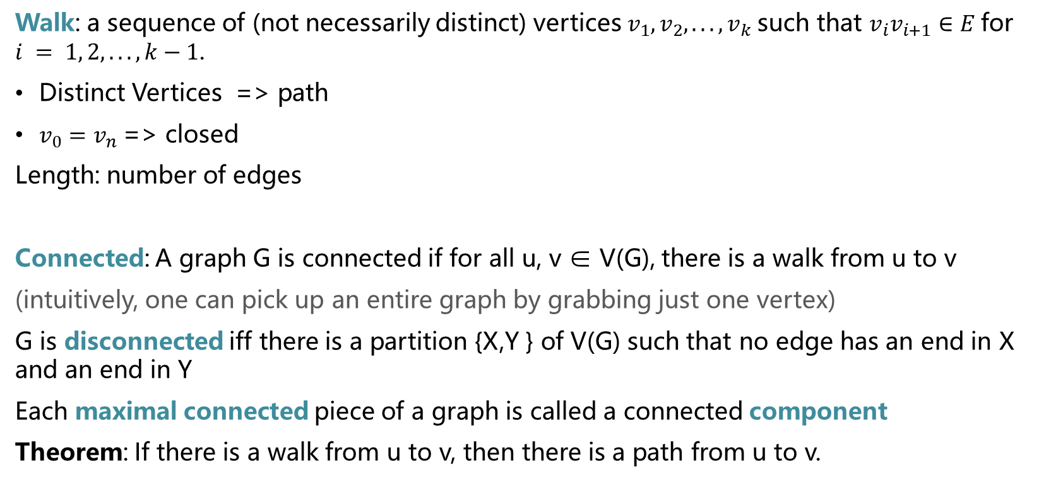
Definition
Walk: a sequence of (not necessarily distinct) vertices $v_{1}, v_{2}, . . . , v_{k}$such that $v_{i}v_{i+1}∈E$for $i = 1, 2, . . ., k−1$.
Distinct Vertices => path
$v_{0}=v_{n}$=> closed
Length: number of edges
Connected: A graph G is connected if for all u, v ∈ V(G), there is a walk from u to v
(intuitively, one can pick up an entire graph by grabbing just one vertex)
G is disconnected iff there is a partition {X,Y } of V(G) such that no edge has an end in X and an end in Y
Each maximal connected piece of a graph is called a connected component
Theorem: If there is a walk from u to v, then there is a path from u to v.

Slide 11
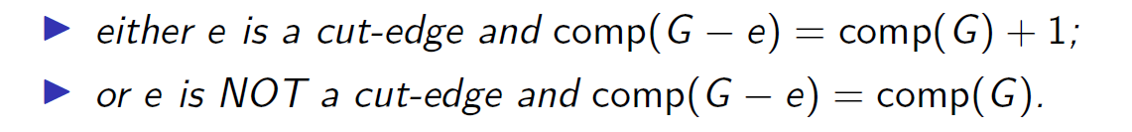
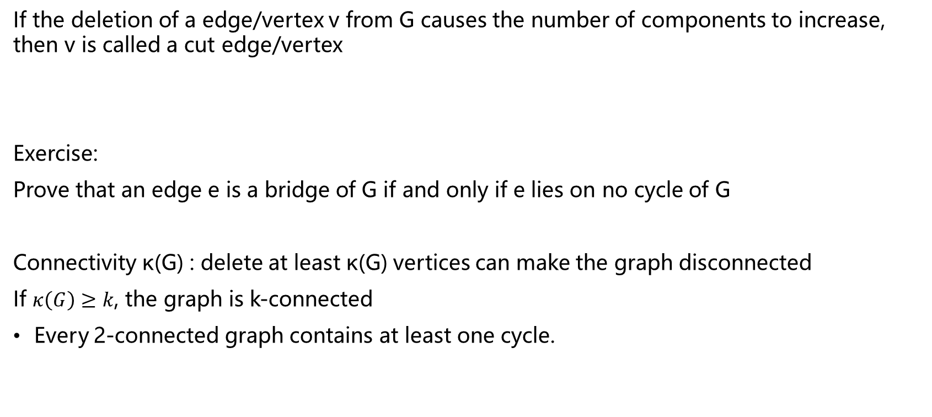
Bridge
If the deletion of a edge/vertex v from G causes the number of components to increase, then v is called a cut edge/vertex
Exercise:
Prove that an edge e is a bridge of G if and only if e lies on no cycle of G
Connectivity κ(G) : delete at least κ(G) vertices can make the graph disconnected
If $κ\left(G\right)≥k$, the graph is k-connected
Every 2-connected graph contains at least one cycle.

Slide 12
δ(G) = min{deg(v) | v ∈ V (G)}.
Let G be a graph where δ(G) ≥ k.
Prove that G has a path of length at least k.
If k ≥ 2, prove that G has a cycle of length at least k + 1
Notes:
https://www3.nd.edu/~dgalvin1/40210/40210_F12/CGT_early.pdf

Slide 13
Let G be a graph with v vertices that is not connected. What is the maximum number of edges of G?
Let G be a graph of order n and size strictly less than n − 1. Prove that G is not connected.

Slide 14
End QAQQ&A

Slide 15
Reference
Combinatorics and Graph Theory by Harris, Hirst and Mossinghoff
Exercise from VE203 2022 spring TA Hamster
Graph from VE203 2022 spring TA Yucheng Huang

