Slide 1
Project Firestorm
Robbie Mckennie
Notes:
Any questions feel free to interrupt

Slide 2
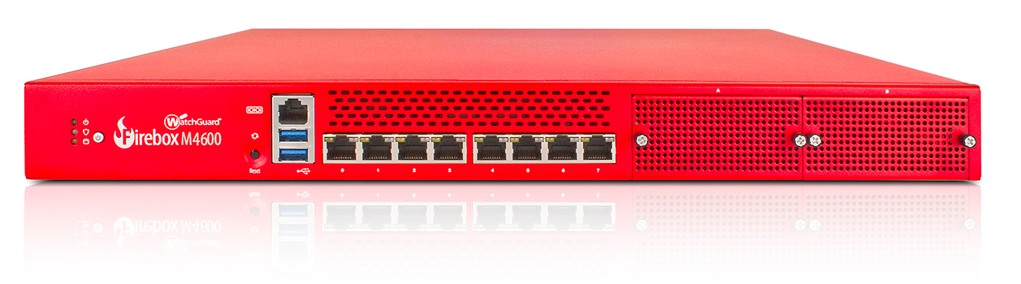
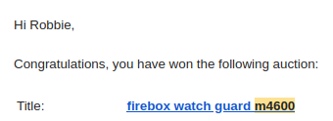
The Firebox M4600
8 port firewall appliance with some kind of hardware cryptography or compression acceleration
neato
Notes:
First I got a firebox m4600, didn't know what I wanted it for, but I knew I wanted it
Got arch running on it, pretty neat, but what do you do with a server with 8 gigabit ethernet interfaces?

Slide 3
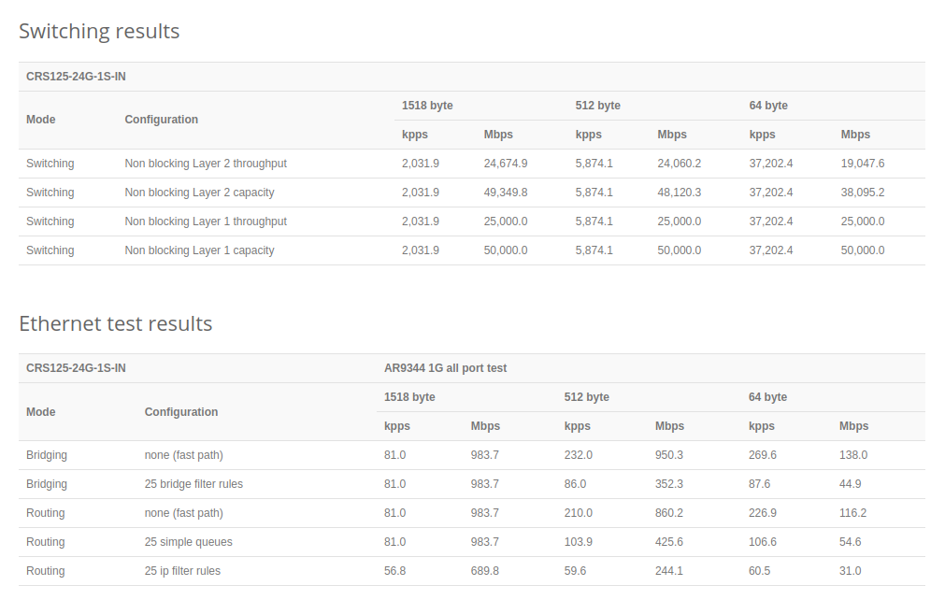
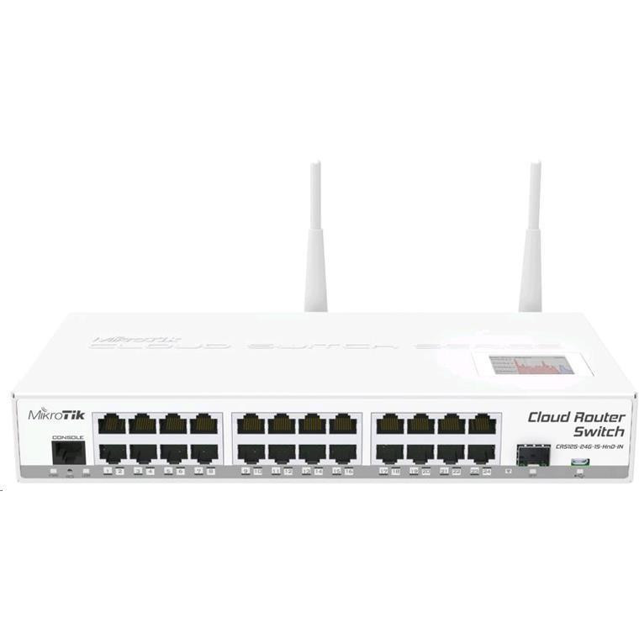
The seed of an idea
Home router died, replaced with spare CRS125
Why?
Notes:
Started with the CRS125, rated for routing at 700mbps by mikrotik, but i'm only getting ~150 mbps on 300mbit fibre
Why? Is it the specific firewall rules I'm using? NAT? PPPoE? Are mikrotik just full of it?
What if you could artificially generate traffic, measure performance, and tweak your configuration to optimize the performance of the device?

Slide 4

Cisco Trex, pretty cool
Different modes of operation, different ways of specifying the parameters of tests
Python library for automation
DPDK
Open source
Notes:
TRex! Pretty cool, a bunch of cool features, so let's use that

Slide 5
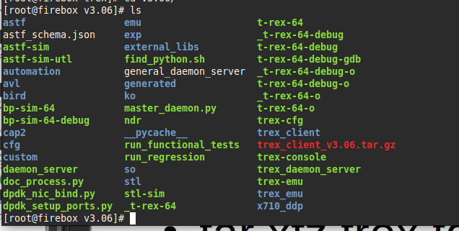
Installation
CentOS Stream 9, with a customized installer
tar xfz trex.tgz, bingo bango bongo
Notes:
Docs recommend CentOS linux, a free equivalent to redhat, necessary to modify the installer to work without a display, pretty smooth
TRex installed by extracting a tarball, configured by a wizard utility, and ready to go
*show config, start trex, show each interface*
*Mikrotik configuration, ip addresses, routes, static ARP*
*run a test, point out unidirectional traffic*

Slide 6
Finding the NDR
TCP has a mechanism for optimizing throughput, but UDP does not, I get to do it myself
All we have control over is the number of packets we transmit per second, and we need the cooperation of the remote server to find the right amount.
Notes:
NDR algorithm
- can't just set it running and see what happens
- the only thing you can control is the number of packets you send
- TCP works by getting feedback from the remote end, and adjusting how much data is sent until a happy rate is found, this is usually handled automagically by the OS
- UDP doesn't do this automatically, how fun!

Slide 7
Binary search
There are different ways to cover the search space, I’m using a binary search
Notes:
- Binary search for NDR
- Iterative bisection
- Start with arbitrary upper and lower bounds, find the midpoint and test it.
- If your drop rate is too high, slow down by moving the upper bound to the point you just tested
- If the drop rate is below the target, speed up by moving the lower bound to the point you just tested
- 10 iterations gets you down to a resolution of about 1/1000th of the search space (1 mbps on a 1gbps interface)

Slide 8
IPerf3
IPerf3 is a simpler throughput testing software
Easier to get going, but less powerful
Better suited to simulating clients directly attached to a router
Notes:
Some tests were also run through IPerf3, which made it easier to test consumer routers, because TRex isn't well suited to generating the kind of traffic they're designed to deal with.

Slide 9
Results
Notes:
(results)

Slide 10
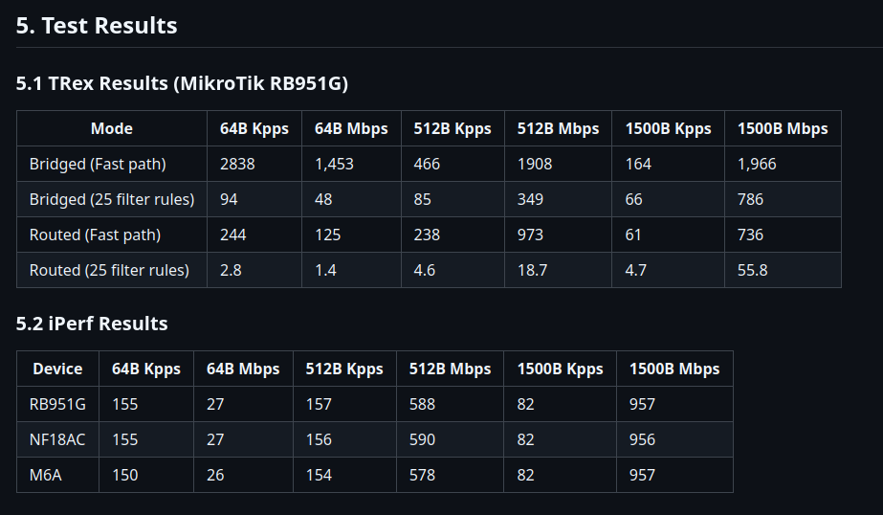
Smaller packets are slower
Notes:
all results show decreased performance for smaller packets
- 2 bottlenecks, how quickly can you analyze the headers on a packet and work out where it needs to go, and how quickly can you move the bulk data? (includes line rate and memory bandwidth)
- for small packets the prior bottleneck dominates, for larger packets the latter bottleneck dominates

Slide 11
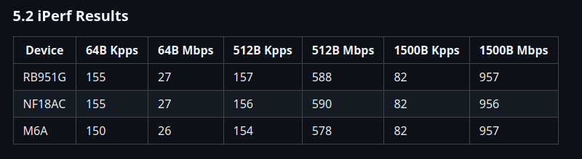
All commercial routers perform well
A little bit boring, but they all look pretty good, and pretty similar
Notes:
comparison of different consumer routers, very comparable performance

Slide 12
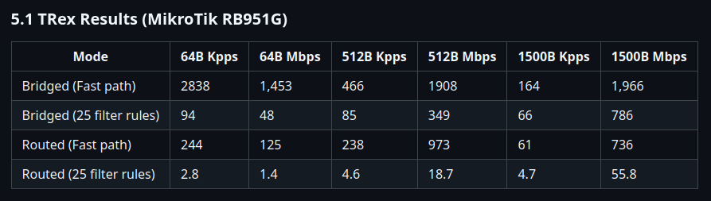
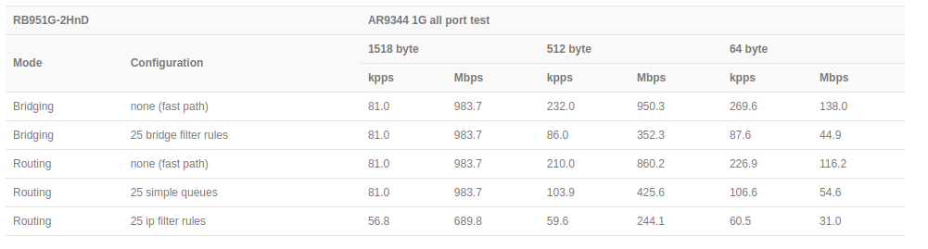
RB951G Deep Testing
Bridging is pretty good, but routing performance is not
Why?
Notes:
rb951g compared with mikrotik numbers, fast path bridging is comparable, all other metrics dramatically worse.
- defective unit?
- systematic problem? suspect an issue with unidirectional traffic

Slide 13
Thanks for listening
Special thanks to Emre Erturk, Graham Ward, John Jamieson, my classmates, and EIT
These slides and more information available on https://github.com/h0dgep0dge/ITSP7/
Any questions?

