Slide 1
Online Customer Complaint System -
DBMS Project
Project Mentor :- Mr. Deepak Sharma

Slide 2
Project Profile :-
“Online Customer Complaint System” is a web based application which will be used for handling the various types of complaints occurred in the product of any kind of organization.
In this project, we made it for a Tech based company which sells software and hardware products.

Slide 3
Utilities provided.
Multiple Complaints can be lodged.
Real Time Status Update on complaints.
Transparency provided between the customers and the Engineers assigned.

Slide 4
Technologies and Build Tools :-
Backend - PHP , MySQL.
Frontend - HTML/CSS.
Tools :-
Sublime Text 3.
Xampp for PHP and MYSQL.

Slide 5
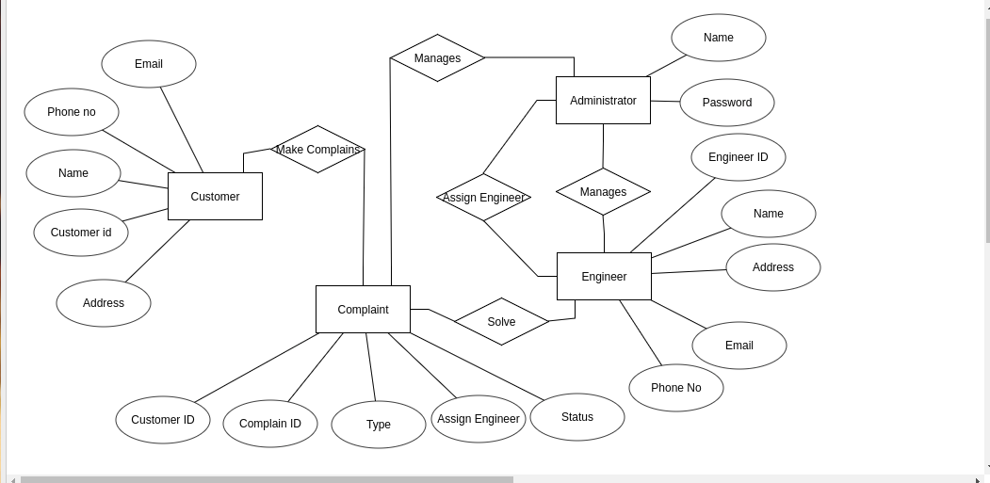
ER - Diagram :-

Slide 6
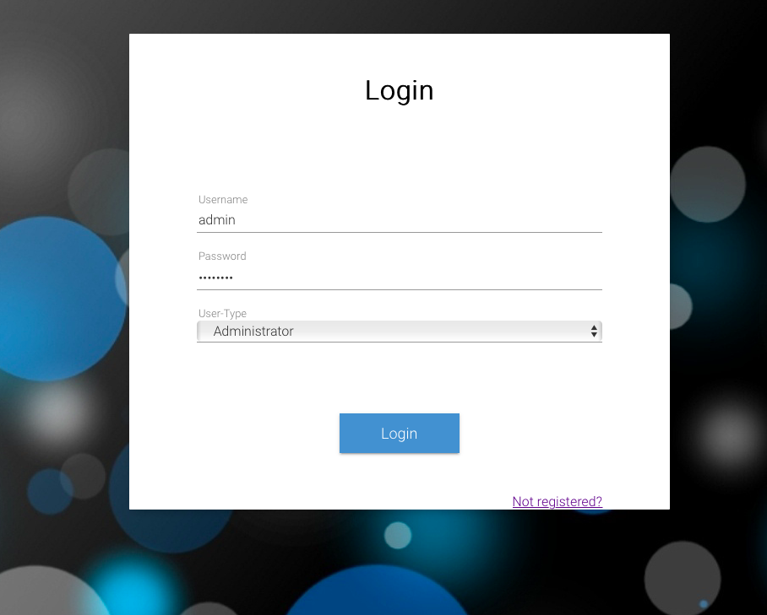
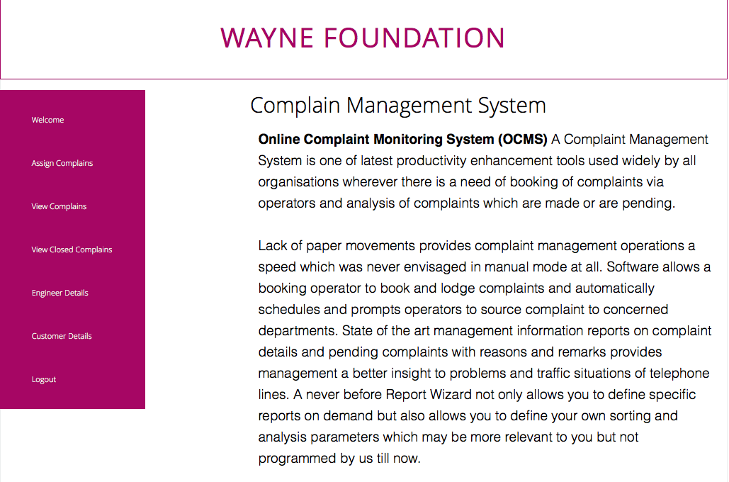
User Interface

Slide 7
Keys In the Schema :-
Super Key in the Complaints Table (tbl_complains) is (Cid , Cust_id , Eng_id) where Cid is Complaint ID , Cust_id is the ID of the customer who has lodged the complaint and Eng_id is the ID of the Engineer assigned to the respective complaint.
Cid is the Candidate Key for Complaints Table(tbl_complains).
Cust_id is the Candidate Key for Customer Table(tbl_customer).
Eng_id is the Candidate Key for the Engineer Table(tbl_engineer).

Slide 8
1 NF :-
The data was repeating initially.
Details of Customer was repeating continuously for every complaint made by the customer thus causing insertion and deletion issue in database.

Slide 9
2 NF :-
Database is made in a way that there should be no partial dependency i.e. no non-prime entity can be accessed from any proper subset of Super Key.

Slide 10
3 NF :-
Database is finally made in a way that there should be NO Non-prime to Non-prime entity relationship (Transitive dependency).
Database finally choose a candidate key in a way that we avoid any Transition relationship by providing relationships either Prme to Non-prime entity considering there is no partial dependency.

Slide 11
Collaborators :-
Himanshu Gusain - IIT2015090
Tushar Murarka - IIT2015091
Pranjul Tripathi - IIT2015094
Prajjawal Agarwal - IIT2015099
Shubhanshu Singh - LIT2015011

