Slide 1

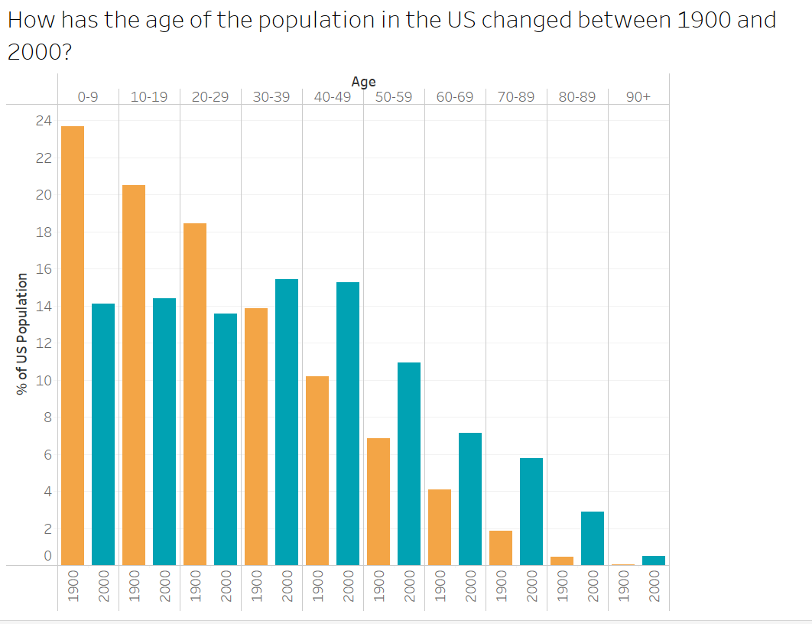
How has the age of the population in the US changed between 1900 and 2000?
using US Census Data from
Infant mortality: In 1900, nearly 24% of babies born died before their fifth birthday. In 2000, that number was under 1%.
Median age: In 1900, the median age was 23 years. In 2000, it was 35 years.
Life Expectancy: In 1900, the life expectancy of a person was 48 years. Less than 5% of the population was 65 or older. In 2000, those numbers were 76 years and over 12%.

Slide 2
How has the age of the population in the US changed between 1900 and 2000?
using US Census Data from
Infant mortality: In 1900, nearly 24% of babies born died before their fifth birthday. In 2000, that number was <1%.
Life Expectancy: In 1900, the life expectancy of a person was 48 years. In 2000, it was 76 years.
Aging Population: In 1900, less than 5% of the population was 65 or older. In 2000, it was over 12%.

Slide 3
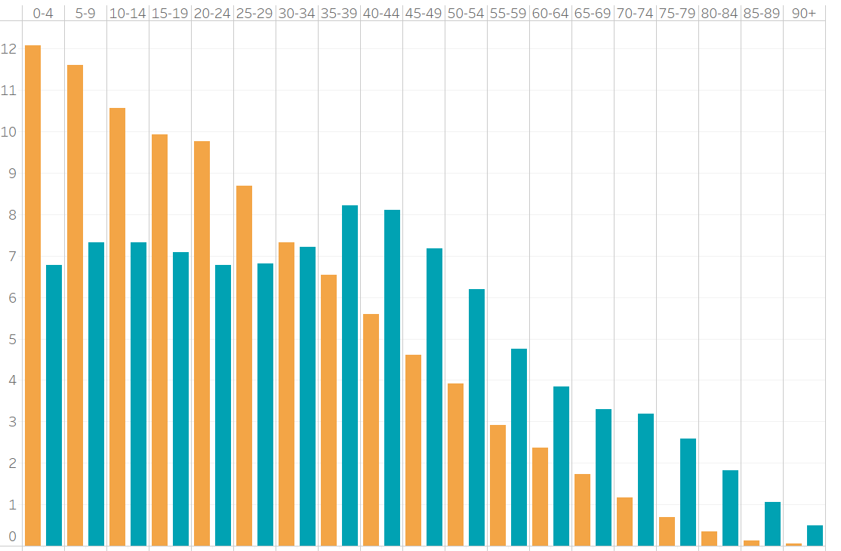



What is the Difference in Age Distribution in the US in 1900 vs 2000?
US Census Data from
Infant mortality: In 1900, nearly 24% of US babies died before their fifth birthday. In 2000, that number was less than 1%.
Life Expectancy: In 1900, life expectancy in the US was 48 years. In 2000, it was 76 years.
% of Population
Aging Population: In 1900, less than 5% of the US population was 65 or older. In 2000, it was over 12%.
Age

