Slide 1
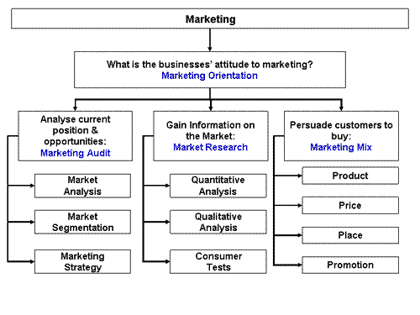

Slide 2
Week 4 – Price
What does price mean?

Slide 3
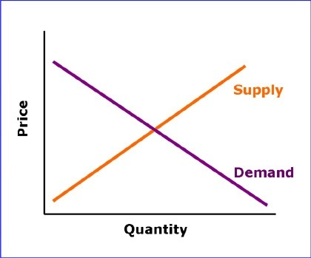
The Supply and Demand Curve

Slide 4

Pricing strategy
Cost + Profit
Value added
Competition based

Slide 5
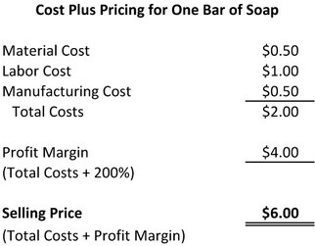
Price: Cost + Profit

Slide 6
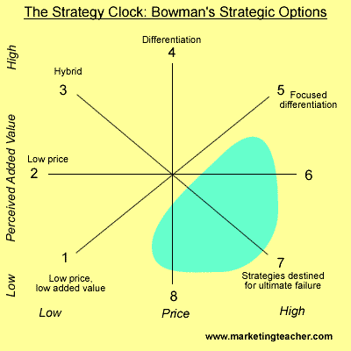
Pricing: Value Added

Slide 7
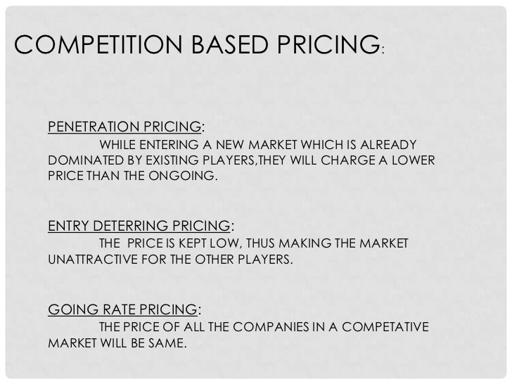
Pricing: Competition Based

