Slide 1

Introduction to Computers and Programming
Lab 2
Date: 2016/09/21

Slide 2


Printf Usage – escape sequence
Print some special character
"\n" means new line.
"\t" means tab.
printf("100%\n");
printf("100%\n");
printf("\");
printf("\\");
printf(""");
printf("\"");
printf("\t");
illegal
illegal

Slide 3

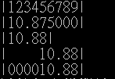

Printf Usage (cont.)
int a = 87;
printf("|12345|\n");
printf("|%d|\n", a);
printf("|%5d|\n", a);
printf("|%05d|\n", a);
float b = 10.875;
printf("|123456789|\n");
printf("|%f|\n", b);
printf("|%.2f|\n", b);
printf("|%9.2f|\n", b);
printf("|%09.2f|\n", b);
int a = 87, b = 123;
float c = 3.21;
printf("%d %d %.1f\n", a, b, c);
printf("%3d + %3d = %3d\n", a, b, a + b);

Slide 4
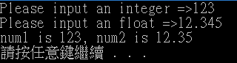
Scanf Usage
#include <stdio.h>
#include <stdlib.h>
int main() {
int num1;
float num2;
printf("Please input an integer =>");
scanf("%d", &num1);
printf("Please input an float =>");
scanf("%f", &num2);
printf("num1 is %d, num2 is %.2f\n", num1, num2);
system("pause");
return 0;
}

