Slide 1
OS HW4
Operating System 107 Fall
W.J.Tsai 蔡文錦 教授
TA 劉晏
蘇聖雅
莊侑穎
盧彥廷
黃資捷

Slide 2
Background
Thread
Only use:
#include <pthread.h>
Declare:
pthread_t thread1, thread2;
Functions:
  int pthread_create(pthread_t * thread, const pthread_attr_t * attr,
  void * (*start_routine)(void *), void *arg);
  int pthread_join(pthread_t th, void **thread_return);
    wait for termination of another thread
  void pthread_exit(void *retval);

Slide 3
Synchronization - mutex lock
Only use:
#include <pthread.h>
Declare: (global variable)
pthread_mutex_t mutex1 = PTHREAD_MUTEX_INITIALIZER;
Functions:
  pthread_mutex_lock()
    acquire a lock on the specified mutex variable. If the mutex is already locked by another thread, this call will block the calling thread until the mutex is unlocked.
  pthread_mutex_unlock()
    unlock a mutex variable. An error is returned if mutex is already unlocked or owned by another thread.
  pthread_mutex_trylock()
    attempt to lock a mutex or will return error code if busy. Useful for preventing deadlock conditions.

Slide 4
Synchronization - semaphore
#include <pthread.h>
  Declare: (global variable)
  pthread_cond_t cond1 = PTHREAD_COND_INITIALIZER;
  Functions:
    pthread_cond_wait
    pthread_cond_signal
    pthread_cond_broadcast
#include <semaphore.h>
  Declare: (global variable)
  sem_t sem1;
  Functions:
    int sem_post(sem_t *);
    int sem_wait(sem_t *);
    int sem_close(sem_t *);

Slide 5


Goal
Problem1: (80%)
Implement image processing by using threads and synchronization.
  1. Smoothing images with Mean filter
  2. Edge Detection with Sobel filter
  ***Please follow the order, Mean filter first ,then Sobel filter.***
  ***Only create two threads(One for Mean filter , one for Sobel filter).***
input
output
1.Mean filter + 2.Sobel filter

Slide 6
Goal
Problem2: (bonus 15%)
Implement image processing by using threads and synchronization.
  1. Smoothing images with Mean filter
  2. Edge Detection with Sobel filter
  ***Please follow the order, Mean filter first ,then Sobel filter.***
  ***Create more than two threads***
input
output
1.Mean filter + 2.Sobel filter

Slide 7

Notice: You need to do Mean filter and Sobel filter at the same time.
In HW4, you need use at least one of mutex lock and semaphore.
For example:
  HW4 with mutex lock.
  HW4 with semaphore.
  HW4 with mutex lock and semaphore.
  HW4 without any one of mutex lock and semaphore.

Slide 8
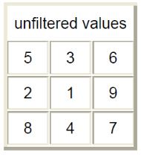
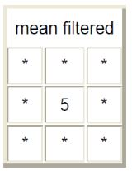
Introduction: Mean filter
For example:

Slide 9
Introduction: Algorithm
Convert RGB image to grey image:
  grey(i, j) = ( R(i, j)+G(i, j)+B(i, j) )/3
Smoothing: convolving the grey image with a Mean filter.
Extend the size of image from HxWx1 to HxWx3 (to save the image)
  R(i, j) = grey(i, j)
  G(i, j) = grey(i, j)
  B(i, j) = grey(i, j)

Slide 10
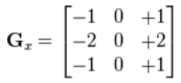
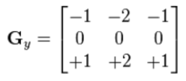
Introduction: Sobel filter
Sobel filter:
  Gradient of horizontal direction
  Gradient of vertical direction
Sobel filter is written in “mask_Sobel.txt”
  The first number is the filter size
  The second line is Gx
  The third line is Gy
  Note: the size of Gx and Gy must be the same.
9
1 0 -1 2 0 -2 1 0 -1
-1 -2 -1 0 0 0 1 2 1

Slide 11
Introduction: Edge Detection algorithm
Convert RGB image to grey image:
  grey(i, j) = ( R(i, j)+G(i, j)+B(i, j) )/3
Convolving the grey image with Gx filter and Gy filter, respectively.
→ Get image_x and image_y
Compute:
Image(i, j) = sqrt( image_x(i, j)*image_x(i, j) + image_y(i, j)* image_y(i, j) )
Extend the size of image from HxWx1 to HxWx3 (to save the image)
  R(i, j) = Image(i, j)
  G(i, j) = Image(i, j)
  B(i, j) = Image(i, j)

Slide 12
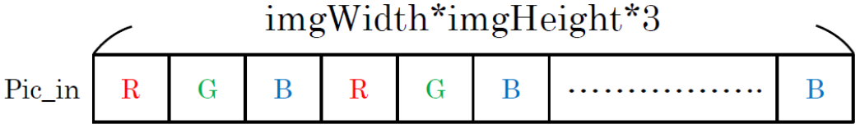
Image read & write
Only use “bmpReader.h“ and ”bmpReader.cpp” we provide to read or write images. (Don’t modify “bmpReader.h” and “bmpReader.cpp”.)
Each pixel is represented by three values.
R G B R G B…..
Accessing the i-th row, j-th col pixel :
  pic_in[3*(i*imgWidth+j)+color], color = 0,1,2
Be careful of the conversion between integer, double (float), and unsigned char.

Slide 13
Input & output format
Input: 5 BMP images and a mask file
  Image name: input1.bmp, input2.bmp, input3.bmp, input4.bmp, input5.bmp
  Mask file name:
  mask_Sobel.txt
  Input location:
  In the same folder with cpp file.
Output: 5 BMP images for each part
  Image name: output1.bmp, output2.bmp, output3.bmp, output4.bmp, output5.bmp
  Output location:
  In the same folder with cpp file.

Slide 14
Score
Correctness score: from 0 to 2 pts for each images (5 images)
  Mean Absolute Error: ,where c=0,1,2
  If MAE==0, then your output is correct.
  We will give you “MAE.out”. Then you can use it to check the correctness.
  Use the following command:
  ./MAE.out [image 1] [image 2]
  If you get “Permission denied” (拒絕不符權限操作), use the following command:
  chmod +x MAE.out

Slide 15
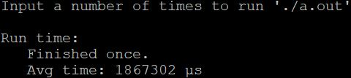
Score (cont.)
Speed score: from 0 to 40 pts
We will provide “example_hw4.cpp”, which doesn’t use multithread programming and synchronized, as a speed baseline.
  We will give you “Speed.sh”.
  Use the following command:
  sh Speed.sh
  We will use it to compute your average run time. (Input = 10 fixed.)
  This is a provisional standard table, we may modify after checking all students’ HW4.
Speedup | HW4
< 0.9 | 0
0.9~1.1 | 0
1.1~1.3 | 25
1.3~1.5 | 30
1.5~1.7 | 35
> 1.7 | 40
 | HW4
Baseline | 1867302 μs
filter size | 3*3

Slide 16
Score (cont.)
Report (20 pts):
  Format is in “report.docx”
  Written in English or Chinese, up to 2 pages
Final score (Total 115 pts):
Speed score * (Correctness score /5) +
Report score + bonus
Others:
  Without mutex lock or semaphore.: will get 0pt directly
  Use other library NOT in “example_hw4.cpp”: will get 0pt directly
  Wrong input/output format: -10pts
  Wrong hand-in file name: -10pts
  Copy or be copied: will get 0pt directly
(you only can use these library)
“example_hw4.cpp”:
#include "bmpReader.h"
#include "bmpReader.cpp"
#include <stdio.h>
#include <iostream>
#include <math.h>
#include <pthread.h>
#include <semaphore.h>
using namespace std;

Slide 17
Requirements
We only use these commends:
g++ -std=c++11 -pthread StudentID_hw4.cpp
g++ -std=c++11 -pthread StudentID_hw4_bonus.cpp
./a.out
↑ no argument
Put the 3 files into a compressed file named “StudentID_OS_hw4.zip”
  StudentID_hw4.cpp
  StudentID_hw4_bonus.cpp
  report.docx (or report.pdf)
Deadline: 2018/12/23 (Sunday) 23:59

