Slide 1
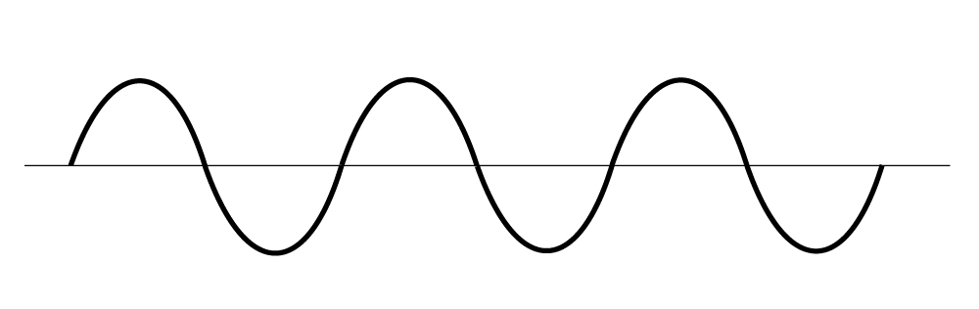
Wavelength: length of one cycle
Amplitude: loudness of wave
Time
Frequency, number of cycles per second

Slide 2
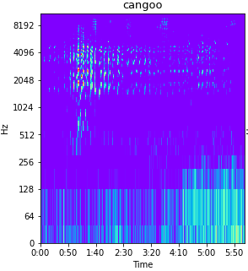
Lower amplitudes (blue)
Higher amplitudes (yellow)

Slide 3
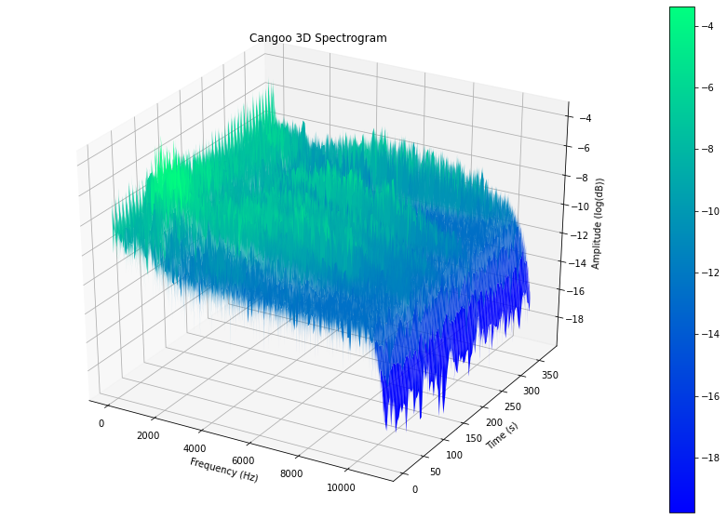
Higher amplitudes
Lower amplitudes

