Slide 1
Prototype for Administrator User-Class

Slide 2
User Class: Administrator
This class of user have the highest privilege among the other classes and the main aim of these users is to keep updating the description based on the feedback given by the users during their tour. So, administrators will keep on exploring the places in the tribal village and watch the feedback available there and based on the feedback they will edit the description of the objects/place. Only Administrators are able to review the whole feedback as it is not available to the other users. So the functions corresponding to viewing feedback and editing description the description is only available for administrators. They can also edit instruction manual as per the need in order to accommodate updates in the software. It is also an unique class of users.

Slide 3
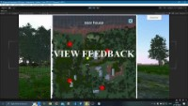

Slide 4
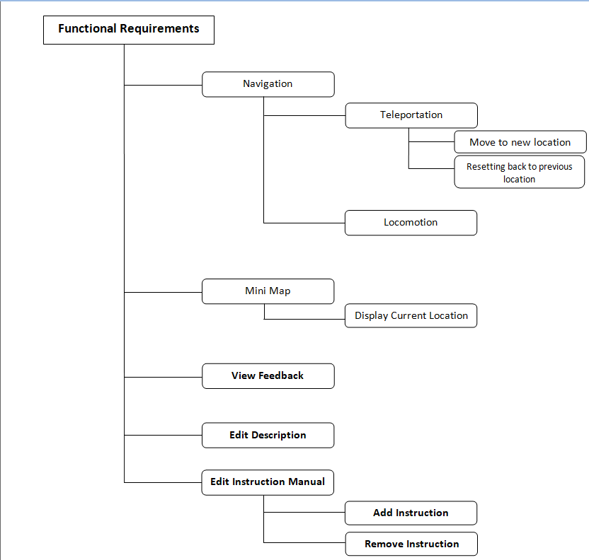

Slide 5
Non trivial/Frequent functions for administrator class :-
View Feedback
Edit Description
Teleportation
Edit Instruction Manual
These functions are written in bold letters in the functional hierarchy. A vertical prototype is made for these functions which implicitly covers the horizonal prototype.
Trivial/Non-frequent functions for administrator class :-
Locomotion
Mini-map

Slide 6
Flow Chart For Administrator Prototype
Description can be changed using map.
Feedback and Ratings of users can be viewed.
Users locomotion is shown
Teleportation by clicking on mini-map
Day and night theme could be applied.
Instruction manual can be updated.
Reverting to previous location using symbol on screen
Images can be viewed by going near.

Slide 7
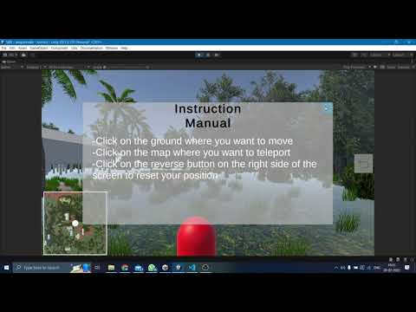
In this user is first locomoting using (00:12 sec). After this teleportation is shown by right clicking on mini-map and user gets directed to that respective location (00:20 sec). At last using the reverse icon in center right, user gets back to its previous location (00:22 sec)

Slide 8
Non-Trivial Function
Feature demonstrated in this video :- Teleportation
This is the basic necessary function available to all types of users like tourists, researchers and administrators. Every user class requires teleportation, so that they can visit the places on the map easily. Thus it is also used by the administrator to reach the location of interest in order to change description, immediately. It is not a specific function for the administrator but he uses it frequently throughout using the application.

Slide 9
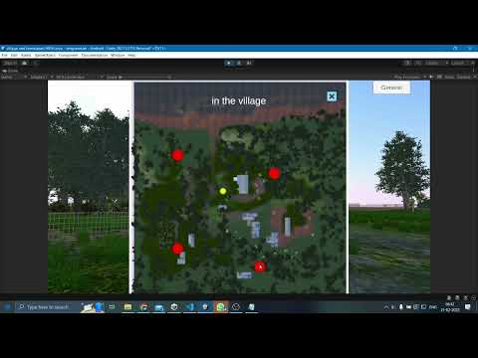
Admin can look at the feedback and ratings given by users by hovering over the location in map. Also he/she can change the description provided there.

Slide 10
Non-Trivial Function
Feature demonstrated in this video :- View Feedback
One of the main functions of the Administrator is to view feedback of the various places given by tourists and researchers who use the application frequently, in order to improve user experience by changing the description provided. It also helps administrators to know about the pros and cons in the description and take actions accordingly. It is also frequently used by administrators because tourists constantly give feedback and it is required for administrators to review them constantly.

Slide 11
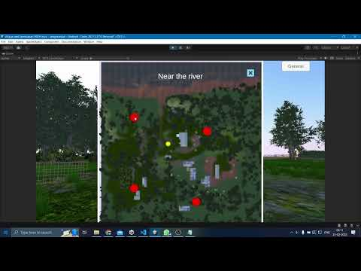
User can enlarge the mini map by left clicking on it(00:06 sec). In the enlarged map, user can see the name of place by hovering over the circle(00:08 sec). Admin can change that description by clicking on description.

Slide 12
Non-Trivial Function
Feature demonstrated in this video :- Edit Description
The main purpose of the administrator is to edit the description about the places and flora and fauna based on the feedback given by tourists and researchers. So it is frequently used non-trivial functions for an administrator as it is used in combination with the view feedback function of the administrator. This function is only available to the Administrator.

Slide 13
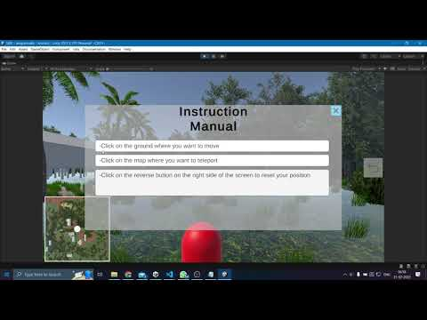
Admin can change the instruction manual that comes at the beginning.

Slide 14
Non-Trivial Function
Feature demonstrated in this video :- Edit the Instruction Manual
The administrator will edit the instruction manual based on the feedback received from the users and as the new updates are incorporated into the model. It is a necessary function because the users might face difficulties while using the interface. Thus in order to increase the usability, editing the instruction manual from the feedback is the necessary and frequent work specific to the administrators.

Slide 15
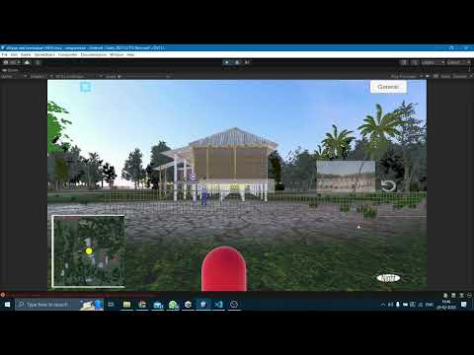
User can change the theme of model by clicking on button in the bottom right corner of screen. When he clicks night, night theme will be displayed, and on clicking day, day theme will be displayed. Default will be day theme.

Slide 16
Trivial Function
Feature demonstrated in this video :- Change Appearance

Slide 17
THANK YOU

