Slide 1
Prototype for Researcher User-Classes

Slide 2
User Class: Researcher
The class of users, whose main motive is to learn about the historical things and the flora and fauna of the village through the view description feature given to them. In order to know about the objects in detail, these users use magnifying/demagnifying objects. And in order to remember the things that they learned about the place or after examining, they make notes and maintain it throughout the tour. This class of users is completely different from the tourists class as the main aim is to research about the cultural village and not to visit tourist destination. The main functions specified below are only available for this class of users only.

Slide 3
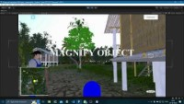

Slide 4
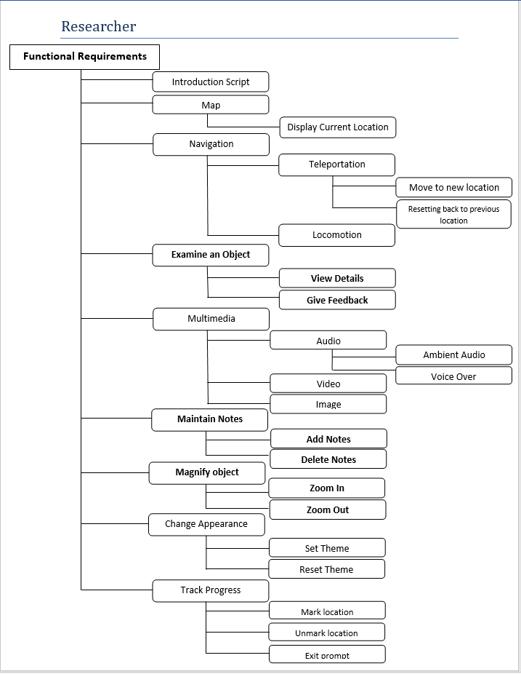

Slide 5
Non trivial/Frequent functions for tourist class :-
Research (examine an object)
Magnify Objects
Maintain Notes
Navigation
These functions are written in bold letters in the functional hierarchy. A vertical prototype is made for these functions which implicitly covers the horizonal prototype.
Trivial/Non-frequent functions for tourist class :-
Multimedia
Change Appearance
Track Progress

Slide 6
Flow Chart For Researcher Prototype
Map is enlarged showing users movement
Description regarding objects by hovering
Users locomotion is shown
Teleportation by clicking on mini-map
Dark and Light theme could be changed.
Objects could be magnified.
Reverting to previous location using symbol on screen
Video played by going in direction of it.
Notes can be added by clicking.

Slide 7
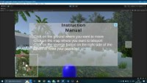
In this user is first locomoting using (00:09 sec). After this teleportation is shown by right clicking on mini-map and user gets directed to that respective location (00:15 sec). At last using the reverse icon in center right, user gets back to its previous location (00:18 sec). Also in the whole process, ambient audio is running in the background.

Slide 8
Non-Trivial Function
Feature demonstrated in above video :- Navigation
This is a basic function necessary in the researcher user group also because a researcher has to travel to different places to research the different objects located at various places. This is also a frequent function as navigation is always used whenever the research on a location is finished and the researcher wants to explore a new place. This is achieved by teleportation to a specific location on the map or by traveling nearby distances by locomotion. This function is also available in the tourist user class.

Slide 9
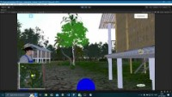
Some trees are shown with different shade of green color to indicate a different specie. Hovering over such trees, information regarding that specie will appear.

Slide 10
Non-Trivial Function
Feature demonstrated in above video :- Research (Examine an object)
It is one of the most frequently used functions of a researcher because the main purpose of the researcher is to explore a place in depth and research on the flora and fauna of that place. So wherever he goes he always tries to research the ecosystem of the place by using this function. This function is only available to the researcher user group.

Slide 11

Researcher can take a closer look at the species or any object of interest by zooming in and can also add notes regarding that object there by left clicking on the object.

Slide 12
Non-Trivial Function
Features demonstrated in above video :- Magnify Objects
While exploring or researching about the objects in a place, the researcher always needs to magnify or demagnify the objects/things to know about it in detail and to do more research on it. It is also frequently used by the researcher as it compliments the researching phase by providing additional details about the objects such as flora and fauna. This function is also only available to the researcher user group.

Slide 13
Non-Trivial Function
Features demonstrated in above video :- Maintain Notes
This feature allows the researcher to take notes of his research as the knowledge and learning about the flora and fauna and in general the ecosystem of the place, need to be noted along the way. Also he can edit the existing notes if he wants. It is also a frequently used function as it is the main tool of the researcher without which there is no point of research itself as he cannot remember everything. This function is only available to the researcher group.

Slide 14

In this user goes near a transparent image. When user goes in direction of that image and reaches quite near to it using locomotion, this is considered as user is interested in looking at what is depicted through image. So going near to it, video will start playing corresponding to what is depicted through that image.

Slide 15
Trivial Function
Feature demonstrated in above video :- Multimedia

Slide 16
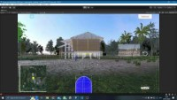
User can change the theme of model by clicking on button in the bottom right corner of screen. When he clicks night, night theme will be displayed, and on clicking day, day theme will be displayed. Default will be day theme.

Slide 17
Trivial Function
Feature demonstrated in above video :- Change Appearance

Slide 18
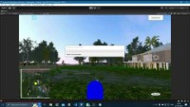
User can enlarge the map by left clicking on it and in the bigger map user can see its movements and position.

Slide 19
Trivial Function
Feature demonstrated in above video :- Mini-map

Slide 20
Thank You

