Slide 1
Three User Groups are made:
Tourists
Researcher
Administrator

Slide 2

This video is common for all the 3 users. User first need to select the user class in which he/she belongs. Based on the selection , user model will come in right side of screen which will be used in all the functions implemented for that user.

Slide 3
This is a trivial function implemented.

Slide 4
Prototype for Tourist User-Classes

Slide 5
User Class: Tourist
Tourists are the users who are mainly enthusiastic to learn about the cultural activities and daily life activities of the village. These people explore most of the cultural places and tourist destinations and experience the various activities using multimedia. They also use navigation, track progress to explore all the places and keep track of the places to be visited. This group is completely different from the other user group as its main aim is to enjoy and experience the village life.

Slide 6
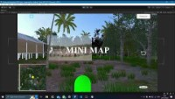

Slide 7
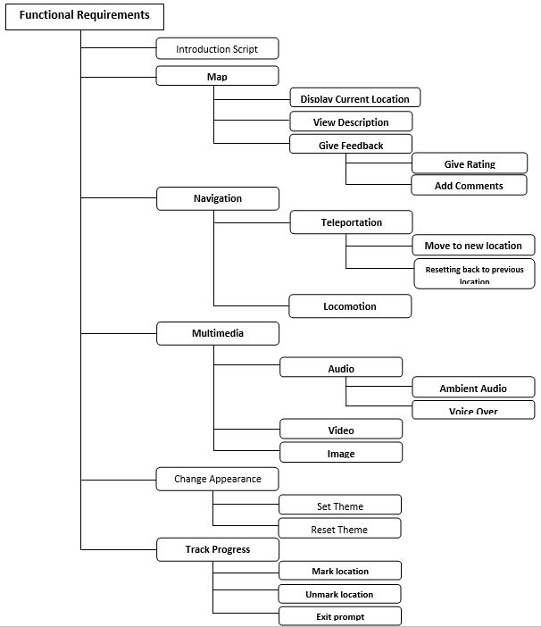

Slide 8
Non trivial/Frequent functions for tourist class :-
Navigation
Multimedia
Mini-Map
Track Progress
These functions are written in bold letters in the functional hierarchy. A vertical prototype is made for these functions which implicitly covers the horizonal prototype.
Trivial/Non-frequent functions for tourist class :-
Change Appearance
Introduction Script

Slide 9
Flow Chart For Visitor Prototype
Day and night theme could be applied.
Names of places can be seen in map
Users locomotion is shown
Teleportation by clicking on mini-map
Image and video could be played.
Feedback and rating could be given
Reverting to previous location using symbol on screen
Ambient audio remains playing.
Exit prompt shown after visiting everything.

Slide 10
In this user is first locomoting using (00:09 sec). After this teleportation is shown by right clicking on mini-map and user gets directed to that respective location (00:15 sec). At last using the reverse icon in center right, user gets back to its previous location (00:018 sec)

Slide 11
Non-Trivial Function
Feature demonstrated in the video :- Navigation
Tourists will frequently navigate through the village through teleportation and locomotion to move to a new area. Tourists require navigation as a basic functionality because they want to visit many tourist destinations and explore village life. For navigating to the destinations far away, tourists use teleportation by selecting coordinates of the location on the map. And for nearby distances tourists use the locomotion feature by selecting location on the screen i.e virtual world.

Slide 12
In this user goes near a transparent image. When user goes in direction of that image and reaches quite near to it using locomotion, this is considered as user is interested in looking at what is depicted through image. So going near to it, video will start playing corresponding to what is depicted through that image.

Slide 13
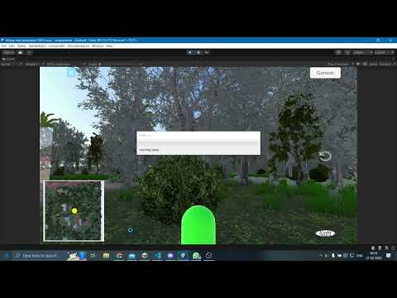
In this user goes near a transparent image. Here, the image on the top the house depicts the activity going on within the house.

Slide 14
Non-Trivial Function
Feature demonstrated in the above video :- Multimedia
Tourists will frequently use this feature to explore various cultural activities of the village at various locations and in general village life including village ecosystem, through multimedia (video, image, audio). Tourists will experience this feature whenever they visit a new place. This feature is important because apart from models, the tourists also want to see short video clips and images of how these activities are going on in the real world rather than the virtual world. Tourists also experience embedded ambient audio everywhere on the island, so that he/she gets a real experience of village life on Majuli Island.

Slide 15
User can enlarge the mini map by left clicking on it(00:06 sec). In the enlarged map, user can see the name of place by hovering over the circle(00:08 sec). User can also give feedback and rating by clicking on the circle and upon clicking red circle changes to green indicating that user visited that place. (00:13 sec).

Slide 16
Non-Trivial Function
Feature demonstrated in the video :- Mini Map
Tourists will frequently use mini-map to know about their current location and a priori get the information of the places yet to be visited, throughout the tour. Tourists will use the map almost all the time through the tour and can give feedback and rating of the places he/she visited in the tour. For all the important tourist destinations, a tourist can get information of that place through the view description function in mini-map.

Slide 17
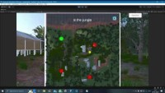
When all the circles in the big map gets changed to green color, this means that the user have visited all the places, so a prompt will come if user want to exit.

Slide 18
Non-Trivial Function
Feature demonstrated in the video :- Track Progress
Tourists track their progress throughout the tour by marking a location and unmarking a location on the map. Tourists will use this feature frequently to guide their tour properly and to know about the places yet to be visited. In addition, tourists can also unmark a location if they like, so that if they love a certain tourist destination, they can unmark it so as to visit it again. Thus this feature will always be used throughout the tour.

Slide 19
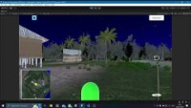
User can change the theme of model by clicking on button in the bottom right corner of screen. When he clicks night, night theme will be displayed, and on clicking day, day theme will be displayed. Default will be day theme.

Slide 20
Trivial Function
Feature demonstrated in the video :- Change Appearance

