Slide 1

IPsec(secure Tunnel)

Slide 2
Introduction
S
Simulate a secure IPsec VPN between two sites
P
Protect communication over public network
B
Build and verify the setup using Packet Tracer
Notes:
"Our goal was to simulate a secure VPN using Packet Tracer, and show how two remote networks can communicate safely."

Slide 3
Benefits of IPsec Secure Tunnel
Authentication of Devices
Enhanced Privacy and Confidentiality
Secure Data Transmission
Notes:
All sensitive data is encrypted across the internet, protecting it from interception or tampering. For secure
Confidential information (e.g., personal, financial, corporate) is kept private even when traveling over public networks. For enhanced
Only trusted devices can establish communication through the tunnel, preventing unauthorized access. For Authentication

Slide 4



Background
IPsec: Encrypts and authenticates IP traffic
VPN: Creates private networks over public internet
Packet Tracer: Cisco's simulation tool for network setups
Notes:
All sensitive data is encrypted across the internet, protecting it from interception or tampering. For secure
Confidential information (e.g., personal, financial, corporate) is kept private even when traveling over public networks. For enhanced
Only trusted devices can establish communication through the tunnel, preventing unauthorized access. For Authentication

Slide 5
Requirements
Secure
Secure traffic between R1 and R3
Encrypt
Encrypt "interesting" traffic
Build
Build using only Cisco CLI inside Packet Tracer
Verify
Verify successful tunnel creation
Notes:
Notes: "We faced some tool limitations, like only DH group 5 available. Also, a small mistake in ACLs could cause the VPN to fail."

Slide 6
System Design
Configure IPsec Tunnel in Packet Tracer
Use Pre-Shared Keys (PSK)
AES-256 encryption
SHA-1 authentication
Notes:
Notes: "We faced some tool limitations, like only DH group 5 available. Also, a small mistake in ACLs could cause the VPN to fail."

Slide 7
Requirements
Secure traffic between R1 and R3
Encrypt "interesting" traffic
Use Pre-Shared Keys (PSK)
Verify successful tunnel creation
01
02
03
04
Notes:
Our requirement was to configure and test an encrypted tunnel in a full simulation environment without using real devices.

Slide 8



Architecture
Two routers (R1 and R3) as VPN endpoints
One router (R2) as a transit router
(no VPN role)
PCs connected to simulate LANs
Notes:
Our requirement was to configure and test an encrypted tunnel in a full simulation environment without using real devices.

Slide 9
Configuration Steps
C
C
Configure IPsec Phase 2 Policies
C
Create Crypto Maps
A
Apply Crypto Maps to Serial Interfaces
V
Verify tunnel status
Configure ISAKMP Phase 1 Policies
Notes:
ISAKMP defines the rules for establishing a secure and authenticated communication channel between two devices
All sensitive data is encrypted across the internet, protecting it from interception or tampering.
For secure Confidential information (e.g., personal, financial, corporate) is kept private even when traveling over public networks. For enhanced
Only trusted devices can establish communication through the tunnel, preventing unauthorized access. For Authentication

Slide 10
Phase 1 (ISAKMP)
An ISAKMP policy includes
Encryption Method
Defines how data will be encrypted.
Hash Algorithm
Ensures the integrity of the data.
Authentication Method
Verifies the identity of both peers.
Notes:
Notes: "We faced some tool limitations, like only DH group 5 available. Also, a small mistake in ACLs could cause the VPN to fail."

Slide 11
Phase 1 (ISAKMP)
An ISAKMP policy includes
Key Exchange Method
Allows two parties to securely exchange encryption keys.
Lifetime
Duration before the security association must be renegotiated.
Notes:
Notes: "We faced some tool limitations, like only DH group 5 available. Also, a small mistake in ACLs could cause the VPN to fail."

Slide 12
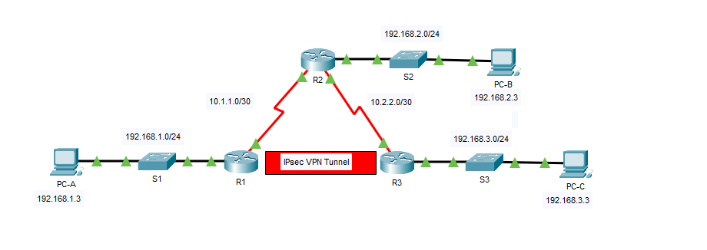
FIGURE

Slide 13
Testing
Ping from PC-A to PC-C
01
Tunnel forms when interesting traffic is detected
02
Packet encryption and decryption verified
03
Notes:
All sensitive data is encrypted across the internet, protecting it from interception or tampering. For secure
Confidential information (e.g., personal, financial, corporate) is kept private even when traveling over public networks. For enhanced
Only trusted devices can establish communication through the tunnel, preventing unauthorized access. For Authentication

Slide 14
Analysis
VPN tunnel triggers only on interesting traffic
Uninteresting traffic not encrypted
Minimal delay observed
Notes:
All sensitive data is encrypted across the internet, protecting it from interception or tampering. For secure
Confidential information (e.g., personal, financial, corporate) is kept private even when traveling over public networks. For enhanced
Only trusted devices can establish communication through the tunnel, preventing unauthorized access. For Authentication

Slide 15
Issues Faced
Packet Tracer limited DH groups
Manual troubleshooting needed for ACLs and Crypto Maps
Careful configuration order required
Notes:
All sensitive data is encrypted across the internet, protecting it from interception or tampering. For secure
Confidential information (e.g., personal, financial, corporate) is kept private even when traveling over public networks. For enhanced
Only trusted devices can establish communication through the tunnel, preventing unauthorized access. For Authentication

Slide 16



Problem Statement
No Protection Against All Threats
Limited Packet Tracer Support
Need for encrypted tunnels even in simulations
Notes:
All sensitive data is encrypted across the internet, protecting it from interception or tampering. For secure
Confidential information (e.g., personal, financial, corporate) is kept private even when traveling over public networks. For enhanced
Only trusted devices can establish communication through the tunnel, preventing unauthorized access. For Authentication

Slide 17



Conclusions
Learned practical VPN configuration
Understood IPsec concepts
Gained troubleshooting experience in simulations
Notes:
All sensitive data is encrypted across the internet, protecting it from interception or tampering. For secure
Confidential information (e.g., personal, financial, corporate) is kept private even when traveling over public networks. For enhanced
Only trusted devices can establish communication through the tunnel, preventing unauthorized access. For Authentication

Slide 18
Thank You / Questions
Thank you!
Any Questions?
Notes:
"Thanks for your attention. We are ready to answer any questions about our project or our Packet Tracer setup."

