Slide 1
TRAINING IN MACHINE LEARNING
HIMANSHU ARORA

Slide 2


DATA IS GENERATED FROM A REAL-WORLD PROCESS

Slide 3

A REAL-WORLD PROCESS FOLLOWS AN UNKNOWN PROBABILITY DISTRIBUTION

Slide 4


TRAINING GOAL: MATCHING THE MODEL DISTRIBUTION WITH DATA DISTRIBUTION
ML Algorithm

Slide 5
STEP 1: INITIALIZE THE MODEL WITH A RANDOM PROBABILITY DISTRIBUTION
RANDOM WEIGHTS
RANDOM DISTRIBUTION

Slide 6
STEP 2: MEASURE DISTANCE BETWEEN THE TWO DISTRIBUTIONS (LOSS)
KL DIVERGENCE

Slide 7

KULLBACK-LEIBLER DIVERGENCE

Slide 8
WE DO NOT WANT TO CHANGE THE DATA DISTRIBUTION: CROSS-ENTROPY
CROSS-ENTROPY

Slide 9

WE DO NOT WANT TO CHANGE THE DATA DISTRIBUTION: CROSS-ENTROPY

Slide 10
STEP 3: REDUCE THE DISTANCE BY UPDATING THE WEIGHTS OF THE MODEL
GRADIENT DESCENT

Slide 11
STEP 3: REDUCE THE DISTANCE BY UPDATING THE WEIGHTS OF THE MODEL
GRADIENT DESCENT

Slide 12
STEP 3: REDUCE THE DISTANCE BY UPDATING THE WEIGHTS OF THE MODEL
GRADIENT DESCENT

Slide 13
STEP 3: REDUCE THE DISTANCE BY UPDATING THE WEIGHTS OF THE MODEL

Slide 14
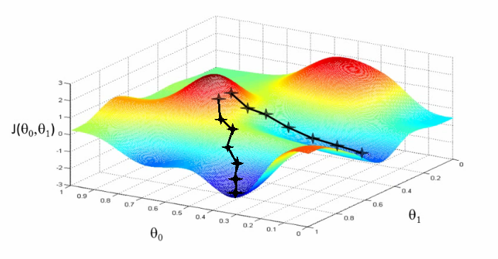
GRADIENT DESCENT
Machine Learning course by Andrew Ng

Slide 15
THANK YOU

