Slide 1

Pulse
Discover. Support. See your impact.
Felix Yin · Oscar Gao · Matthew Heng
Diamond Bar FBLA
Coding & Programming 2025–26 · Byte-Sized Business Boost
Pulse · FBLA Coding & Programming 2025–26
1
Notes:
FELIX (0:00-0:30)
Good morning, judges. I'm Felix Yin, and with me are Oscar Gao and Matthew Heng from Diamond Bar FBLA. For the "Byte-Sized Business Boost" topic we built Pulse — a web platform that helps people discover small local businesses, and then shows them exactly how their spending strengthens their own community. Discovery gets a customer in the door once; visible impact brings them back. That second half is what makes Pulse different.
Handoff: "Oscar will show you the problem we started from."
[Assets: Lucide icons (ISC); Pulse logo (original work)]

Slide 2
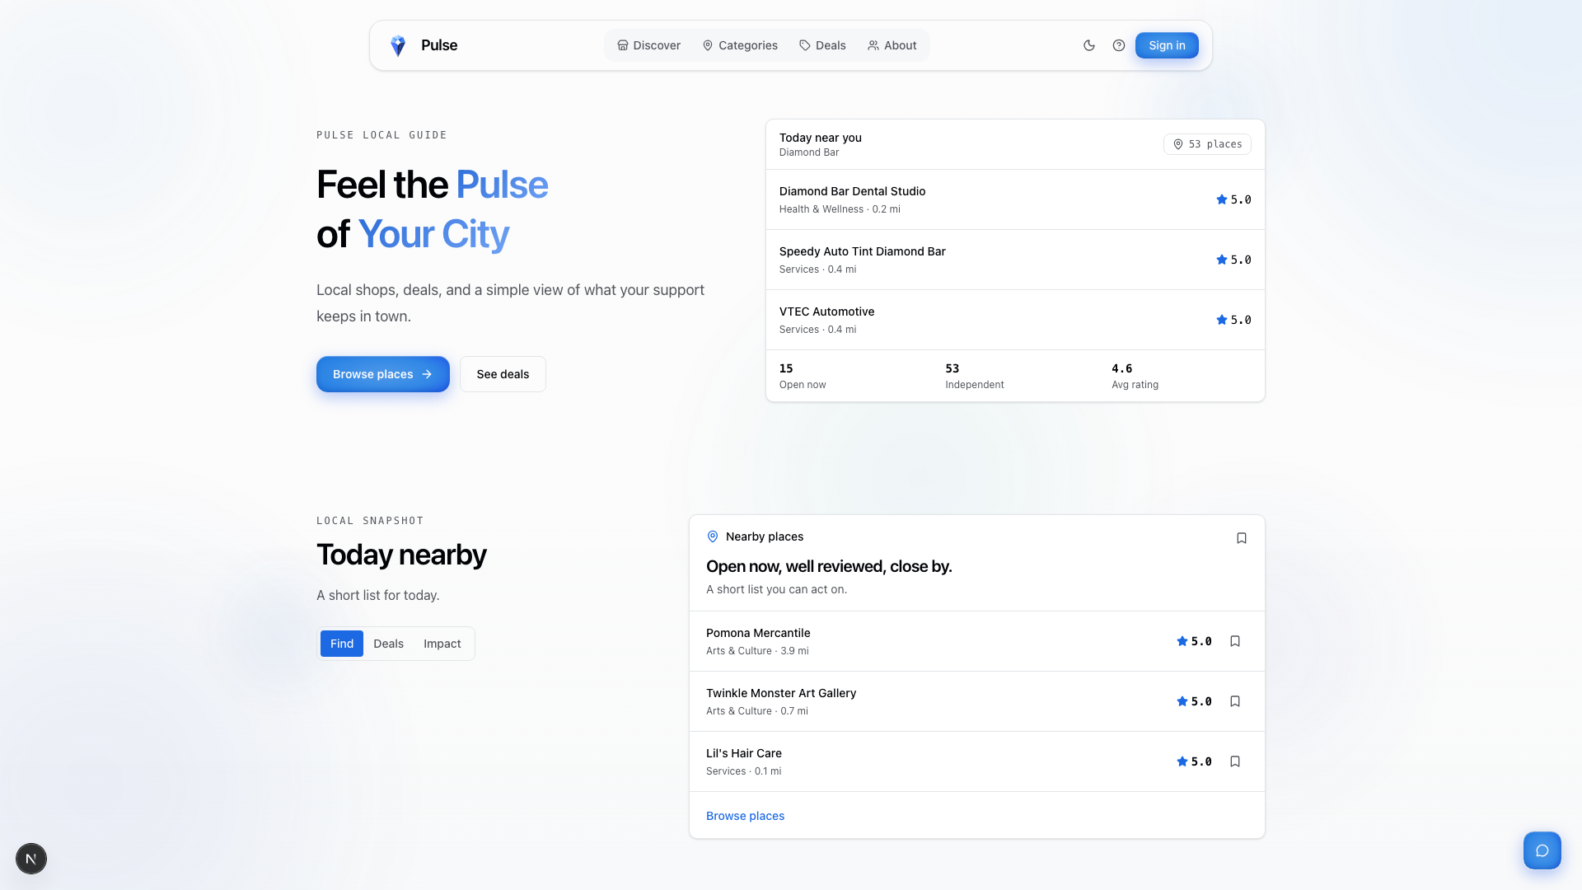
THE PROBLEM & OUR SOLUTION
Local dollars work harder — when they stay local
68¢ of a local dollar stays local
43¢ at a national chain
Category sort
Reviews & ratings
Sort by rating
Bookmarks
Deals & coupons
Bot verification
Every prompt requirement — one platform.
Pulse home — live local guide for Diamond Bar
Pulse · FBLA Coding & Programming 2025–26
2
Notes:
OSCAR (0:30-1:10)
Research shows 68 cents of every dollar spent locally recirculates in the community — versus just 43 cents at a national chain. Yet small businesses keep losing customers to chains, because they have no shared platform for discovery. Pulse answers every requirement of the prompt: users browse businesses sorted by category, leave reviews and ratings, sort by those ratings, bookmark favorites, claim deals and coupons, and every submission passes bot verification. On top of that foundation we added an AI assistant and a live economic-impact dashboard — you'll see all of it today.
Handoff: "Felix will explain the technology choices behind it."
[Assets: app screenshot (original); business data via Google Places, attributed]

Slide 3
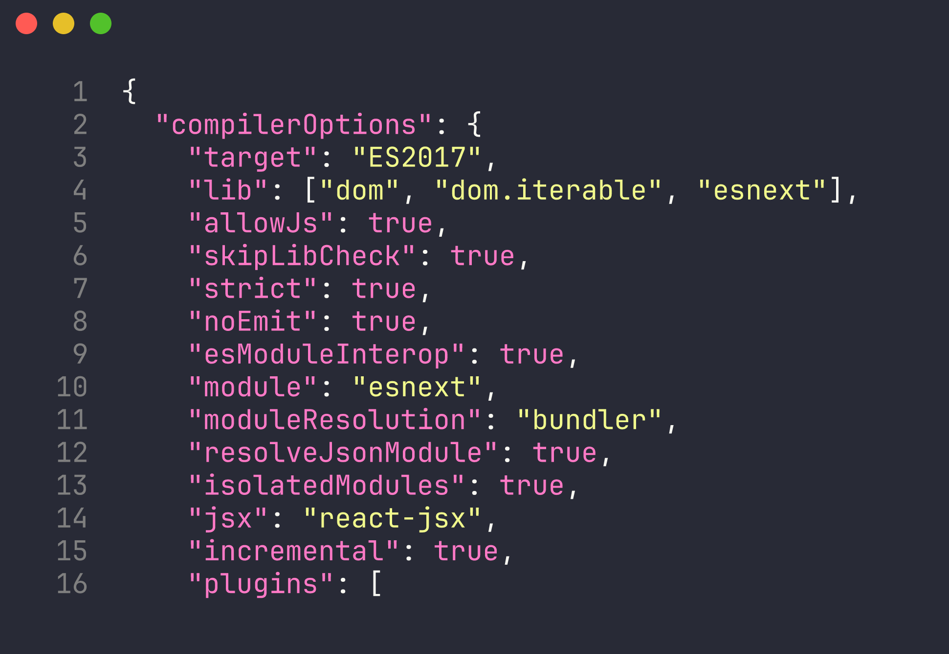
LANGUAGE SELECTION
TypeScript + Next.js 16
Static typing
bugs caught at compile time, not on stage
strict: true
no implicit any, no null surprises
SSR + API routes
one production artifact, fast first paint
Considered Python/Flask
no end-to-end type safety across client + server
web/tsconfig.json — strict mode on
Pulse · FBLA Coding & Programming 2025–26
3
Notes:
FELIX (1:10-1:45)
We chose TypeScript with Next.js. TypeScript's static type system catches entire classes of bugs at compile time — null references, wrong argument types — before they ever reach a judge's screen, and strict mode is enabled in our compiler config. Next.js gives us server-side rendering for fast first paint, file-based API routes so we don't maintain a separate backend, and React's component model for the UI. We weighed Python with Flask — simpler, but no end-to-end type safety across client and server — and chose the industry-standard production stack used by companies like Netflix and Vercel.
Handoff: "Matthew will walk through how the code is organized."

Slide 4
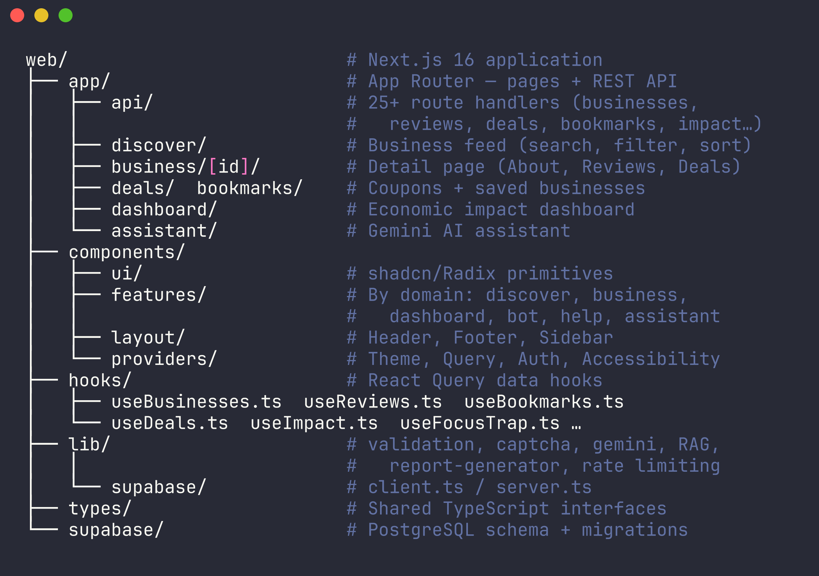
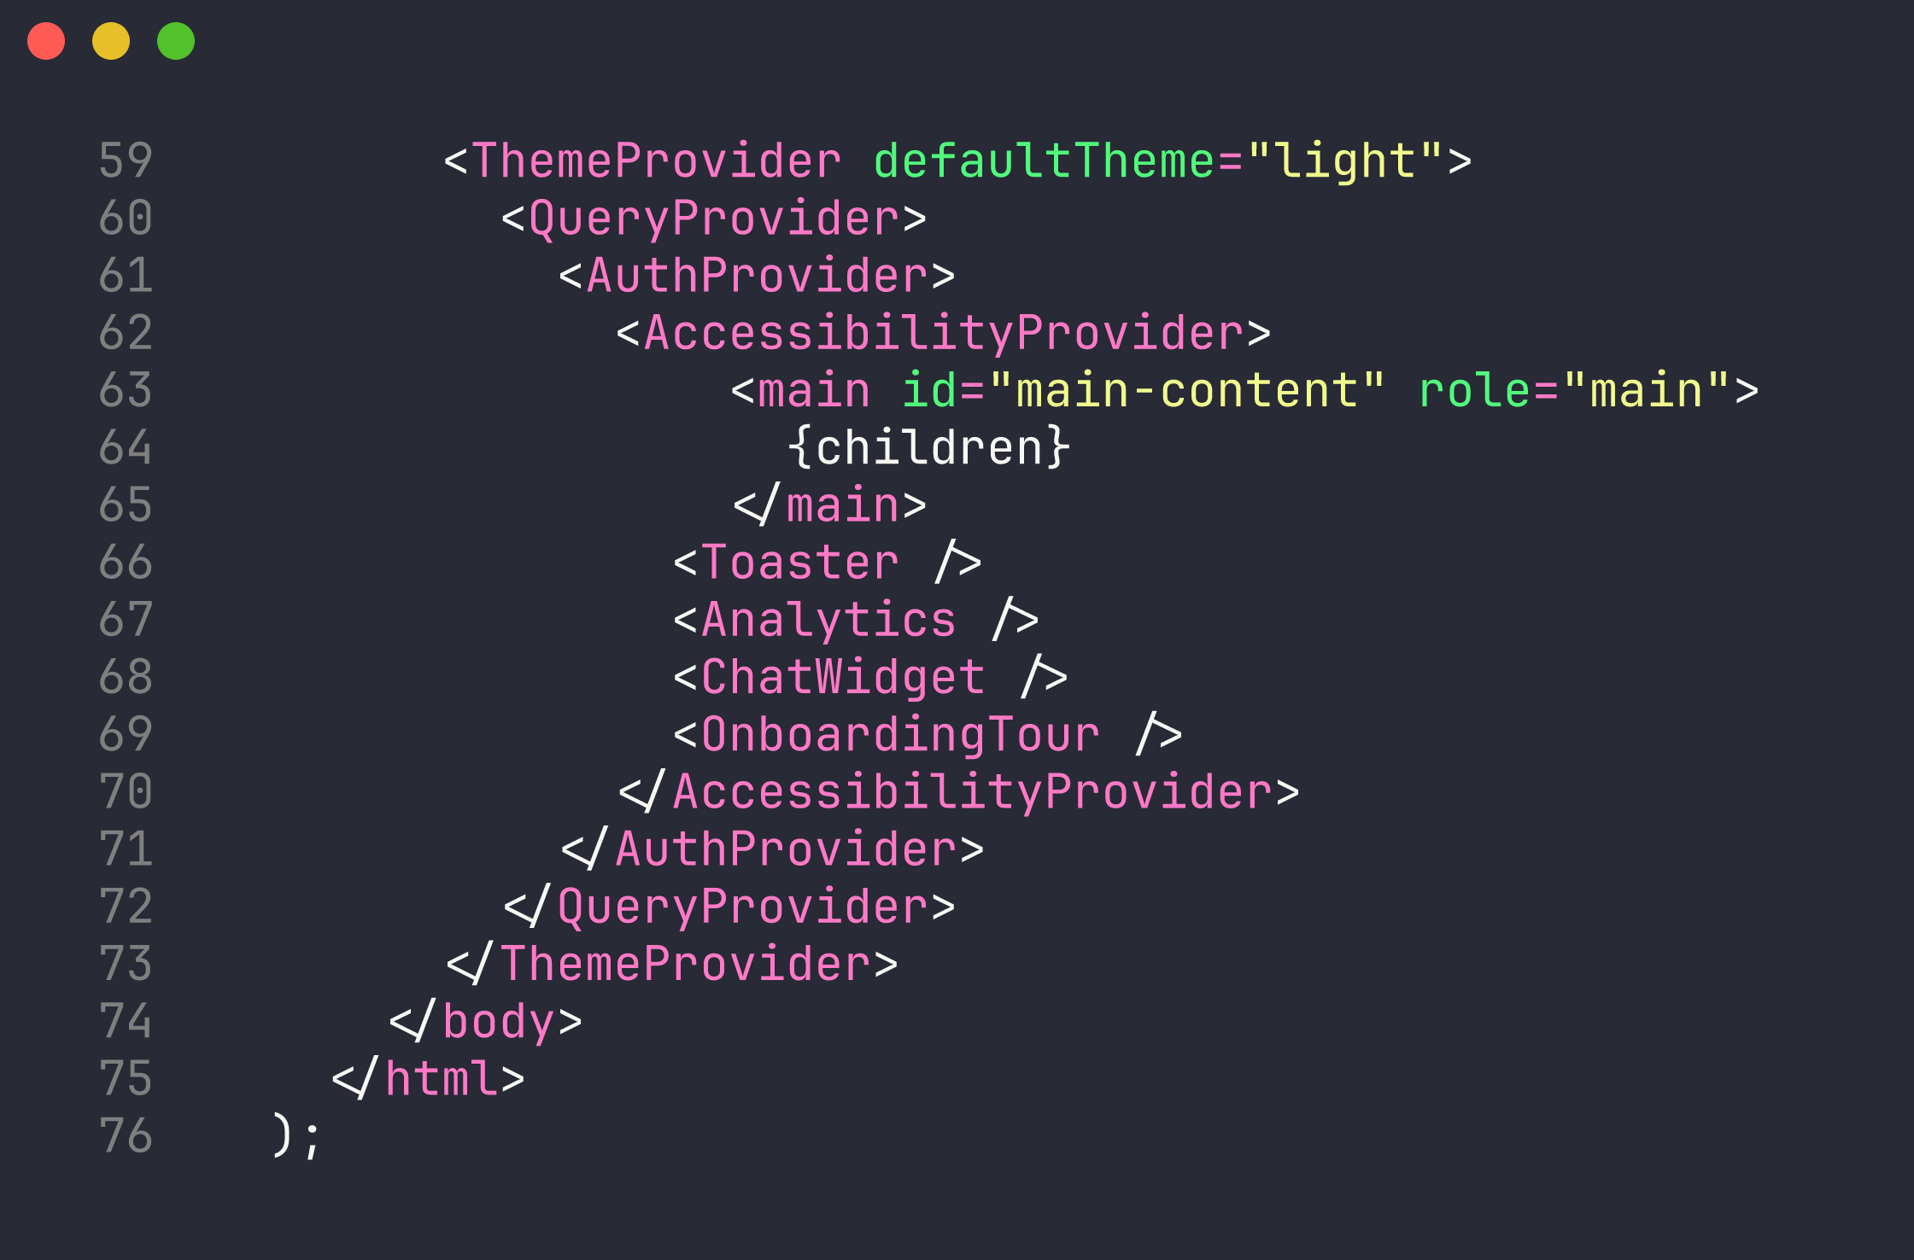
ARCHITECTURE & MODULAR DESIGN
Organized by responsibility
app/layout.tsx — four single-purpose providers
PostgreSQL + row-level security beneath
Module structure — routes, features, hooks, lib, types
Pulse · FBLA Coding & Programming 2025–26
4
Notes:
MATTHEW (1:45-2:20)
The codebase is organized by responsibility, which you can see in this structure. Pages and API routes live in app, reusable components are grouped by feature, all data fetching is isolated in React Query hooks, shared utilities in lib, and every data shape is a TypeScript interface in types. At the root, four nested providers — theme, server-state, authentication, and accessibility — each do exactly one job. Behind it all sits Supabase PostgreSQL with row-level security, so authorization is enforced in the database itself, not just in our code.
Handoff: "Felix will zoom into the code itself."

Slide 5
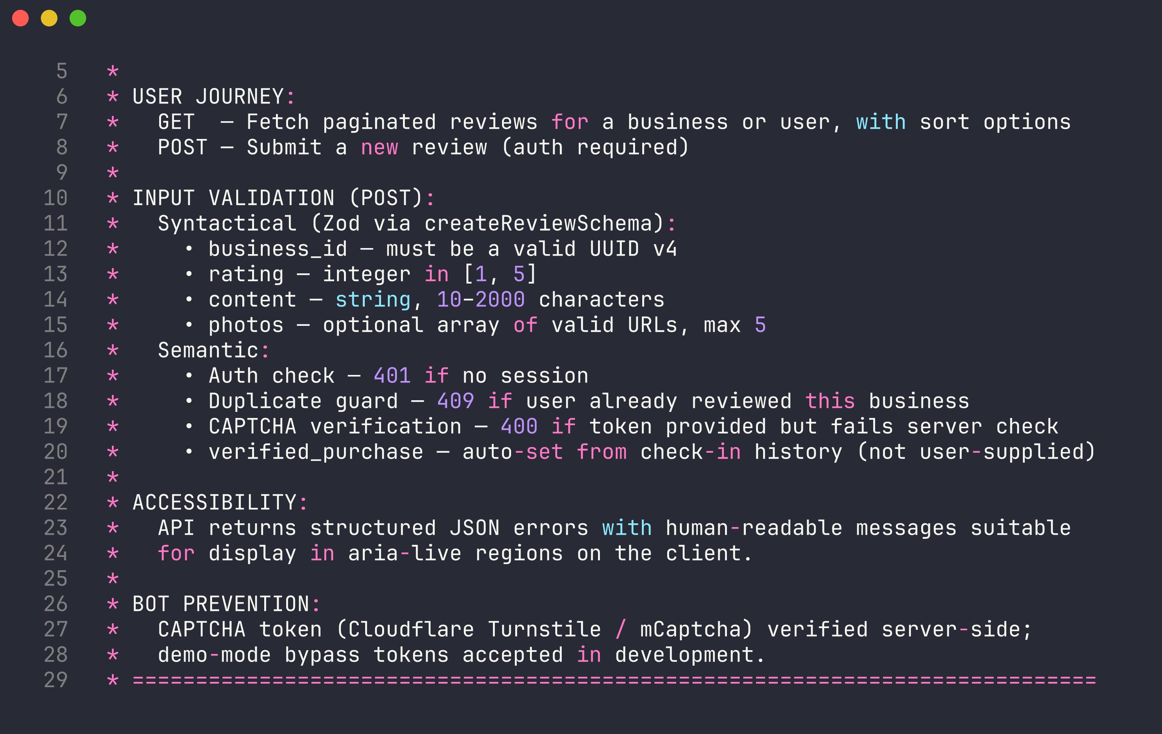
CODE QUALITY
Every file tells you its job
app/api/reviews/route.ts — User Journey · Input Validation · Accessibility · Bot Prevention
Pulse · FBLA Coding & Programming 2025–26
5
Notes:
FELIX (2:20-2:50)
Every significant file opens with the same four-section comment header: User Journey, Input Validation, Accessibility, and Design Rationale — here it is on our reviews API. Naming follows one convention everywhere: PascalCase components, camelCase utilities, typed named exports. The point isn't decoration — a teammate can open any file cold and know what it does, what it checks, and why it's built that way.
Handoff: "Oscar will cover the user experience."

Slide 6
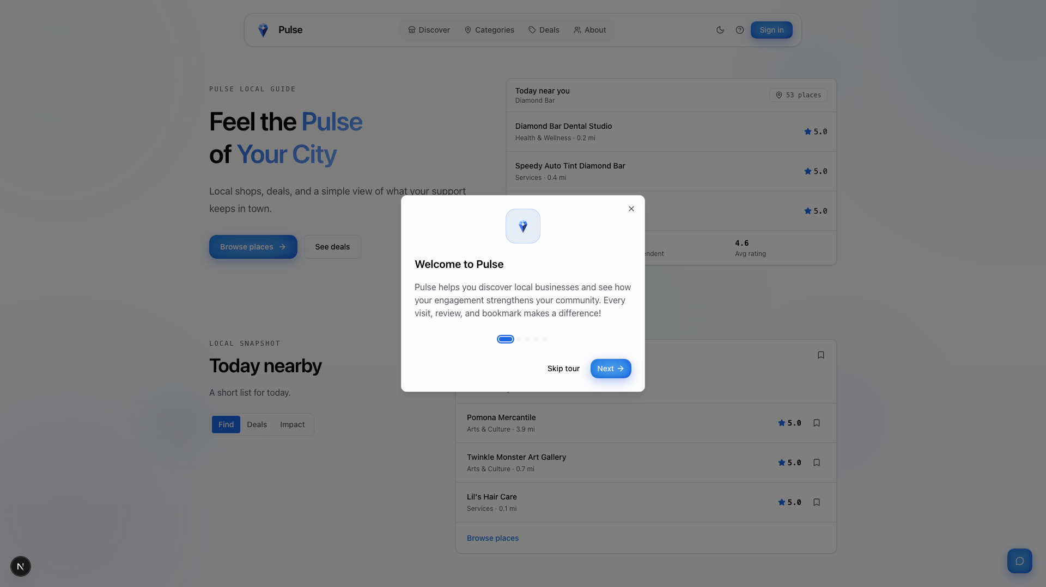
UX DESIGN
Designed for everyone
Discover
→
Engage
→
Impact
Skip-to-content link · full keyboard navigation
Focus traps in dialogs · aria-live announcements
WCAG contrast — light & dark mode
Honors reduced-motion preference
Built-in onboarding tour + help menu
Onboarding tour — in-app instructions, no manual needed
Pulse · FBLA Coding & Programming 2025–26
6
Notes:
OSCAR (2:50-3:25)
We designed for everyone. The user journey is three steps — discover, engage, see your impact — and the persistent header reaches every feature in one click. Accessibility is engineered, not assumed: a skip-to-content link for keyboard users, focus trapping inside dialogs, screen-reader announcements through live regions, WCAG-compliant contrast in light and dark mode, and the app honors your system's reduced-motion setting. A built-in onboarding tour and help menu mean nobody needs a manual.
Handoff: "Now the part we're most excited about — Matthew, take it away."

Slide 7
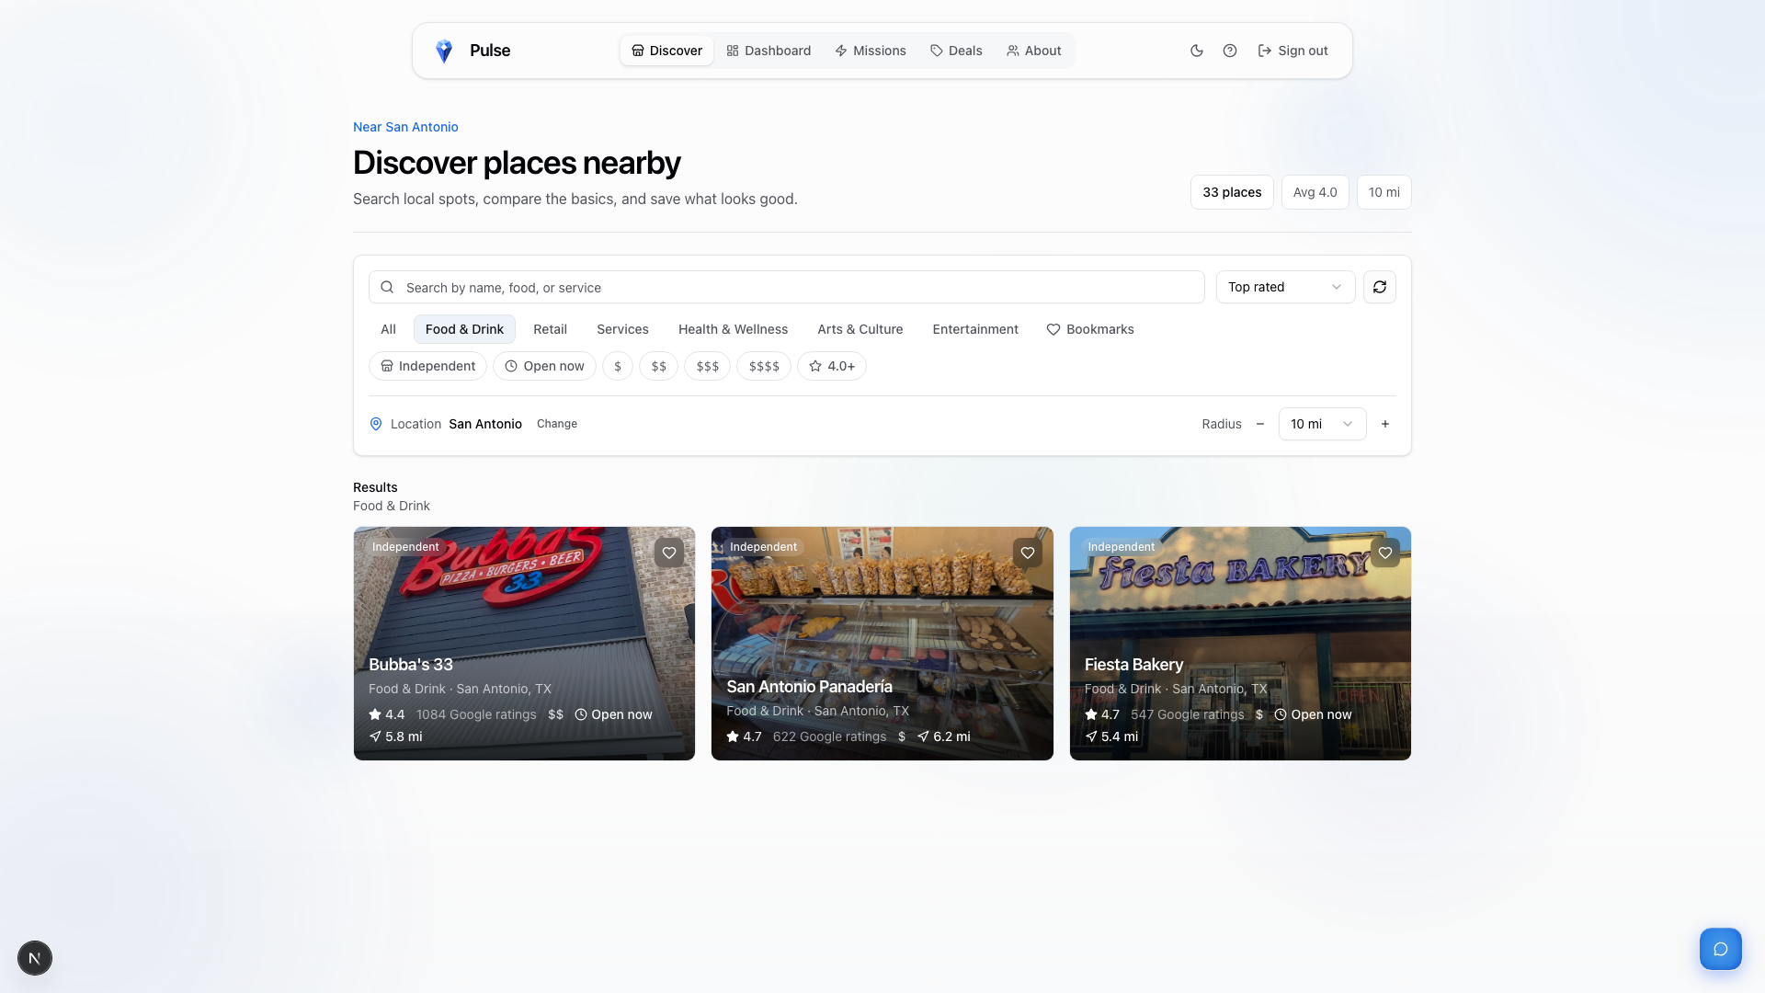

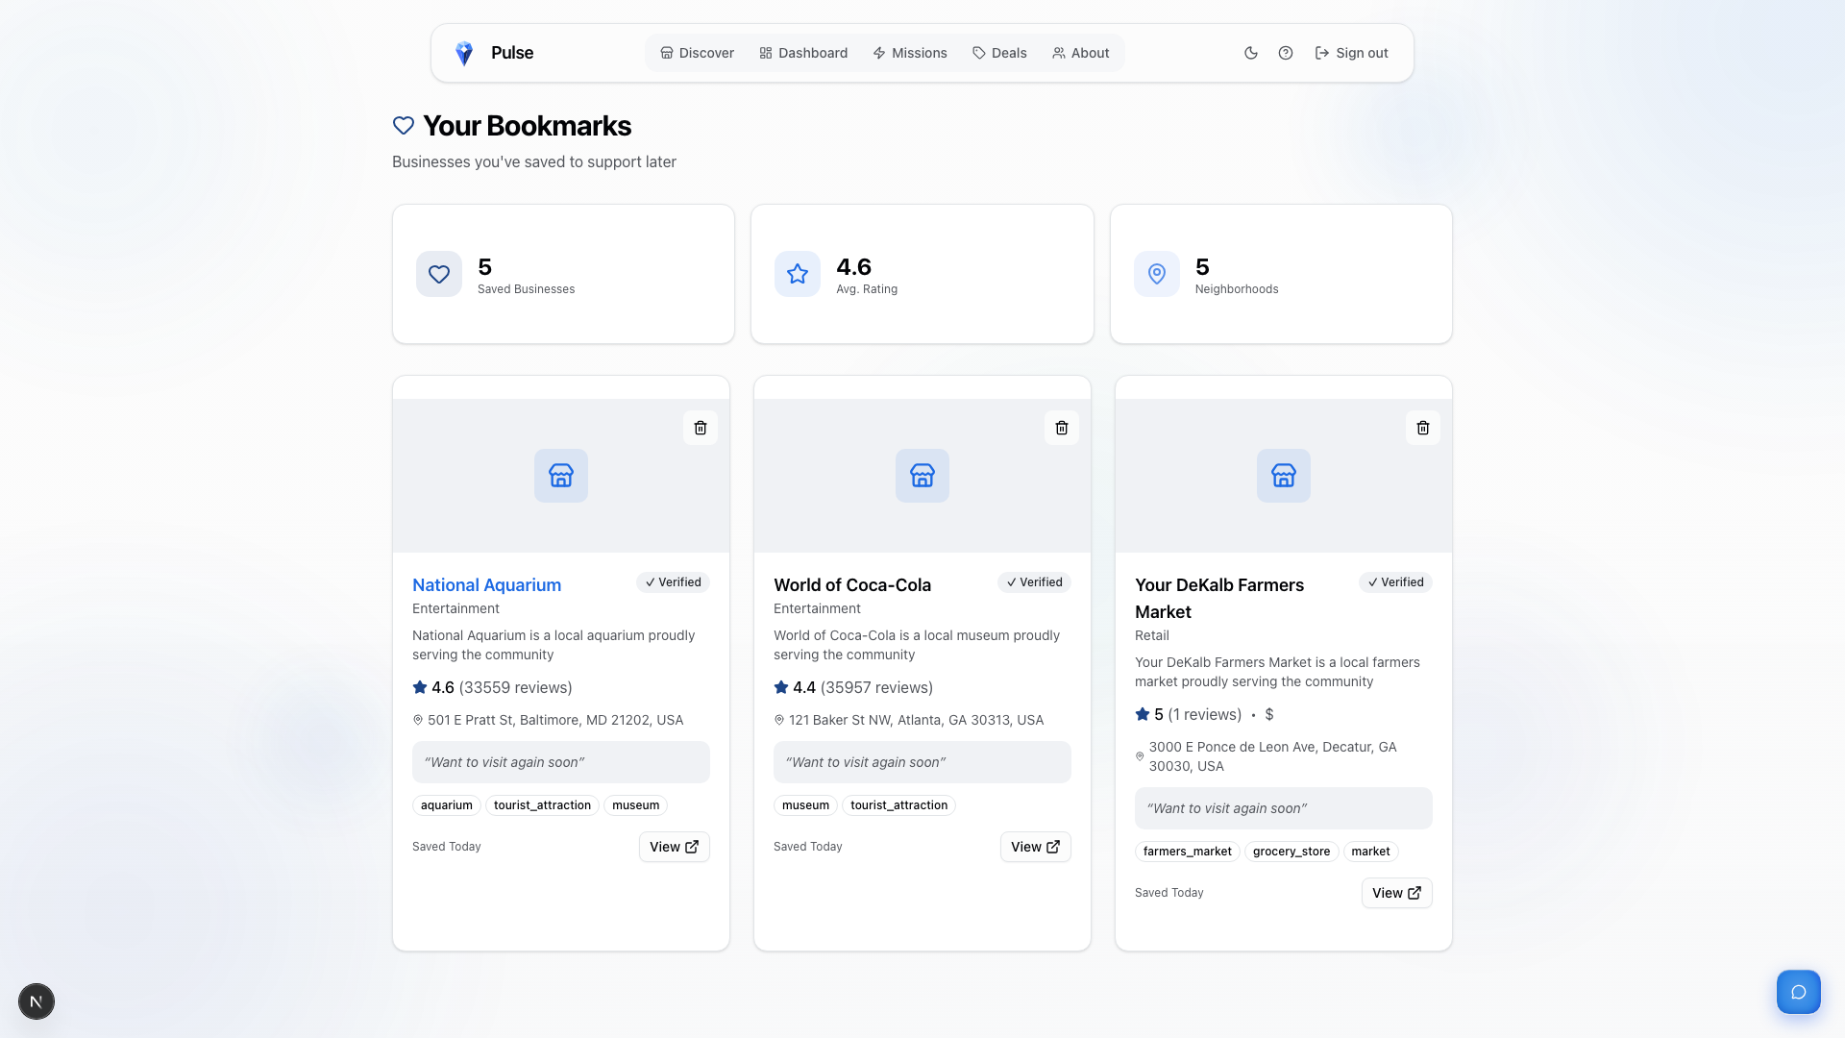
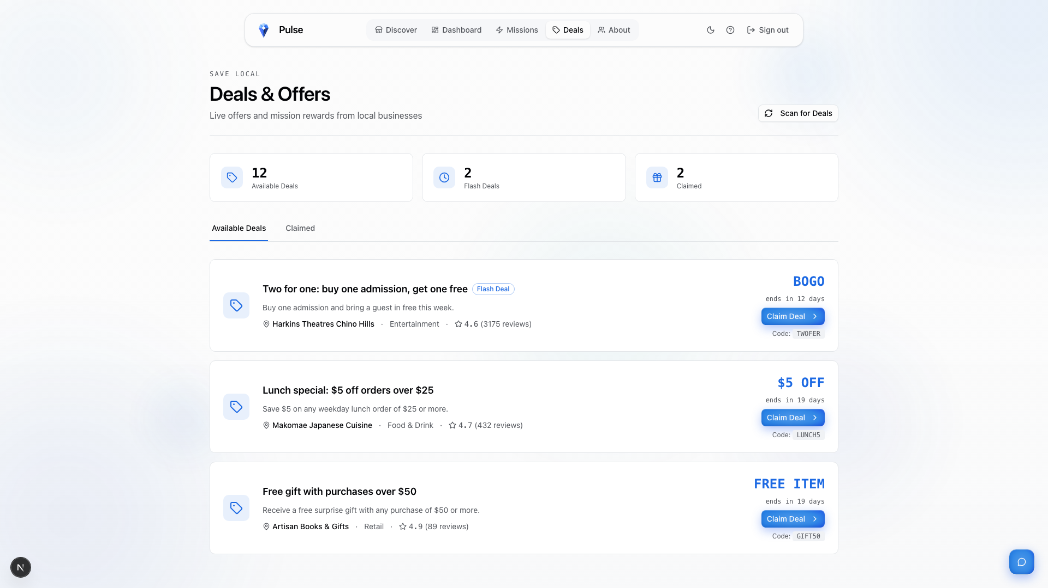
LIVE DEMO
Watch every requirement, live
✓ Sort by category
✓ Leave a review & rating
✓ Sort by ratings
✓ Bookmark favorites
✓ Claim deals & coupons
✓ Bot verification
✓ Customizable impact report
Category sort
Sort by rating
Bookmarks
Deals & claims
Pulse · FBLA Coding & Programming 2025–26
7
Notes:
MATTHEW (3:25-5:25) — THIS SLIDE STAYS UP DURING THE LIVE DEMO
Follow DEMO_SCRIPT.md click-by-click. Narration: Here's Pulse running live. On Discover, these category pills filter instantly — Food & Drink, Retail, Services — that's sort by category. The sort menu ranks by highest rated, weighted by review volume, so one five-star review can't beat a hundred. On a business page I'll leave a review — four stars, my feedback — and before submitting I complete this puzzle: bot verification, validated again on the server. Tapping the heart bookmarks a favorite; here's my saved list. The Deals page shows live coupons — I claim one and get a redemption code under my Claimed tab. Finally, my dashboard: dollars kept local, businesses supported — and this customizable impact report filters by date and category, downloads as CSV, and prints clean. Every required feature, live, with zero errors.
Handoff: "Felix will show you the intelligence underneath."

Slide 8
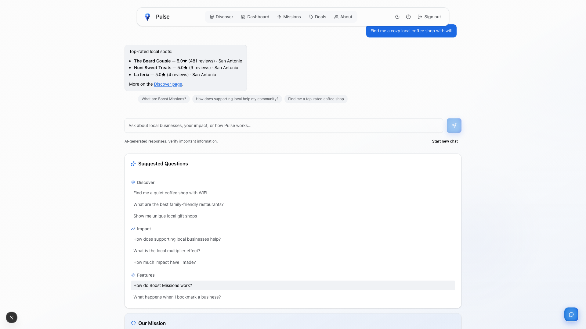
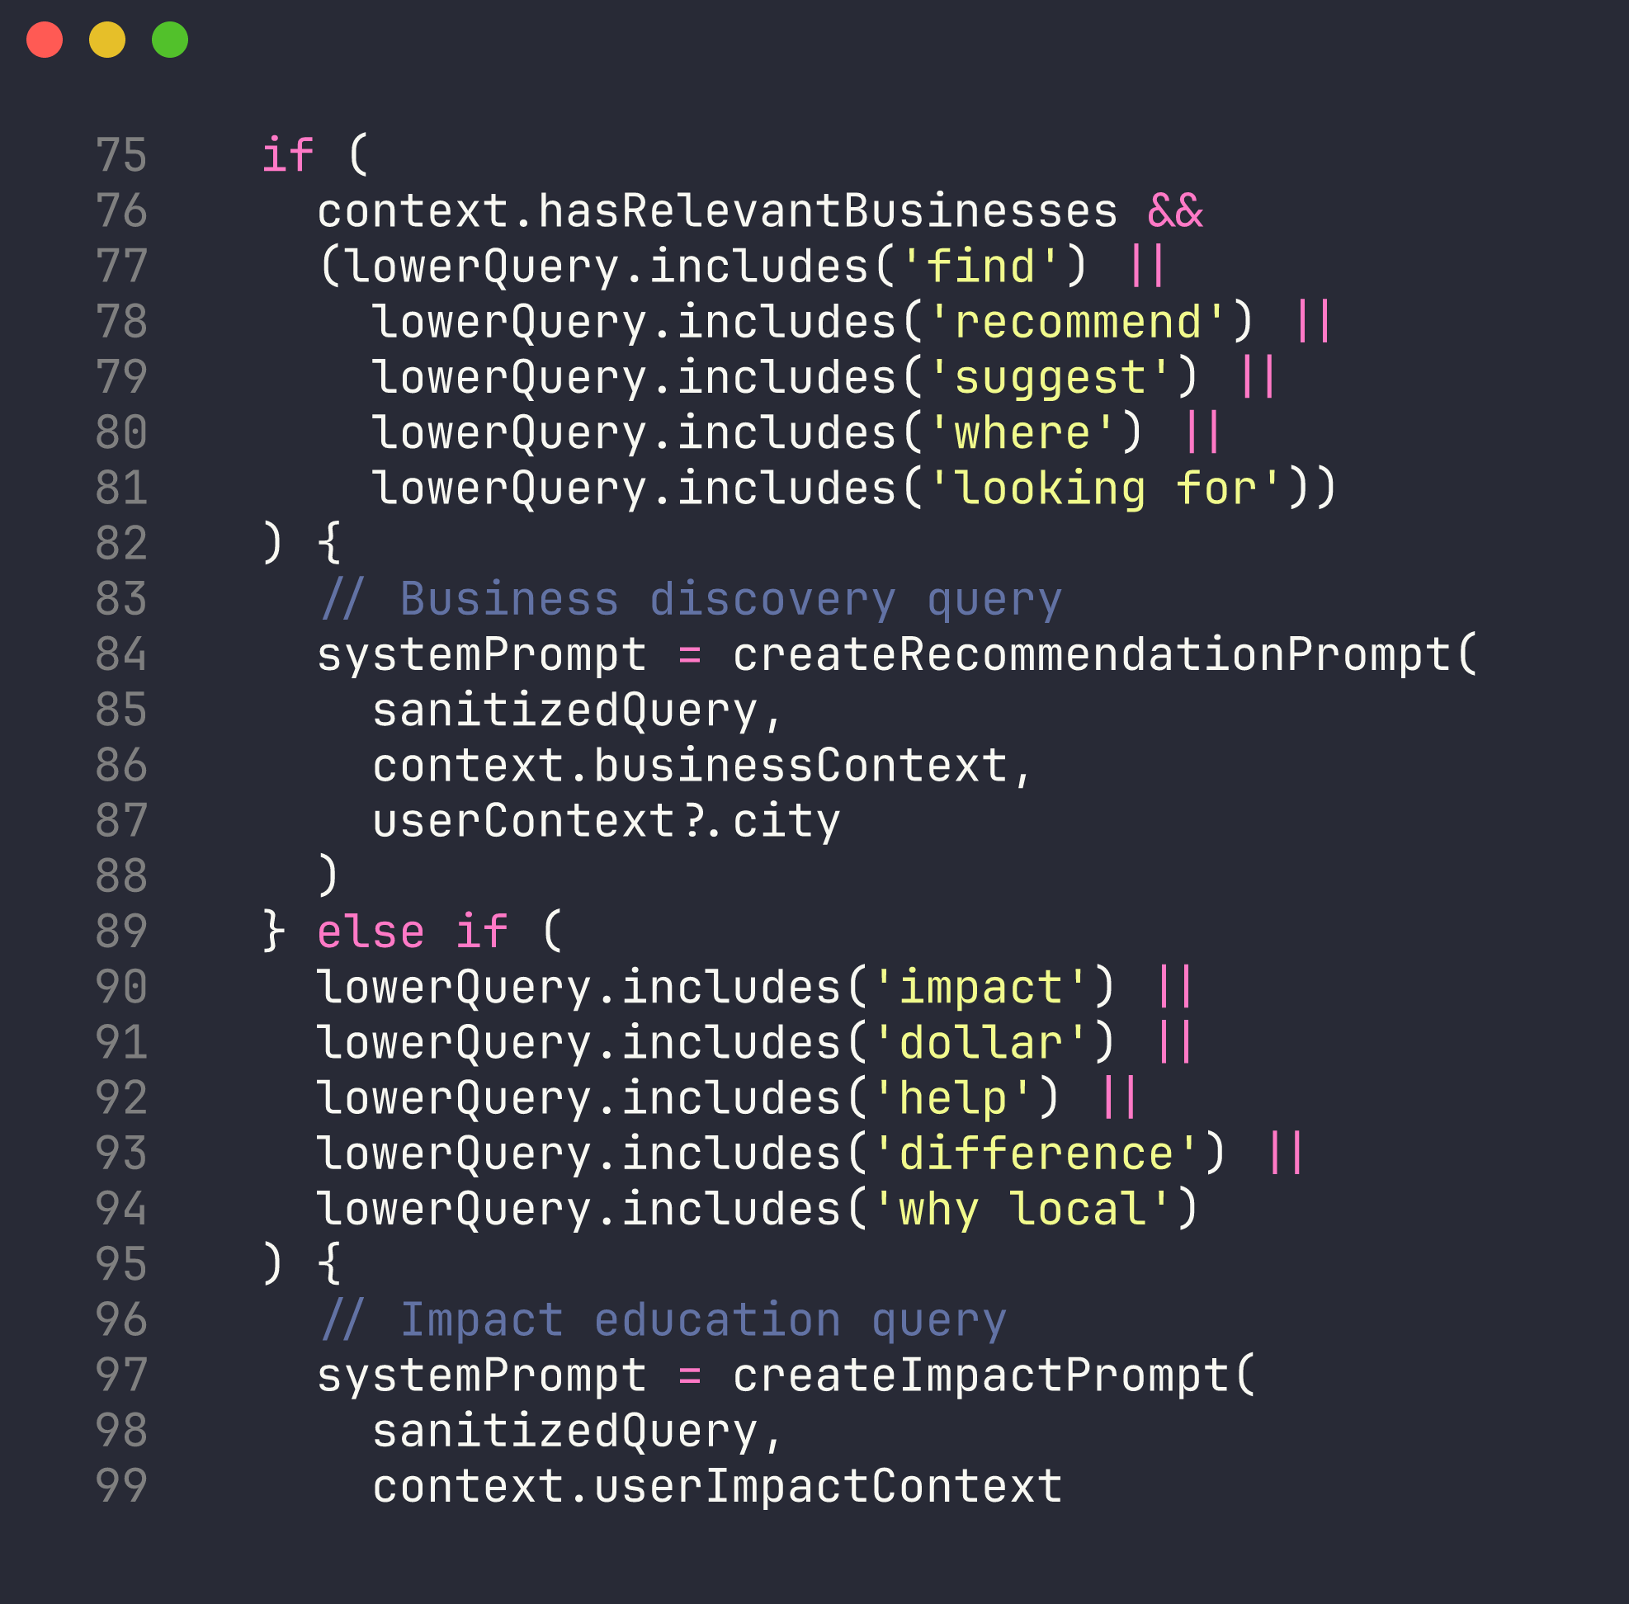
INTELLIGENT FEATURE
AI assistant with retrieval-augmented generation
User query
→
Extract keywords
→
Detect category
+ amenities
→
Retrieve real
businesses
→
Gemini answers
Assistant answering from live business data
lib/assistant — query-type routing
Real data, never hallucinated — prompt-injection filtered.
Pulse · FBLA Coding & Programming 2025–26
8
Notes:
FELIX (5:25-5:55)
Our assistant uses retrieval-augmented generation. When you ask for "a cozy coffee shop with wifi," we extract keywords, detect the category and amenities, pull matching businesses from our own database, and only then hand that context to Google's Gemini model — so answers cite real local businesses, never hallucinated ones. Prompt-injection filters sanitize every query before it reaches the model.
Handoff: "Oscar — how we keep bad data out."

Slide 9
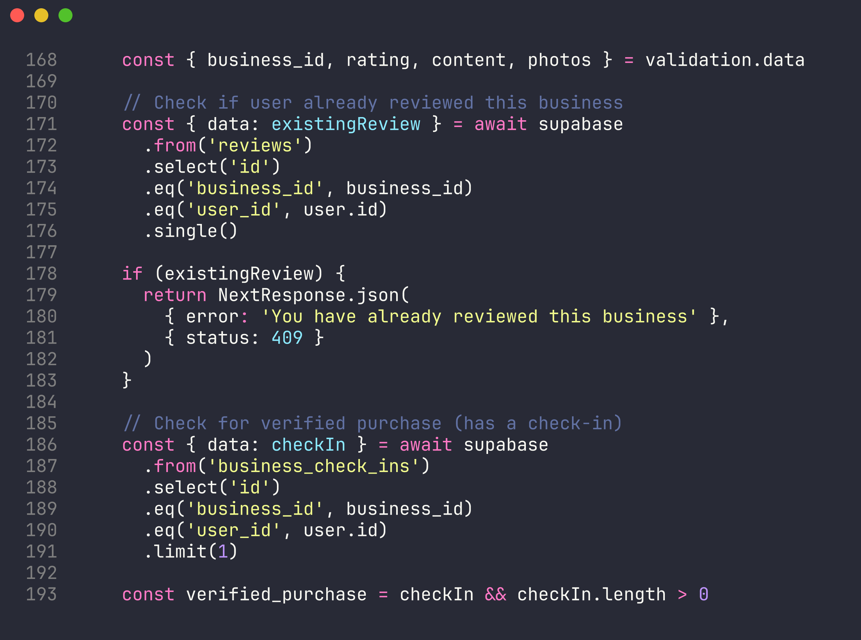
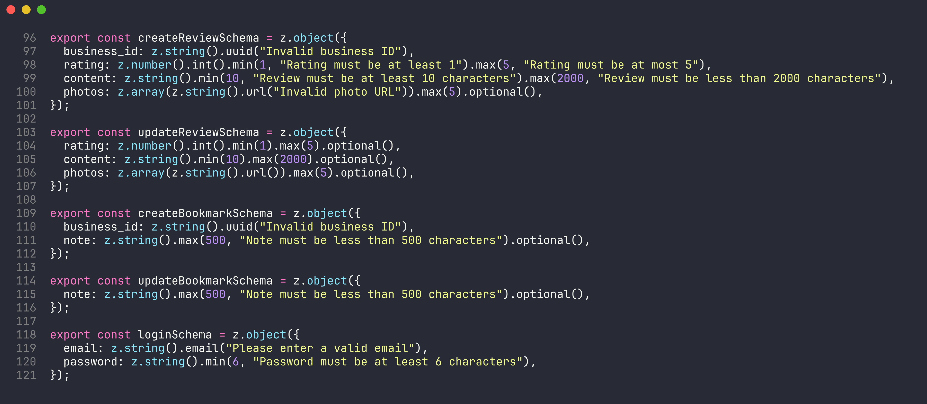
INPUT VALIDATION
Checked twice: format, then meaning
SYNTACTIC Zod schemas — format
SEMANTIC server checks — meaning
Rating 1–5 · content 10–2000 chars · UUIDs · duplicates → 409 · CAPTCHA re-verified · friendly errors, no crashes
Pulse · FBLA Coding & Programming 2025–26
9
Notes:
OSCAR (5:55-6:15)
Validation happens twice. Syntactic — Zod schemas verify format: ratings must be integers one through five, reviews ten to two thousand characters, IDs valid UUIDs. Semantic — the server checks meaning: duplicate reviews are rejected with a clear message, CAPTCHA tokens re-verified. Friendly errors, never crashes.
Handoff: "Matthew — where the data lives."

Slide 10
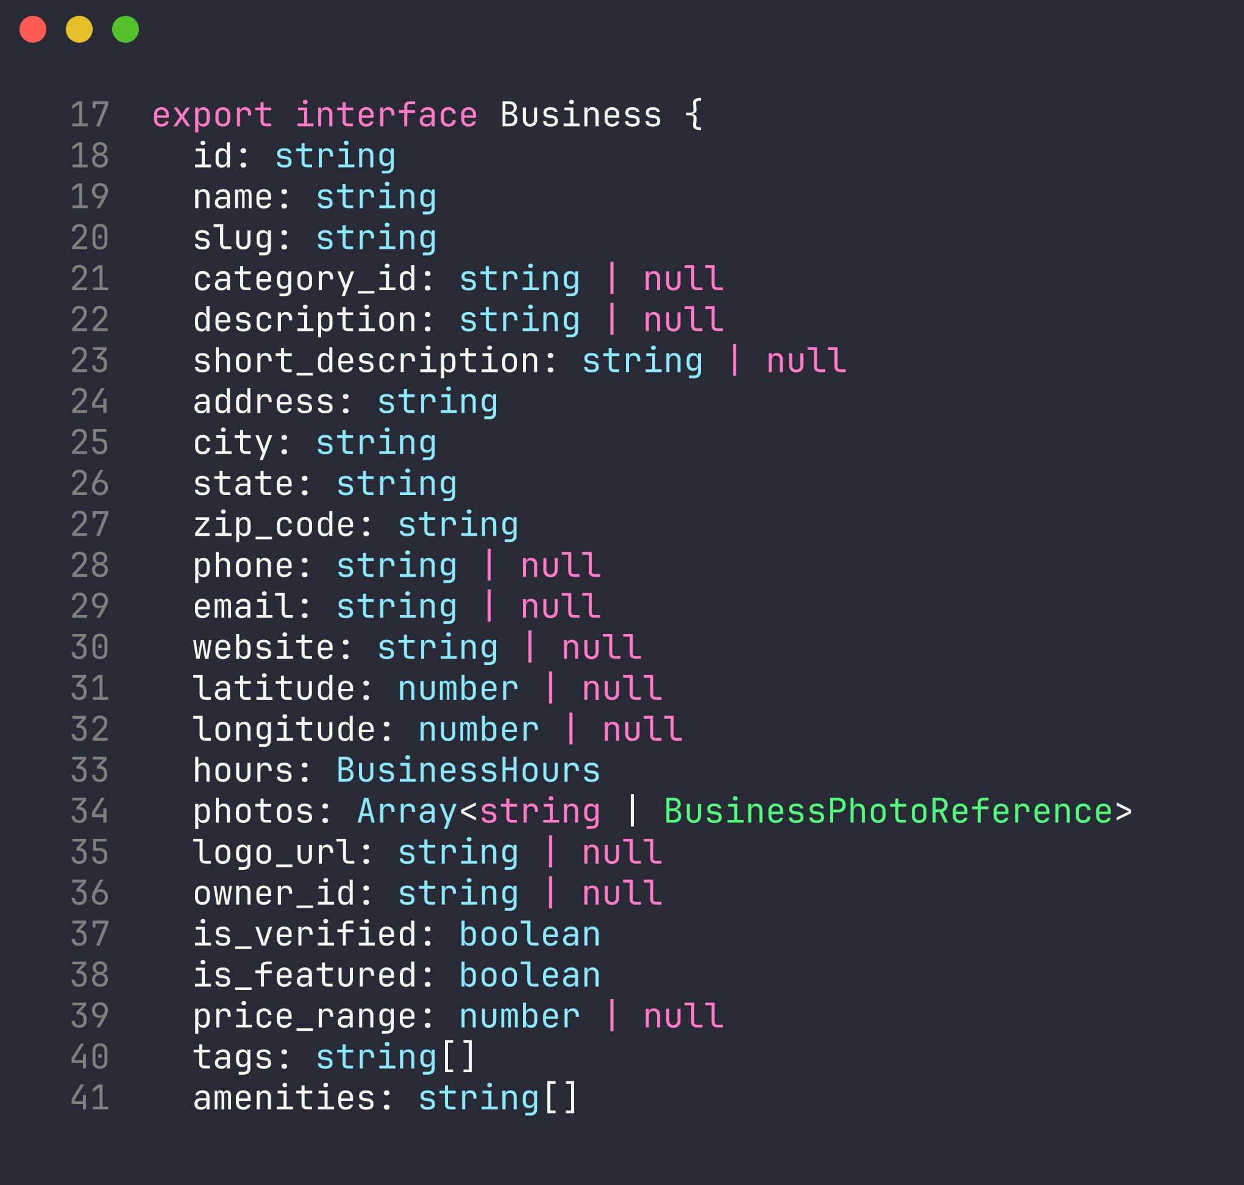
DATA STORAGE & STRUCTURES
Typed end to end
Typed arrays of interface objects
businesses, reviews, deals — compiler-enforced shape
Module constants
static data: categories, tiers
Component state
UI only: filters, sort order
React Query cache
server data, deduplicated, 24h TTL
PostgreSQL
persistence — foreign keys, unique constraints, RLS
types/business.ts — the Business interface
Pulse · FBLA Coding & Programming 2025–26
10
Notes:
MATTHEW (6:15-6:35)
Data flows as typed arrays of interface objects — every business, review, and deal matches a TypeScript contract. Scope is deliberate: module constants for static data, component state for UI, React Query cache for server data, PostgreSQL for persistence.

Slide 11
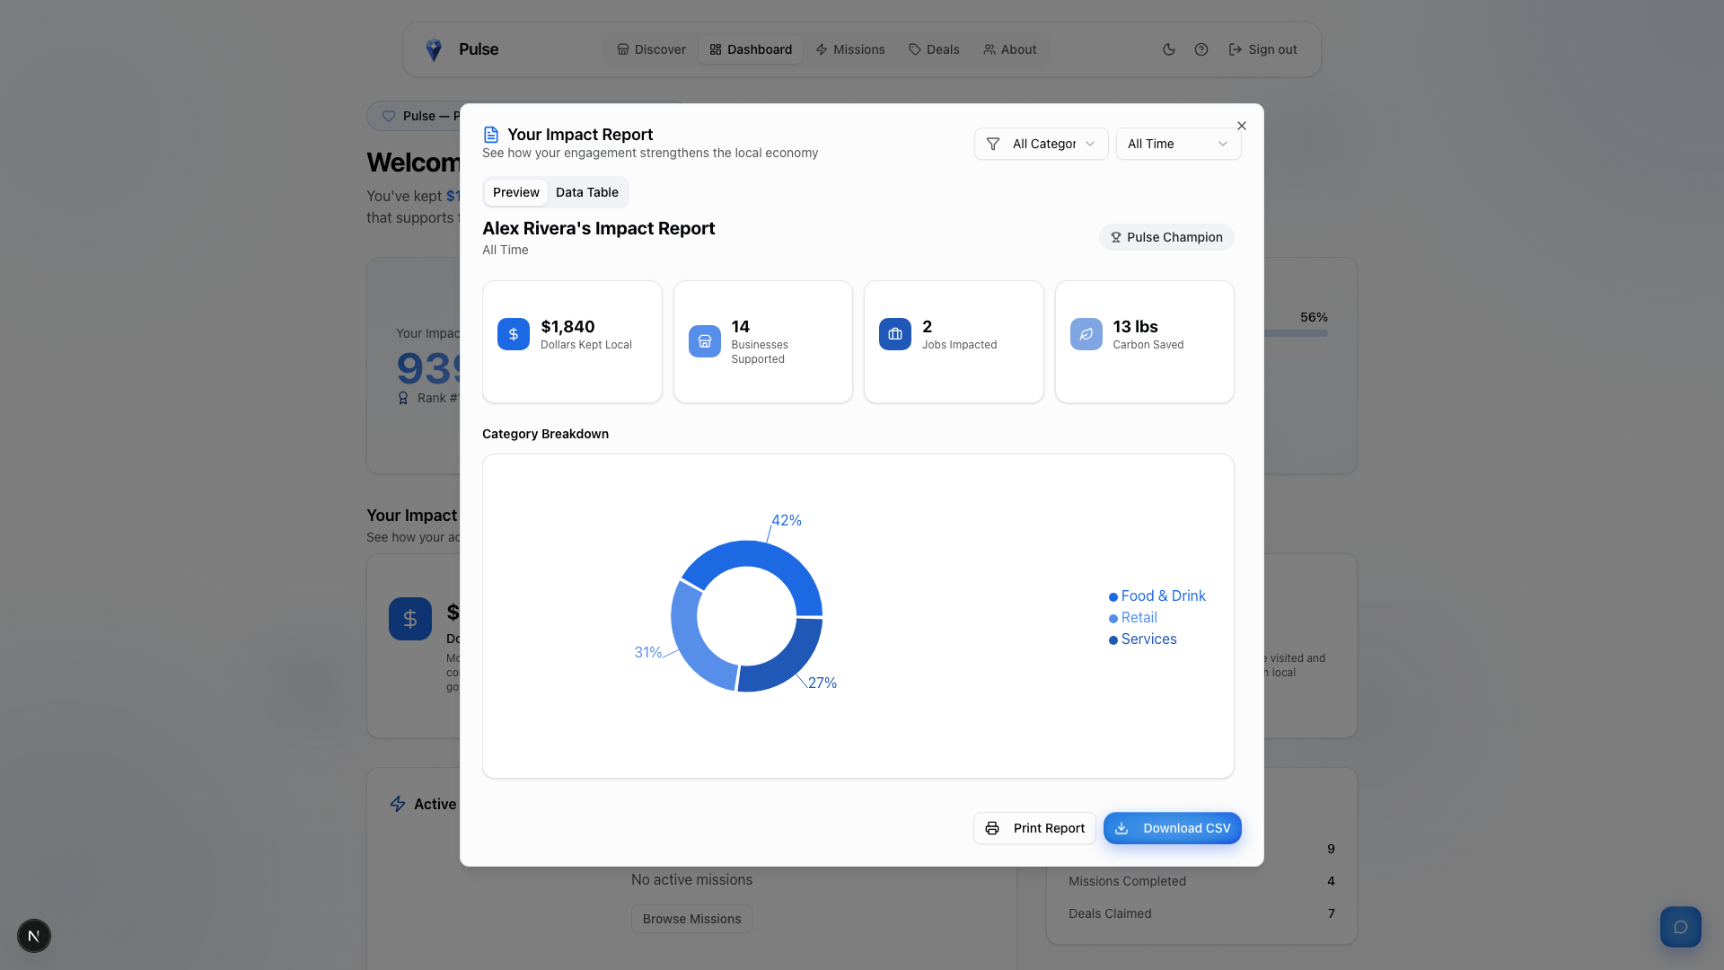
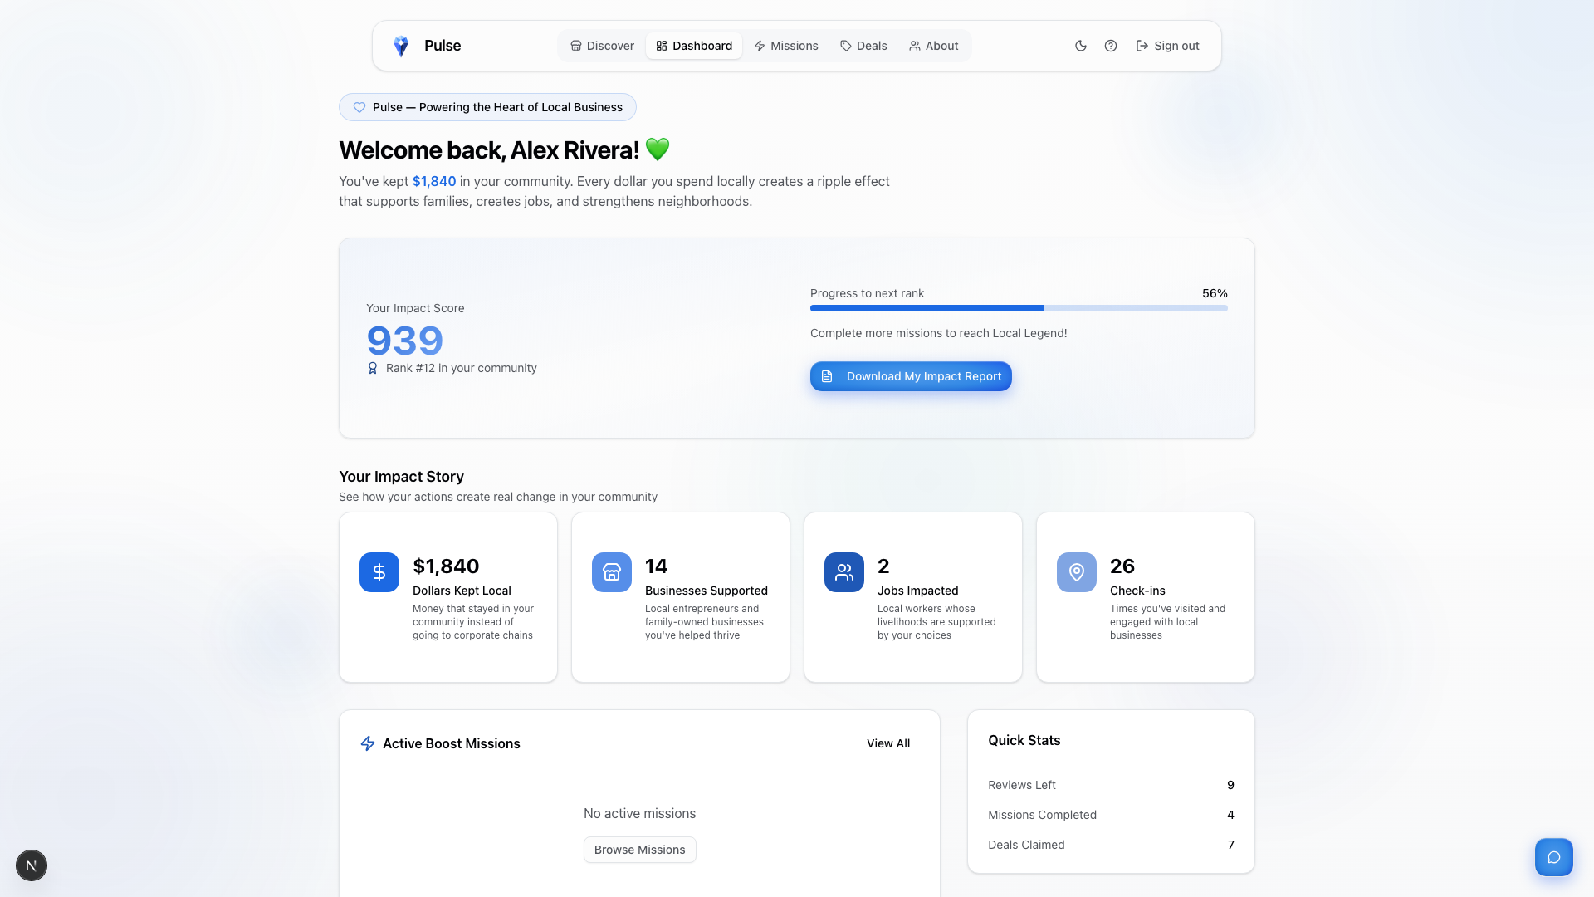
OUTPUT & DATA ANALYSIS
Reports users act on
Live impact dashboard
$1,840 kept local
14 businesses · 26 check-ins · 2 jobs
Impact report — date & category filters, CSV export, print layout
Pulse · FBLA Coding & Programming 2025–26
11
Notes:
OSCAR (6:35-6:50)
The impact report turns raw check-ins into insight: category breakdowns, a sortable business table, CSV export for spreadsheets, and an economic multiplier showing your dollars kept local — data analysis users actually act on.

Slide 12
A byte-sized business boost
Six required features · one intelligent assistant · measurable community impact
Questions?
Felix Yin · Oscar Gao · Matthew Heng — Diamond Bar FBLA
Pulse · FBLA Coding & Programming 2025–26
12
Notes:
FELIX (6:50-7:00)
Six required features, an intelligent assistant, and measurable community impact — that's Pulse: a byte-sized business boost. Thank you, judges — we welcome your questions.
[Assets cited: Lucide icons (ISC), Pulse logo (original), all screenshots original from our application and source code; business photos within screenshots are Google Places content displayed with attribution.]

