Slide 1



Alice
Bob
N
N-x
->

Slide 2
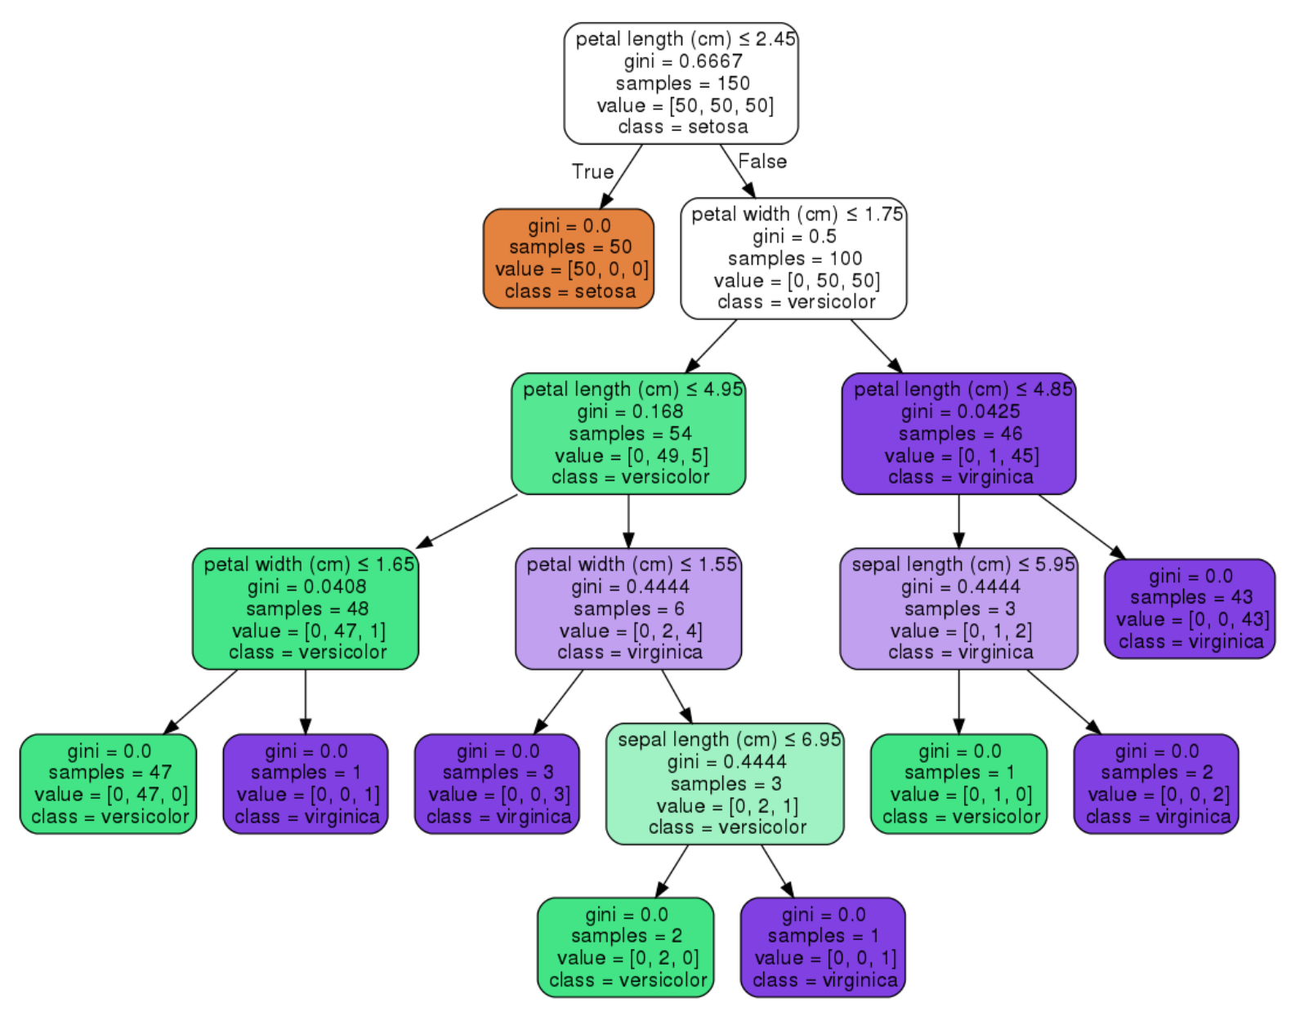
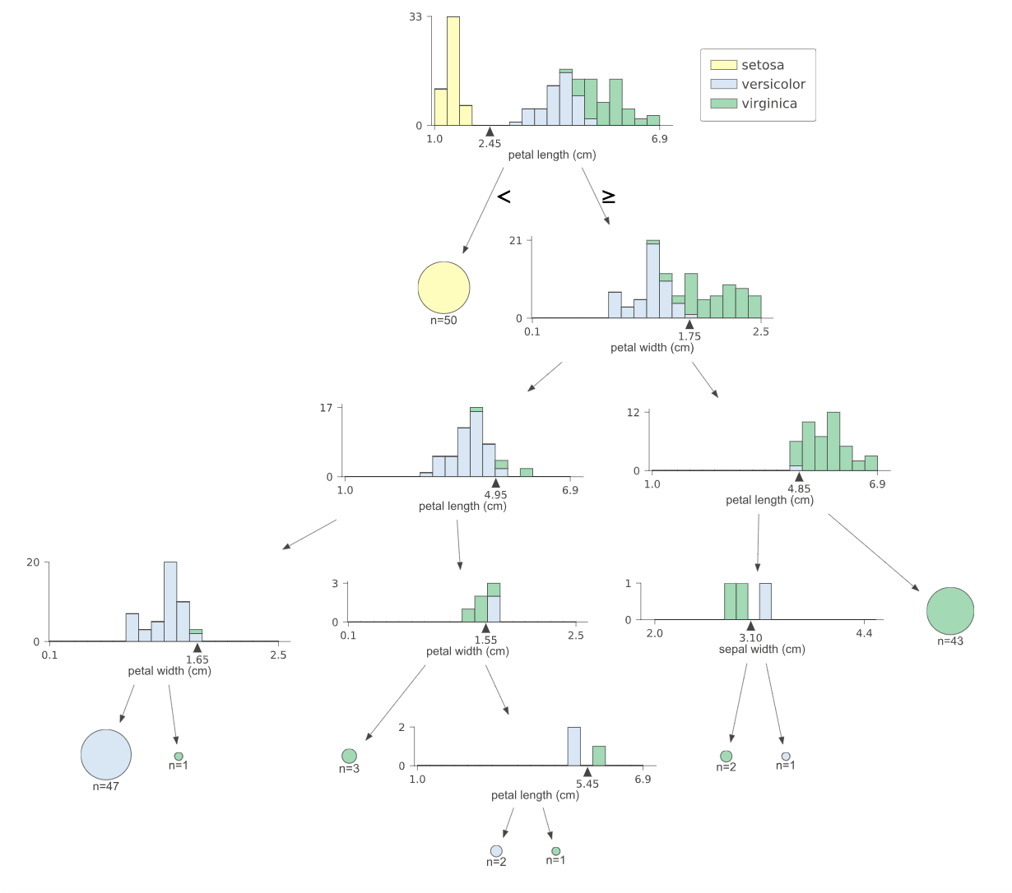
Before (scikit-learn)
After (dtree-viz)

Slide 3
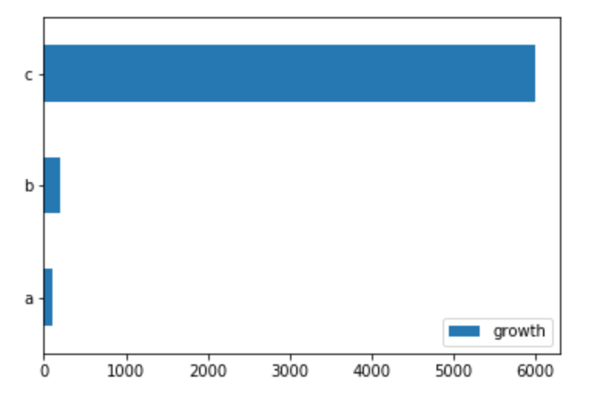
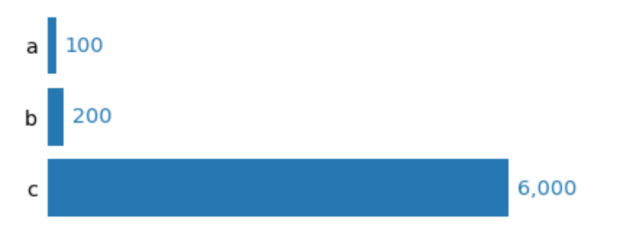
Design / simplify Bar chart
Before
After

