Slide 1
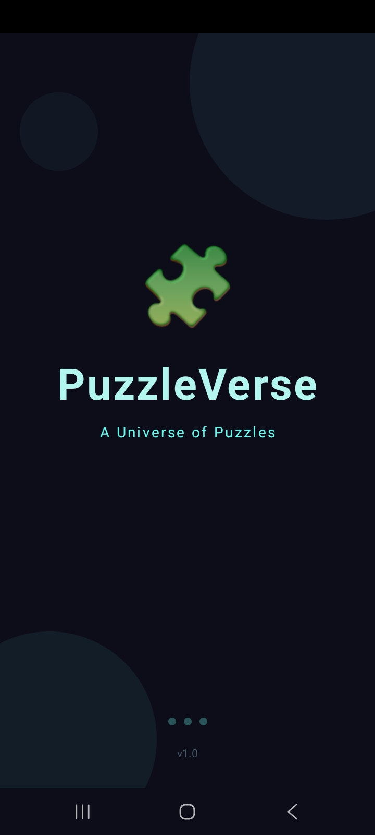
PuzzleVerse
A Universe of Puzzles
Every piece tells a story. Find yours.
v1.0
Android Puzzle Game

Slide 2
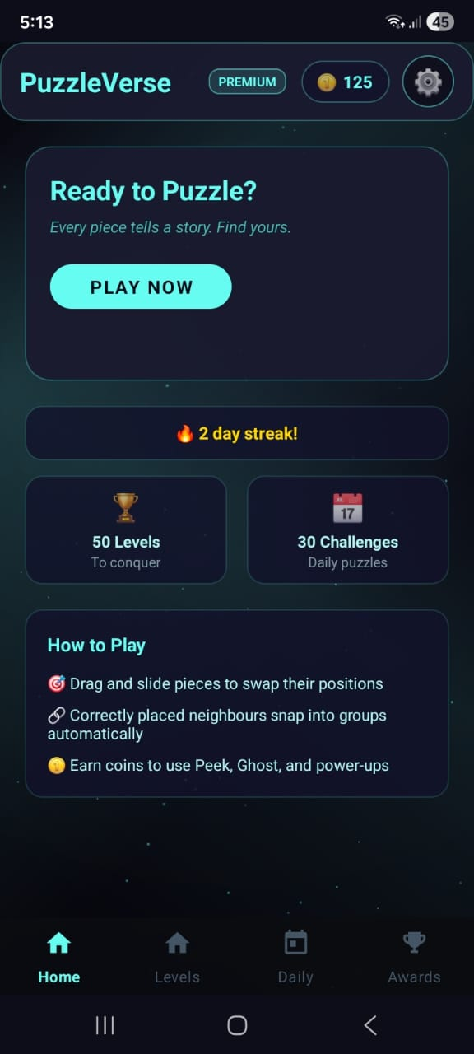
Project Overview
What is PuzzleVerse?
🎮 An Android puzzle game inspired by Jigsaw Explorer but reimagined with fresh mechanics
🧩 Players swap scrambled image pieces to reconstruct the original picture
⚡ Each level has a move limit — strategy matters, not just speed
📈 Difficulty scales progressively across 50 unique levels
🪙 Coin economy rewards skill and exploration

Slide 3
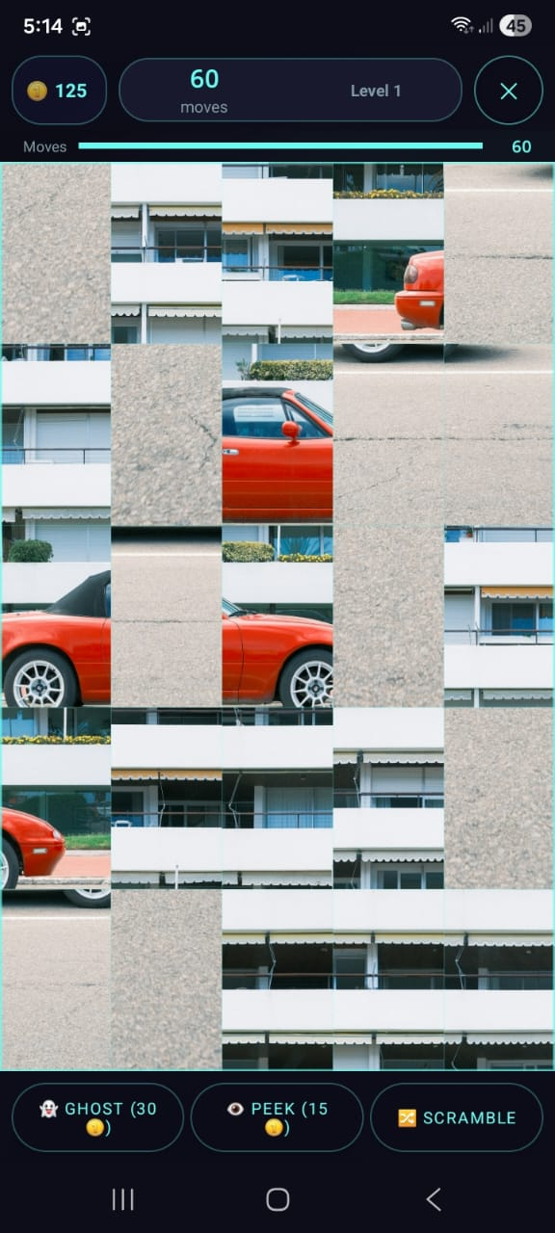
How to Play
🎯
🔗
👻
Drag & Swap
Auto-Snap
Power-Ups
Drag and slide pieces to swap their positions on the board. Simple touch controls make it intuitive.
Correctly placed neighbouring pieces snap into groups automatically — great visual feedback.
Use Ghost, Peek, and Scramble power-ups. Earned coins let you activate these strategically.
Live Gameplay

Slide 4
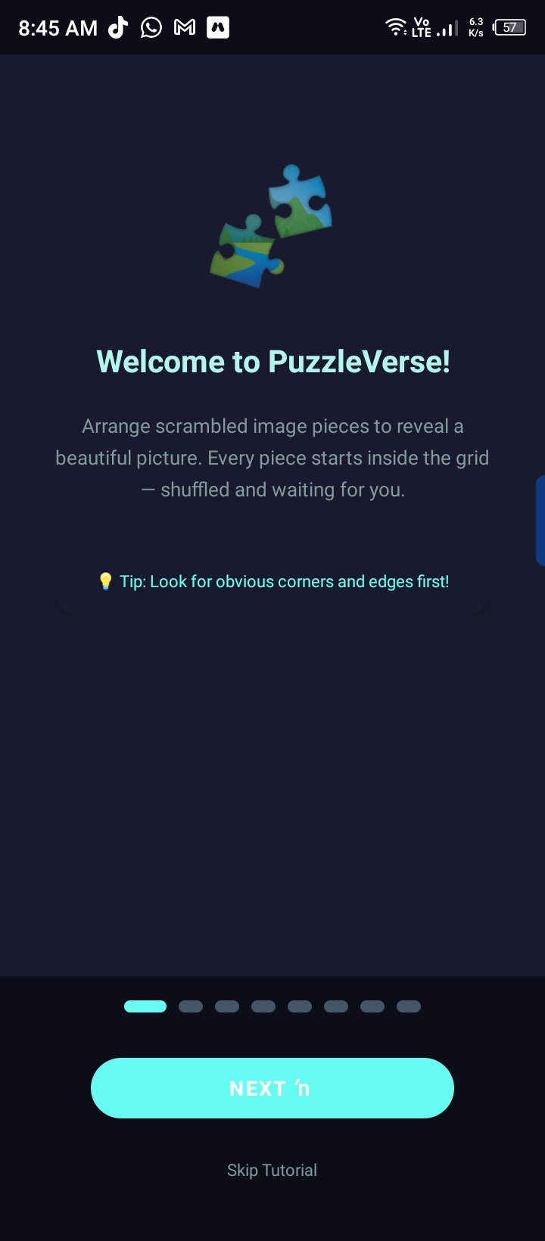
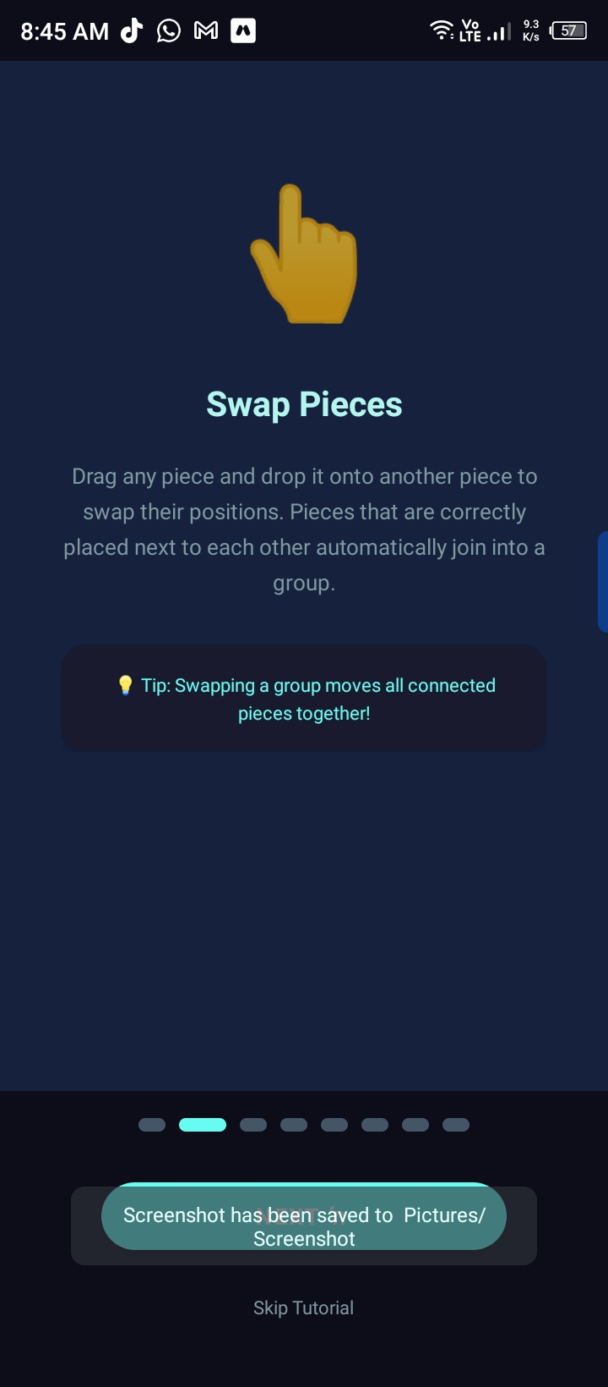
In-App Tutorial
PuzzleVerse includes a built-in 8-step interactive tutorial that walks new players through every core mechanic before their first puzzle.
01
Welcome
Intro screen — arrange pieces to reveal images
02
Swap Pieces
Drag & drop to swap; neighbours auto-join groups
03
Ghost Image
30 coins — faint image overlay stays visible permanently
04
Ready to Play!
Complete tutorial and jump into Level 1

Slide 5
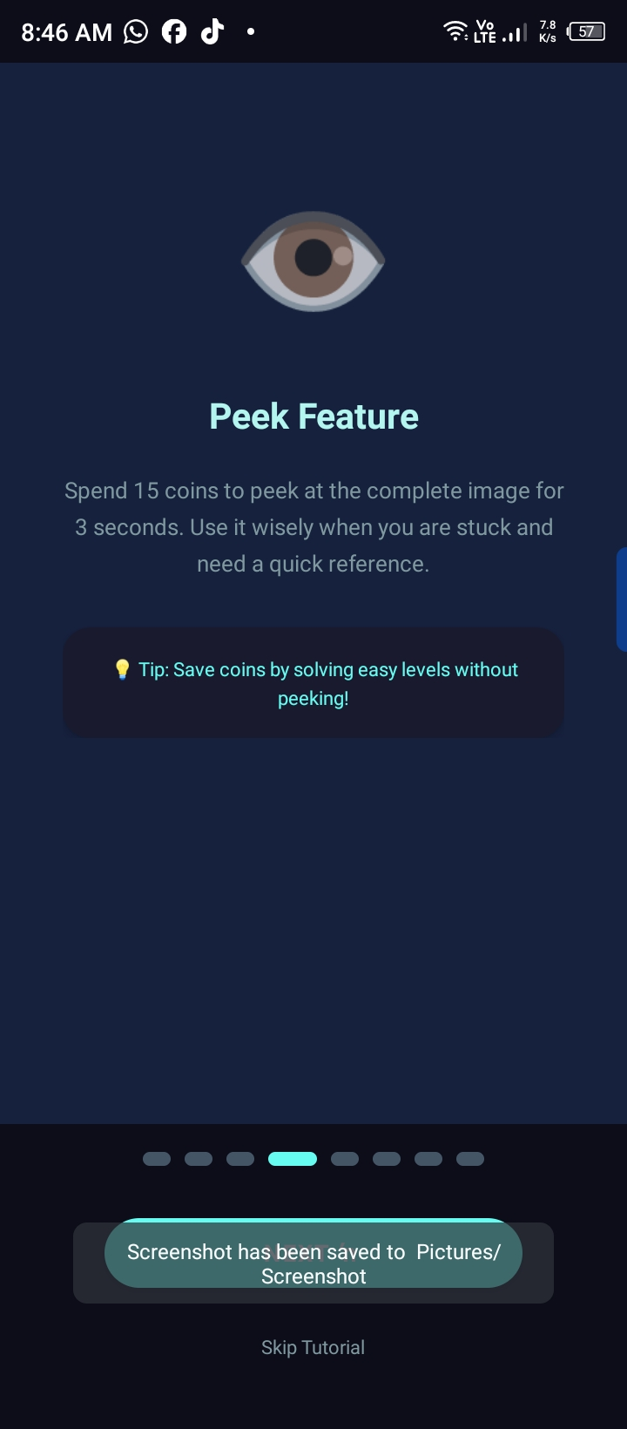
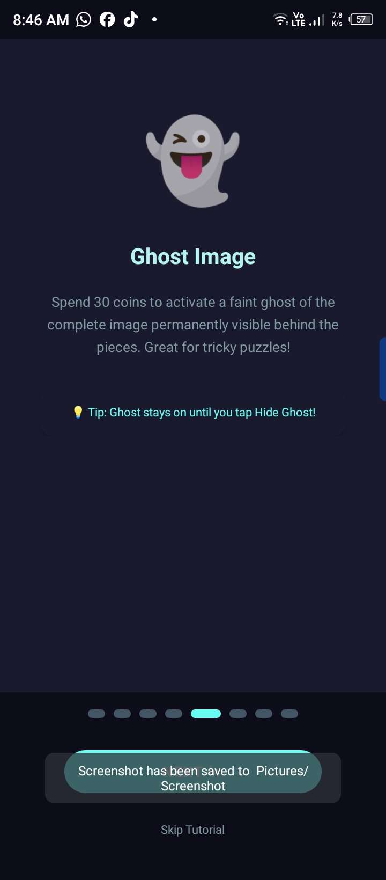
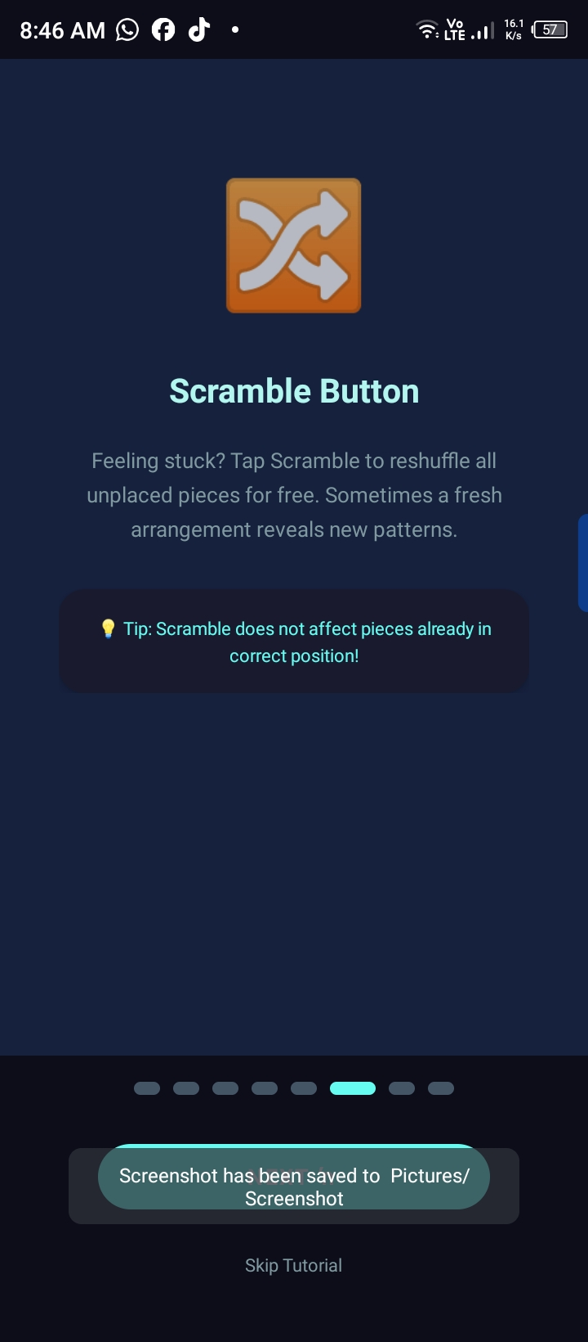
Tutorial: Power-Ups & Challenges
👁 Peek Feature
👻 Ghost Image
🔀 Scramble Button
15 coins
30 coins
FREE
Reveals the full target image for 3 seconds. Best used when you're stuck and need a quick visual reference.
Places a permanent faint overlay of the complete image behind all puzzle pieces until you hide it.
Reshuffles all unplaced pieces randomly. Doesn't affect correctly placed pieces — great when stuck.
💡 Save coins by solving easy levels without peeking!
💡 Ghost stays on until you tap Hide Ghost!
💡 Scramble does not affect correctly placed pieces!

Slide 6
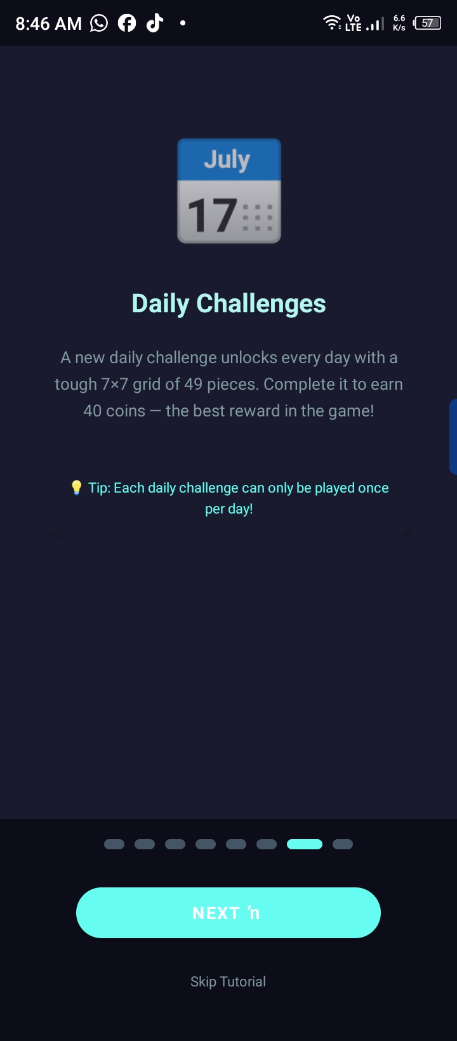
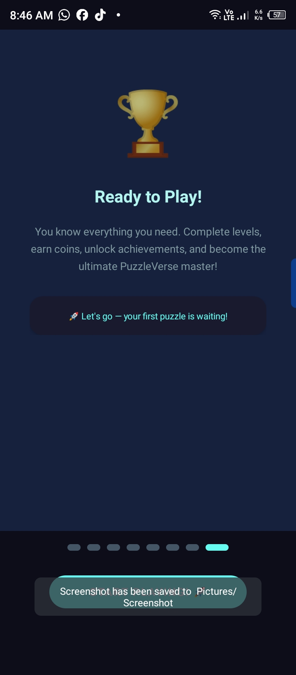
Tutorial: Daily Challenges & Let's Go!
Daily Challenges
Ready to Play!
📅 7×7 Grid
49 pieces — the toughest puzzle format in the game
🪙 40 Coins Reward
Highest coin payout — best reward available
⏰ Once Per Day
Each challenge can only be played one time daily
🔓 New Unlock Daily
Fresh challenge unlocks every 24 hours automatically
🚀 Complete the tutorial → Level 1 unlocks → Begin your PuzzleVerse journey!

Slide 7
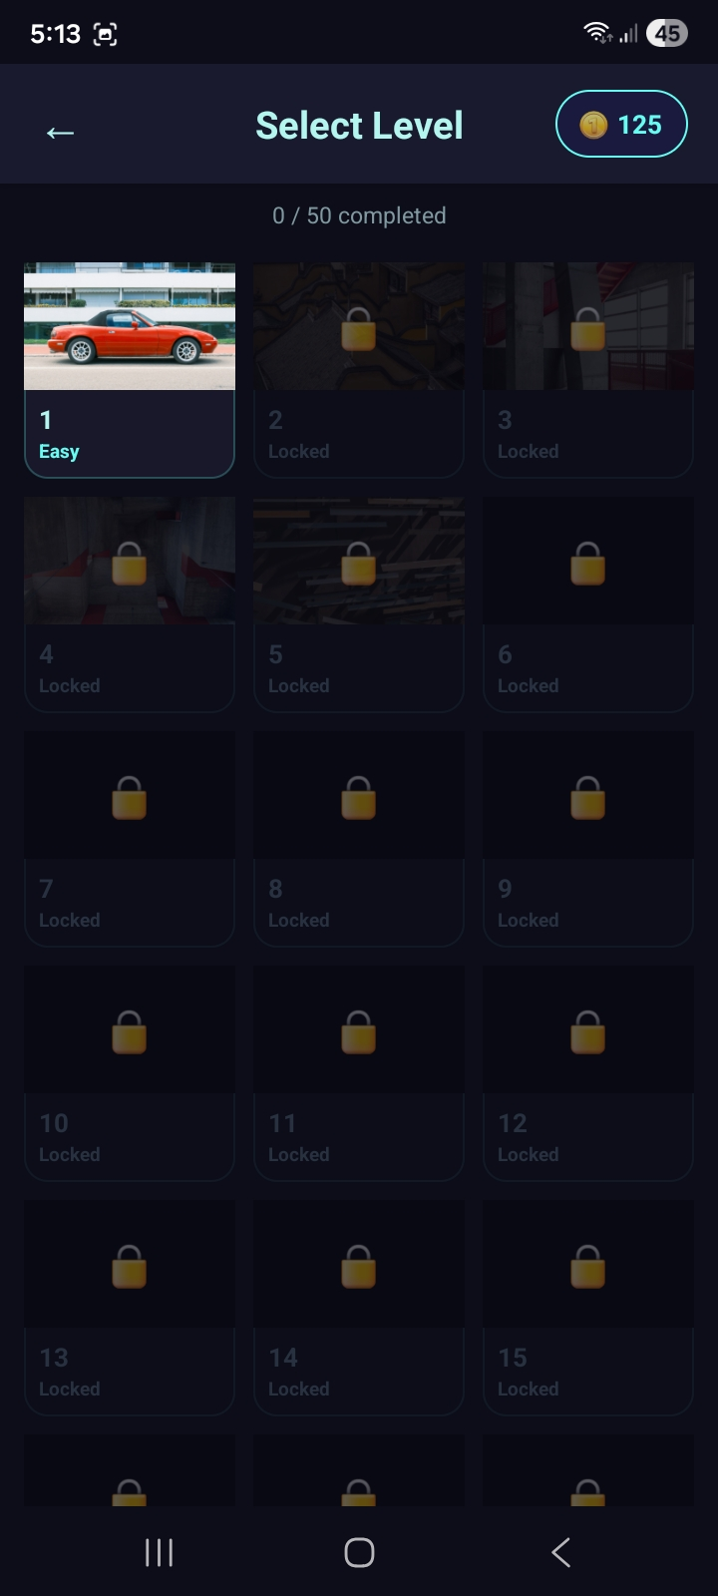
50-Level Journey
50
60
3
Unique Levels
Move Limit
Difficulty Tiers
Each with a different image
Per level to complete
Easy → Medium → Hard
Progressive Difficulty
Levels unlock sequentially — complete one to access the next.
The number of scrambled pieces grows with each level, making later stages significantly more challenging.
Completing each level earns +10 coins to spend on power-ups.

Slide 8
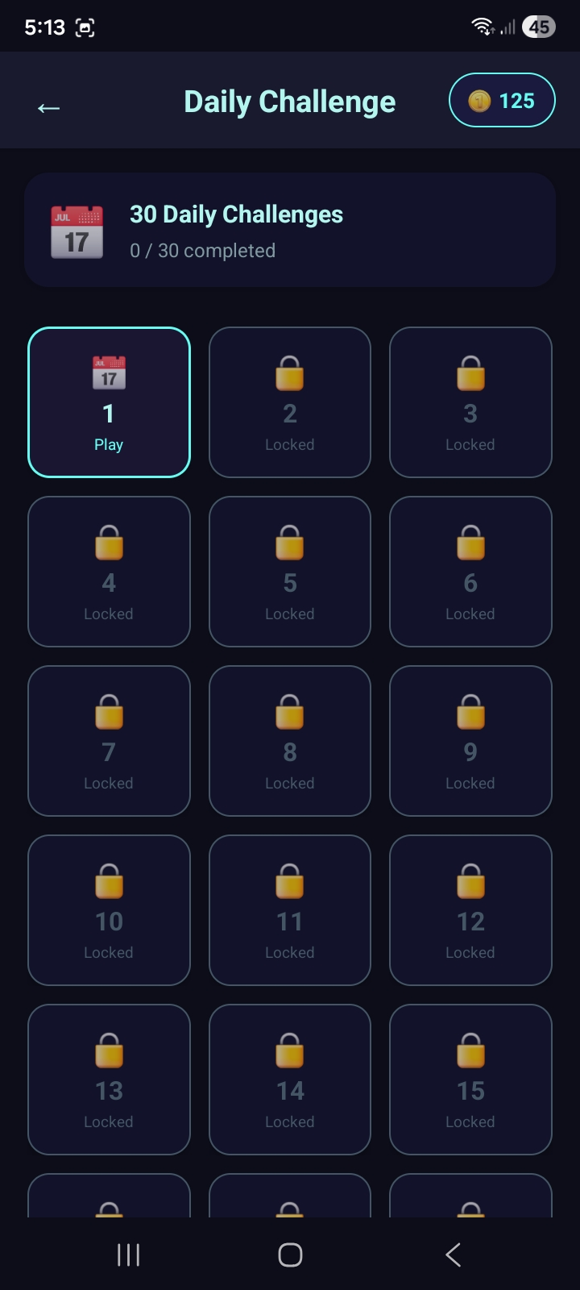
Daily Challenges
🗓️ 30 Daily Challenges
Complete 1 challenge per day — fresh content every 24 hours
🔥 Daily Streak
Keep your streak alive by playing every day
📅 One Per Day
A new challenge unlocks daily — pace your progress
🏆 Reward System
Completing a daily challenge earns coins & achievements
📊 Track Progress
0/30 tracker shows your overall challenge completion

Slide 9
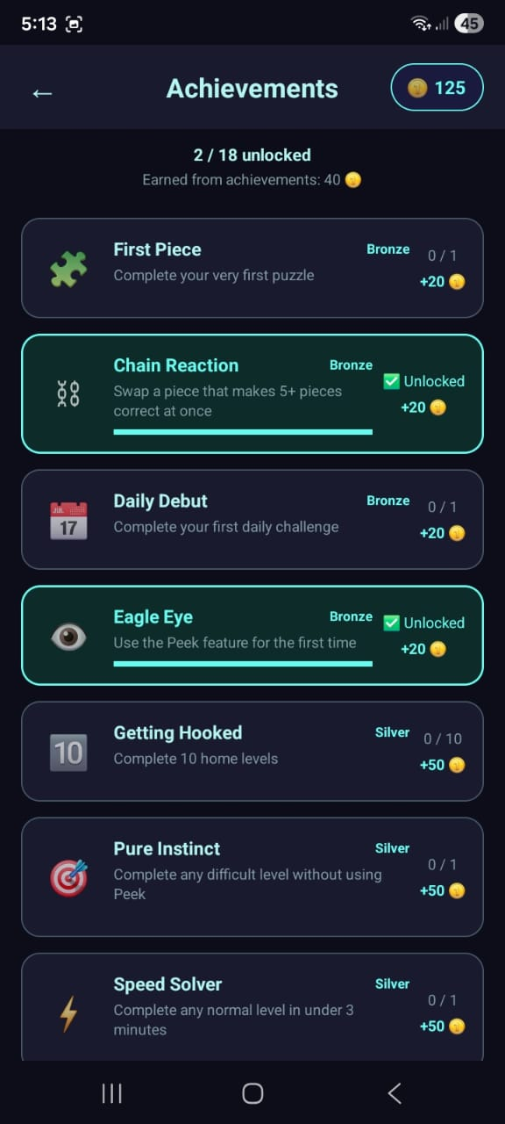
Achievements & Rewards
18 Total Achievements | Bronze · Silver · Gold tiers
Bronze Tier
Silver Tier
• First Piece — Complete your first puzzle
• Getting Hooked — Complete 10 home levels
• Chain Reaction — Snap 5+ pieces at once
• Pure Instinct — Finish a hard level without Peek
• Daily Debut — Finish your first daily challenge
• Speed Solver — Complete a level in under 3 mins
• Eagle Eye — Use the Peek feature
🪙 Each achievement grants +20 to +50 coins as reward

Slide 10
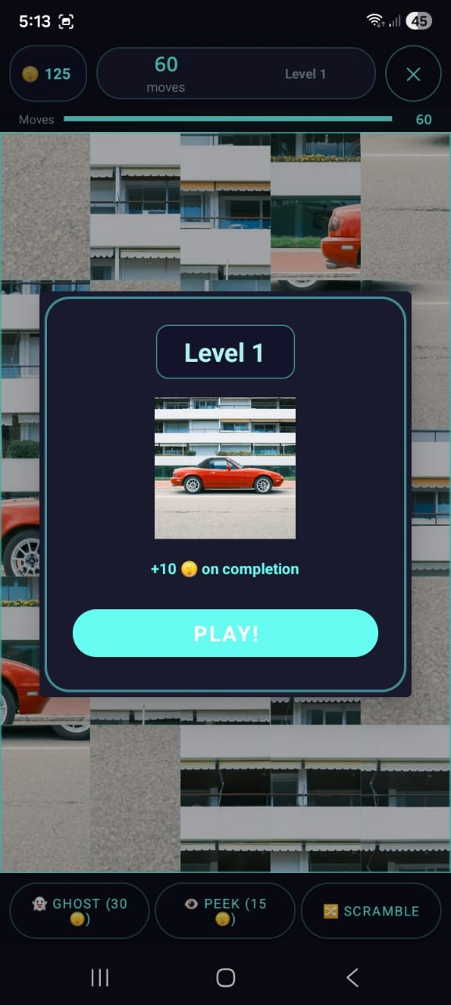
Gameplay in Action
Level Start Preview
Scrambled Board (In-Progress)
👻 Ghost (30 coins) | 👁 Peek (15 coins) | 🔀 Scramble | 60 moves per level

Slide 11
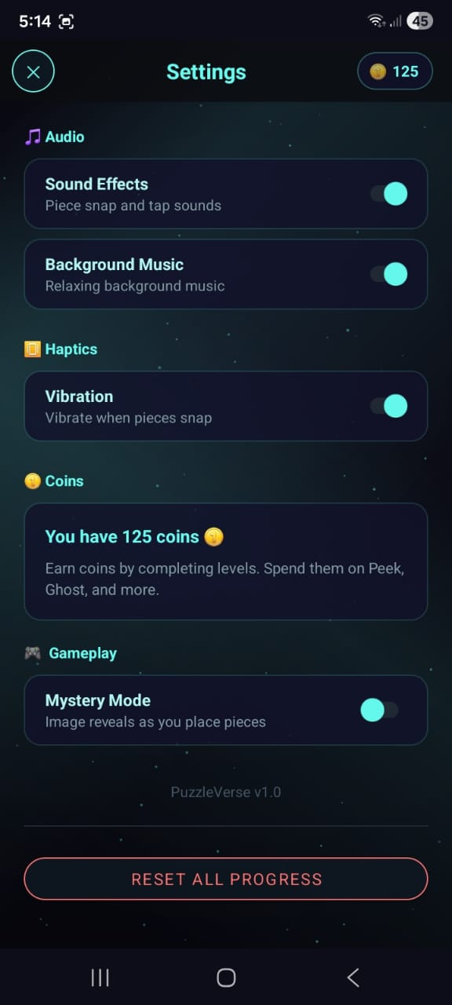
App Settings & Features
🎵
📳
Audio Control
Haptics
Sound effects & relaxing background music — both toggleable
Vibration feedback when pieces snap into place
🪙
🕵️
Coin System
Mystery Mode
Earn coins from levels & achievements. Spend on power-ups
Image reveals progressively as you place correct pieces

Slide 12
Why PuzzleVerse Stands Out
🏆
📅
⭐
⚡
50
30
18
60
Levels
Daily Challenges
Achievements
Moves/Level
What Makes It Different
✅ Swap-based mechanics vs. traditional drag-to-slot — unique feel
✅ Move-limited gameplay adds strategy depth not found in standard jigsaw apps
✅ Auto-snap group mechanic for satisfying chain reactions
✅ Mystery Mode: progressive reveal keeps players engaged and curious
✅ Robust coin economy with power-ups encourages replay without being pay-to-win

Slide 13
🧩
PuzzleVerse
A Universe of Puzzles
Thank You
50 Levels
30 Daily Challenges
18 Achievements
Android v1.0

