Slide 1

DOCKERIZE YOURSELF

Slide 2
Hüseyin Ekemen
Ege Üni. Compeng
19 Years : Linux & Open-Source
18 Years : Java Technologies
15 Years : Software Development / R&D/ Management
Co-Founder @ H2H Secure
Cyber Security, Big/Fast Data, Dev-Ops, Software Technologies.
huseyin.ekemen@h2hsecure.com
linkedin: Huseyin Ekemen

Slide 3
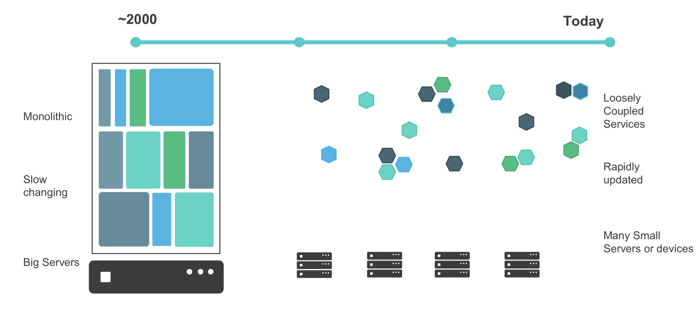
IT Transformation

Slide 4
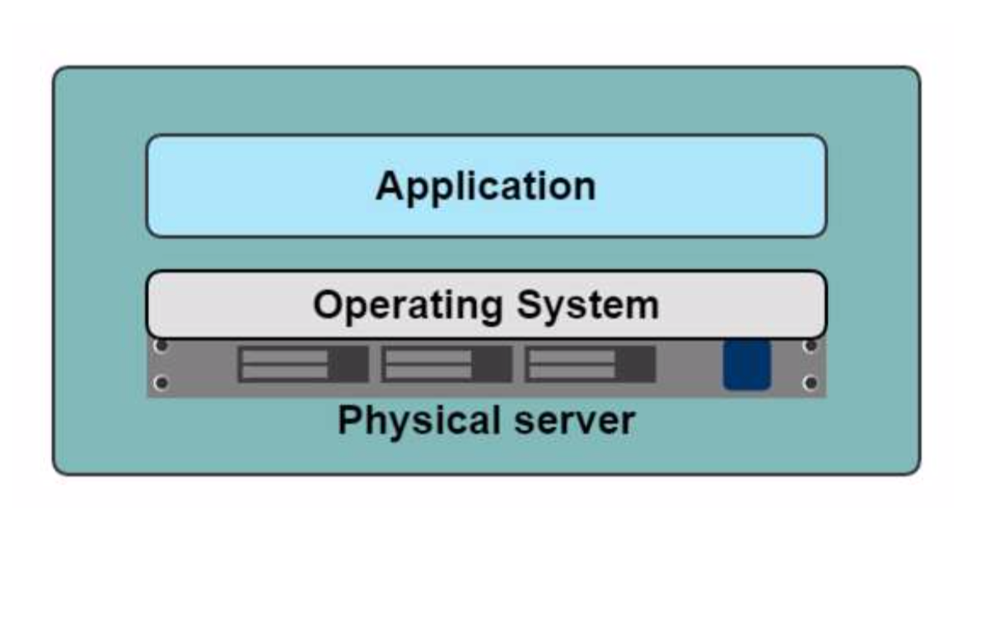
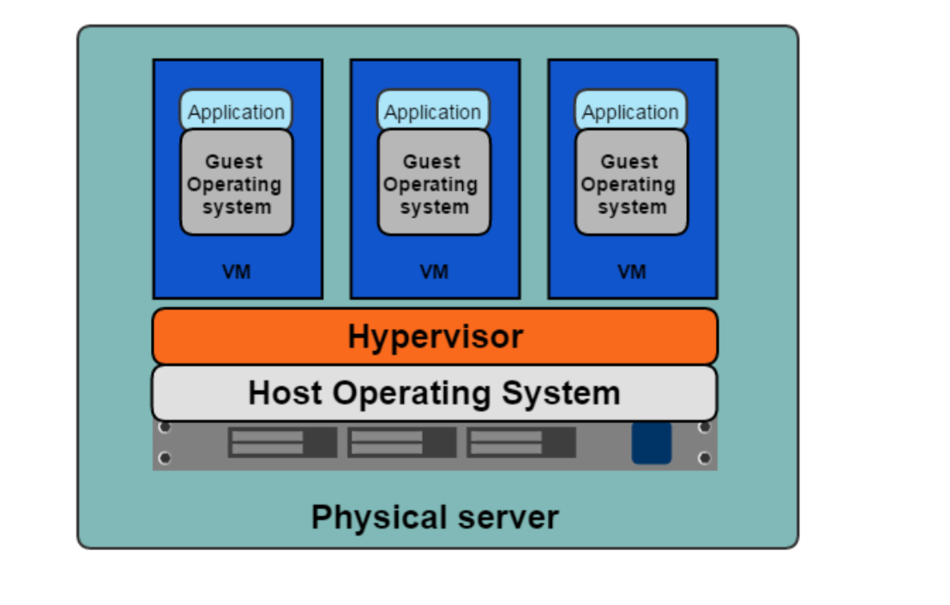
Why Containers?

Slide 5
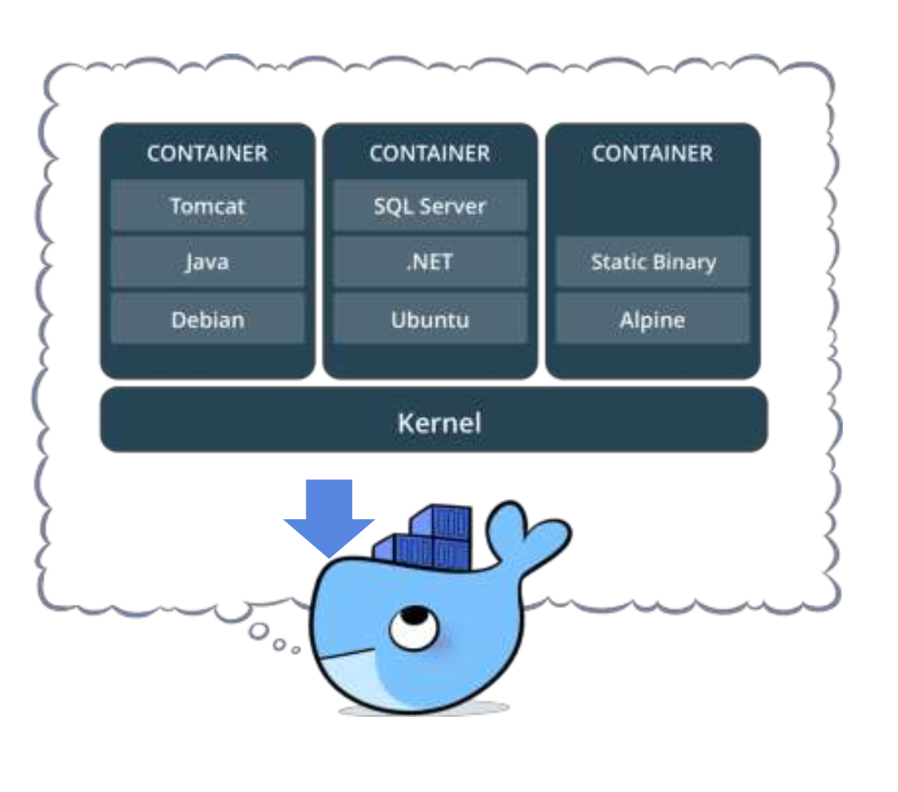
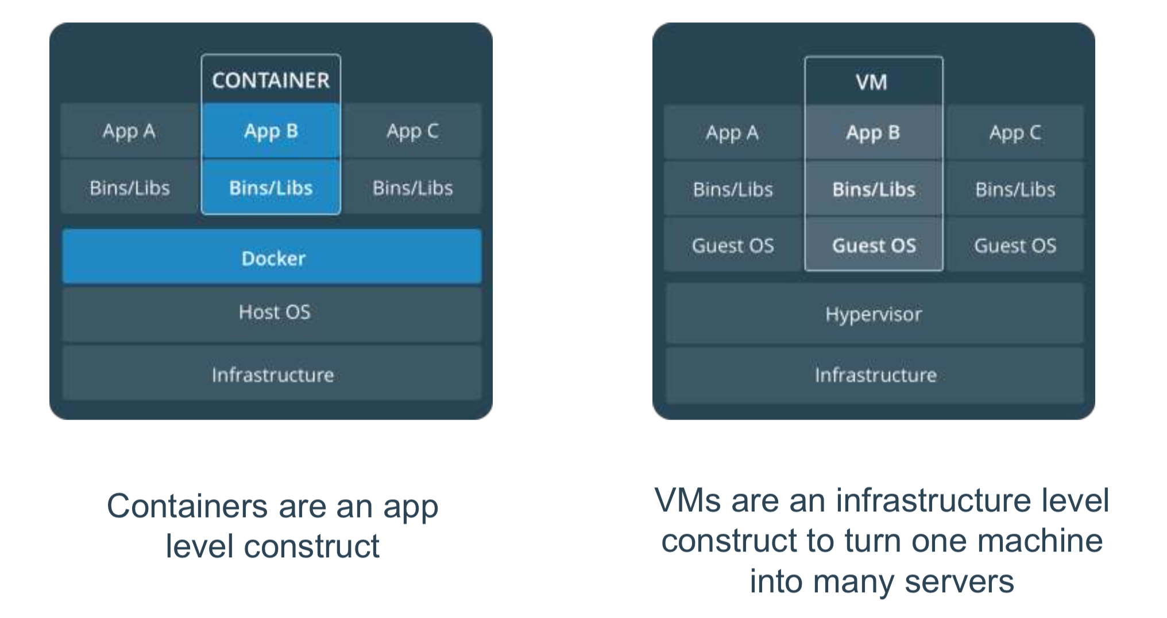
Why Containers?

Slide 6
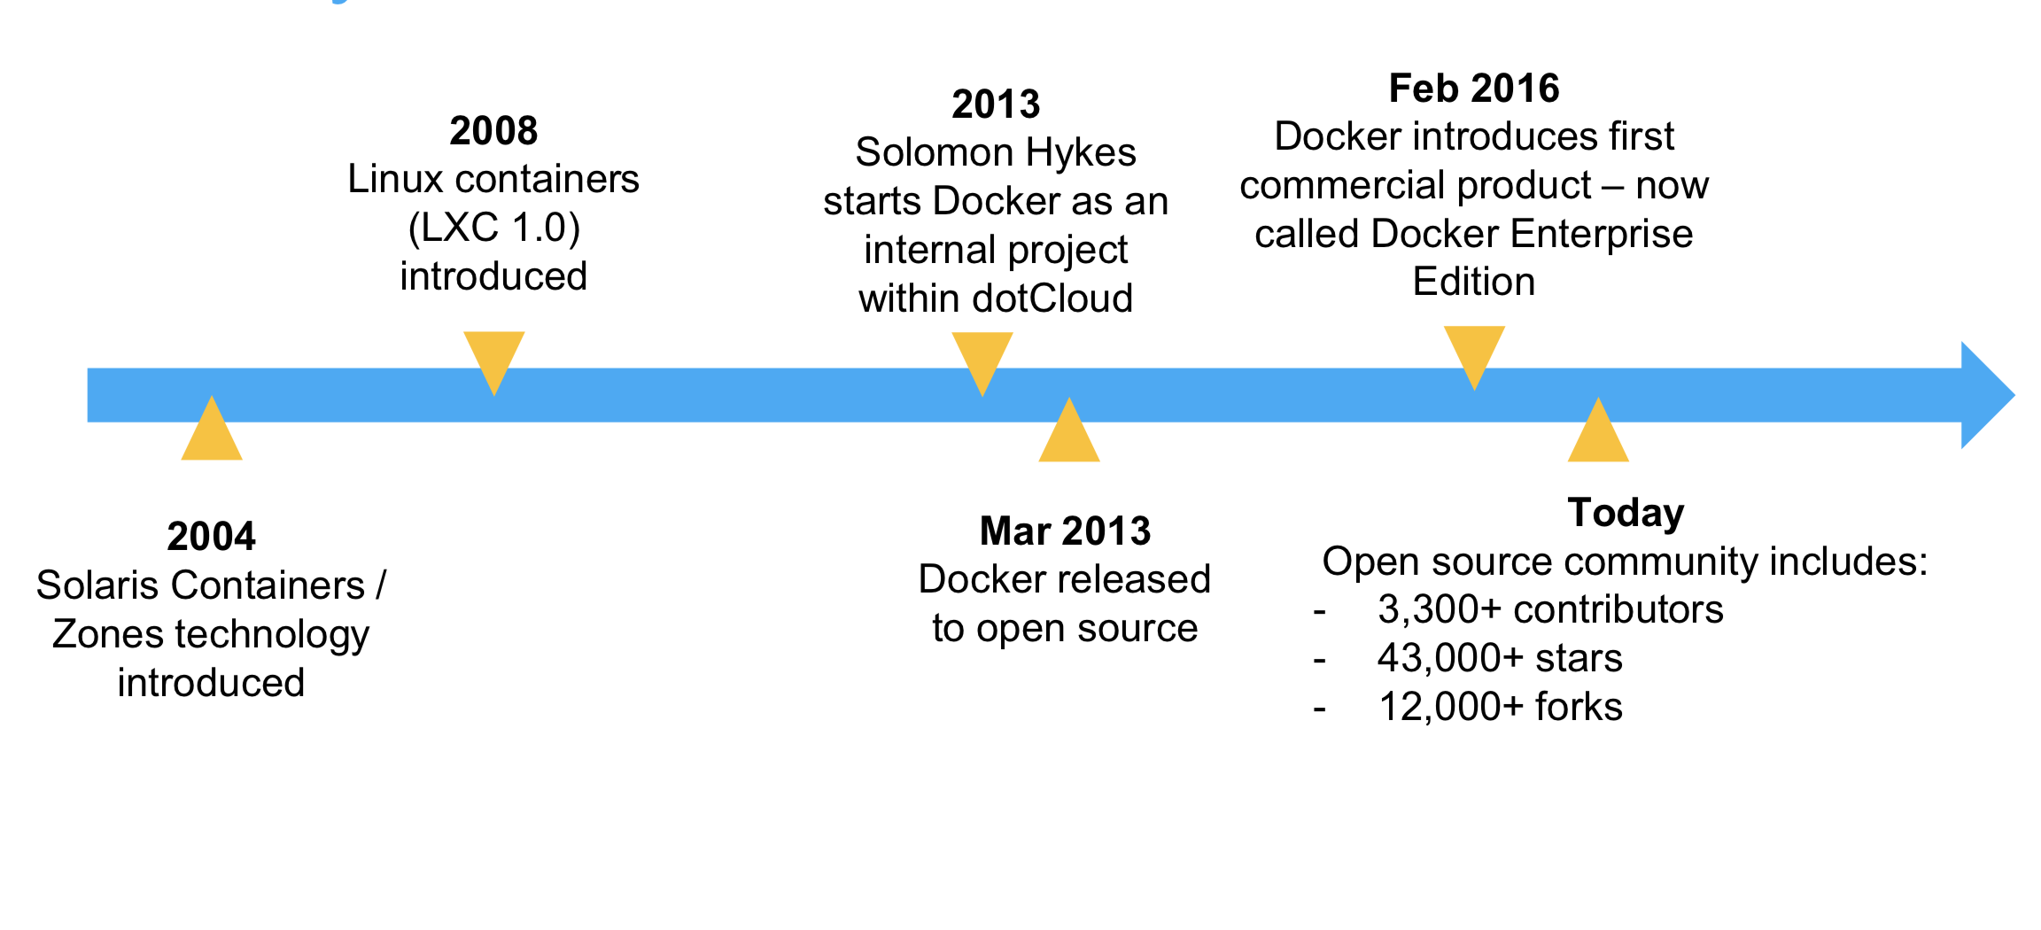
History of Docker (Containers)

Slide 7
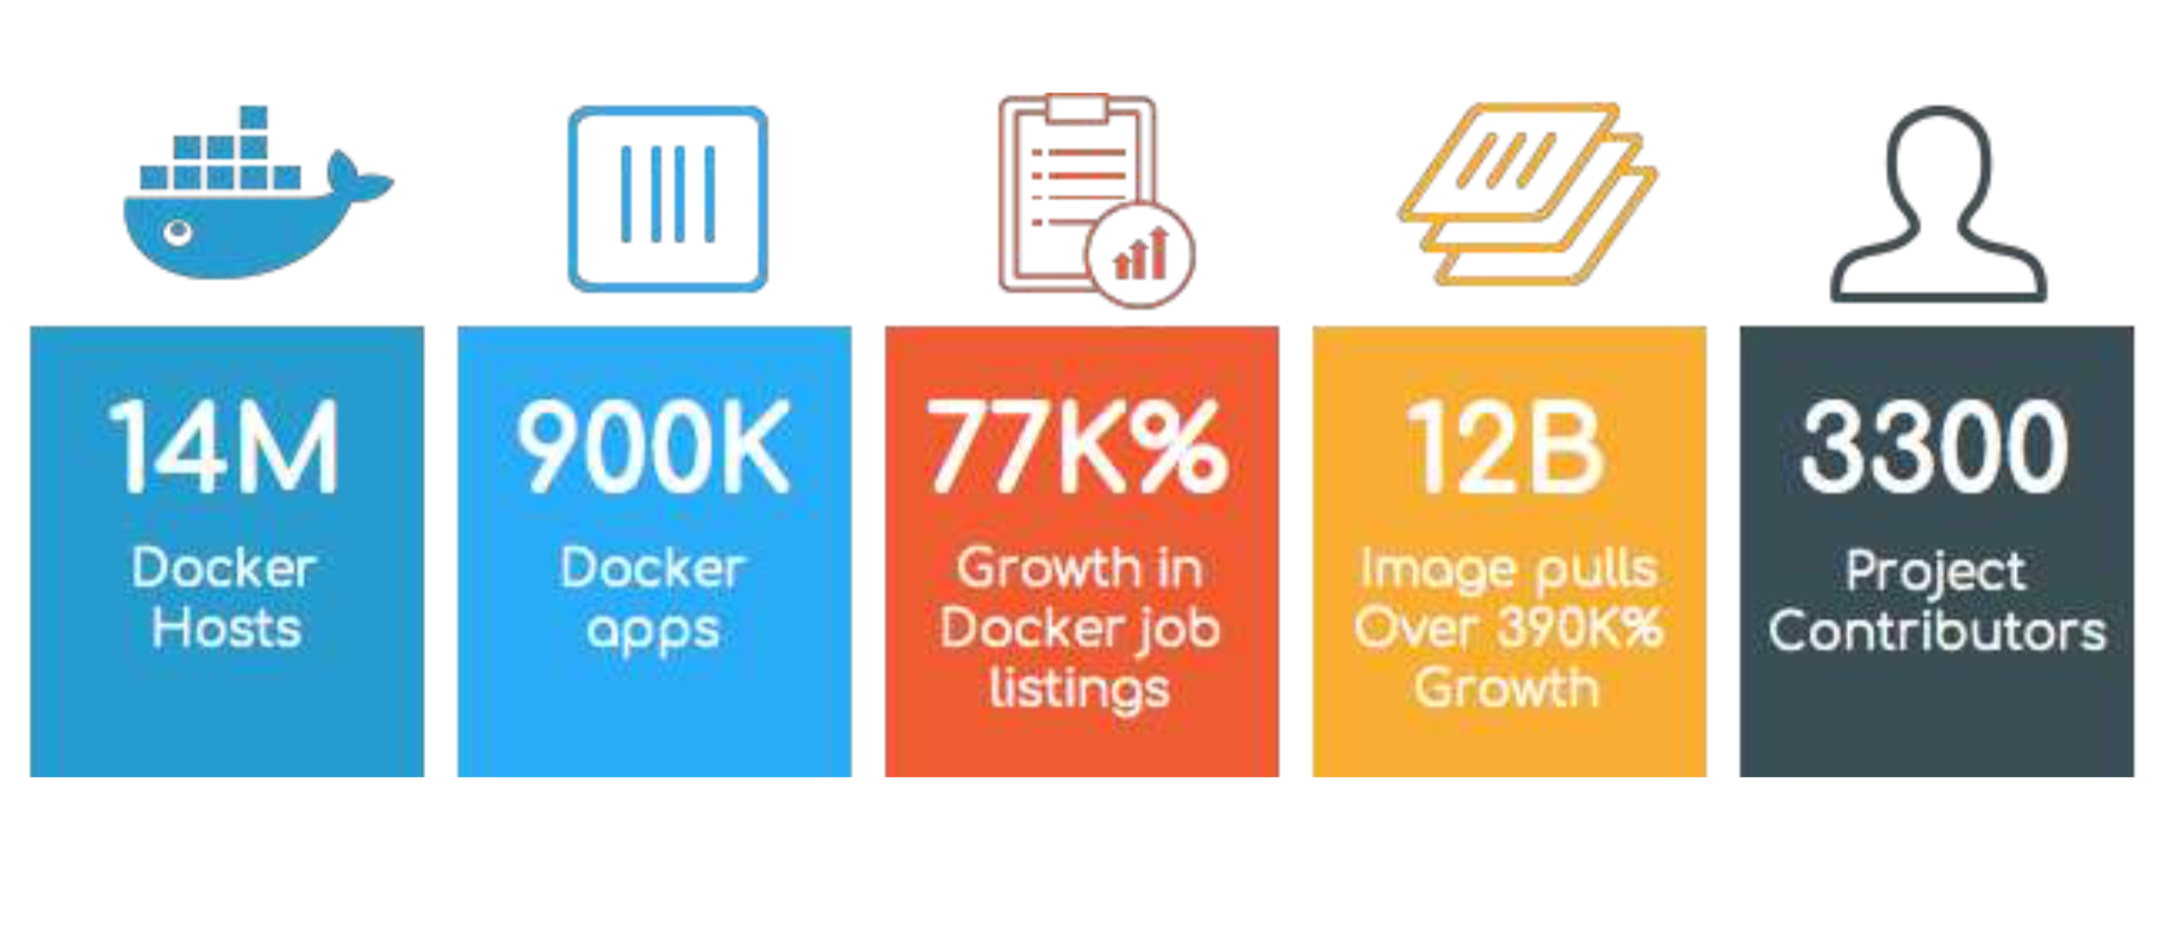
History Of Docker (Numbers)

Slide 8
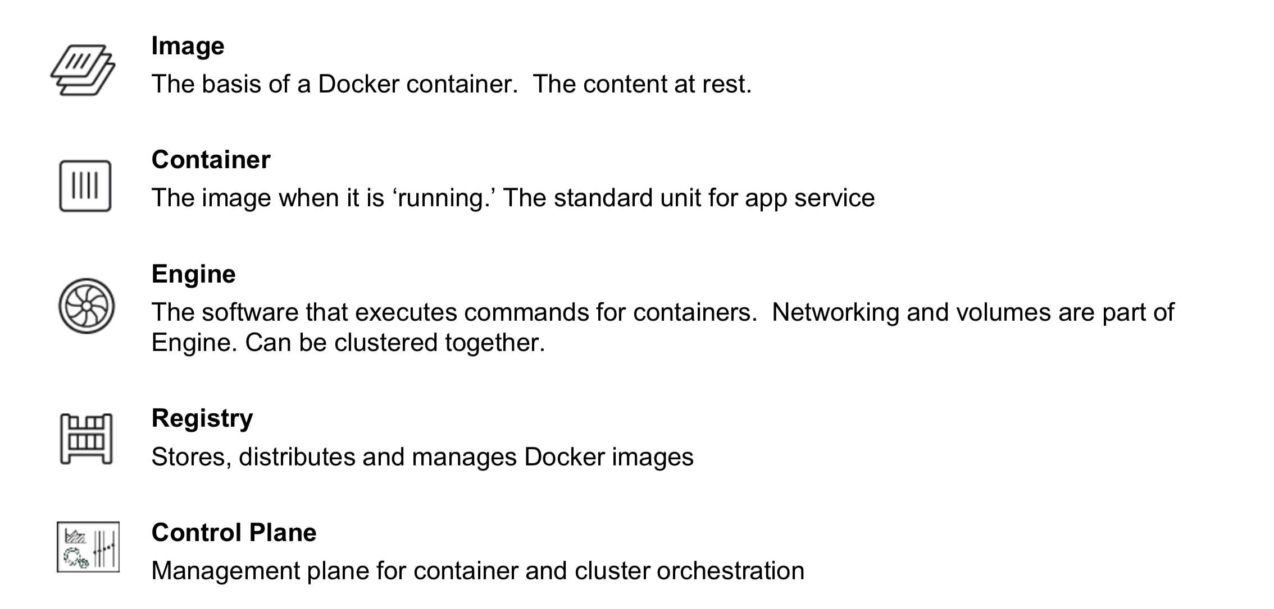
Docker Basics

Slide 9
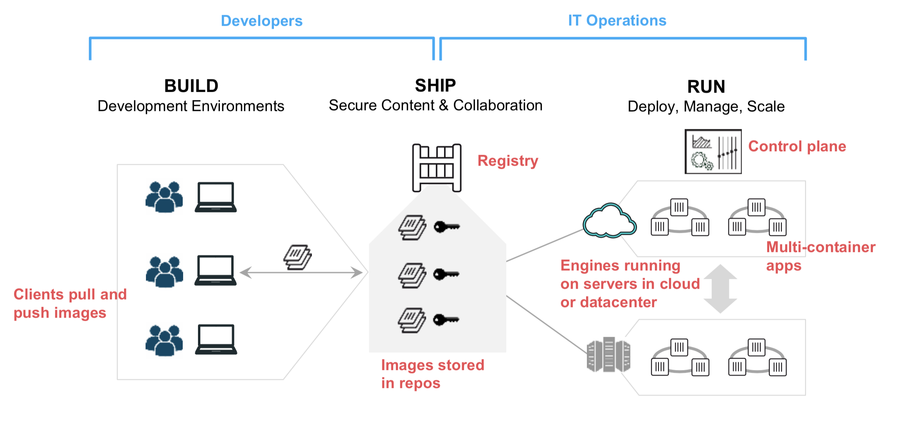
Docker & DevOps

Slide 10
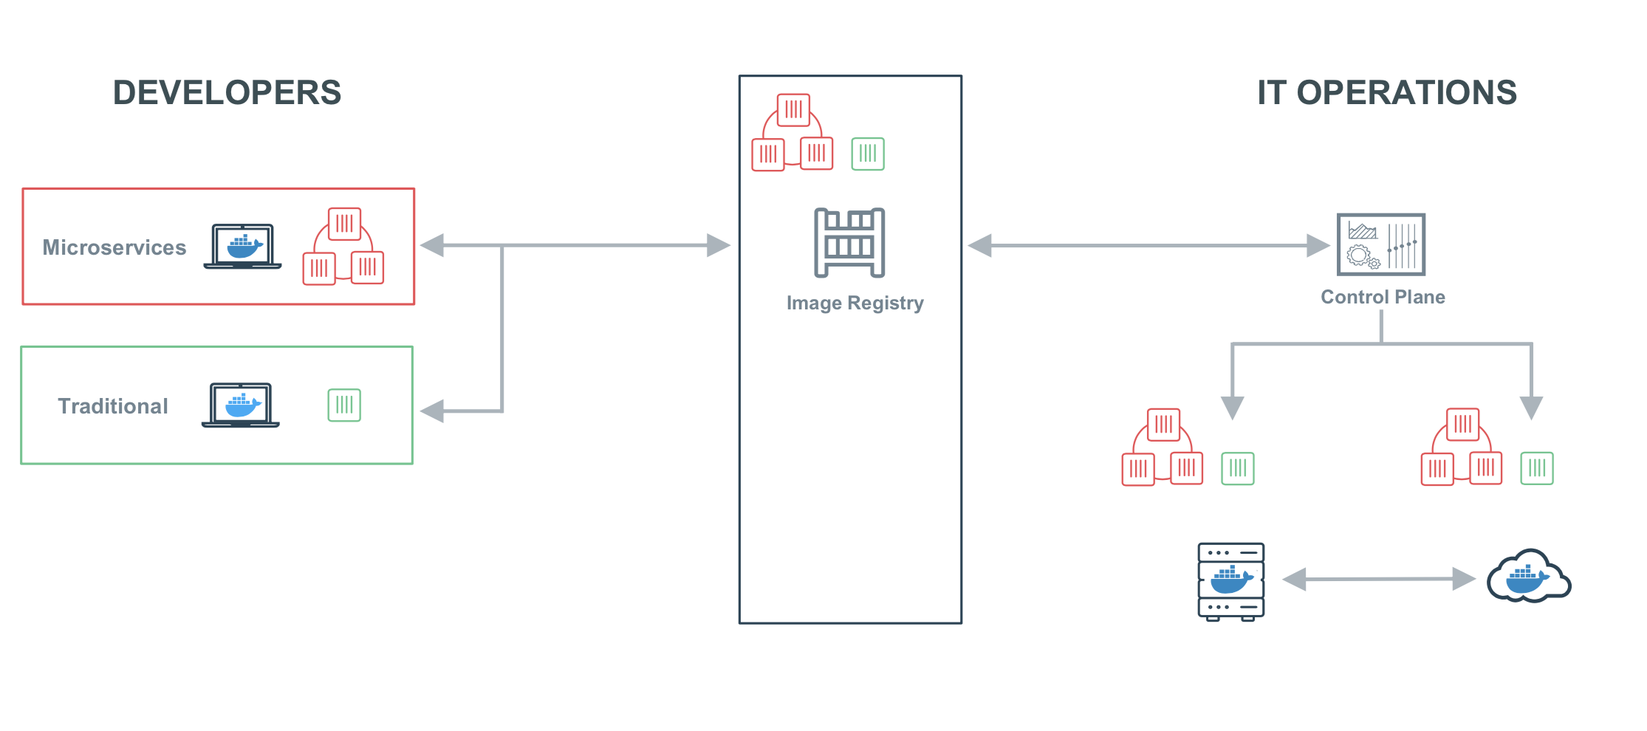
Docker & SDLC

Slide 11
Resources
https://www.slideshare.net/Docker/introduction-to-docker-2017
https://docs.docker.com
https://kubernetes.io/docs/home/?path=users&persona=app-developer&level=foundational
https://learn.openshift.com/?extIdCarryOver=true&sc_cid=701f2000001OH7iAAG
https://istio.io

Slide 12
WE ARE HIRING!!!
İf you like open source software stack;
info@h2hsecure.com

