Slide 1
Gamification Admin Platform
Loyalty + Gamification for Retail Banking
Product Overview • May 2026
1 / 15

Slide 2
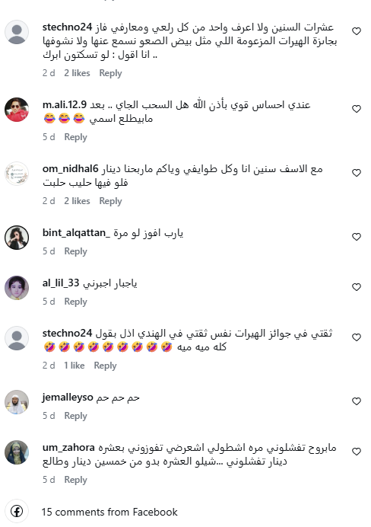
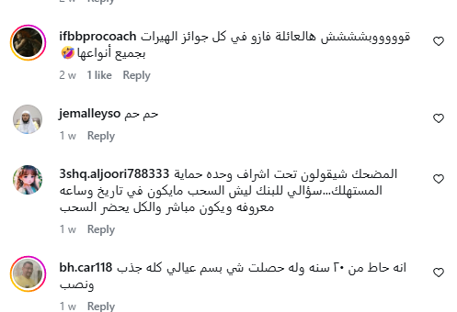
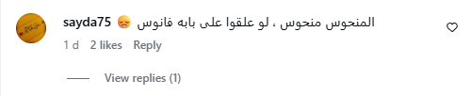
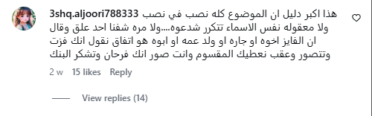

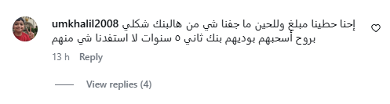
THE OBSERVATION
A lot of campaigns in the social media regarding the ruffle
2 / 15

Slide 3
THE VISION
Loyalty Program Meets Gamification
This project combines a traditional loyalty program with gamification mechanics. Instead of passive point collection, customers actively complete quests — real banking actions — to earn XP, climb leaderboards, and qualify for a grand prize. The result: deeper engagement, stronger deposits, and measurable revenue.
Loyalty
Gamification
Grand Prize
Reward customers for repeat banking behaviour over the full year
Quests, XP, tiers & leaderboards make banking fun and competitive
Year-long quests journey culminating in a high-value prize draw for top players
2 / 15

Slide 4
REWARD STRUCTURE
Redeem Small Prizes Anytime — Chase the Grand Prize All Year
Customers earn XP from every quest. They can instantly redeem points for small everyday prizes OR keep accumulating XP across the full year to qualify for the grand prize draw. This dual model keeps customers engaged daily while building towards a major reward.
Instant Small Prizes
Grand Prize (Year-End)
Redeem XP anytime for tiny rewards
Keep XP all year to enter the big draw
● Free coffee voucher (e.g. Starbucks)
● Complete many quests across the year
● Small merchant discount coupons
● XP accumulates toward Diamond tier
● Mobile top-up credits
● Top-tier customers enter grand draw
● Movie or event ticket discounts
● High-value prize (car, travel, cash)
● Cashback on next card transaction
● Creates a powerful retention loop
● Digital gift cards (small value)
● Drives sustained banking behaviour
Key: Customers choose — spend points on small rewards now, or save them for the grand prize.
3 / 15

Slide 5
DEPOSITS & SAVINGS
Grow Fixed Deposits & Savings to Reach the Grand Prize
A core strategy: quests encourage customers to increase their fixed deposits and savings balances. The more a customer saves, the more XP they earn — directly linking deposit growth to grand prize eligibility.
Fixed Deposit Quests
Savings Account Quests
→ Open a new fixed deposit account
→ Save 2K+ in Al Hayrat for 2 months
→ Increase FD balance by 5K or more
→ Set up automatic monthly savings
→ Renew an existing FD at maturity
→ Grow savings balance by 10% quarter
→ Maintain FD for 6+ months bonus XP
→ Move salary to a savings account
Result: The bank grows CASA balances while customers earn their way to the grand prize.
4 / 15

Slide 6
REVENUE MODEL
Multiple Revenue Streams
The platform generates revenue from two major sources, creating a self-sustaining gamification ecosystem that funds prizes while driving profit.
① Merchant Affiliates
② Customer Services
Revenue from partner merchants
Revenue when customers use bank services
● Starbucks, Gulf Air, Lulu & more
● New fixed deposits & savings accounts
● Commission on every card transaction
● Personal / auto / mortgage financing
● Co-branded quest sponsorship fees
● Bill payments & transfers via app
● Merchant pays for featured placement
● Card activation & transaction fees
● Higher volume = better merchant rates
● Insurance & investment products
5 / 15

Slide 7
BUSINESS GOALS
What Does the Bank Achieve?
Increase CASA Balances
Encourage deposits, savings, and salary transfers
Boost Digital Engagement
Drive mobile & internet banking adoption
Encourage Card Spending
Promote card usage through merchant quests
Reduce Risk
Incentivize responsible banking behaviours
Social Responsibility
Support charity, sustainability & community
6 / 15

Slide 8
TARGET USERS
Who Uses the Platform?
Campaign Managers — create & manage quests
Product Owners — define objectives & segments
Digital Banking Team — publish to channels
Marketing Team — plan promotions & campaigns
Risk & Compliance — review rules & behaviour
Management — monitor KPIs, ROI & performance
7 / 15

Slide 9
STRATEGIC CATEGORIES
Five Pillars of Gamification
Improve CASA
Increase Engagement
Encourage Spending
Risk Reduction
Social Responsibility
Salary movement, savings, deposit growth
App usage, bill pay, digital adoption
Card transactions, merchant partnerships
On-time payments, phishing awareness
Charity, green finance, community impact
e.g. Salary Anchor
e.g. Bill Pay Streak
e.g. Starbucks Quest
e.g. Phishing Fighter
e.g. Donate to Charity
8 / 15

Slide 10
USER JOURNEY
End-to-End Workflow
1. Create a new quest via Quest Forge form
2. Set category, dates, segment & financials
3. Quest appears in Campaign Calendar
4. Quest listed in Digital Channel Table
5. Monitor customer participation & rankings
6. Track KPIs, revenue forecast & ROI
7. Export data as CSV for reporting
9 / 15

Slide 11
COMMAND CENTER
Dashboard KPIs at a Glance
Active / Scheduled
Customers Doing Quests
Forecast Revenue
Forecast ROI
13
249K
$1.7M
594%
total quest programs
forecast completion
across all quests
after prize budget
These KPIs auto-calculate from quest data — no manual input needed.
Category Summary Cards
Each of the 5 categories shows: number of quests, participating customers, and ROI. This helps PMs ensure a balanced portfolio across all strategic objectives.
10 / 15

Slide 12
KEY FEATURES
Platform Capabilities
Quest Forge Form
Campaign Calendar
Digital Channel Table
Create/edit quests with title, category, dates, segment, targets, XP, revenue & budget
Month/week views, filters by category & status, load indicators, quick-schedule with + button
Full quest list with search, sort, filter, paginate, edit, delete, and CSV export
Customer Ranking
Analytics Suite
Data Persistence
Top 10 leaderboard by XP, completion & impact; Diamond / Platinum / Gold / Silver tiers
Revenue forecast, quest mix donut, customer funnel, and strategic KPI radar scorecard
Quests stored in browser localStorage; reload sample data with one click
11 / 15

Slide 13
SAMPLE QUESTS
Pre-loaded Campaign Examples
Quest
Category
Customer Action
Target
Salary Anchor
CASA
Move salary to the bank
42K customers
Bill Pay Streak
ENGAGE
Pay 2 bills via mobile
55K customers
Navigate in the App
SPEND
Complete guided app tutorial
36K customers
Starbucks Coffee
SPEND
Buy coffee with bank card
28K customers
Phishing Fighter
RISK
Report phishing attempts
75K customers
Pay CC On Time
RISK
Timely credit card payment
75K customers
Donate to Charity
SOCIAL
Donate to verified charity
22K customers
Green Financing
SOCIAL
Finance a solar project
18K customers
12 / 15

Slide 14
OPERATING MODEL
Suggested Roles & Responsibilities
Campaign Manager
Creates and manages quests day-to-day
Product Owner
Defines business objectives and target segments
Risk Team
Reviews risk quests and behaviour rules
Compliance Team
Reviews prize-linked campaign regulations
Digital Team
Publishes quests to mobile and web channels
Management
Reviews KPIs, ROI, and program performance
13 / 15

Slide 15
Summary
This platform turns customer banking actions into structured campaigns with points, rewards, monitoring, and management reporting. It is a single dashboard for creating, scheduling, tracking, and analysing prize-linked quests across all digital channels.
Next Steps
✓ Review prototype with stakeholders
✓ Prioritize production requirements
✓ Define integration scope with IT
✓ Plan pilot with one quest category
15 / 15

