Slide 1
Clustering Hong Kong’s neighborhoods
Find your next apartment in similar yet cheaper locations

Slide 2
Introduction
Hong Kong – financial center
Large expat population
Communication problem
High rents
Ideal neighborhood

Slide 3
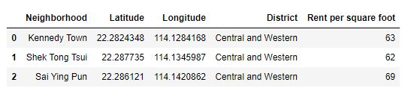
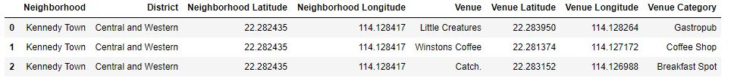
Data
Dataset from Spacious
Venue data from Foursquare

Slide 4
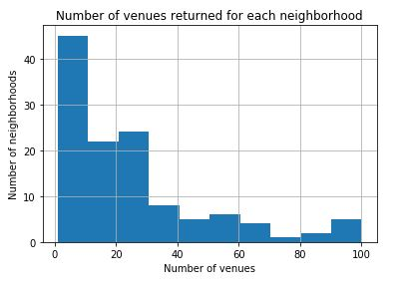
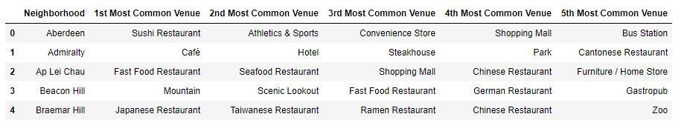
Methodology
Right-skewed Foursquare venue data
Data processing including one-hot
encoding and standardization

Slide 5
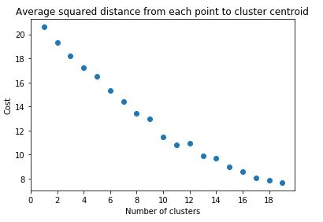
Methodology (continued)
Optimal number of clusters is 10 using elbow method

Slide 6
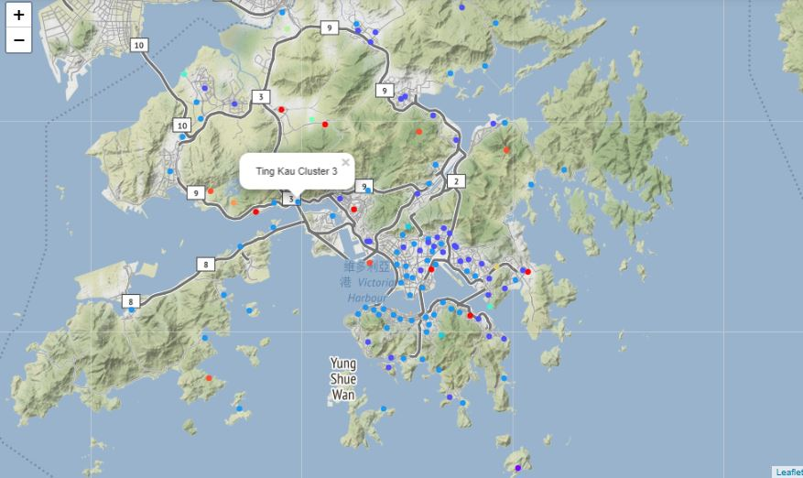
Results

Slide 7
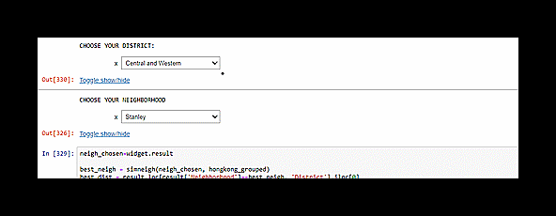
Results (continued)
Tool to identify most similar neighborhood using Euclidean distance

Slide 8
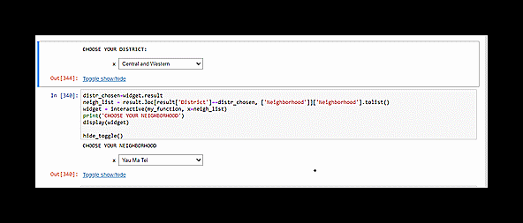
Result (continued)
Tool to identify cheapest neighborhood in the same cluster

Slide 9
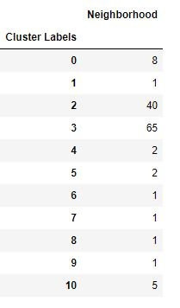
Discussion
Cluster overfitting?
Data quality?
Other data sources?
Other K-means optimization
methods

Slide 10
Conclusion
Useful tools have been created
Better data is needed

Slide 11
Thank you!
If you have any questions, feel free to send me a message on Github :)

