Slide 1
Fast, stable and scalable true radix sorting
useR!, Aalborg
02 July 2015
Matt Dowle

Slide 2
Overview
Released in data.table v1.9.2 (Feb 2014)
Propose to move to base so R community can benefit with no code changes
Find sponsor from core team with time
Your feedback and suggestions please

Slide 3
2009 : Tom Short
Tom: I like data.table! But setkey is slow and I have issues with dates. Any ideas?
Matt: Sorry, not really. I can have a think. You're welcome to join the project?
Tom: Ok thanks, I will. What about using sort.list(x, method=”radix”)?
Matt: What's sort.list(x,method=”radix”)?

Slide 4
> sort(c(4,2,8,7))
[1] 2 4 7 8
> order(c(4,2,8,7))
[1] 2 1 4 3
> sort.list(c(4,2,8,7))
[1] 2 1 4 3
> ?sort.list
“ sort.list is the same [as order], using only one argument. “
“ x is an atomic vector “

Slide 5
sort.list(x)
would be better named
order.vector(x)
but we love it anyway ...

Slide 6
2009-2015 : base R
> x = sample(1:100000, 1e8, replace=TRUE) #380MB
> system.time(o1 <- order(x))
user system elapsed
79.444 0.056 79.402
> system.time(o2 <- sort.list(x, method="radix"))
user system elapsed
1.572 0.028 1.597
> identical(o1,o2)
[1] TRUE

Slide 7
Tom used sort.list(x,method=”radix”)
nrow(DT) = 10 million v1.2 => v1.3
setkey(DT, a, b) 37s 5s
Column by column in reverse :
  1. o = 1:nrow
  2. order o by column b [1st call to sort.list]
  3. order o by column a [2nd call to sort.list]
Hard to beat, even today.

Slide 8
R's C code for method=”radix” step 1 / 4
// find range(x) = max(x) - min(x)
for(i=0; i<n; i++) {
if(ISNA(x[i])) continue;
if(x[i] > xmax) xmax = x[i];
if(x[i] < xmin) xmin = x[i];
}
range = xmax – xmin + 1;
NB: essence of code presented in these slides

Slide 9
R's C code for method=”radix” steps 2-4 / 4
if(range > 100000) error("too large a range of values in 'x'");
long counts[ range+1 ]; // allocate
for(i=0; i<n; i++) counts[x[i] – xmin]++; #2
for(i=1; i<=range; i++) counts[i] += counts[i-1]; #3
for(i=n-1; i>=0; i--) ans[--counts[x[i] - xmin]] = i; #4

Slide 10
method = “radix”
would be better named
method = “counting”
but we love it anyway
because it is so fast

Slide 11
R 3.0.0
“ sort(), sort.int() and sort.list() now use radix sorting for factors of less than 100,000 levels when method is not supplied. So does order() if called with a single factor, unless na.last = NA. “
Default changed only for factors. For integers with range < 100,000 you still have to call sort.list(x, method=”radix”) manually.

Slide 12
[Aside] R 3.1.0
“ sort.list(method = "radix") now allows negative integers (wish of PR#15644). “
PR#15644 by Matt Dowle
In step 1 (finding the range), remove one line :
if(tmp < 0) error("negative value in 'x'");

Slide 13
Current R 3.2.1
> x = sample(1:100001, 1e8, replace=TRUE) #380MB
> system.time(o1 <- order(x))
user system elapsed
79.444 0.056 79.402
> system.time(o2 <- sort.list(x, method="radix"))
user system elapsed
1.572 0.028 1.597
> identical(o1,o2)
[1] TRUE

Slide 14
Current R 3.2.1
> x = sample(1:100002, 1e8, replace=TRUE)
> system.time(o1 <- order(x))
user system elapsed
79.416 0.044 79.361
> system.time(o2 <- sort.list(x, method="radix"))
Error in sort.list(x, method = "radix") :
too large a range of values in 'x'

Slide 15
data.table:::forderv(x)
> x = sample(1:100002, 1e8, replace=TRUE)
> system.time(o1 <- order(x))
user system elapsed
79.416 0.044 79.361
> system.time(o2 <- data.table:::forderv(x))
user system elapsed
1.664 0.060 1.722
> identical(o1,o2)
[1] TRUE

Slide 16
Scaling up now possible
> x = sample(1:1e6, 1e9, replace=TRUE)
> system.time(o2 <- data.table:::forderv(x))
user system elapsed
18.716 0.288 18.982
> system.time(o1 <- order(v))
Over 20 mins then I stopped it

Slide 17
true radix sorting
To illustrate, consider these 2 numbers as 4 columns of bytes, each with range 256 :
705788748
25
00101010 00010001 01111011 01001100
00000000 00000000 00000000 00010111
42 17 123 76
0 0 0 25

Slide 18
Proceed just like Tom did on columns in reverse order, but on bytes within the integer

Slide 19
numeric
Terdiman, 2000
http://codercorner.com/RadixSortRevisited.htm
Herf, 2001
http://stereopsis.com/radix.html
Arun Srinivasan implemented forder() in data.table entirely in C for integer, character and double
Matt Dowle changed from LSD (backwards) to MSD (forwards) for cache efficiency and to benefit from (partially) sorted data inputs

Slide 20
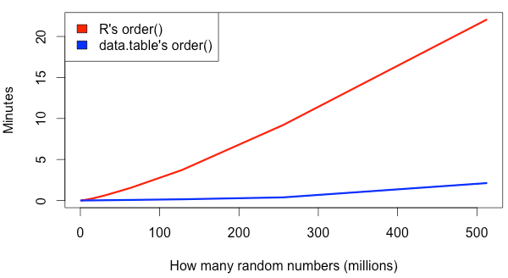
> x = runif(500e6) # unique this time
> system.time(data.table:::forderv(x))
22 mins
2 mins
4GB
MacBook Pro 2.8GHz Intel Core i7 16GB
R 3.1.3 data.table 1.9.4

Slide 21
Miscellaneous
setNumericRounding(2|1|0)
CHARSXP are sorted by pointer value to get uniques, then uniques are sorted by forwards radix on the character string
Endian dependent hence QEMU emulation of PowerPC before release to CRAN
We appreciate CRAN's Solaris Sparc – it's proxy for other big endian machines
Partial sorting, median, quantiles
MSD radix sort is parallelizable

Slide 22
Thank you
Please try out data.table:::forderv()
Questions / suggestions?

