Slide 1
The joy of Clean Data!
San Francisco Big Data Science Meetup
15 Dec 2015
Matt Dowle

Slide 2
Overview
For beginners
Examples from my background
Tools along the way
Live demo of “80% munging”
How H2O fits in
Q & A

Slide 3
1996 – Lehman Brothers
Just graduated – Applied Maths & Computing
Dividend claims
Cleaning at source; e.g. data entry typos
Estimate cash flows, alerts etc
Nothing fancy
Tools: VB & Sybase
How I accidentally created messy data

Slide 4
1999 - Salomon Brothers
Equity risk model
  Multiple time series regression (10 year)
  DEM proxy for EUR prior to 1 Jan 1999
  IPOs get their sector's median; e.g. France Telecom
  Abbey National X0004455
  90% of the lines of code was not the regression

Slide 5
2002 - Citigroup
Pairs Trading
200 most liquid stocks
200 x 199 / 2 = 19,900 pairs
Stock splits, id changes
Dickey Fuller test for stationarity
Bollinger bands => buy/sell signal
Excel spreadsheet to clients with embedded S-PLUS plot, daily, 50 custom variants
Rebalance => orphan & surrogate pairs

Slide 6

2004 moved to fund management
Bigger data
e.g. 25TB

Slide 7
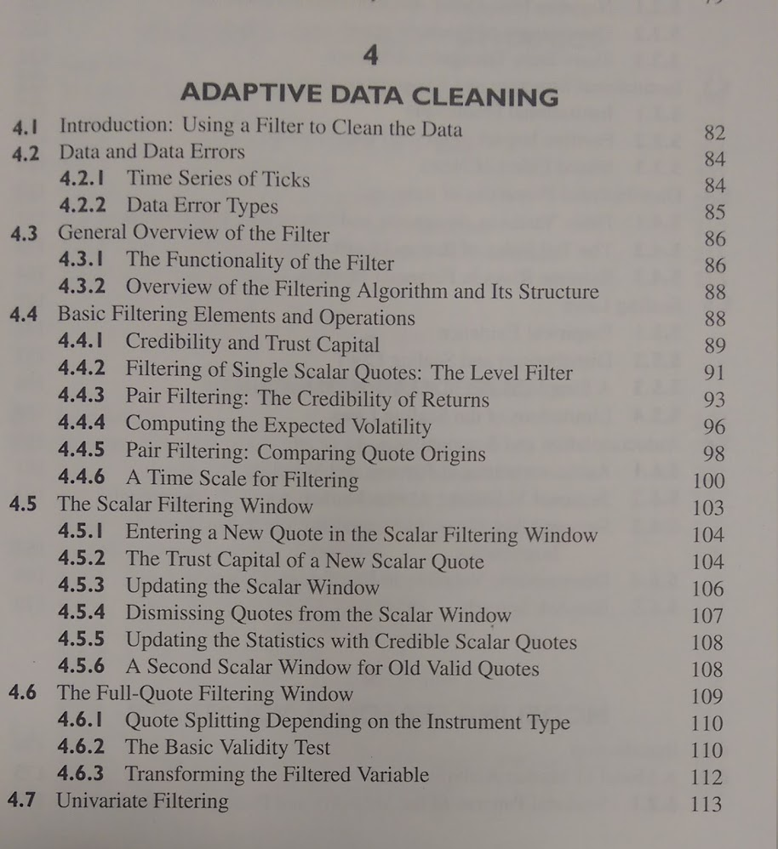

Slide 8
Over cleaning
1. I queried for intra-day auctions
  select from quote where bid>ask
No results; i.e. all bid<ask.
Asked data provider
Grrrrr
2. Negative prices can be correct

Slide 9
Tools
KDB http://kx.com/
        @kxsystems
OneTick https://www.onetick.com/
        @OneMarketData

Slide 10


Slide 11
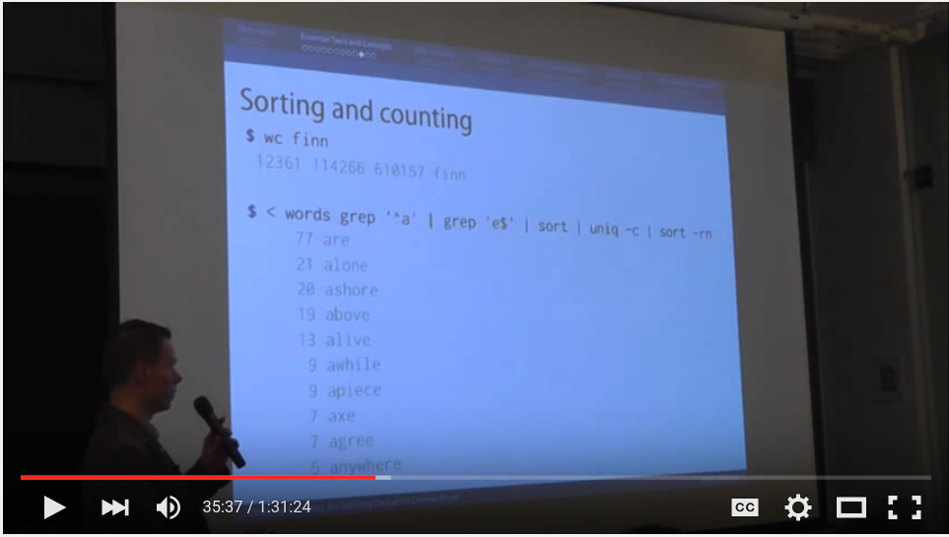
https://www.youtube.com/watch?v=QxpOKbv-KQU

Slide 12
alias
awk
aws
bc
bigmler
body
cat
cols
csvcut
csvgrep
csvjoin
csvlook
csvsort
csvsql
csvstack
csvstat
curl
cut
dseq
find
for
grep
head
header
in2csv
jq
json2csv
less
parallel
paste
pbc
python, R and r
Rio
Rio-scatter
run_experiment
sample
scrape
sed
seq
shuf
sort
split
sql2csv
tail
tapkee
tee
tr
tree
uniq
wc
weka
xml2json
Can be faster than loading the whole file into R or Python
Can be faster workflow
Pre-processing before loading into R or Python

Slide 13
tidyr by Hadley Wickham
https://cran.r-project.org/web/packages/tidyr/vignettes/tidy-data.html
Untidy data defined as :
  Column headers are values, not variable names.
  Multiple variables are stored in one column.
  Variables are stored in both rows and columns.
  Multiple types of observational units stored in the same table.
  A single observational unit is stored in multiple tables.
Solves by: gathering, separating and spreading
That's the shape of the data. Yes, good, but not the kind of messy data I'm talking about in this presentation.

Slide 14
To illustrate
In June 2013, RStudio made available download logs from their CRAN mirror http://blog.rstudio.org/2013/06/10/rstudio-cran-mirror/
R-Bloggers search “CRAN download stats” 154 results; e.g.
http://www.r-bloggers.com/finally-tracking-cran-packages-downloads/
https://github.com/metacran/cranlogs
http://www.r-bloggers.com/working-with-the-rstudio-cran-logs/
http://www.r-bloggers.com/cran-download-statistics-of-any-packages-rstats/
http://www.r-bloggers.com/my-r-packages-worldmap-of-downloads/

Slide 15
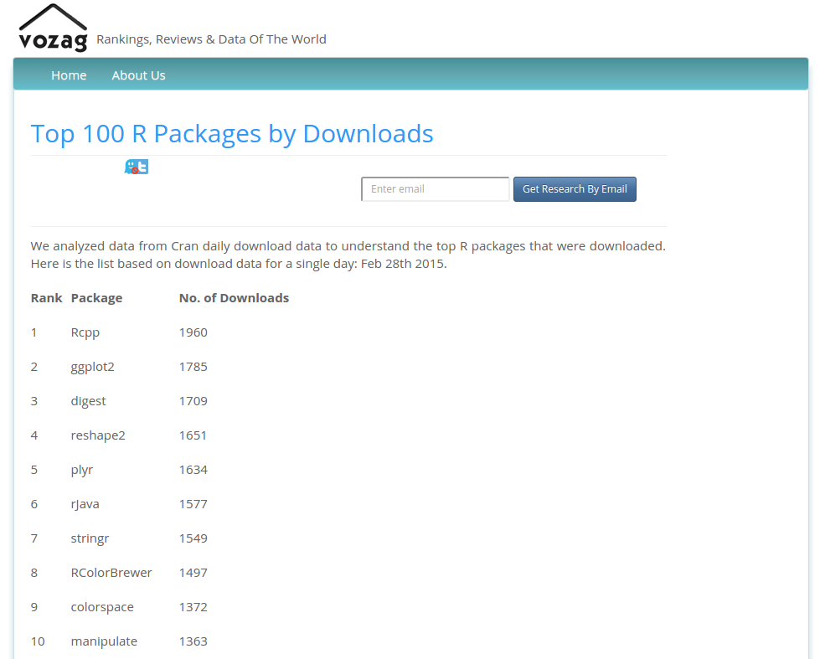
March
2015

Slide 16

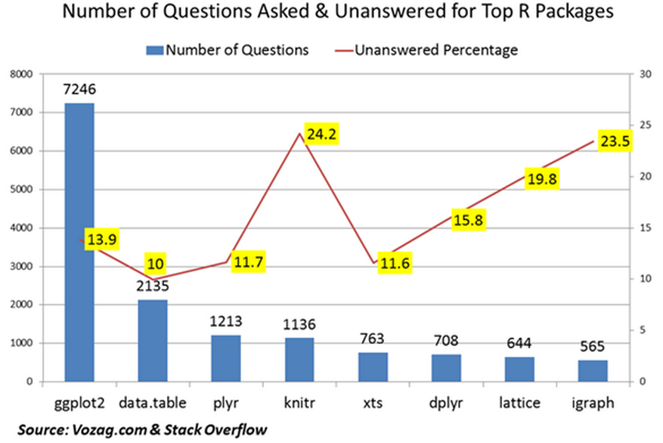
April
2015

Slide 17
Comparing the top downloaded packages with the most discussed packages shows little correlations between them. For Instance, ggplot2 has the most questions asked & is the second highest downloaded package but data.table package (the second highest ranked R package for questions asked) is not even in the top 100 packages downloaded. Knitr is another example which is in the top 5 questions asked, but is 27th ranked in downloaded packages.
So- does the R community need to focus on packages that have the highest questions to resolve their issues rather than the ones with the most downloads?

Slide 18
Let's look at the data!
Live demo of munging
Observations and comments on meetup video recording
https://youtu.be/4VWQEvYIfV8
( ~ 22 mins in )

Slide 19
“Big data”
1. Data > 240GB
  needle-in-haystack e.g. fraud
2. Data < 240GB
  compute intensive, parallel 100's cores
3. Data < 240GB
  feature engineering > 240GB
Speed for i) production and ii) interaction
NB: 240GB is currently largest available on EC2

Slide 20

http://yourdatafitsinram.com/

Slide 21
Dell PowerEdge R920 60 core
( 4 * Intel® Xeon® E7-8880L 2.2GHz, 37.5M Cache, 15 Core )
with 1.5TB RAM $60k ( 96 * 16GB )
with 6TB $150k-$200k? ( 96 * 64GB )
But, still “only” 60 cores
In the office here we already have 2.5TB RAM and 320 cores on 10 machines.
So do many businesses.

Slide 22
data.table's radix join
Now parallel and distributed
e.g. high cardinality 1bn/1bn/1bn row join
  data.table 10 min
  H2O 1 node 32 core 3.5 min
  H2O 4 node 128 core 1.5 min => demo
  H2O 10 node 320 core 2.0 min
Known improvements to be made

Slide 23
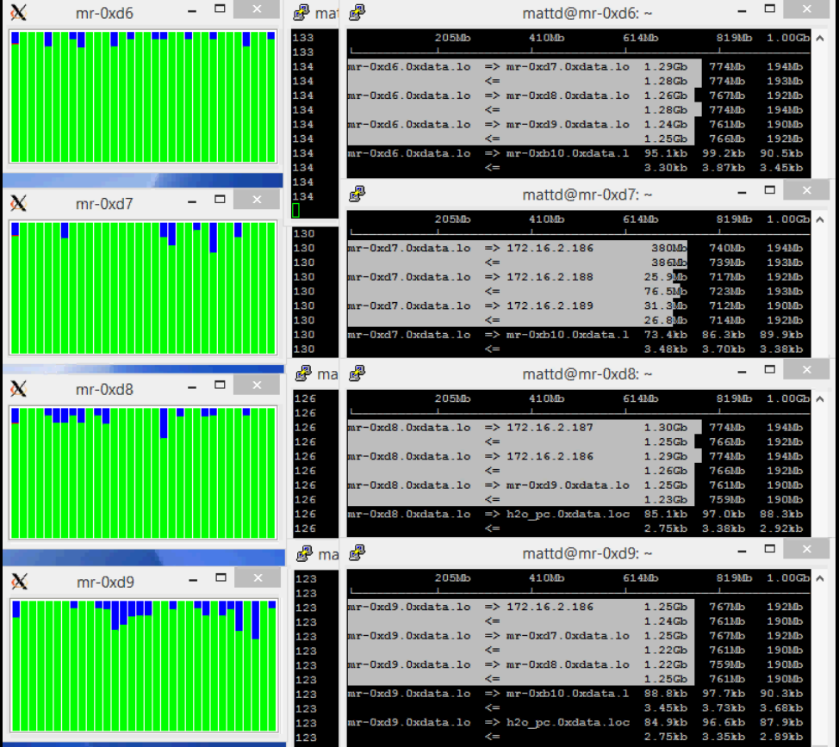
https://www.youtube.com/watch?v=8VpzNibOme0

Slide 24
Thank you.
Q & A

