Slide 1
News from data.table 1.9 and H2O
London R Meetup
15 Jun 2015
Matt Dowle

Slide 2
Past presentations here at LondonR
2015 June – News from v1.9
2012 June - News from v1.6, v1.7 and v1.8
2010 July - News from v1.4.1 and v1.5
2009 July - data.table: Higher speed time series queries
http://www.londonr.org/Presentations.html
https://github.com/Rdatatable/data.table/wiki

Slide 3
At recent conference in Chicago
Thomas in audience to me:
“dplyr has completely killed off data.table.”
I'll tackle this now in one slide and one Stack Overflow question

Slide 4

https://github.com/Rdatatable/data.table/wiki
fast aggregation of large data; e.g. 100GB in RAM (see benchmarks on up to two billion rows)
fast ordered joins; e.g. rolling forwards, backwards, nearest and limited staleness
fast overlapping range joins; e.g. GenomicRanges
fast add/modify/delete of columns by reference by group using no copies at all
cells may themselves contain vectors/objects/functions; i.e. columns of type list
fast and friendly file reader: fread
data.table compared to dplyr
+ speed e.g. research into production (e.g. daily or intra-day) with no code changes
+ or might need speed in future and don't want to rewrite then
+ brief syntax to prevent code bloat; e.g. do anything in j
+ optimization of combined DT[where, select|update|do, by]

Slide 5
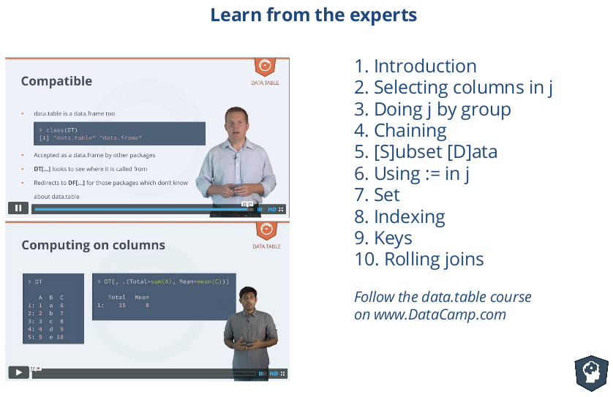
data.table course on DataCamp

Slide 6
Automatic indexing
> DT # 1.5GB
id val
1e+00: BAR 5
2e+00: FOO 1
3e+00: REW 4
4e+00: NUR 5
5e+00: AMW 3
---
1e+08: QNP 1
1e+08: HXB 2
1e+08: FOO 1
1e+08: CYY 2
1e+08: VKG 1
> DT[id=="FOO",]
id val
1: OSK 1
2: OSK 3
---
5813: OSK 5
5814: OSK 1
user system elapsed
1.928 0.064 1.991
> DT[id=="BAR",]
user system elapsed
0.000 0.000 0.001
> DT[id %in% c("FOO","BAR"),]
user system elapsed
0.000 0.000 0.001
1st time
2nd time

Slide 7
> options(datatable.verbose=TRUE)
> DT[id=="FOO",]
creating new index 'id'
forder took 1.991 sec
bmerge took 0.001 sec
> DT[id=="BAR",]
using existing index 'id'
bmerge took 0.001 sec
1st time
2nd time

Slide 8
> DF %>% filter(id=="FOO")
user system elapsed
1.952 0.020 1.970
> DF %>% filter(id=="FOO")
user system elapsed
1.940 0.012 1.949
> DF[DF$id=="FOO", ]
user system elapsed
2.244 0.124 2.367
> DF[DF$id=="FOO", ]
user system elapsed
2.260 0.112 2.369
1st time
2nd time
1st time
2nd time

Slide 9
> DT %>% filter(id=="FOO") # v0.3.0.2
# Oct 2014
using existing index 'id'
Starting bmerge ...done in 0 secs
user system elapsed
0.000 0.000 0.001
> DT %>% filter(id=="FOO") # v0.4.0
# Jan 2015
user system elapsed
1.952 0.020 1.982
It used to work great via dplyr
I don't know why dplyr changed – need time to investigate.

Slide 10
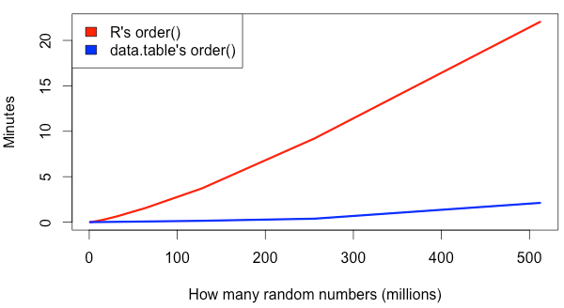
22 mins
2 mins
4GB
MacBook Pro 2.8GHz Intel Core i7 16GB
R 3.1.3 data.table 1.9.4

Slide 11
References
Terdiman, 2000
http://codercorner.com/RadixSortRevisited.htm
Herf, 2001
http://stereopsis.com/radix.html
Arun Srinivasan implemented forder() in data.table entirely in C for integer, character and double
Matt Dowle changed from LSD (backwards) to MSD (forwards)

Slide 12
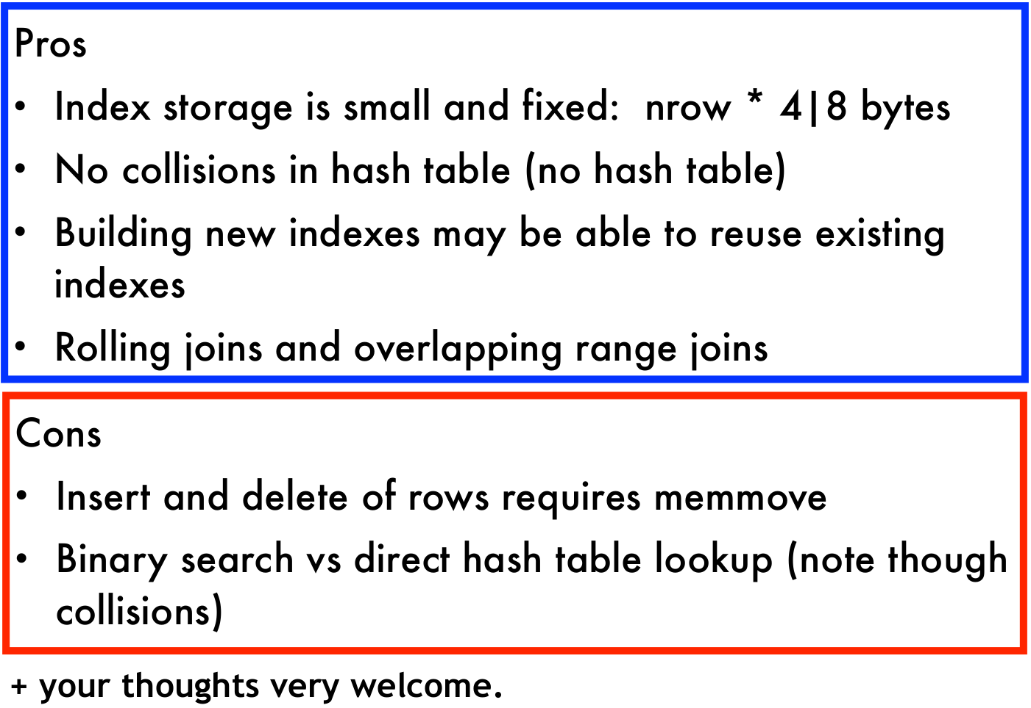

Slide 13
Other items from v1.9
by=.EACHI
Overlap joins
.() shortcut for list()
rbindlist gains use.names and fill arguments
bit64::integer64 in grouping and joins
setNumericRounding()
setorder by reference
anyDuplicated.data.table

Slide 14
… continued
Gforce optimization
Fast melt and dcast from reshape2
Joins scale better as the number of rows increases
Sorting adapts to almost sorted data
fread system commands
.SDcols can de-select columns

Slide 15
H2O
Machine learning e.g. Deep Learning
In-memory, parallel and distributed
1. Data > 250GB needle-in-haystack; e.g. fraud
2. Data < 250GB compute intensive, parallel 100's cores
3. Data < 250GB where feature engineering > 250GB
Speed for production
Open source on GitHub, liberal Apache license
I now work here

Slide 16
Install H2O
# If java is not already installed :
$ sudo add-apt-repository -y ppa:webupd8team/java
$ sudo apt-get update
$ sudo apt-get -y install oracle-java8-installer
$ sudo apt-get -y install oracle-java8-set-default
$ java -version
$ R
> install.packages(“h2o”)
That's it.

Slide 17
Start H2O
> library(h2o)
> h2o.init()
H2O is not running yet, starting it now...
Successfully connected to http://127.0.0.1:54321
R is connected to H2O cluster:
H2O cluster uptime: 1 sec 397 ms
H2O cluster version: 2.8.4.4
H2O cluster total nodes: 1
H2O cluster total memory: 26.67 GB
H2O cluster total cores: 32

Slide 18
h2o.importFile
23GB .csv, 9 columns, 500e6 rows
> DF <- h2o.importFile("/dev/shm/test.csv")
user system elapsed
0.775 0.058 50.559
> head(DF)
id1 id2 id3 id4 id5 id6 v1 v2 v3
1 id076 id035 id0000003459 20 80 8969 4 3 43.1525
2 id062 id023 id0000002848 99 49 7520 5 2 86.9519
3 id001 id052 id0000007074 89 16 8183 1 3 19.6696

Slide 19
library(h2o)
h2o.importFile("/dev/shm/test.csv") # 50 seconds
library(data.table)
fread("/dev/shm/test.csv") # 5 minutes
library(readr)
read_csv(“/dev/shm/test.csv”) # 12 minutes
Parallel
Single thread
Single thread

Slide 20
h2o.importFile also
compresses the data in RAM
profiles the data while reading; e.g. stores min and max per column, for later efficiency gains
included in 50 seconds

Slide 21
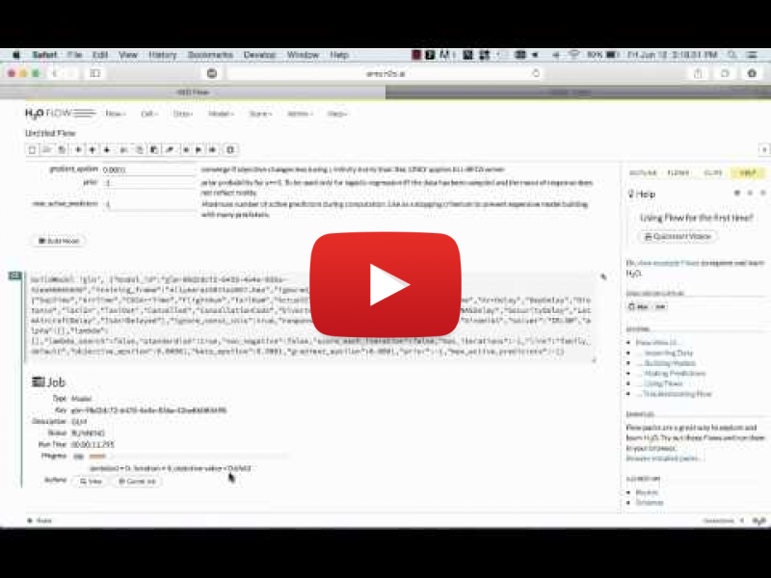
8 min demo https://www.youtube.com/watch?v=bInMSgZhDd4

Slide 22
Questions?
https://github.com/Rdatatable/data.table/wiki
http://h2o.ai/product

