Slide 1
Parallel and Distributed
Joins in H2O
Lightning 12min Talk
Bay Area R User Group
09 Feb 2016
Matt Dowle

Slide 2
True radix sorting
Terdiman, 2000 http://codercorner.com/RadixSortRevisited.htm
Herf, 2001
http://stereopsis.com/radix.html
Dowle & Srinivasan, 2015
http://user2015.math.aau.dk/presentations/234.pdf
Now included in R itself thanks to time and skill of Michael Lawrence.

Slide 3
But
Single threaded
Single node
Limited to 2 billion rows (2^31)
=> H2O
Every step has now been parallelized and distributed

Slide 4
data.table join
Find order of the left join columns
Find order of the right join columns
Binary merge the two sorted indexes
No hash table at all
Fast ordered joins; e.g. rolling forwards, backwards, nearest and limited staleness

Slide 5
Further info
https://github.com/Rdatatable/data.table/wiki
Presentations
Articles
DataCamp course

Slide 6
Cardinality
Not just the number of rows, but what’s in the rows
A 10 billion row file could contain :
500 stock tickers (low cardinality)
Millions of people (medium cardinality)
Billions of devices (high cardinality)

Slide 7
Create some test data
#!/usr/bin/awk -f
nrow = ARGV[2]
while(i<nrow)
{
printf "%d,%d\n",
rand()*nrow,
rand()*nrow*2 - nrow;
i++;
}

Slide 8
1e6 rows; 14MB
$ head X
KEY,X2
82967,-9233
550105,-819078
963516,-663146
706905,-128965
766103,774695
$ head Y
KEY,Y2
610198,322685
872395,-887505
340972,535361
23067,346231
295498,918692

Slide 9
1e7 rows; 156MB
$ head X
KEY,X2
829673,-92335
5501052,-8190789
9635168,-6631465
7069052,-1289657
7661030,7746956
$ head Y
KEY,Y2
6101982,3226855
8723957,-8875053
3409724,5353612
230673,3462315
2954985,9186925

Slide 10
1e8 rows; 1.8GB
$ head X
KEY,X2
8296733,-923350
55010523,-81907897
96351686,-66314650
70690522,-12896576
76610309,77469562
$ head Y
KEY,Y2
61019825,32268551
87239579,-88750532
34097244,53536122
2306734,34623153
29549857,91869251

Slide 11
1e9 rows; 19GB
$ head X
KEY,X2
82967333,-9233501
550105235,-819078974
963516860,-663146506
706905226,-128965762
766103099,774695629
$ head Y
KEY,Y2
610198251,322685514
872395790,-887505326
340972449,535361227
23067343,346231535
295498572,918692512

Slide 12
1e10 rows; 200GB
$ head X
KEY,X2
829673335,-92335012
5501052357,-8190789743
9635168607,-6631465068
7069052265,-1289657629
7661030994,7746956291
$ head Y
KEY,Y2
6101982517,3226855142
8723957901,-8875053263
3409724497,5353612273
230673439,3462315357
2954985724,9186925123

Slide 13
H2O commands
library(h2o)
h2o.init(ip="mr-0xd6", port=55666)
X = h2o.importFile("hdfs://mr-0xd6/datasets/mattd/X1e9_2c.csv")
Y = h2o.importFile("hdfs://mr-0xd6/datasets/mattd/Y1e9_2c.csv")
ans = h2o.merge(X, Y, method="radix")
system.time(print(head(ans)))

Slide 14
Results on 4 nodes
4 physical 256GB / 32core
1e6 6s
1e7 7s
1e8 13s
1e9 49s
1e10 ...

Slide 15
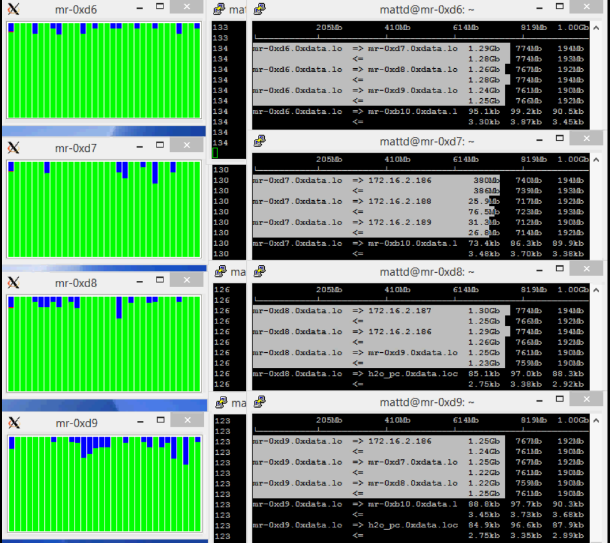
https://www.youtube.com/watch?v=8VpzNibOme0

Slide 16
Thank you.
Q & A

